Slide 1
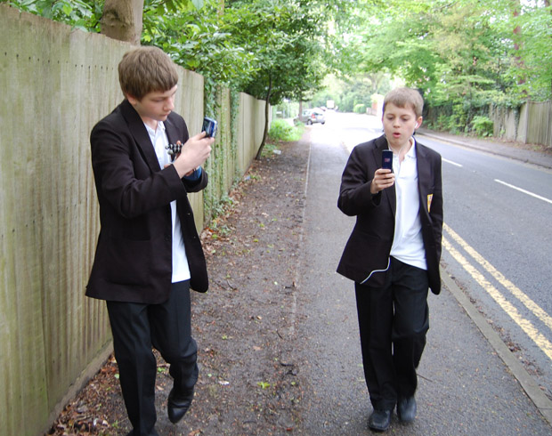

Interactionism and Education
Dave King

Slide 2
Objectives
To review the interactionist account of education and its problems
To relate interactionist accounts of education to the wider concerns of micro-sociological theory
To assess the usefulness of interactionist theory

Slide 3
Main Themes in Interactionist Theory
Role and self concept
The importance of typing and labelling
The self-fulfilling prophecy
Sub-culture formation

Slide 4
Role and role-taking
Individuals depend on their self-concept
This is shaped by other’s reactions to us – Cooley talks of a “looking glass self”
Significant others will have a particularly strong effect on us
We often take roles which we are thus assigned

Slide 5
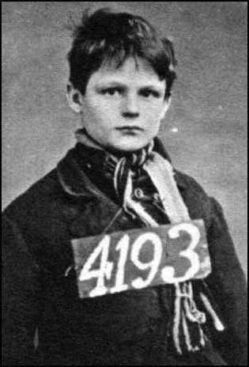
Typing and labelling
Students are labelled by teachers – an inevitable part of the classroom process
Labels often reflect pre-existing assumptions e.g., the ideal pupil
Schools exist to label students (processes of reports, marks, references, etc – i.e., role allocation)

Slide 6
The self-fulfilling prophecy
Students may take on the label given by teachers and schools
A self-fulfilling prophecy may be the result – coming true simply because it is made
Some labels may be stickier than others!

Slide 7
THE LABELLING PROCESS IN COLLEGE
“Thou shalt not get caught”
ALTER BEHAVIOUR IN AN ATTEPT TO CONFORM Student toes the line – conforms to rules and expectations – further “trouble” avoided
Desired response
RESPONSES OF THE INDIVIDUAL SEEN AS PROOF OF ODDITY Student behaviour is monitored for signs of rule breaking and even commonplace, minor infringements are noted and added to the record
INITIAL SITUATION Student the same as others and engaging in similar behaviour
LABEL APPLIED Behaviour comes to the attention of authorities: Cause for Concern, reports, informal discussions, parents’ evenings – CfC, Disciplinary hearing, Principal’s Office…
DEVIANT SUBCULTURE DEVELOPS Student finds others similarly labelled looking for alternative forms of status and companionship. Deviant behaviour (bunking, fighting or whatever) reinforced by group
DEVIANT CAREER IS BEGUN Student takes on the identity of “deviant” and lives up (?) to reputation
Other response?

Slide 8
Teacher defines or labels the pupil in a particular way e.g. – ‘dull’ or ‘bright’
Teacher’s interaction with pupils will be informed by their labelling of the pupils.
Pupils will respond accordingly, making the label true = SELF FUFILLING PROPHECY

Slide 9
Forming a sub-culture
Students may associate with others students who are similarly labelled
This may reinforce the label and begin a “deviant career”
Anti-school subcultures may result

Slide 10
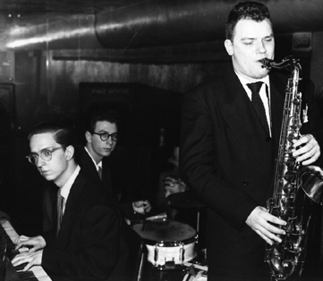
Howard S Becker
Key figure in development of labelling theory and key terms
Study of drugtaking among jazz followers
The Ideal Pupil – a construction in the minds of teachers

Slide 11
A FEW Key Studies
Interactionism

Slide 12

Valerie Hey
Key study into girls’ friendships and subcultures in schools
Aims at an “understanding of how girls simultaneously survive their schools, their families, their relations and subordination to boys and men.”

Slide 13
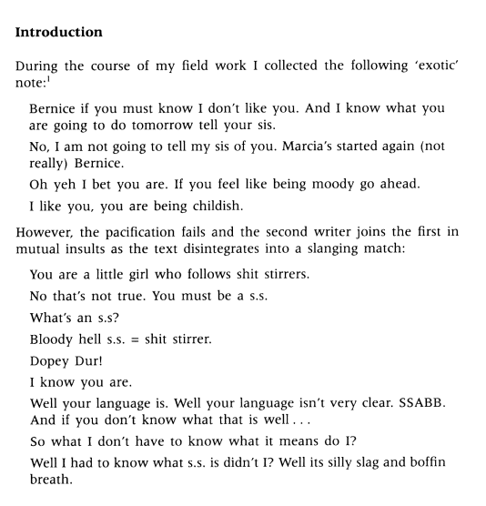
Valerie Hey
Uses student notes alongside observation to obtain an insight of how girls behave – aim of empathetic understanding
An example of a feminist methodology blended with interactionism

Slide 14

David Hargreaves
Blended interactionist methodology with functionalist theory (ethnography?)
Combined small scale studies of interaction with Durkheimian approach

Slide 15

Paul Willis
Blended school ethnography with Marxist theory to develop neo-Marxist ideas
Useful account of subculture formation – linked to wider social processes

Slide 16

Robert Rosenthal and Lenore Jacobson – Pygmalion in the classroom
American social psychologists
Used field experiment to demonstrate the power of labelling
Concentrated on lower years of schooling

Slide 17


Louise Archer et al
Studied working class styles and their link to educational failure
Used qualitative ethnographic methodology

Slide 18
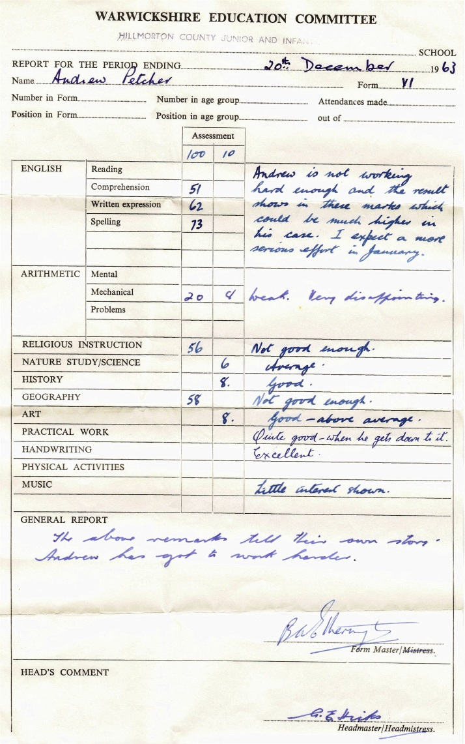
Stephen Ball - Beachside Comprehensive
An ethnographic study of an ordinary English comprehensive school
Demonstrated the power of institutional labelling and classroom interaction

Slide 19
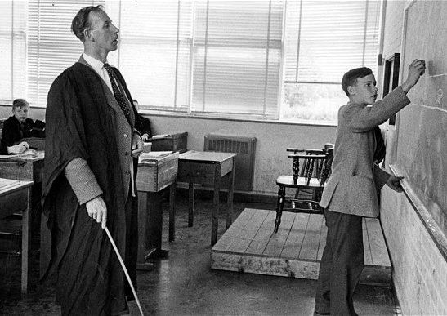
Peter Woods – The Divided School
Ethnographic study of school
Observed pupil and staff responses to school environment
Centred around the central issue of power and control
  Teachers – how to achieve it
  Pupils how to deal with it.
Notes:
C1 start monday

Slide 20
Some Problems with Interactionist Theory
Often lacks concerns with wider issues of power – how and why do some label others?
Often neglects the ability of subjects to resist the label – i.e., less than truly interactionist
(better studies account for this)

Slide 21
Problems for Interactionists and the Education System
Problem of measurement – cannot identify the influence of any specific teacher – issues of reliability and validity
Stereotypical? – can become as clichéd as those being studied.

Slide 22
Uses of Interactionism
A feature of many ethnographic studies carried out by educational practitioners
Overcomes the idea of the school as a “black box”

Slide 23

Teacher
prejudices
Peer groups
Labelling
EDUCATION
SYSTEM
Significant others
Reports
Discipline
IN
OUT
Hidden
Curriculum
Bullying
Grading
Sub-cultures

Slide 24
Interactionism
Marxism
Functionalism
Feminism
Neo Marxists such as Paul Willis looking at pupils’ interaction and decisions in the light of the functions of education under capitalism as outlined by other researchers
Researchers such as David Hargreaves, studying the Comprehensive school and assessing Durkheim’s ideas on education, or Peter Woods adapting Merton’s work on strain theory
Archer’s work on working class girls shows both a focus on how sexuality is constructed as well as how individual students perform the latter in the context of the school

Slide 25

Impact of Interactionism
Used by educational practitioners – often carrying out micro-studies/ethnographic work
Particularly influential on equal opportunities policies (and their critics)
Ofsted still relies on classroom observation …

Slide 26
Further Work
Describe in interactionist terms how school labelling can be a powerful influence on children.
Some necessary terms:
Labelling
Self-fulfilling prophecy
Deviant career
Sub-culture

