Slide 1
Material deprivation

Slide 2
What is material deprivation?
Material deprivation relates to poverty and is seen as the main cause of underachievement. It relates to the lack of necessities and materials needed to help someone achieve, such as poor living conditions and income.

Slide 3
Material Deprivation - poverty
Sociologists of poverty have identified the cycle of deprivation or cycle of disadvantage ‑ this suggests that the "hard core" in society who are in poverty remain largely the same from one generation to another, i.e., deprived children in their turn become parents of deprived children.
Material deprivation is closely linked to the problem of educational failure, partly as cause and partly as effect.
How can poverty be linked to educational underachivement? P.9

Slide 4
The cost of schooling
Using the list in the booklet and your own experiences, add up the cost of your own schooling per year P.10

Slide 5
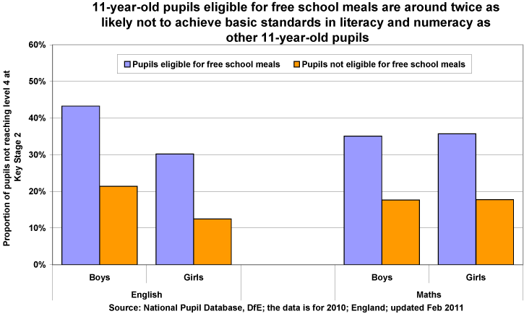
Free school meals and achievement

Slide 6
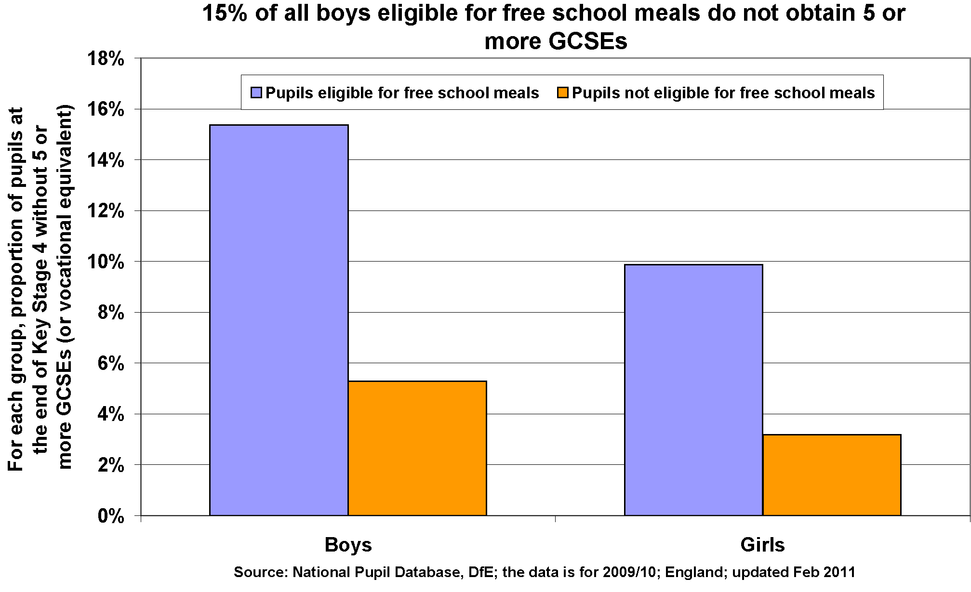

Slide 7
Poor Housing
An example of material deprivation is poor housing and living in poverty. It has direct and indirect effects leading to someone's underachievement. A direct effect of this could be overcrowded homes meaning it can be difficult for people in education to study as everyone may be worrying more about bills, food and water. However, an indirect effect from poor housing could be the health and welfare problems of those living there as money worries can mean no hot water, heating and electricity.

Slide 8
Diet and hEALTH (MATERIAL DEPRIVATION )
Free school meals indicate that children come from a poorer backgrounds
Marilyn Howard – young from poorer homes have lower intakes of energy, minerals and vitamins resulting in a weaker immune system meaning they cant go to school and study.
Waldfogal and washbrook (2013) - lower income can result in children living in damp unclean and unsafe conditions ending up in higher levels of illness a making home study hard.

Slide 9
Financial support
Lack of financial support means children from poorer families have to do without equipment and miss out on experiences that would enhance their education achievement
David Bull refers to this as the cost of free schooling
Study by Emily tanner found the cost of items such as uniform, transport, books etc. placed a huge burden of poor families. This may result in children wearing hand me downs and old revision books which can result in being isolated or bullied by peers.
Lack of funds also mean children from low income families also need to work putting a negative effect on their studies.

Slide 10
Fear of debt
Attitudes towards debt may deter working class students to local universities so they can live at home and save on travel costs, but this can give them less opportunity to go to higher status universities.
They are also more likely to work part time to fund their studies making it harder for them to gain higher class degrees.
Dropout rates are also higher for universities with a large number of poor students; 16.6% dropout at some London unis with only 1.5% dropout at Oxford.

Slide 11
POLICIES THAT HAVE DISADVANTAGED CHILDREN FROM MATERIALLY DEPRIVED BACKGROUNDS
:)

Slide 12
Policies
Marketisation – due to the league tables schools discard children from materially deprived backgrounds as they are likely to make the school look bad.
Parentocracy – parents of a materially deprived child don’t have the option to shop around for schools
Academies/Free Schools – can select 10% of their intake so will reject kids from materially deprived backgrounds
EBACC – can use educational triage to filter the materially deprived children into the useless cases (suggest different, less academic subjects for students with lower grades)

Slide 13
:|

Slide 14
CULTURAL DEPRIVATION

Slide 15
Cultural Deprivation - What is it?
Cultural deprivation is a type of cultural poverty and tends to view any culture which is not that of the teacher (white, middle class) as inferior.
These arguments were popular in the 1960s, and they’re often linked to some functionalist approaches.
Subcultural Theory - SugarMan
Barry sugarman (1970) argues that working class subculture has 4 features that act as a barrier to educational achievement:
fatalism- whatever will be will be and there’s nothing you can do to change your status
Collectivism - valuing being part of a group over individual achievement
immediate gratification- seeking pleasure now rather than making sacrifices for the future.

Slide 16
Language: Bernstein
Bernstein found that success in education depended on language- for reading, writing, speaking and understanding.
If children don’t develop language skills in the home, cultural deprivation could occur, which could ultimately disadvantage them at school.
Bernstein argued there are two types of language:
Elaborate code- used mainly by middle class people. Greater range of words and ability to communicate and understand. Used in more formal context.
Restricted code- all people use it but it is predominantly used by lower working class, who are constrained to it’s use. More informal language.

Slide 17
Willis- Learning to labour

Slide 18
The lads
The 12 pupils (the lads) formed a friendship group with particular attitudes to school. Willis refers to this as a counter school subculture.
The lads felt superior to the teachers and conformist pupils who they called “ear’oles”
The saw no value in gaining qualifications.
Manual labour was seen as more worthy than “pen pushing”
The lads were highly influenced by there fathers as they were an influential masculine figure in their lives who they would hope to follow in the footsteps of.

Slide 19
Working class subcultures: Archer
Number of working class students going to university is low.
The urban working class are looked down on by the middle class.
“university's not for me” less likely to succeed in education system
Archer et al also argues – working class urban youth style differs from the middle class = educational inequalities

Slide 20
Compensatory Education
Aims to tackle cultural deprivation
Offers supplementary programmes and services
Providing extra resources to schools and communities in deprived areas
Early Excellence Centres are widely discussed programs of compensatory education
Poor children score between 6 and 13 points lower on various standardized tests of IQ

Slide 21
CULTURAL CAPITAL

Slide 22
What is it and who would make this argument?
It is the knowledge and the abilities that the higher class children possess before even entering the school system and which they can invest into it
The argument would be made by Bourdieu from a Marxist conflict view.

Slide 23
Bourdieu
He believes that the main function of the education system is cultural and social reproduction, transmitting privilege and wealth from one ruling class to another.

Slide 24
Evaluation
Doesn’t really talk about fixing problems within the home
Middle class children have a higher success rate in education then working-class children because of the dominant culture

