Slide 1
Social Democratic vs New Right theory
E Group … or most of it anyway …

Slide 2
Social democratic Theory
Equality of opportunity

Slide 3
Social democracy, political ideology that originally advocated a peaceful evolutionary transition of society from capitalism to socialism using established political processes. In the second half of the 20th century, there emerged a more moderate version of the doctrine, which generally espoused state regulation, rather than state ownership, of the means of production and extensive social welfare programs. Based on 19th-century socialism and the tenets of Karl Marx and Friedrich Engels, social democracy shares common ideological roots with communism but eschews its militancy and totalitarianism. Social democracy was originally known as revisionism because it represented a change in basic Marxist doctrine, primarily in the former’s repudiation of the use of revolution to establish a socialist society.
Some researches argue that the growth in education greatly exceeds the needs of the economy.

Slide 4
What are the social democratic main arguments?

Slide 5
Social Democrats are strongly critical of society when it is divided, they would argue artificially divided, into classes or groups based on socio-economic position, access to education, gender,
Education serves the needs of an advance industrial economy
Believe in welfare state for example benefits and human capital

Slide 6
Social Democratic – Schultz and Human Capital
Schultz argued that high levels of spending on education and training are justified so people can have good knowledge and skills, this is investment in human capital. Investing in education makes a successful economy. Functionalists see this as necessary to provide a properly trained, qualified and flexible work force, that have high levels of skill and knowledge, that can do a wide range of jobs.
HOWEVER
Brown et al (1997) believed that the increased pace of technological and economic change needs a flexible workforce with a good education rather than specific traits.
CRITICS
Randall Collins (1972) claims that once mass literacy has been achieved, education makes little difference to economic growth. He also stated when companies do require specific skills they usually provide their own training courses.
Woolf (2002) said that we are may be over educating the population for example there are many unemployed graduates. In Switzerland they spend less money on education than other countries however it is still one of the richest countries. The link between high levels of education and economic success is not inevitable.

Slide 7
1. What Problems do Social Democrats See With the Education System? 2. What Solutions Do They Offer?
Social Democrats like Halsey argued that the grammar school system was a disadvantage to working-class children. Also, the 11+ exam tested the middle class culture and labelled working-class children as less intelligent.
Social Democrats believed that the selective education system needed to be abolished and replaced by a comprehensive system, where everyone would receive the same opportunities and working-class children and middle-class children could mix in lessons. Social democrats agree with functionalists who argue that education has a key role in creating a skilled workforce, so by creating meritocracy would release more talent into society.

Slide 8
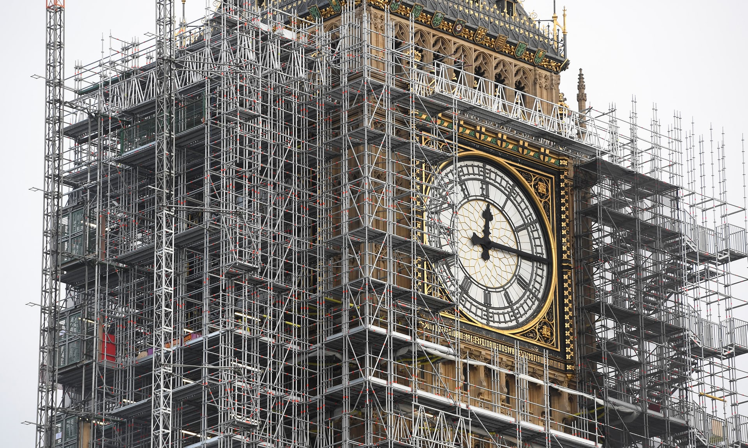
WORK IN PROGRESS …

Slide 9
New right theory
The consumer must decide

Slide 10
New Right: who are the key thinkers?
Milton Friedman and Peter Bauer influenced the economic policy of Thatcherism and Reaganism.
- Friedman argues that …
Governments should not be involved in the economy except four main functions:
Defence
Law and Order
Provision of the necessary public works that private enterprise does not find profitable to provide.
Protection from members of the community who ‘cannot be regarded as ‘responsible individuals’.
Bauer advocates a wider range of functions fore governments:
The basic provision for healthy ands education
The management of the monetary and fiscal (taxation/spending) system.

Slide 11
New Right – Main Arguments
Too much state control – The state had become too involved within peoples lives resulting in welfare dependency.
High taxation was the only way forward due to the high expenses of welfare benefits.
Individuals should have full responsibility and control of their lives instead of relying on the welfare state and the judgements of the government .
Drive, initiative and enterprise are key for success.
Advocates for investment into the privatisation of industries e.g. NHS, Private schools

Slide 12
Problems with the Education System & Solutions
Problems
Too much state control
Less money to invest in private industry, leads to welfare dependency
Cost a lot of money, high taxation
Solutions
More competition between schools and colleges – best ones attract students, worst get no students and go out of business.
Allowed schools and colleges to be more self-managing, gave them more control.
Leads to better school management, higher teaching quality, leads to higher qualifications

Slide 13
Evaluation of the New Right
They agree that the Functionalist agenda should be in education, but in reality, it is not.
The New Right supports competition (in education, for example) since it encourages marketization and makes them more efficient – the businesses strive to be greater than others to attract customers. Also, this encourages a competitive spirit and drive to succeed in people.
They are about tradition and hierarchy
They believe the Welfare State encourages a Dependency Culture – people take advantage of/rely on benefits and services when they don’t need to. The Welfare State is too controlling as well.
They are trying to cut the cost of the welfare state by getting rid of ‘unnecessary’ benefits and services. E.g. lone-parent benefits.
A Dependency Culture will undermine people’s values; they will become lazy and stay at home.
The idea of a market – people should be able to chose what is best for them.
Meritocracy is about individual’s choices and effort (merit = ability and effort), not what the state decides – if an individual is able, they should support themselves.

