Slide 1
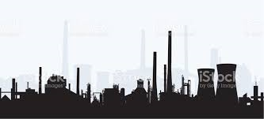
What is Industrialisation?

Slide 2
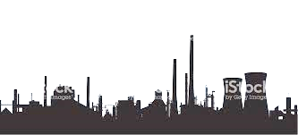
What is Industrialisation?
Industrialisation, which took place from the 18th to 19th centuries, was a period during which predominantly agricultural, rural societies in Europe and America became industrial and urban.
This means that Britain changed from having a predominately agricultural society to an industrial, urban one
Remember however, Industrialisation is an ongoing process
http://www.history.com/topics/industrial-revolution
https://www.youtube.com/watch?v=KHmqEqJN59o

Slide 3
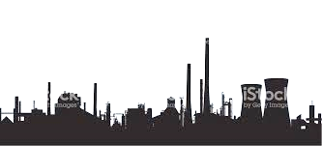
Why is Industrialisation important in Sociology?
Movement from an agricultural to industrial economy has huge impacts on society
2 Minutes paired work:
Thinking about what you learned in the video, discuss the kind of changes this may cause in society…..

Slide 4
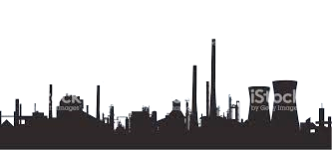
Why is Industrialisation important in Sociology?
The process of Industrialisation and the Industrial Revolution created the very way of life that we learn about in Sociology today
The movement of people from living in small, rural self sufficient communities to large towns and cities meant many changes to the way in which society works:
For example:
Movement from predominately extended families to small, nuclear families (with people moving to towns to get jobs)
Types of jobs available – people developing specialist skills and trades needed for the new industries being developed
A new class structure – those that worked in factories and industry and those that owned the factories and industry
New laws (and therefore new types of crime) to organise and control the changes and new way of life
Over time, the need for workers and childrens rights were established – principles we still adhere to today

Slide 5
Tasks.
Using the information sheet you have been given and notes from discussion, complete the mind map about the impact of industrialisation in more detail.
Complete the following exam question:
‘Identify and explain three ways that Industrialisation changed society’ (6 marks)

