Slide 1
FUNCTIONALISM AND THE FAMILY

Slide 2
Functionalism
Functionalism is a consensus theory- can you remember what is meant by this?
Notes:
Society is based on agreement and shared norms and values

Slide 3


Organic analogy
Functionalists regard society as being like a body, with different parts working together for the harmony of the whole.
Functionalists see the family as a vital ‘organ’ in maintaining the ‘body of society.
They are interested to see how the family contributes to the functional prerequisites (or basic needs) of society.
The family is seen by functionalists as being the ‘heart of society’, what do you think they mean by this? [Complete p.8]

Slide 4

The importance of socialisation p.8
Functionalists stress the importance of primary socialisation as a key function of the family.
Primary socialisation is the way in which our parents and other siblings teach us the norms and values of our culture
Values- general beliefs about what is right or wrong in society and standards we think should be maintained.
Norms- acceptable forms of behaviour linked to those values.
Value consensus- agreement about shared values
Social solidarity- a feeling of belonging based on shared culture
Example
Value- protection of life
Norm- wearing a seatbelt in a car

Slide 5
What does the Family
need to do for society
and the individual?
FUNCTIONS
What type of Family is
best for contemporary society?
STRUCTURE
What do family members need to do to make the family “work”?
ROLES/RELATIONSHIPS

Slide 6
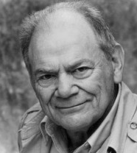
George murdock (1949) p.9
According to Murdock, the nuclear family is universal- it exists as an institution (an organisation founded for social reasons) in all societies cross-culturally or through time either on its own or part of a more complex extended network.
In groups research the other family forms on p.9, using p.268 of the Browne textbook and the internet.
Then answer the question underneath What does the presence of these other types of family indicate about Murdock’s argument?

Slide 7

Murdock’s Definition of the Nuclear Family (p.10)
He identified the following characteristics:
Common residence
Economic co-operation
Reproduction
Adults of both sexes
Socially approved sexual relationship
One or more children
What problems can you identify with Murdock’s 4 ideas about the family and his definition of a nuclear family?- p.10

Slide 8
George murdock (1949)
According to Murdock, the family is universal because only it family can fulfil functional prerequisites (basic needs) that societies need to function (p.10)
These are
  Sexual
  Reproductive
  Socialisation/education
  Economic

Slide 9
Exam focus
Outline and explain two functions of the family
Identify Reason One
Provide evidence to support your argument. This should include named sociologists and may also include contemporary evidence, theory, statistics or other relevant points.
Add a tiny bit of evaluation
Explain how evidence relates to question

Slide 10
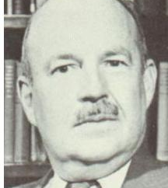
Talcott Parsons (1955)
According to Parsons, the nuclear family as it is now emerged with industrialisation because it is the ‘best fit’. It is not universal as Murdock claims.
He also argues it has lost many functions to other agencies and institutions such as the health and education system:
The nuclear family only has left, what he describes as 2 basic and irreducible Functions:
Primary socialisation- socialising children into their culture and acceptable gender roles
Stabilisation of the adult personality- adults providing support for each other in a society that puts a lot of pressure on people at work. Sexual division of labour helps stabilise adult personalities.
Complete p.11

Slide 11
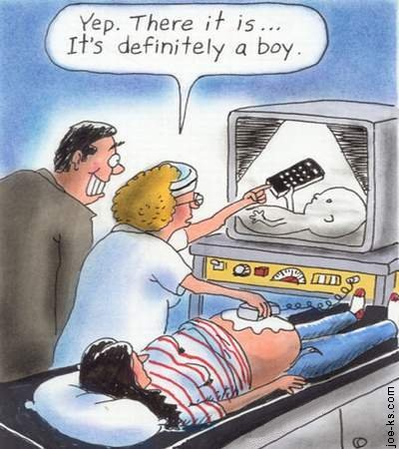
Parsons and the sexual division of labour
Functionalists argue that differing behaviours are natural for men and women. They argue that men and women are socialised into different roles but this is shaping tendencies that are innate (we are born with them)
In jargon they argue that there is a biological imperative for sex role differentiation.

Slide 12
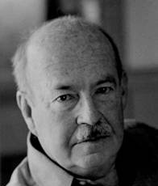
Parsons and the sexual division of labour
Talcott Parsons argues that in industrial society men perform an instrumental role (an economic role) and women perform an expressive role (nurture and emotional support).
This best suits their innate tendencies
This is referred to as the sexual division of labour

Slide 13
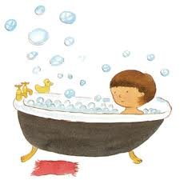
Parsons’ Warm bath theory
As part of the stablisation of adult personalities, Parsons’ theory is often called a ‘warm bath’ Whereby the woman should act as a metaphorical warm bath, welcoming her husband home after a hard day at work and looking after his needs.
Who might be critical of this idea (complete p.12)

Slide 14
Parsons: the nuclear family is the ‘best fit’ for society
According to Parsons, pre-industrial society was characterised by the extended family, but as a direct result of industrialisation, this was replaced by the isolated nuclear family. (i.e. the nuclear family was caused by industrialisation). The isolated nuclear family is seen as ‘best fitting’ the needs of an industrial economy (i.e. that it is particularly suited to an industrial society). Young and Willmott and Fletcher would also support the view that the classic extended family has largely disappeared and a privatized nuclear family or some form of modified extended family has emerged.

Slide 15
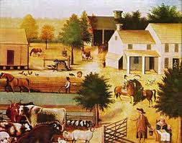
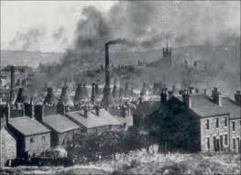

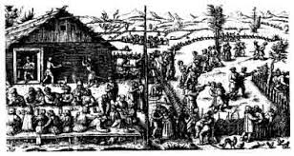
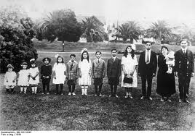
Modernity
Pre-industrialisation
industrialisation
People living in smaller units, seen as isolated. Less connected to wider kin on a regular basis.
Pre 1800s
Agricultural communities whose extended families depended on each other
1800-1920s
Still large families but in smaller housing, becoming more isolated

Slide 16
Family Change – the Parsons Model
Extended, Large Families
Isolated Nuclear Families
Limited Number of Children
Loss of functions – but still always responsible for emotional work, i.e.,
- Primary socialisation
- Stabilisation of adult personalities.
Multifunctional Families:
Welfare, Education &
Training, Religion, Work, Placement, etc.
INDUSTRIALISATION
Source of status (ascribed)
Irrelevant to status (achieved)

Slide 17
The changing functions of the family
Talcott Parsons
Evolutionary view of the family (march of progress)
With industrialisation the family lost many of it functions to other institutions (structural differentiation)
Maintains 2 basic and irreducible functions
Ronald Fletcher
The family continues
to perform a range of important functions
Family operates in partnership with other institutions to perform functions such as education, healthcare etc.

Slide 18
Parsons- reasons for ‘best fit’
Weakened extended family and growth of isolated nuclear family
Strengthened bonds between partners protect family stability
A more meritocratic society- not based on who you know, but what you know
Need to avoid economic and status conflict between kin
Need for small family unit for geographical mobility
High rates of social mobility weaken kin links
Greater affluence and reduced family functions- less need for kin

Slide 19
Parsons- reasons for ‘best fit’
Parsons argues the isolated nuclear family allows for geographic and social mobility. What does he mean by these concepts? Complete p.13
Geographical mobility
The size of the family allows it to be more easily moved around the country for work needs etc.
Social solidarity
Helps to form social bonds based on shared attitudes
Complete the questions about the decline of the extended family on p.14
Complete the fill in the gaps summary on p.15

