Slide 1
Judith Stacey (1998) says that the greater freedom and choice has benefitted women. It has allowed them to break free from patriarchal oppression and has meant they can shape their family arrangements to meet their needs.
Stacey used life history interviews in order to create a range of case studies of postmodernist families in Silicon Valley, California. She discovered that women are the main reason for changes in the family, as opposed to men. Example; many of the women she interviewed had rejected the traditional housewife-mother role, instead they had worked, returned to education as adults, improved their job prospects, divorced and re-married. These women had often created new types of family to better suit their needs.
Stacey calls one of these types of family the divorce-extended family where all the members are connected by divorce instead of marriage. The key members within this family are usually women and may include former in-laws, or a man’s ex-wife and his new partner. Example; Stacey found in one of her case studies that a women called Pam Gamma had married young, cohabitated and then remarried; her second husband had also been married previously. By the time the children from Pam’s first marriages were in their 20s, she had formed a divorce extended family with the women cohabitating with her first husband, Shirley. They helped each other financially and domestically.
Anthony Giddens and Ulrich Beck explore the effects of increasing induvial choice upon families and relationships. The individualisation thesis argues that traditional social structures like class, gender and family have lost a lot of their influence over us. In the past, people were prevented from choosing their own life course because their lives were defined by fixed roles. For example, everyone was expected to marry and to take up their ‘appropriate’ gender roles. However, today individuals have fewer fixed roles to follow. According to the individualisation thesis, we have become disembedded from traditional roles and structures, leaving us with more freedom to choose how we lead our lives. As Beck (1992) says, that the ‘standard biography’ or life course that people followed in the past has been replaced by a ‘do it yourself biography’ that individuals must have constructed today. This reduces family size because women live their individual lives and therefore will usually have children later on in life than they did in the past.
In 2005 the average age of mothers having their first child was 27.3. This is more than 3 years older than the national average in 1971.
This could be due to the change in women's aspirations:
Sue Sharpe showed that there is a major shift in the way that girls see or picture their future.
In 1974, girls had low aspirations; they thought that educational success was unfeminine and that having ambitions would be seen as unattractive. Their priorities were given as ‘love, marriage, husbands, children, jobs and careers, more or less in that order’.
But by the 1990s, girls’ ambitions had changed and they had a different order of priorities – having careers and being able to support themselves. Sharpe discovered that girls are more likely to see their future as an independent women with a career rather than someone who is dependant on her husband.
This change has meant that women have children later on in their lives because they are focusing on careers before thinking about having a family. And because of women’s ‘body clocks’, they are unable to have less children because they start having children later. The average number of children has rose from 1.63 in 2001, to 1.94 in 2010.
Reduction in family size
Blue = important people/theorists.
Orange = important information.
Thus, David Morgan (1996;2011) says that it is pointless trying to make large-scale generalisations about ‘the family’ as if it were simple, like functionalists do. Rather a family is simply whatever those involved choose to call their family.
In this view, sociologists should focus their attention on how people create their own diverse family lives and practises. One way of exploring this is through life course analysis.
Women’s employment has changed over the years:
The 1970 Equal Pay Act makes it illegal for women to be paid less than men for doing the same job and the 1975 Sex Discrimination Act outlaws any sex related discrimination in the workplace.
Since 1975, the pay gap between men and women has halved from 30% to 15%.
The proportion of women in employment has risen from 53% in 1871 to 67% in 2013. This is because the growth in flexible part-time work has offered women more opportunities.
Some women are now breaking through the ‘glass ceiling’, this is an invisible barrier that keeps them out of high level professional jobs.
The advance in contraception has also led to a change in family size.
In the 1960s, when the contraceptive pill was first approved, it killed women and caused serious illnesses. This was because women didn’t tell their husbands that they were taking the pill so when they became ill, they eventually died.
But nowadays there are several types of contraception and they are much safer than they were. Contraception was the first time women were allowed to be in charge of their own fertility; beforehand a women's husband was the one who arranged contraception.
This means that women can decide when, and if, they become pregnant meaning they have little, or no children.

Slide 2
Legal acts and issues:
The Race Relations act made it illegal to discriminate against someone of an ethnic minority. This piece of legislation equated to an increase in acceptance of ethnic minorities in the UK.
How did this affect the family:
The increasing acceptance towards ethnic minorities lead to an increase in interracial marriages by 29% in the UK. This equated to more mixed race children being born in the UK. Some statistics suggest that today there are more Muslim or black live births a year than White/British live births a year.
Changes in Values:
-Nearly 1 in 10 people (9% or 2.3 million) who were living as part of a couple were in an inter-ethnic relationship in England and Wales in 2011. This has increased from 7% in 2001.
We focus on the increasing ethnic diversity within England and Wales. Whilst the majority of the population gave their ethnic group as “White” in the 2011 Census, results from the past 20 years show a decrease, falling from 94.1% in 1991 down to 86% in 2011. London was found to be the most ethnically diverse area, while Wales was the least diverse.
How does this affect the family:
- This information highlights that ethnic groups are a very apparent part of our society. An iconic place such a London, our capital, is now recognised as a place of diversity and acceptance.
changes in views towards ethnic differences in the family
Sociological studies:
Early American sociologist W.E.B. du Bois offered one of the most important and lasting theoretical contributions to the sociology of race and ethnicity when he presented the concept of "double-consciousness" in The Souls of Black Folk. This concept refers to the way in which people of colour in predominantly white societies and spaces and ethnic minorities have the experience of seeing themselves through their own eyes, but also of seeing themselves as "other" through the eyes of the white majority. This results in a conflicting and often distressing experience of the process of identity formation
Key statistics:
-1.2 million interracial marriages in England and Wales
-80% of the population are white British/Asian/Pakistani
-3.4% of the population is made up of ‘black groups’
-Chinese groups 0.7%
-according to the Office for National Statistics, there were approximately 64.6 million people living in the UK in mid-2014. Of these, 56.2 million (87.2 per cent) were White British.

Slide 3
.cohabitation is a norm now, living together without being married is no longer seen as a sin. In the 1950s only 2% of marriage partners had cohabited . Today cohabitation prior to marriage is over 80%.
The changing role of women has influenced an increase in cohabitation.
This is because there has been a shift in the aspirations and attitudes of women, sue sharpe found that in the 90s women were more focused on pursuing a career, whereas prior to this in the 60s/70s they were focused on housework and having children. Evidence suggest that woman do less housework in cohabiting relationships than in married relationships and more women today are less likely to adopt the traditional role of being a housewife and mother. Women also today are no longer economically dependent on their husbands as 14 million women now have jobs.
Increase in the number of couples cohabiting
Today there are over 2 million couples cohabiting. Growing secularisation has also influenced this because less people see relationships as religious obligations that they have to fulfil. Bech and Giddens argue because of individualisation people “have become freed from traditional roles and structures”, which means that people can choose how to live their lives, whether they want to marry or cohabit is up to them as they have more choice.
Compared to marriage cohabitation is a lot cheaper according to the Guardian a survey of 4,000 brides showed the average cost of a UK wedding is now a whopping £27, 161 the highest it’s ever been and up 9.6 per cent from last year. And if you add on the cost of getting a divorce, marriage is a lot more expensive.

Slide 4
Family trend: Changes to extended families
Brannen (2003):
Saw the families as a ‘beanpole’. There are multigenerational families where there is more intergenerational contact, that’s between generations (e.g. grandparents and grandchildren) as well as intragenerational contact within generations (e.g. between cousins)
Grundy and Henretta (2006) us the concept of ‘sandwich generations’ to refer to women between 55 and 69 who sandwiched between their needy parents and their own children, offer assistance to both
Technology
The increase in technology has allowed family to have easier access to communication meaning rather than most extend families, needing travel to see they can either skype, or video call to catch up. This is now known as the modified extended family.
Declining numbers of children within each generation as well as a longer life expectancy has caused the beanpole family to become ’thinner’, with more brothers and sisters but less grandparents to support
Family used to be one of the only sources of education, Before state schools in 1880, illiteracy rates were extremely high.
Now the education of children has been overtaken by the state and children are taught by professional teachers from 5 to 18. However the family still contribute towards children through primary socialisation.
Previously the family provided help for the ill and elderly; so if any of your family became ill you’d have to look after them. Nowadays the welfare state shares this through the NHS and social services, Providing help for care for the elderly through care homes, state pensions and welfare clinics.

Slide 5
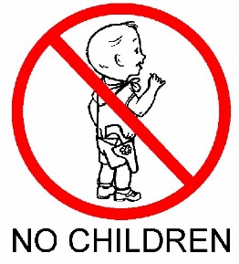
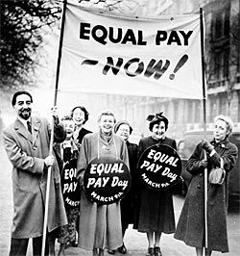
Post Modernism
The life course of families are changing. People don’t necessarily get married anymore or have children as they have more choice nowadays compared to previous years where you had to marry and have children to fit the perfect nuclear family and prevent being shunned by society.
Alan and Crow – The life course is no longer one set pattern. Individuals may choose to focus on career progression rather than starting a family which increases the number of one person households.
By 2005 the number the number of one person households had doubled since 1971 from 3 million to 7 million.
There has been a big rise in the number of people living alone. In 2013, roughly 3 in 10 households were one person households. This meant that 7.7 million people were living alone which is nearly triple the number in 1961.
40% of all one-person households are over the age of 65. These pensioner one-person households have doubled in number since 1961 whilst those households of non-pensioners have tripled. Men under 65 were the most likely to live alone.
The influence of the Feminist Movement
Empowering women to assertively make their own life choices. More women are wanting to progress through their careers rather than focusing on being in a relationship and living with their partner.
Second wave feminism has had an important impact on legal changes making it easier now for women to live on their own than it was before the laws were put in place.
Equal Pay Act 1970 and Sex Discrimination Act 1975 (Equality Act) allowed women to earn equal amounts of money for their work which in turn allowed them to be able to live independently as they no longer needed to rely on men to support them.
An increase of one person households.
Living apart together
Simon Duncan and Miranda Phillips (2013) found that 1 in 10 adults are living apart together (LAT) meaning they are in a significant relationship but are not married or cohabiting. This is half of all the people classified as single which may reflect a trend towards less formalised relationships and families of choice.
Found that both choice and constraint play a part in whether couples live together – some said they couldn’t afford to live together, however, a minority chose to live apart because they wanted to keep their own home, because of a previous troubled relationship or because they considered it to be too early to cohabit.
The decline in marriages means more people are remaining single. By 2033 it is predicted that over 30% of the adult population will be single meaning un-partnered and un-married.
The proportion of adults who are single has risen by half since 1971, many of which live alone. Many may be opting for creative singlehood which is the choice to live alone.
While many choose to live alone, many are alone as they are too few partners available in their age group. These are mainly older widows.

Slide 6
Family Trend: Decrease in the birth rate
Legal acts/issues:
The Abortion Act:
The Abortion Act allowed doctors in Britain (apart from Northern Ireland) to perform abortions legally. This meant women could stop unwanted pregnancy.
Policy in 1961 which meant the birth control pill becomes available on the NHS for the first time:
This improved women’s rights and allowed them more sexual freedom, which led to a reduce in birth rate
‘Equal Pay Act’ (1963) and ‘Sex Discrimination Act’ (1975):
The Equal Pay Act and the ‘Sex Discrimination Act’ (1975) has encouraged women to take part in paid labour. This has encouraged women to have fewer children and has made the idea of having children more problematic.
Changes in values:
Society’s attitudes and values towards contraception have changed from disapproval to acceptance this is because of the result of feminist movement
Also, there is growing secularisation in society and a declining influence of the church and religion
Sociological changes which have influenced the decrease in birth rate
Sue Sharpe
Sue Sharpe (1994) argues that the view that changes in the family and employment are producing changes in girl’s ambitions. Sharpe interviewed a group of girl and she found evidence there was a shift in the way girls see their future. In 1974 girls had low aspirations and believed educational success was seen as unattractive. However, by 1990 girl’s ambitions had changed. Careers and being able to support themselves were now the girl’s ambitions. Sharpe found that girls were now more likely to be ambitious about their future as an independent woman with a career rather than as dependent on their husband for economic support. This has reduced the need for women to have children because in a contemporary society women’s priorities are centred around educational success not love and marriage.
Beck and Giddens (1992) argue that in modern society, traditional norms, such as the duty to remain with the same partner for your life has lost their hold over individuals. This is because people are making their own choices in society and there are more options open to us. This contrasts with an older society where people were being controlled by social structures and social norms dictating how we behave. In the past marriage was seen as something that people did for live and men were expected to play the instrumental role in the family and women were expected to play the expressive role in the family. This was known as the ‘patriarchal family’. In recent years the ‘patriarchal family’ has been replaced by the ‘negotiated family’. This is because the ‘patriarchal family’ was seen as being oppressive and has been undermined in a contemporary society because there is greater gender equality which means more women are now working and are treated more equally in marriage. There is also greater individualism where people’s actions are influenced by self-interest. The evolution of the ‘negotiated family’ has led to great power and independence for women which means the birth rate has declined. Furthermore, the fact marriage is less important in society there has been an increase in the number of one-person households which has meant women do not feel the need to have a child.
Social issues
Due to an increase in income in compulsory education children are draining all the money and resources from their parents. For example, there has been an increase in the pay of university for students, school trips are expensive and school meals can be seen as being over price. This means parents are not willing enough to have children because of the cost
In a contemporary society, a geographically mobile workforce is needed because it means people can easily move to other areas to gain promotion or have access to better schools. This has encouraged smaller families and a decline in the birth rate because people can easily be mobile.
Stats:
Nearly 25% of women born in 1973 are expected to be childless at the age of 45
Hirsch (2004) estimated that a child costs a couple approximately £154,000 to the age of 18 in 2014
The number of married or cohabitating couples who have one child has increased from 16% in 1967 to 20% in 2018
The average cost of raising a child to the age of 21 is around £271,000

Slide 7
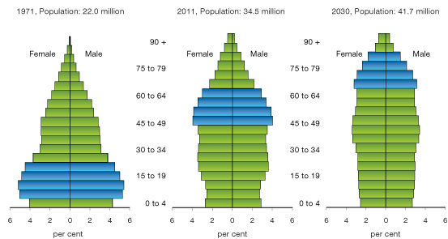
What is the dependency ratio?
This is where the working force needs to be bigger than those people who are not working (such as children, older people, adults that can’t work).
What is an ageing population?
The average age of the population is increasing, as a greater number of people are over the retirement age.
It is predicted that by 2041 there will be as many 78 year olds as 5 year olds.
Main 3 factors that caused an ageing population:
Increasing life expectancy
people and now living to an older age
Declining infant mortality rate
not as many people die at a young age
Declining fertility rate
fewer babies are being born compared to the number in the older population.
The negative impacts on society due to an ageing population:
Pension costs are likely to increase as the ageing population need more money in order to sustain themselves the younger generation are going to have to pay for them.
More people are living alone, especially woman as there are twice as many woman over the age of 75 than men, this is increasing the number of people suffering from loneliness. Also, more than 200,000 old people haven’t spoken to friends or family in over a month.
Due to the ageing population the number of elderly living in houses is increasing reducing the number of houses for younger families and people looking for their first home.
The positive impacts on society due to an ageing population:
This provides more family support (such as financial support or childcare) as the older people in the family not working are able to help out any of the younger generation.
The ‘grey pound’ helps the economy. This is where marketing such as films are aimed at the elderly increasing the amount of money the country in in taking.
Finally, there would be a reduce in crime. This is because not many people over retirement age are likely to commit a crime.
What is the impact of the Ageing Population?
Donald Hirsch (2005) stated that the traditional age pyramid is disappearing and being replaced by more equal sized blocks as seen in the image bellow. This also links to dependency ratio as these diagrams show how the number of people working is becoming smaller than those not working.

Slide 8
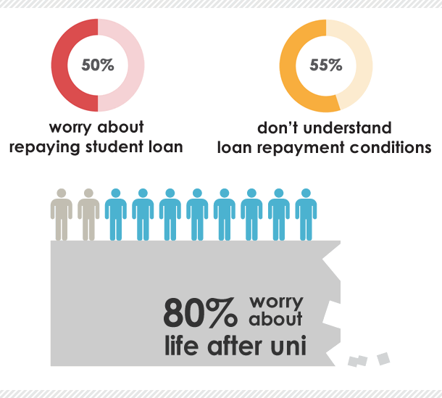
The increase in student debt is also to blame for the increase of young adults living with their parents. The debt means people simply cannot afford to move out because of the thousands of pounds they owe, as a result of going to university.
There were 618,000 more young adults living with their parents in 2015 than in 1996 – 3.3 million compared with 2.7 million.
Increase of young adults living with their parents
Young men are considerably more likely to still be living with their parents than their female counterparts. The figures show that nearly a third (32 per cent) of males aged 20 to 34 years are currently living with their parents, compared with only a fifth (20 per cent) of females in the same age group.
People are warned that house prices could double in the next 10 years if current broken trends in the housing market continue, and could quadruple by 2034.

