Slide 1
Starter
Answer the following 10 mark question and spend about 10-15 minutes answering the question
  Outline and explain two changes in society which demonstrate that society has become increasingly child-centred
Make sure you include a brief intro and two clear paragraphs

Slide 2
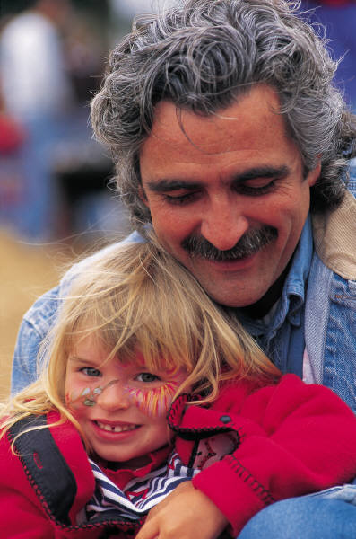
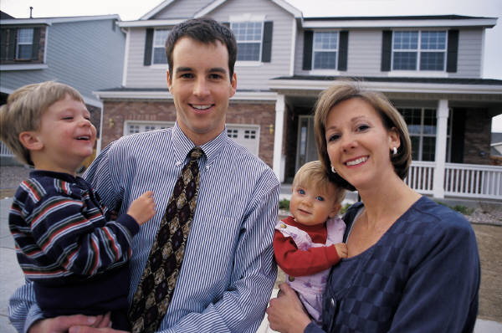
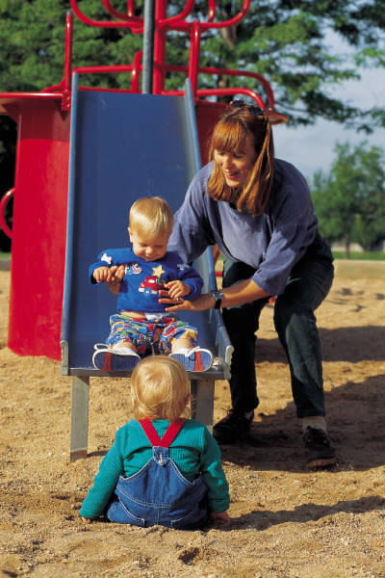
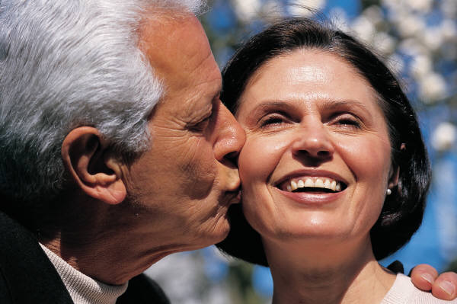
Family Diversity

Slide 3
Learning Outcomes
Outline the meaning of the term diversity, especially via the family
Outline and evaluate the dominant stereotypical family in the UK
Evaluate statistics on the dominance of the nuclear family
Revisit and explain the Functionalist and New Right view of the family

Slide 4
What do we mean by the term diversity? (1 minute brainstorm on p.3)
DIVERSITY

Slide 5
Activity p.4 (5 min to complete in booklet)
Draw a picture of the dominant stereotypical family in the UK.
What problems can you see with this stereotypical image of the family?
Who would agree with this image?
Who would be opposed to or challenge this image?

Slide 6
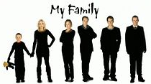
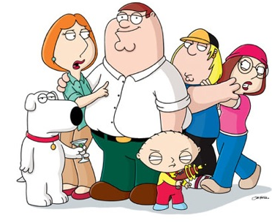
Key Question: Is the nuclear family still dominant?
This is the key issue when discussing diversity.
Is the nuclear family dominant or are British families a bit more complicated than this?

Slide 7
Statistic (p.5 in booklet)
In 2006, 76 % of children were living in a couple-headed household. In contrast, 24 % were living in a lone parent household
What do these statistics NOT tell us?

Slide 8
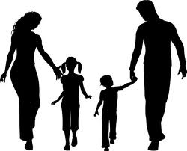
Dominance of the nuclear family?
This dominance only relates to the structure, it ignores
Sexuality
Class
The lifecycle of the family- change over time e.g. divorce
Ethnicity
Differences in conjugal roles
Statistics indicate that the structure of 2 parents and children is still dominant in contemporary Britain. In 2006 76% of children were living in this structure of family.
Religion
Where the family is living

Slide 9

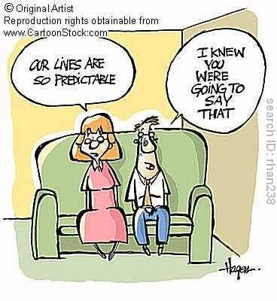
Functionalism and Family Diversity
Modernist perspective Modern society is fixed and predictable. One type of family is the best.
Parsons the functional fit is the nuclear family as provides 2 main functions
Primary socialisation
Adult stabilisation

Slide 10
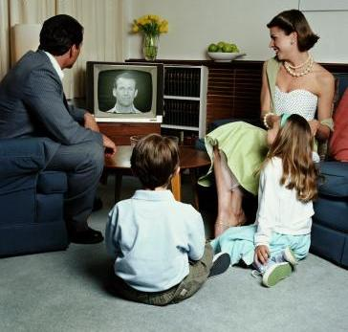
Functionalism
Parsons believes we can generalise about the family type we will find in society (i.e. nuclear family with clear division of labour)
Other types = deviant or unproductive as they are less able to perform the functions required of the family.

Slide 11
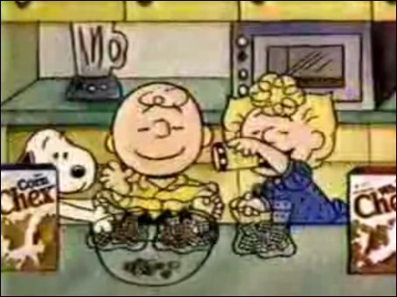
Traditional ideas of the nuclear family (p.5)
The nuclear family is presented as ‘normal’- Edmund Leach (1967) regarded the nuclear family as the ‘cereal packet’ family often shown in advertisements, with clear gender roles
HOWEVER, for Leach, the modern nuclear family is broadly dysfunctional when compared to more extended family networks in pre-industrial times – a source of conflict
Like other functionalists though, he assumes this family structure is dominant in our society

Slide 12
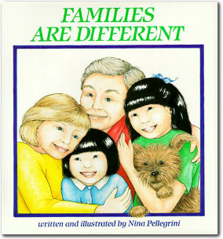
The Neo-conventional Family
Robert Chester (1985) accepts recent diversity, but does not see this as significant or negative.
1 important change is move from:
Traditional Neo-conventional
Nuclear family Family

Slide 13
The Neo-conventional Family
Dual earner family (symmetrical family)
Nuclear family remains an ideal.
Most people will be part of a nuclear family at some point.
Most people still:
marry
have children
stay together till death
jointly register births
live in a household with a married couple.
The New Right Exagerrate

Slide 14


The New Right (p.7)
Conservative and anti-feminist approach.
The nuclear family is ‘natural’
Decline in nuclear family = cause of many social problems.
Benson’s (2006) study shows that cohabitating couples (20%) are more likely to separate after having a child than married couples (6%).
Amato (2006) children in nuclear family are less likely to experience poverty, education failure crime and health problems.
Example: https://www.youtube.com/watch?v=NEao02xkXKk

Slide 15
Homework for 26.11.2015
Complete the booklet up to p.8 (including p.8)
Childhood booklet will be collected

Slide 16
Recap: Robert Chester talks about what family type?
a.) neo-conventional family
b.) symmetrical family
c.) extended family
d.) beanpole family

Slide 17
Recap: What does Edmund Leach mean by the cereal packet family?
The stereotype of the ideal family found in the media and advertising. It is generally seen as involving first-time married parents, their own natural children, living together, with the father as breadwinner and the mother concerned with the children and the home

Slide 18
Recap: What do we mean by family diversity?
The existence of different family types alongside the traditionally dominant nuclear family, differences along the lines of class, ethnicity, religion etc. as well as differences in terms of conjugal roles

Slide 19
Learning outcomes
To outline and explain elements of family diversity
To outline, explain and give examples of regional diversity
To examine studies on the presence/absence of extended families
To explore and give reasons for ethnic differences in family patterns

Slide 20
Key Study: Rapoport and Rapoport (1982)
Postmodernists
Although families might look like nuclear families from the outside they may be very differently set up on the inside.
There are many other types of family, which traditional theorists (e.g. Parsons) tend to ignore.

Slide 21

Family Diversity

Slide 22
Rapoport and Rapoport (1984) identified five elements of family diversity:
Organisational: different structures and how roles are divided in the household.
Cultural: the nature of the family and relationships can vary considerably between different ethnic and cultural groups
Class/Economic: differences may be based on class, such as sharing of domestic roles and decisions, employing a nanny. Differences in socializing children.

Slide 23
Life Course: The nature of the family can change over the life-course of an individual. For example, living in a nuclear family is more likely for those in their thirties than those in their sixties
Cohort: individuals born at the same time may have similar experiences because of wider social and historical events, such as economic depression, war, expansion of education

Slide 24
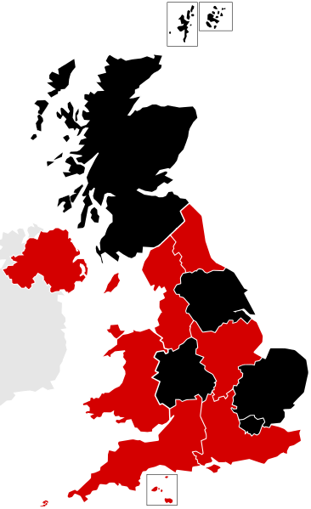
Eversley and Bonnerjea (1982) – Diversity and Location (p.8-9)
David Eversley and Lucy Bonnerjea add in the additional factor of regional diversity
Local influences produce different life experiences and therefore diversity.
They identify FIVE areas of Britain which offer different types of family organization- affluent, rural, coastal, inner cities, old industrial

Slide 25
Eversley and Bonnerjea (1982) – Diversity and Location (p.8-9)
Many coastal regions attract elderly couples ‘geriatric wards’, e.g.
Inner city areas have greater concentrations of lone parents and ethnic minority families in the poorer areas, e.g.,
Traditional rural areas have more reliance on extended family, e.g.,
Affluent Suburbs tend to attract young families ‘family builders’, e.g.,
Old industrial areas may have the kind of extended family networks identified by Young and Willmott in their original study, e.g.,

Slide 26
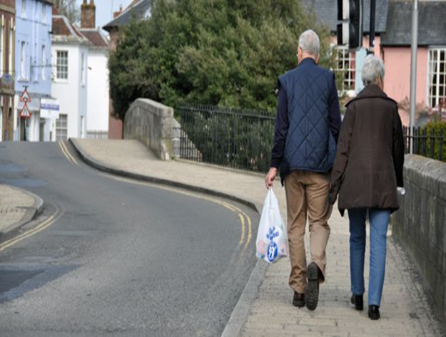

Coastal Regions
Many coastal regions attract elderly couples ‘geriatric wards’, e.g.

Slide 27
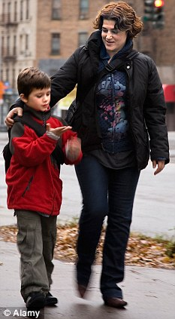
Inner Cities
Inner city areas have greater concentrations of lone parents and ethnic minority families in the poorer areas, e.g.,

Slide 28
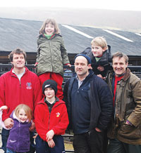

Rural areas
Traditional rural areas have more reliance on extended family, e.g.,

Slide 29
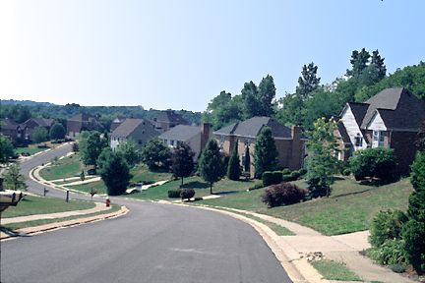
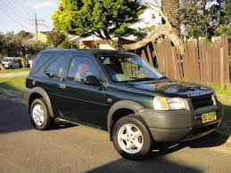
Affluent Suburbs
Affluent Suburbs tend to attract young families ‘family builders’, e.g.,

Slide 30
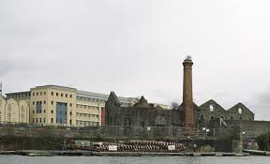
Old Industrial Areas
Old industrial areas may have the kind of extended family networks identified by Young and Willmott in their original study, e.g.,
Notes:
E2 Group fin

Slide 31
Extended families (add to bottom of page 9 or separate sheet)
Although families may look nuclear they may in fact be part of a more complex extended structure.
Functionalist sociologist Sussman (1965) rejects the thesis of family units being isolated (e.g. made by Parsons)
Aid and assistance (e.g. financial) flows from parents to children = extended family networks occur widely in industrial societies.
The findings of Willmott and Young, etc support this

Slide 32
Extended families continued
Chamberlain (1999) – Caribbean families are geographically dispersed, but continue providing support. They constitute ‘multiple nuclear families’
HOWEVER: Charles (2008) –the classic three-generation family is all but extinct except in the Bangladeshi community

Slide 33
Peter Willmott (1988) (p.9)
Conducted a study of families in a North London suburb and identified FOUR main types of extended families:
Extended family of residence – where members of the family live in the same household
Local extended family – where 2 or 3 nuclear families live separately, but in close proximity and see each other often
Dispersed extended family: nuclear families who see each other reasonably frequently but live further apart and do not see each other as regularly
Attenuated extended family: similar to the dispersed extended family but the contact is even less frequent

Slide 34
Activity (15 minutes, then feed back)
Read p.10 and pages 220-221 (on ethnic differences) in your textbook and answer the questions on p.10 in your booklet
Additional questions
Why do many Asian families live in larger households?
How do Mirza (1997) and Reynolds (2010) explain the presence of lone parent households among Black families?

Slide 35
Conclusion
Diversity is not just about the structure- the extent to which the family looks like the nuclear family- it is also about the interpersonal level. For example
  differences in male/female roles
  ideas about socialising children
  the role of religious ideas
  etc.
  What matters in interpreting this is the emphasis placed on different features.

Slide 36



Explanations for changes in the family
Notes:
F group – next section.

Slide 37
LIST
Legal (changes in law and government policy)
Ideological (changes in ideas about what is right or desirable)
Social (includes sociological theory and studies)
Technological

Slide 38
LEGAL

Slide 39
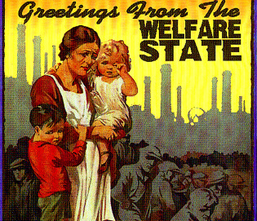
Legal Factors – Expansion of the Welfare State System
Since the 2nd world war there has been a rapid expansion of the welfare state system – this has included improved healthcare and the development of the ‘safety net’of the benefits system including housing child and income support benefits

Slide 40

Legal Factors – Divorce Reform Act (1969/71)
Before this act there needed to be proof that one partner was the ‘guilty party’ and had committed one of 3 ‘matrimonial offences’:
  Cruelty
  Adultery
  Desertion
The act removed the need to prove a guilty party and made ‘irretrievable breakdown’ the grounds for divorce

Slide 41

Legal Factors – The Matrimonial Family Proceedings Act (1984)
This act reduced the length of time that a couple needed to be married before filing for divorce down from 3 years to 1 year

Slide 42
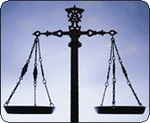
Legal Factors – Equality Act 2010
This Act brought together key anti-discrimination policy to protect people against discrimination in the workplace based on grounds of gender, religion, sexual orientation and age.
It Includes the:
The Sex Discrimination Act 1975 and Equal Pay Act 1970

Slide 43
Children Act 2004
The Act aims to make living in the UK, as a child, as safe as possible by protecting their welfare and rights.
The act allows the state to intervene in a family should the welfare of a child be called into question.

Slide 44
Child Maintenance Service (2012)
Requires absent parents to pay maintenance for children they do not live with.
This service is used when parents cannot agree on a ‘family-based arrangement’
This maintenance is calculated using a set formula.

Slide 45
Civil Partnership Act (2004)
Gave legal recognition to the relationships of same-sex couples who enter a civil partnership, involving similar arrangements to a legal marriage.
Allows same-sex couples to marry on the same basis as opposite- sex couples.
Marriage (Same Sex Couples) Act 2013

Slide 46
IDEOLOGICAL

Slide 47

Ideological Factors – Materialism / Individualism
Many social commentators point to the following changes in values:
Increased individualism and an emphasis on personal fulfilment (Beck and Beck)
Increased materialism and a pursuit of wealth
A greater emphasis on careerism

Slide 48

Ideological Factors – Cohabitation as the Norm
The idea of living together without being married is no longer widely regarded as ‘living in sin’ but as the norm
In the 1950’s only 2% of marriage partners had cohabited prior to marriage today it is estimated to be over 80%

Slide 49
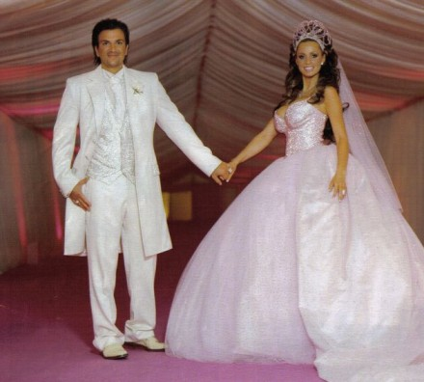
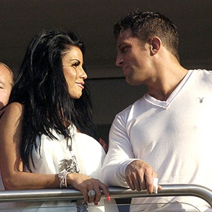

Ideological Factors – Changing Norms of Love, Marriage and Divorce
The primary reason given for modern marriage is ‘love’. Giddens argues people seek confluent love (fulfilment).
The idea of ‘permanence’ is not regarded as a central idea
There is less social stigma attached to divorce
Some Functionalists such as Talcott Parsons have argued that the increase in the divorce rate may actually be due to the increased importance placed upon marriage.

Slide 50
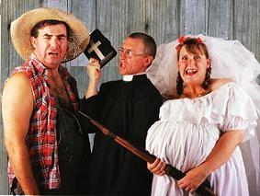
Changing attitudes towards single parent families
There is less social stigma toward lone parenthood.
Historically women who were unmarried that became pregnant would be socially shunned and depending on their age may have had to give the baby up for adoption.
Becoming pregnant without being married often led to many ‘shot gun’ weddings to avoid the social stigma. This did not always mean the couple were happy together.

Slide 51
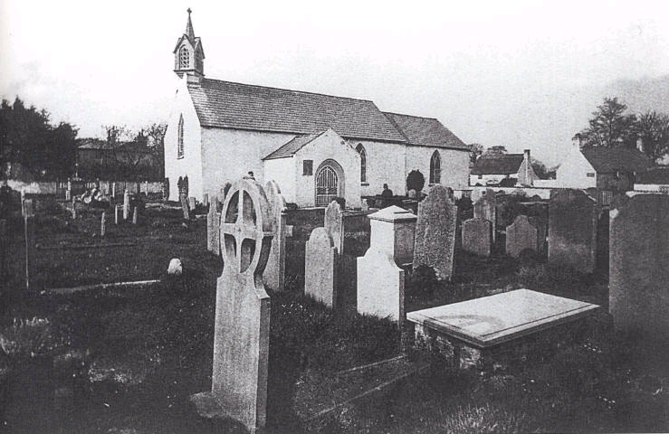
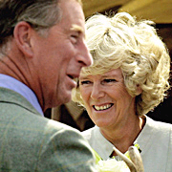
Ideological Factors - Secularisation
The decline in religious values, has led to:
The influence of religious ideas about ‘til death us do part’ weakened.
Fewer weddings in churches
Living together and not being married no longer viewed as ‘living in sin’

Slide 52

Ideological Factors – The influence of the Feminist Movement
The feminist movement has done much to empower women to be able to assertively make their own life choices.
Sue Sharpe demonstrated women’s aspirations have changed between the 1970s and 1990s, with more focus on careers rather than marriage.
Second wave feminism of the 1970s has had an important impact on many legal changes.

Slide 53
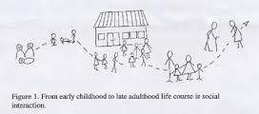
Changing life course of the family
A wide range of choices and options means there is far more uncertainty when it comes to making decisions about an individual’s life course.
Allan and Crow argue our lives are now characterised by choice, which makes families far more diverse.
The life course no longer occurs in one set pattern, but can vary massively between people.

Slide 54
SOCIAL

Slide 55
Social factors- Finance
Economic issues- costs of weddings (av £20,000), problems with getting mortgages.
Cost of childcare- A survey in 2004 by the Daycare Trust found that childcare costs were nearly a quarter of an average household income.
Bills going up due to cost of living rising

Slide 56
Social factors- demographics
Demographics are the statistical data about a population e.g. age, life expectancy, income, level of education, number of families etc.
Some examples of demographics linked to the family- there has been a decline in the size of the average family from 3.1 people in 1961 to 2.4 in 2006.
Why is it important for the government to take account of demographic change in relation to the family? P.15

Slide 57
Key terms
LIFE EXPECTANCY
BIRTH RATE
DEATH RATE
AGEING POPULATION
IMMIGRATION AND MIGRATION
DEPENDENCY RATIO
ASSIMILATION
MULTICULTURALISM

Slide 58
TECHNOLOGICAL

Slide 59
How have changes in technology impacted upon the family? p.22
INFLUENCE OF TECHNOLOGY

