Slide 1
Increase in the rate of divorce
Before 1970, to get a divorce one partner had to be at fault, and must have committed a crime or a sin. These were adultery, abandonment, cruelty or intoxication.
It was after the 1950s in the USA that couples no longer needed to prove someone was at fault.
It was also mandatory to have a large period of separation before the divorce.
It was also the case that because of the great cost of a divorce, only the rich could afford it.
From 1940 to 1965, the divorce rate remained near 10 divorces for every 1,000 married women. By 1979, the rate had doubled.
It was the divorce reform act between 1969 and 1971 that led to easier and quicker divorces.
Nowadays, divorce is a lot more common and is no longer a rarity, so there is less shame attached to divorcing your partner.
Since the 1980’s divorce rate has been decreasing slowly, but steadily. This is due to couples marrying later when they are more mature and their lives are more stable, couples are having children later as women want to establish their careers before they settle down, it is also now acceptable to stay single later or not to marry at all. Furthermore, for struggling marriages there is much more help available in order to keep them together and in a happy, healthy marriage.
Legal acts/issues changes in values changes in social issues statistics

Slide 2
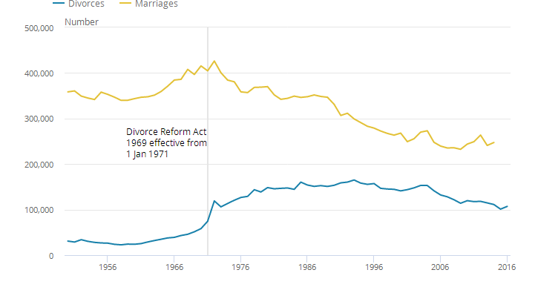
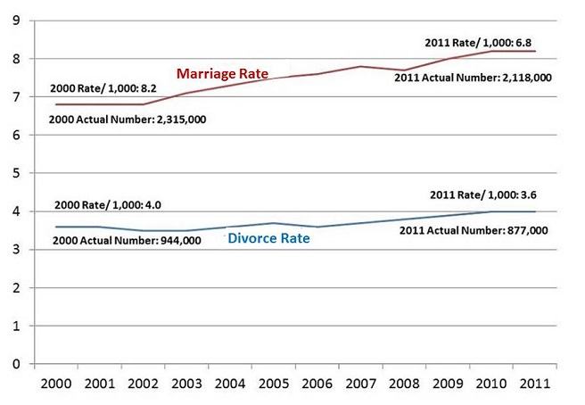
As women gained more rights and independence in the work place, it left them with more independence in the home as well, meaning more and more women felt better about leaving unhappy marriages, especially as they can now provide for their family.
Research also shows that cohabitation (living together unmarried) before getting married is also more likely to end in divorce.
Children of divorced parents are more likely to get divorced.
There were 106,959 divorces of opposite sex couples in 2016 and an increase of 5.8% compared with 2015.
There were 112 divorces of same sex couples in 2016 of these, 78% were female couples.
The divorce rate of opposite sex couples was highest among men aged 45 to 49 and women 30-39.

