Slide 1
ROLES, RESPONSIBILITIES AND RELATIONSHIPS WITHIN THE FAMILY
Paper 2, workbook 3 – family roles
ajt

Slide 2
What are conjugal roles?
CONJUGAL (or marital) ROLES are the different roles taken by husband and wife within a marriage.
several sociologists have engaged in a debate regarding conjugal roles and how they may have been shaped or altered by socio-economic change.
There are a number of basic positions on how these roles have changed over the last 40 years:

Slide 3
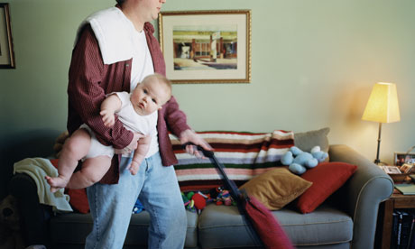
View 1: Marriage is an equal partnership
An equal partnership has come into the family - some even alleging that a "new man" may be found prepared to fully engage with responsibilities for domestic tasks, child-rearing, etc.

Slide 4
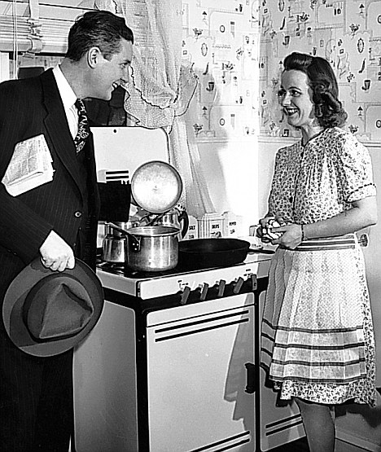
View 2: The partnership between men and woman is no more equal than before.
the new man is essentially an ideological construction - this argument is particularly associated with feminist approaches. Roles essentially have stayed divided.

Slide 5
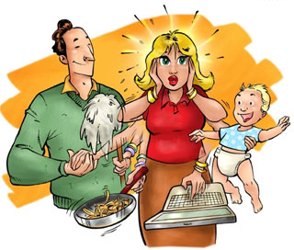
View 3: Men and women have become less equal
As women have increasingly taken on an economic role as wage earners they have also maintained their role in homecare / childcare. This is known as the dual burden hypothesis or triple shift (this is also associated with feminist approaches)

Slide 6
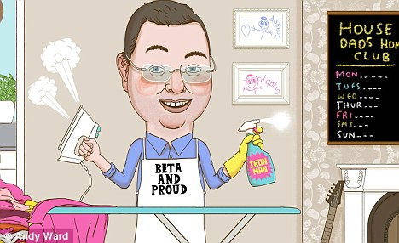
View 4: Roles between men and women are now based on choice
a postmodern argument, is that the roles between men and women are now based on choice, which can lead to variety in how conjugal roles are formed, such the mother going back to work and the husband looking after the children.

Slide 7
So what view do you agree with?
Consider which position you agree with.
Write a detailed response explaining your answer on page 4 of your workbook.
Be prepared to share you response.

Slide 8
Sociological Perspectives on conjugal roles:
Varieties of Functionalism
Liberal Feminists
Marxist Feminists
Radical Feminists
Postmodernists

Slide 9
Your Homework
Familiarise yourself with the entire gender roles workbook – READ IT!
Especially page 5 (perspectives on conjugal roles summary sheet)

Slide 10

Match up activity:
INDEPENDENTLY (without talking) complete the conjugal roles match up sheet. WITHOUT THE USE OF YOUR WORKBOOK.

Slide 11
Varieties of functionalism
The “biological imperative”. Earlier functionalists (Parsons, Murdock) have tended to see the sexual division of labour in the home as biologically inevitable. Women are seen as naturally suited to the caring and emotional roles, which Parsons terms the ‘expressive role’.
Cultural Change and its critics Later sociologists who might also be seen as functionalist (Young and Willmott, etc.) have tended to see the growth of greater equality between men and women as culturally determined and inevitable – this is sometimes described as a “march of progress” – inevitable and necessary
However, New Right theorists, whilst agreeing that such changes are occurring, see them as destabilising and against the best interests of those involved – a return to an earlier functionalist position

Slide 12
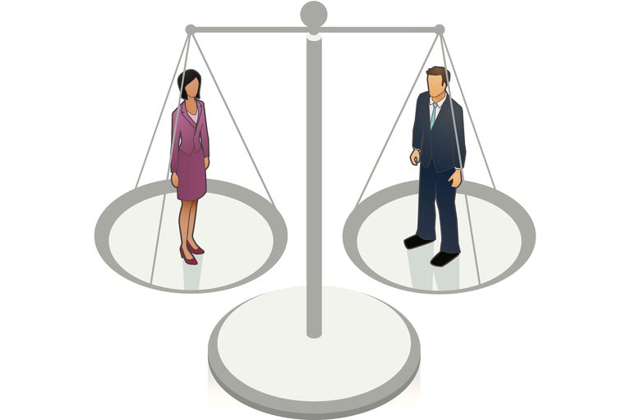
Liberal Feminists:
Meaningful change. Liberal Feminists believe women have made real progress in terms of equality within the family and particularly in education and the economy. They generally believe that men are adapting to change and, although they culturally lag behind women in terms of attitudes and behaviour, the future is likely to bring further movement towards domestic and economic equality. But it may not be quick enough. See Oakley

Slide 13
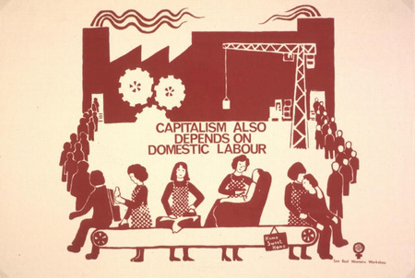
Marxist Feminists
Capitalism and domestic labour. Marxist feminists argue that the housewife role serves the needs of capitalism and maintains the present workforce and reproduces future labour-power, all at low cost

Slide 14
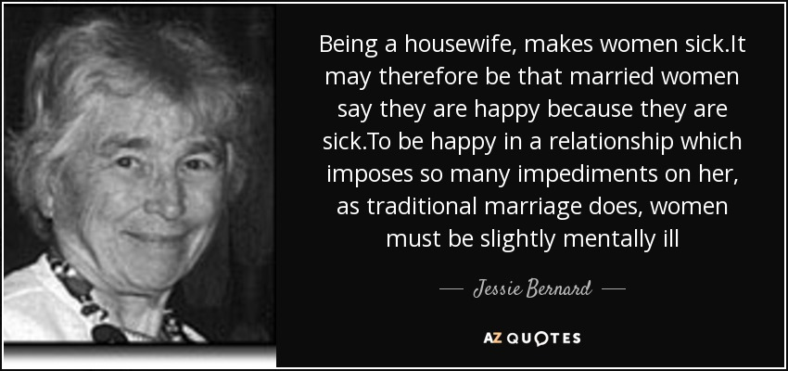
Radical Feminists
Men as the problem. They believe that the housewife role is created by patriarchy and geared to the service of men and their interests. The family is the main source of men’s oppression of women and the root to gender inequality in society. This is expressed in the fact that women are expected to do most of the unpaid labour of housework and childcare. They argue men use the threat of domestic violence to keep women subordinate to their will. See Duncombe and Marsden, Bernard

Slide 15
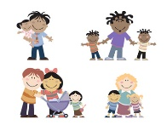
Postmodernists
The problem of generalisation and meaning. They believe that the nature of postmodern society means that relationships between people are based far more on individual choice. If a woman wishes to be a housewife she can, if not she need not, but it will be a matter of individuals exercising choice over their own lives.

Slide 16
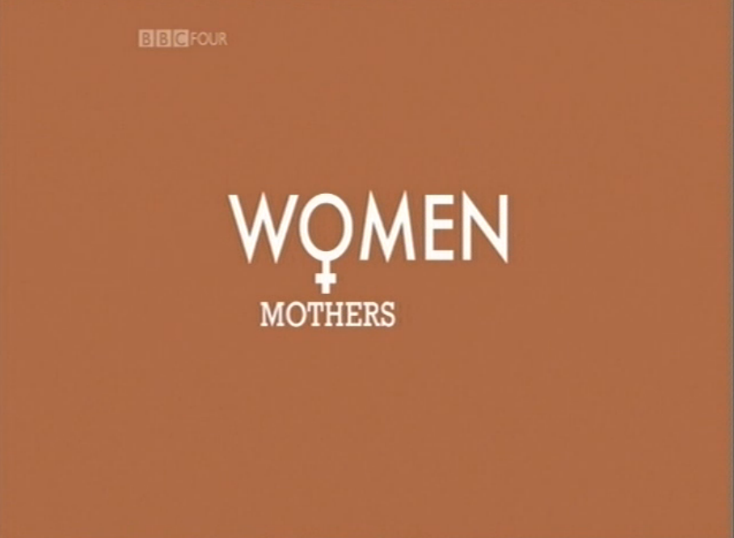
The Conjugal role debate
Documentary: Mothers (estream 5609)
Whilst watching consider what evidence could be applied to either side of the conjugal roles debate
ROLES ARE SYMMETRICAL – men and women are equal within the family.
ROLES ARE SEGREGATED – there is a clear division/ difference between the roles of men and women.

Slide 17
After the video:
Individuals in the video often respond negatively to the question ‘Are you a feminist?’ What reasons might you give for this? Why does feminism remain important?
Do you think that men and woman’s roles have changed significantly in the last 40 years? Explain your answer
Do you feel that the Feminist movement has encouraged changes within the family, or do you feel that other factors have contributed to change?
Do you think that the methods used when making the documentary could alter the responses from the interviewees.

Slide 18
Cover work for INSET/ Homework - Conjugal role studies
You will be missing your lesson on Thursday 25th January due to INSET.
Using your workbooks, textbooks and any other resources you can find write up summaries for the conjugal role studies on the worksheets.
Avoid simply copying from the workbook. Read the text, process it and write a summary IN YOUR OWN WORDS.
This work needs to be submitted on Tuesday 30th January.
FAILURE TO DO THE WORK WILL MEAN YOU’RE UNABLE TO PARTICIPATE IN THE LESSON. YOU WILL BE ASKED TO LEAVE.

Slide 19
Conjugal Roles Studies Test
For INSET cover/ homework you was asked to write summaries of relevant conjugal role studies/ research.
How well do you know these?
WITHOUT your notes complete the multiple choice test.

Slide 20
THE CONJUGAL ROLE DEBATE
What do we mean by conjugal roles?
What do you think the debate would be around this?

Slide 21
DEBATE
Conjugal roles are now more equal/symmetrical – men are taking on more of a parenting role
Conjugal roles are more shared but the bulk of cooking and cleaning still falls to women
Conjugal roles have worsened since equality laws with women doing a triple shift
There is more choice in relationships now, men and women can choose how they divide up their roles
Men and women's roles are biologically determined – there are different roles better suited to either sex.

Slide 22
THE CONJUGAL ROLE DEBATE: Is the family still patriarchal?
You will be given a viewpoint on this and will need to collect the relevant evidence using your booklet, powerpoint online and textbooks.
Areas to cover:
Which theory would support the argument
Examples of named sociologists and what they have said to support the argument
Examples of how they might view domestic labour, money & power, parenting (if appropriate)
How they would challenge the other arguments
What would they say about the family still being patriarchal?
What would they say about gender roles/conjugal roles now being more equal?

Slide 23
The Debate: is the family still patriarchal?
Initially each group will outline their view of the conjugal debate and what they think about whether the is still patriarchal. 5 mins per group
Then each group will take it in turns to argue against other groups. 3 mins per group
Then the debate will be opened up so that each team can individually counter previous points

Slide 24
Homework
Ensure the conjugal workbook is complete by your next lesson.
Define the concepts in the glossary on page16.
Next week:
We will look at some conjugal roles exam questions (10 mark and 20 mark)
Start looking at Childhood.

Slide 25
It’s that time again…
INDEPENDENTLY (without talking) complete End of Workbook Conjugal Roles Test. WITHOUT THE USE OF YOUR WORKBOOK.

Slide 26
20 mark essay questions
Example 1
Item B
In contemporary Britain, families are often thought to be more “symmetrical”, whereby the relationship between married or cohabiting couples has become less patriarchal, or male-dominated, and much more an equally balanced partnership.
Both partners share household chores, childcare and decision-making, and both partners are more likely to be involved in paid employment.
Applying material from Item B and your knowledge, evaluate the view that contemporary families have become a partnership of equals. (20 marks)

Slide 27
20 mark essay questions
Example 1
Item B
In contemporary Britain, families are often thought to be more “symmetrical”, whereby the relationship between married or cohabiting couples has become less patriarchal, or male-dominated, and much more an equally balanced partnership.
Both partners share household chores, childcare and decision-making, and both partners are more likely to be involved in paid employment.
Applying material from Item B and your knowledge, evaluate the view that contemporary families have become a partnership of equals. (20 marks)
Blue – AO1
Red – AO2
Purple – AO3

Slide 28
20 mark essay questions
NEVER RUSH INTO AN ESSAY… HAVE A PLAN!
Stage 1 – identify the debate:
View in the question:
that contemporary families have become a partnership of equals.
VS
?

Slide 29
20 mark essay questions
Stage 2 – identify evidence for both sides of the debate:
View in the question:
that contemporary families have become a partnership of equals.
VS
Evidence for this side of the debate? | Evidence for this side of the debate?
The Item!

Slide 30
20 mark essay questions
View in the question:
that contemporary families have become a partnership of equals.
VS
Evidence for this side of the debate? | Evidence for this side of the debate?

Slide 31
20 mark essay questions
Stage 3 – come up with your conclusion BEFORE YOU START WRITING:
View in the question:
that contemporary families have become a partnership of equals.
VS
Evidence for this side of the debate? | Evidence for this side of the debate?
The Item!
Which side has the most evidence/ most compelling argument?

Slide 32
20 mark essay questions
Example 2
Item B
Research by feminist sociologists such as Oakley showed that gender roles were unequal in many families, with women taking the greatest share of housework and childcare. Some sociologists argued that this was because these roles were ‘natural’. However, it is now claimed that there is a growing equality between partners, with domestic tasks being shared more equally.
Applying material from Item B and your knowledge, evaluate the contribution of feminists to our understanding of the family (20 marks)

Slide 33
Useful conjugal roles revision activity:
https://quizlet.com/64761323/as-sociology-conjugal-roles-division-of-labour-key-terms-flash-cards/

