Slide 1
Gender and DEA
D¹ 2018

Slide 2
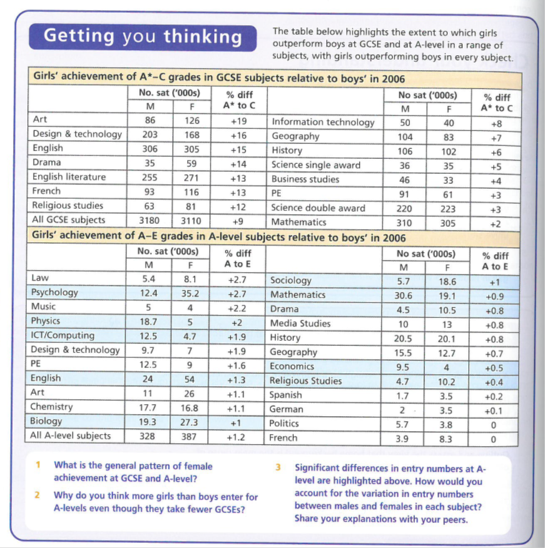
Gender and DEA: Data

Slide 3
Girls and Boys achievement in Education
STUDENT WORK
D1 group
Jan 2018

Slide 4
The impact of the women’s movement | Webb 52 Browne 69
The Family | Webb 52
Changes in women’s employment | Webb 52 Browne 69-70
Girls’ ambition | Webb 52 Browne 70
Maturity | Browne 69 & 70
Globalisation and declining traditional male employment | Webb 57 Browne 71 SIF 184
Male Identity Crisis | SIF 43 & 184
Hegemonic Masculinity | Webb 72 SIF 41
Over estimation of ability | Browne 70 & 71
Labelling and the Self-fulfilling prophecy | Webb 54
Equal Opportunities Policies | Webb 53-54 Browne 69
Positive role models in school | Webb 53 & 54
Challenging gender stereotypes | Webb 55
Marketization | Webb 55
Labelling and the Self-Fulfilling Prophecy | Webb 58 Browne 70
Anti-school subcultures | Webb 58 Browne 71
Feminised curriculum | Webb 57 & 58
Lack of male role models | Webb57-58

Slide 5
EXTERNAL FACTORS: Girls’ relative achievement

Slide 6
The impact of women’s movement
Gabriella catilli

Slide 7
What is feminism?
Feminism is a social movement that strives for equal rights for women in all aspects of life. Feminists have challenged the traditional stereotype of a woman’s role as exclusively that of mother and housewife in a patriarchal nuclear family and inferior to men outside the home, in work, education and the law.

Slide 8
Impact:
Considerable improvement of women’s rights and opportunities.
Feminism has raised women’s expectations and self-esteem
This change in perspective has been reflected in the media. Angela McRobbie found that girls’ magazines in the 1970s emphasized the importance of getting married and not being ‘left on the shelf’ whilst nowadays they contain images of assertive, independent women.
Changes encouraged by feminism may affect girls’ self-image and ambitions with regard to the family and careers therefore explaining movements in girls’ educational achievement

Slide 9
Sophie Astbury
The family
According to Talcott Parsons there is a functional fit between the nuclear family and modern society. Nuclear family uniquely suited to meeting needs of modern society for geographically and socially mobile workforce and as performing two irreducible functions the primary socialisation of children and the stabilisation of adult personalities.
There have been major changes in the family since 1970s these include; increase in divorce rate, increase in cohabitation and a decrease in the number of first marriages, an increase in lone-parent families and smaller families in general.
These changes subsequently affect girls attitudes towards education in a number of ways. For example, increased numbers of female headed lone parent families may mean more women need to take on a breadwinner role- the financial independent woman. To achieve this independence , women need well paid jobs and therefore good qualifications. Likewise, incr5eases in divorce rate may suggest to girls that this is unwise to rely on a husband to be their provider. Again, this may encourage girls to look to themselves and their own qualifications to make a living.

Slide 10
Changes in women's employment
Mae

Slide 11
Growing ambition more postitive role models and more employment opportunity for women.
There has been a decline in recent years in the number of what were traditionally regarded as ‘men's jobs’, particularly in semi- and unskilled manual work, while there are growing employment opportunity's for women in the service sector.
As a consequences, girls have become more ambitious, and they are less likely to see having a home and family as their main role in life. Many girls growing up today have mothers working in paid employment, who provide positive role models for them. Many girls now recognise that the future involves paid employment, often combined with family responsibilities.

Slide 12
Girls’ Ambition
Talvin Blake

Slide 13
The view that changes in the family and employment are producing changes in girls’ ambitions is supported by evidence from research.
For example, Sue Sharpe’s interviews with girls in the 1970s and 1990s show a major shift in the way girls see their future.
In 1974, the girls had low aspirations; they believed educational success was unfeminine and that appearing to be ambitious would be considered unattractive. The gave their priorities as ‘love, marriage, husbands, children, jobs, and careers, more or less in that order’.

Slide 14
Maturity
Jody
Boys mature later, and overestimate ability so don’t work hard enough
The educational underperformance of girls in the past led to a greater emphasis in schools on equal opportunities
There has been a decline in the recent years in the number of what were traditionally regarded as ‘men's jobs’
Girls work harder and they are better motivated and have more peer-group support
Girls mature earlier, by the age of 16 girls are estimate to be more mature than boys, up to 2 years
Boys underachieve because they have lower expectations and are more likely to extend deadlines for work
boys a re more disruptive in lessons that girls and the male peer group often devalues schoolwork
Boys may achieve peer-group status by aggressive and dominating disruptive classroom behaviour
Girls are more likely to view exams in a far more responsible way

Slide 15
EXTERNAL FACTORS: Boys’ relative underachievement

Slide 16
Globalisation and declining traditional employment
Ethan

Slide 17
Since the S1980s, there has been a significant decline in heavy industries such as iron and steel, shipbuilding, mining, and engineering. This has been partly the result of the globalisation of the economy, which lead to manufacturing industry relocating to developing countries.
Traditionally these industries were mainly employed by men

Slide 18
Declining traditional male employment opportunities and the male identity crisis
Mac an Ghaill suggests the decline in traditional male working-class jobs is also a factor explaining why in particular working-class boys underperform in education. They lack motivation and ambition because they feel that they only have limited prospects, and getting qualifications wont get them anywhere so why bother. Boys and men having a lower expectations, a low self-image and a low self-esteem has lead to the collapse of the traditional male role of being breadwinners in the family; further more this has lead to a masculinity crisis.

Slide 19
Male identity crisis
Sam & Jamie

Slide 20
Traditionally concern with appearance was seen as a women's problem but now this is changing.
David Abbot (2000) describes big shifts in fashion styles for young men over recent decades
Their identities increasingly revolve around their dress sense, body image and the right look
Lone parents, mother headed families are concentrated in the lower working class, growing up in these family threatens traditional working class masculinity.

Slide 21
INTERNAL FACTORS: Girls’ relative achievement

Slide 22
Equal Opportunities Policies
Equal opportunities for girls and boys in education is now mainstream thinking and has influenced policies. These polices have monitored girls achievement and led to greater equality of opportunities for girls by removing bias
Policy examples:
GIST (Girls into science and technology) and WISE (women into science and engineering) has worked to encourage girls into science/maths jobs by giving non gender bias advice and showing female scientist as role models
National curriculum 1988 - has removed gender inequality as girls and boy study similar subjects ranges
The Equality Act 2010
Amelia

Slide 23
Challenging Gender stereotypes
Eliza Weller

Slide 24
Some sociologists argue that by removing gender stereotypes from textbooks and reading schemes, the barrier to girls learning achievement has been removed
Reading schemes in the 1970s and 1980s portrayed women as housewives and mothers
Since the 1980s, teachers have challenged stereotypes and removed sexist learning materials
This may have helped to raise girls’ achievement by presenting them with more positive images of what women can do

Slide 25
Marketization
Emma

Slide 26
Marketization have created a more competitive climate in which see girls as more desirable workers because they receive better exam results.
David Jackson note that the introduction of exams have improved opportunities for girls. Because of this girls are more likely to be accepted into good schools resulting in them doing better than boys in the future.
Roger Slee argues that boys are less desirable to schools because they are more likely to have behavioural problems and are four times more likely to be excluded. As a result boys are seen as the ‘liability student’

Slide 27
INTERNAL FACTORS: Boys’ relative underachievement

Slide 28
Labelling and the self-fulfilling prophecy
By Kieran Freeland

Slide 29
Girls are seen as better motivated then boys and do their homework to a better standard and this is seen to teachers as making them better so they will be labelled as good at their work so they will carry on doing well on the work fulfilling the teachers prophecy.
Forde et al (2006) suggest male peer groups pressure encourages resistance to school so they will be labelled as not trying hard enough so teachers prophecy will be fulfilled when they underachieve.

Slide 30
Labelling and the self fulfilling prophecy
By matty

Slide 31
Teacher attention
Jane and Peter French in 1993 analysed a classroom and discovered that boys get more harshly disciplined than girls. Boys often felt like they were getting picked on. This could be seen as labelling.
Swann in 1998 also discovered that there are gender differences in group discussions, e.g. in class. Boys dominate the classroom talks and girls tend to keep quite. Girls are better at listening and pair work while boys like attention.

Slide 32
Anti-school subcultures
Callum cole

Slide 33
Laddish subculture
Laddish subculture- Some sociologists claim that the growth in ‘laddish’ behaviour within schools is causing the underachievement of boys. Debbie Epstein-working class boys are subject to verbal homophobic abuse and are more likely to be harassed, labelled as sissies.

Slide 35
Feminised Curriculum
By Princess Aryana

Slide 36
Feminised Curriculum
Boys fall behind because education has become feminised. That is, school don’t nurture masculine traits such as competitiveness and leadership. Instead they celebrate qualities more closely associated with girls, such as methodical working and attentiveness in class.
Tony Sewell sees coursework as a major cause of gender differences in achievement. He argues that some coursework should be replaced with final exams and a greater emphasis placed on outdoor adventure in the curriculum.

Slide 37
He argues ‘We have challenged the 1950s patriarchy and rightly said this is not a man’s world. But we have thrown the boy out with the bath water’.

Slide 38
Lack of male role models.
Fabienne
Gender gap in achieving in schools with more boys failing.
At home parents might spend less time reading to sons, and if so it is the mothers as seen as a more feminine activity.
Reports claiming that education have become ‘feminised’. As schools don’t nurture ‘masculine’ traits like competitiveness and leadership. There are less male role models within the school as more female teachers.
The lack of male role models could be the cause of underachievement. Eg. Large numbers of biys are being brought up in 1.5million female lone parent families.
Only 14% of primary school teachers are male. And 39% of 8 – 11 year old boys have no lessons with male teachers. Yet most boys surveyed said the presence of the male teacher made them behave better and 42% made them work better.
But research shows that it might not actually be the reason for the underachievement.

Slide 39
Over estimation of ability
Hannah

Slide 40
Why do boys underachieve?
Lower expectations- There is some evidence that staff are not as strict with boys as with girls. They are more likely to extend deadlines for work, to have lower expectations of boys, to be more tolerant of the disruptive, unruly behaviour often found more commonly from boys in the classroom and to accept more poorly presented work. These lower expectations could create a self-fulfilling prophecy contributing to boys’ lower achievement, as they perform less well than hey otherwise might.

Slide 41
So overall…

Slide 42
FEMINIST ANALYSIS blends the structuralist and Interactionist
Concerned with the ways schooling may systematically disadvantage girls and reinforce the nature of patriarchy.
PAST | PRESENT
Concerned with the underperformance of girls in the educational system The ways in which this may have been reinforced by school structures and interaction. | The remaining patriarchal systems that exist in education. Interactions in the classroom and how they create DEA. Some Feminists maybe interested in looking at why boys are now failing. (Liberal feminism)
[What may have influenced this change in focus?]

Slide 43
Recent Trends in Gender from the late 1980s to the present day.
GCSE was introduced in 1988 and from then onwards the female- male gender difference in educational achievement at GCSE level widened
By the late 1980s females were more likely than males to gain two or more A Level passes and during the course of the 1990s they also became more likely to gain 3 or more A level passes.
Females became more likely than males to gain A grades in almost all A Level subjects BUT gender differences in exam performance at A level are smaller than at GCSE.
Females are more likely than males to enrol on Undergraduate and Post Graduate courses.
Males are still marginally more likely than females to gain First Class degrees but females are significantly more likely than males to gain Upper Second degrees.
There are still some significant gender differences in subject choice at Advanced level and Degree level and these differences could potentially restrict women’s future employment prospects.

Slide 44
Problems with this picture
It is important to consider the relative sizes of gender, social class and ethnic differences in educational achievement and the interconnected effects of gender, ethnicity and social class on educational achievement. This is called INTERSECTIONALITY.
Gender differences are far smaller than social class differences in educational achievement. Students of both sexes who are eligible for free school meals are far less likely than students of both sexes ineligible to be successful at all levels of the education system.
Some ethnic differences in educational achievement are also greater than gender differences in educational achievement.
NOTE: All of these are potential evaluation points to include in a relevant essay!

Slide 45
Summary: Explaining the differences
In order to analyse the relative educational improvement from the 1980s onwards we must distinguish between:
factors accelerating the rate of female improvement
factors restricting the rate of male improvement.
and then look at the possible division between schools as a factor in this or wider socio-economic issues
BUT REMEMBER:
Females’ and males’ educational achievements have both improved over time - the rate of female improvement has been faster and this widened the female-male achievement gap
Gender, social class and ethnicity are interconnected. Girls are more successful than boys in all ethnic groups but middle class boys are still more educationally successful than working class girls in all ethnic groups.

Slide 46
CONTINUING PROBLEMS FOR GIRLS? 2 examples
IN EMPLOYMENT
The so-called “glass ceiling” still exists in employment – as women’s careers can stall because of
family pressures / maternity leave
Stereotyping by employers
“Old Boy” Networks
etc
(Post?) feminist approaches – THE “GENDER REGIME”
Valerie Hey/ Martin Mac an Ghaill – Heteronormativity
Heterosexuality is a learned characteristic for most if not all, and hegemonic male sexuality dominates
Other sexualities and genders are relatively stigmatised, marginalised or punished through the hidden curriculum of the school, or the actions of other pupils in reinforcing group norms.
So girls still learn subordination and schools still reinforce patriarchal attitudes

Slide 47
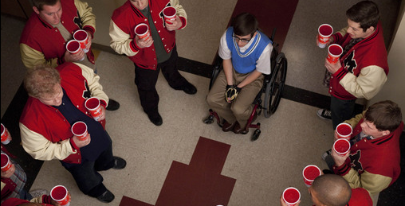
Heteronormativity represented in US TV shows/ Films:
The hierarchy of gender/sexuality
Heterosexual male
Heterosexual female
Homosexual female
Homosexual male
Gender Regime
“Jock Culture”

Slide 48
CASE STUDY: Archer et al
You will need to review the booklet on page 7 and use the textbook pages 56-57 and article. This follows the main headings only

Slide 49
Archer et al Key headings
Symbolic Capital
Hyperheterosexual feminine identities
Boyfriends
Being "loud"
Working Class Girls' dilemma
'Successful' working class girls

Slide 50
Symbolic Capital
Symbolic Capital = status, recognition, sense of worth from others
This is gained by "performing" working class feminine identities
Contrast to educational capital lost in conflict with schools
strategies to create valued sense of self include:
hyper-hetrosexuallity
having a boyfriend
being "loud"
etc.

Slide 51
Hyperheterosexual feminine identities
Bid for status amongst peers to create a desirable/glamorous identity
Uses branding, etc - identity through consumption
Takes time / effort / money
Leads to conflict with schools
rules on jewellery / makeup / clothing etc
Seen as a distraction from education
THEREFORE school "othered" girls (Symbolic Violence)
Working class girls deemed “unworthy” / “incapable” by school and teachers

Slide 52
Boyfriends
Increased symbolic capital with peers
BUT
obstructs schoolwork
lowered aspirations
“Settling down” becomes the only ambition/aspiration

Slide 53
Being "loud"
Alternative option to be outspoken / assertive
BUT
This leads to conflict with school
Questioning teachers' authority
Behaviour interpreted as aggressive

Slide 54
Working Class Girls' dilemma
EITHER
gain symbolic capital from peers and
maintain hyperheterosexual identity
OR
gain educational capital from school through conformity but
This rejects working class identity
MAYBE ALSO
Try to be "good underneath"
coping mechanism to deal with rejection by school
establish self-worth in face of rejection

Slide 55
“Successful” working class girls remain “home centred”
Even successful girls wish to remain in parental home because
They want to succeed educationally to help their family (Evans)
Its an economic necessity
debt averse and may struggle to meet costs (limited resources)
They positively choose home (Archer)
Habitus – they prefer local to distant
BUT taking the home option limits
Their university choices
The market value of available degrees

Slide 56
Planning/Evaluating?
Gender & Education

Slide 57
Q. Why do girls do better than boys in the education system?
INTERNAL
EXTERNAL
Key factors within schools with studies/evidence
Key factors from outside schools with studies/evidence
Identify 3/4 key factors and supporting evidence you would use
Identify 3/4 key factors and supporting evidence you would use
NB
Do these factors effectively explain the change from 1988 onward?
Are these factors measurable/quantifiable?
Do they focus on girls’ relative success or boys’ relative failure?
Can we assume that girls really “do better” in an unqualified way?

