Slide 1


Slide 2
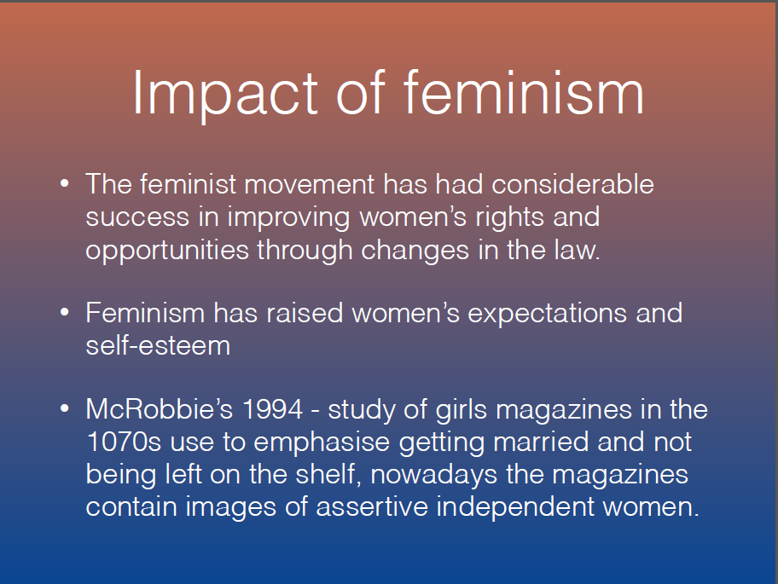

Slide 3
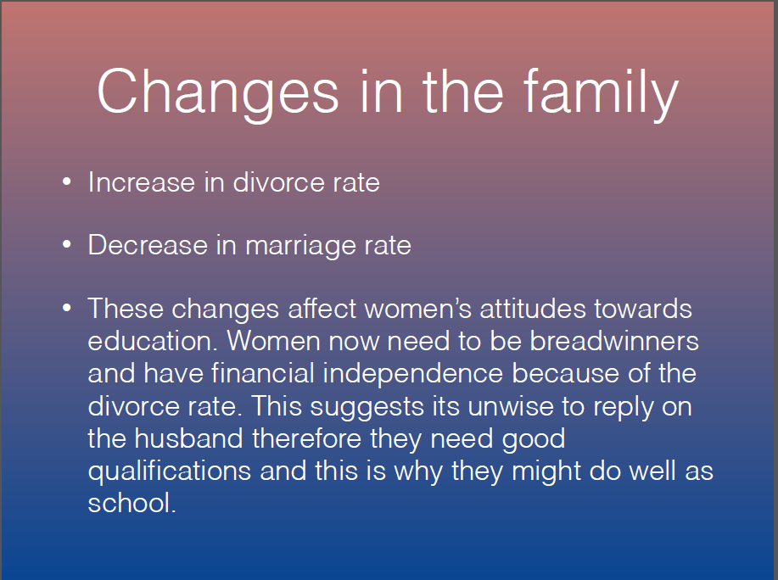

Slide 4
Changes in women’s employment
1970 Equal pay act makes it illegal to pay women less than men for work of equal value.
The Sex Discrimination Act outlaw stopped discrimination at work.
Since 1975 the pay gap between men and women has halved from 30% to 15%.
The proportion of women in employment has risen to 67% since 1971.

Slide 5
Equal opportunities policies and gcse coursework
The belief that boys and girls are entitled to same opportunities influences educational policies. For example, the ‘girls into science and technology’ policy encourages girls to pursue careers in non traditional areas.
Jo Boaler (1998) sees the impact of equal opportunities policies as the key reason for changes in girls achievement. Schooling has become more meritocratic so girls who genuinely work harder than boys achieve more.
Along with GCSEs has come the greater use of oral exams which is said to benefit girls because of their generally better developed language skills.

Slide 6
Changing ambitions
Changes in the family and employment are producing changes in girls’ ambitions – SUE SHARPE
Interviews in the 1970s and 1990s show a major shift in the way girls see their future
1974 – low aspirations, ‘educational success is unfeminine and appearing ambitious is unattractive’. Priorities were love, marriage, husbands, children, jobs, and careers more or less in that order.
1990s – ambitions changed, different priorities – careers, being able to support themselves. Independent women, therefore not dependent on husband’s income

Slide 7
Positive role models
There has been an increase in the proportion of female teachers and heads. These women in senior positions may act as role models for girls, showing them women can achieve positions of importance.
Women teachers are likely to be particularly important role models for girls educational achievement because to become a teacher, the individual must undertake a lengthy and successful education.

Slide 8
Teacher attention
The way teachers interact with boys and girls differs.
Jane and Peter French analysed classroom interaction, they found boys received more attention because they attracted more reprimands.
Becky Francis also found while boys get more attention, they were disciplined more harshly and felt picked on by teachers, who tended to have lower expectations.
Swann found gender differences in communication styles. Boys dominate in whole class discussion, whereas girls prefer pair work and group work and are better at listening and cooperating.

Slide 9
Selection and league tables
Marketization policies have created a more competitive climate- schools see girls as more desirable so they’ll recruit more girls in order to get a better exam result.
David Jackson- intro of exam league tables has improved opportunities for girls which can lead to a self-fulfilling prophecy because high achieving girls are more attractive so are more likely to get recruited.
Roger Slee- argues that boys are less attractive to schools because they are more likely to suffer from behavioural difficulties and are four times more likely to be excluded
As a result, boys may be seen as ‘liability students’ – obstacles to the school improving its league table scores.

Slide 10
Symbolic capital
In her study of working class girls Archer uses the concept of ‘symbolic capital’ to understand this conflict. Symbolic capital refers to the status, recognition and sense of worth that we are able to obtain from others.
Archer found that by performing their working class feminine identities, the girls gained symbolic capital rom their peers. However, this brought hem into conflict with school, preventing them from acquiring educational capital and economic capital

Slide 11
Hyper- heterosexual feminine identities
Many girls spent time and money trying to look desirable and glamorous. Identities that combined black urban American style with unisex sportswear. Sexy clothes and makeup- brought them status from peer group. Conflict in school because they're going against uniform so teachers will see them as being less successful.

Slide 12
Boyfriends and being loud

Slide 13
Boyfriends
Having a boyfriend got in the way of schoolwork and lowered girls aspirations.
This included losing in going to university, in studying masculine subjects such as science or in gaining a Professional career. Instead these girls aspired to ‘settle down’ and have children an d work locally in working-class feminine jobs such as childcare.
One girl had to drop out of school after becoming pregnant.

Slide 14
Being loud
Some working-class girls adopted ’loud’ feminine identities that often led them to be outspoken, independent and assertive, for example questioning teachers authority.
This failed to conform to the schools stereotype of the ideal female pupil identity as passive and submissive to authority and brought conflict with teachers, who interpreted their behavior as aggressive rather than assertive.

Slide 15
Working class girls’ dilemma
Either gaining symbolic capital from their peers by conforming to a hyper – heterosexual feminine identity.
Or gaining educational capital by rejecting their working – class identity and conforming to the school’s middle – class notions of a respectable, ideal female pupil.

Slide 16
Successful working class
Sarah Evans (2009) shows her study of 21 working – class sixth form class in a South London comprehensive school. She found that girls wanted to go to university to increase their earning power. However this was not for themselves it was for their family.

Slide 17
Boys in school factors
Ben and Paul

Slide 18
Feminisation of the curriculm
Tony Sewell claims that boys fall behind because education has been feminised (BBC, 2006).
Schools do not nurture ‘masculine’ traits such as competiveness and leadership.
Instead they celebrate qualities more closely associated with girls, such as methodical working and attentiveness in class.

Slide 19
Shortage of male primary school teachers
Feminisation has caused the lack of males.
Lack of male role models cause boys to under achieve.
E.g 1.5 million boys are being brought up in female-headed lone parent families.
YouGov: 39% of 8-11 year old boys have no lessons whatsoever with a male teacher.
Most boys said in the presence of a male teacher they behave better and 42% said it made them work harder.

Slide 20
‘laddish’/ anti-learning subcultures
Forde: Peer groups pressure on boys to maintain dominant masculine identity.
Boys reject feminine academic behaviour and replace with disruptive classroom behaviour.
Working class boys earn ‘street credit’ for adopting these subcultures from peers.
Boys are bullied and called ‘gay’ if they are seen working hard at school by peers. (Epstein)
Boys are more likely to develop anti-school behaviour than girls.
Lack of male role models have an influence.

Slide 21
Differences in how boys and girls think and feel
Boys overestimate their ability and girls underestimate theirs.
Stanworth (1983) found girls lack confidence and Renold (2006) supports this is still happening today.
Girls are torn between being bright academically and being attractive.
Girls in order to attract boys played down their abilities.
Barber showed that more boys than girls think they are able to get good results. The results themselves show the opposite.
Boys blame families and teachers for failing and not their own ability.

Slide 22
Boys and literacy
Girls like reading while boys don’t. Boys see it as a predominantly feminine activity. Seen as boring, not real work and a waste of time.
Reading is ‘Feminized’ – woman be the ones to read, talk about and ‘spread the word’ about the books. Woman are more likely to read to their children (more likely to read to their daughters than their sons). Girls therefore have a positive role model and also educational to prepare for school. Boys lose intrest in reading at 8 years old.
Girls tend to read fiction, boys tend to read information. Schools set fiction books for the students to read mainly which the girls already tend to read so this is a advantage for them.
Oakhill and Petrides (2007) found boys’ interest in the content of what they read influences their ability to understand a text and their motivation and development in that subject. Girls – less influenced by the content of what they read.

Slide 23
Globalisation and the decline of traditional manual jobs
Mac an Ghail 1999 suggests the decline in traditional male working class jobs is also a factor in explaining why many boys fail in the education system. They lack aspiration as there is a lack of work they wish to do to go into

