Slide 1
BTEC Unit 10: Film Fiction
Continuity and Non-continuity Editing

Slide 2
Continuity Editing
Widely established editing style used through early Hollywood and much of today's film
This editing style tries to ‘hide’ cutting from the audience, so they immerse themselves in the world of the film instead of looking at the editing.
This system enables the audience to quickly understand what was happening and avoid confusion.
It developed into a set of ‘continuity rules’ designed to make storytelling clear.

Slide 3
The Rules
Continuity editing is a technique that relies on particular shots being ordered (cut) in a familiar, conventional sequence.
Audiences are so familiar with these techniques, that they barely notice them.
This is not a definitive list, but it does represent the key techniques.
Degrees
Shot/reverse-shot
Eyeline match
Match on action

Slide 4
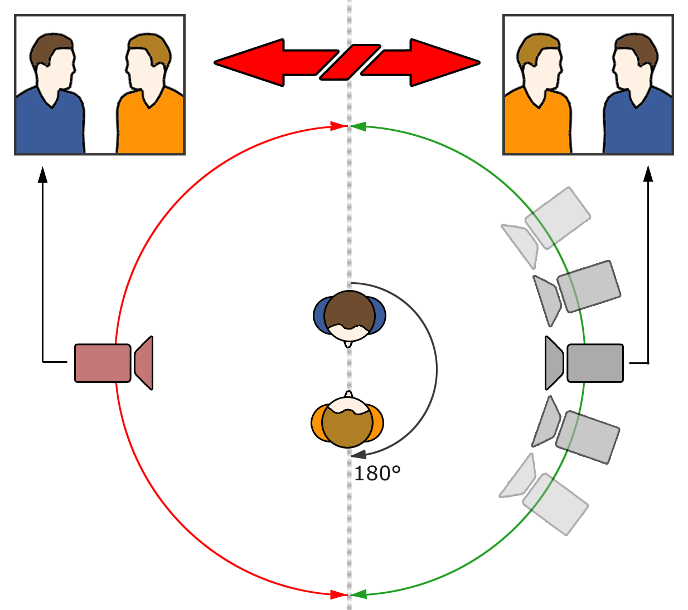
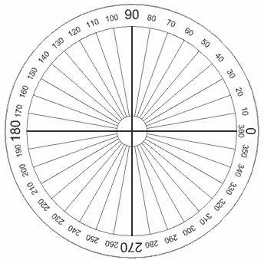
A
B
A
B
For continuity editing to work, the director must adhere to the 180° Rule and the 30° Rule

Slide 5
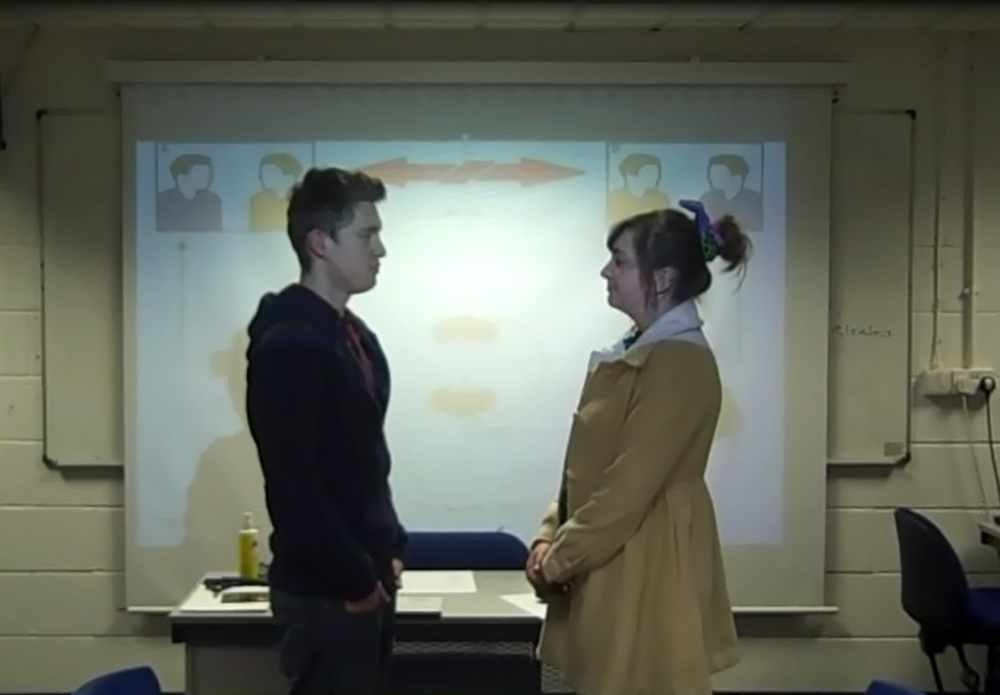
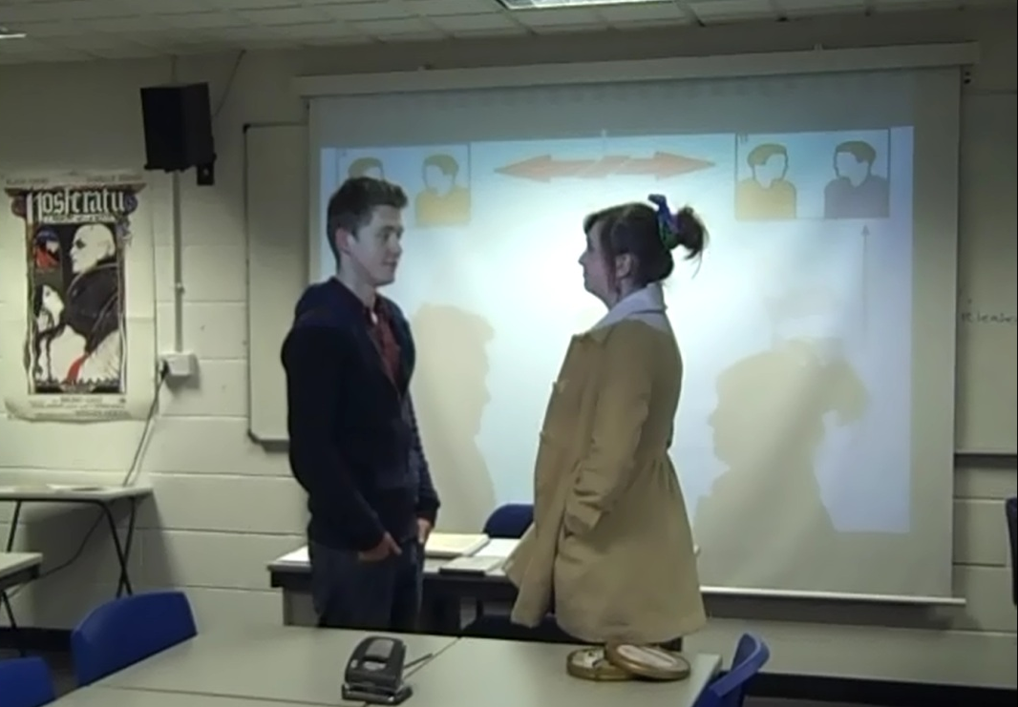
0-25 Degree Rule
Not quite a big enough camera movement. So we get a jump cut.

Slide 6
A
B
A
B
For continuity editing to work, the director must adhere to the 180° Rule and the 30° Rule

Slide 7
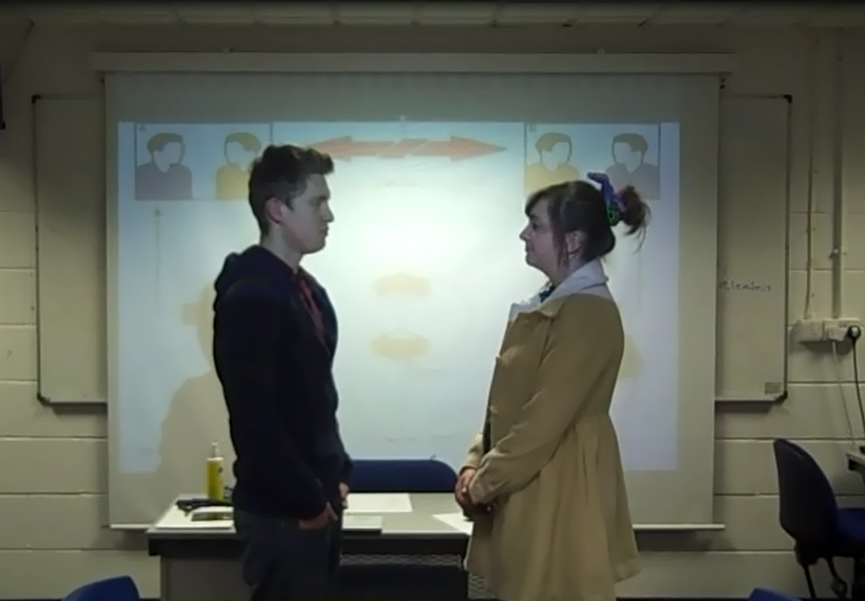
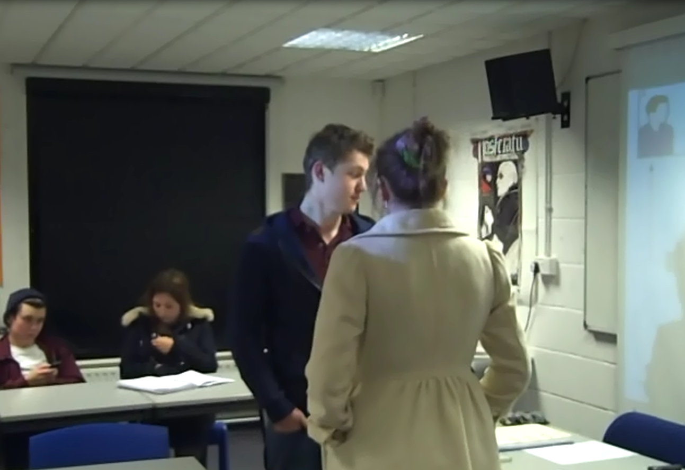
0-85 Degree Rule
A much more traditional cut, from ‘front on’ to ‘over the shoulder’. This is how continuity works, through well planned filming, leading to seamless editing.

Slide 8
A
B
A
B
For continuity editing to work, the director must adhere to the 180° Rule and the 30° Rule

Slide 9
0-180 Degree Rule

Slide 10
A
B
A
B
For continuity editing to work, the director must adhere to the 180° Rule and the 30° Rule

Slide 11
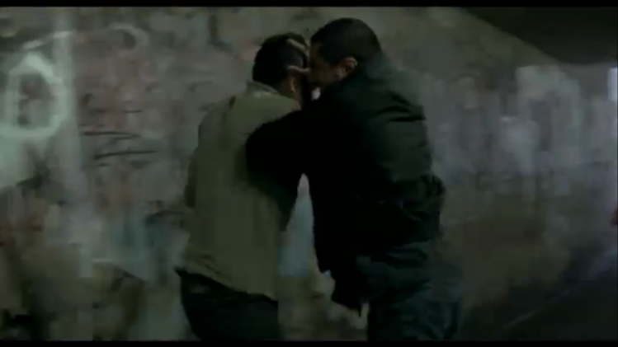
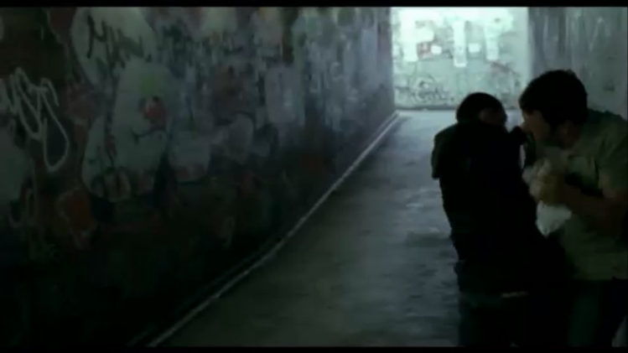
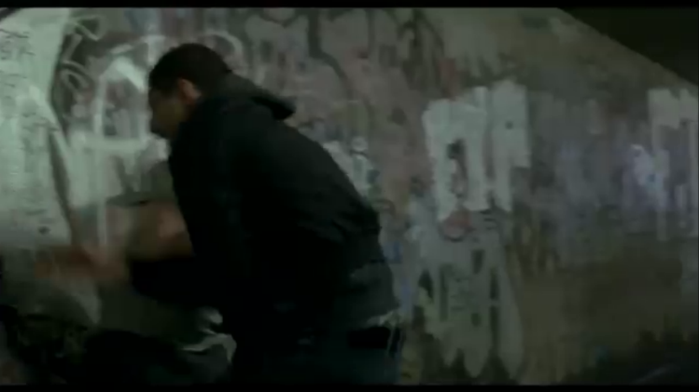
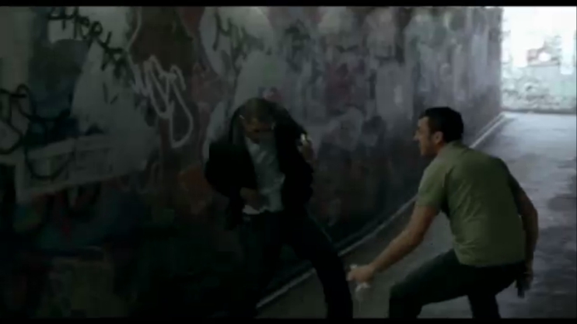
SHIFTY
An unexpected altercation is made all the more frantic with the intentional breaking of the 180 degree rule

Slide 12
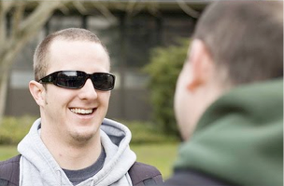
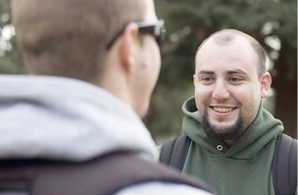
Shot/reverse-shot
This shows characters reactions to another person or object. It creates a relationship between the two characters in a shot.

Slide 13
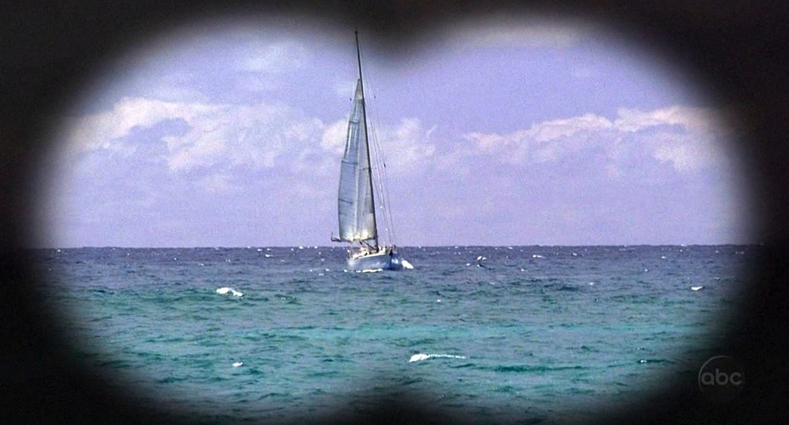
Eyeline match
A character looks at an object or person and the audience are shown a shot of what they are looking at.

Slide 14
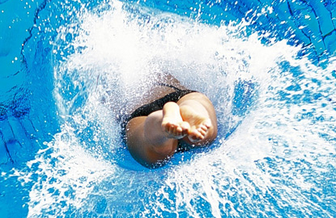
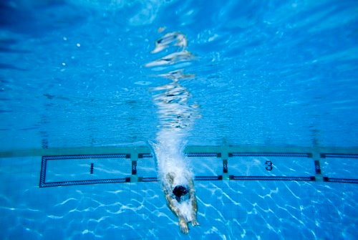
Match on action
It is used mainly in action scenes to increase pace.
If we show the character's movement beginning in shot 1, & then we can cut to shot 2, which shows the continuation of the movement

Slide 15
Non-continuity Editing
The opposite of continuity editing it is not seamless
It draws attention to itself
It often disrupts the audience's suspended disbelief
It can be deliberately confusing and/or shocking, playing with time and space.
https://www.youtube.com/watch?v=UU3AWF7P0Ho
from 25:30

Slide 16
Task
FIND
ANALYSE
Find film clips that demonstrate continuity and discontinuity editing:
0-85 degrees
0-180 degrees
Shot/reverse-shot
Eyeline match
Match on action
At least 2 examples of non-continuity editing
Put the youtube links and use the ‘snipping tool’ in a word document
Label the clips clearly with the correct terms
Analyse the effect of the technique

