Slide 1
Audience theories

Slide 2
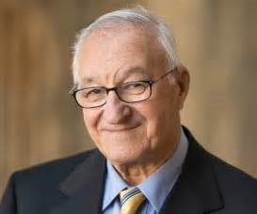
1. Effects models: Albert Bandura
The Effects Model is based around the idea that the media can implant ideas in the mind of the passive audience directly. So when audiences see some inappropriate behaviour, such as violence or physical aggression in the media this can lead audience members to imitate those forms of behaviour.
This suggests there is only a single meaning in a text and the audience fully accepts the messages.
This idea is not without criticism, but is often cited when discussing violent effects of video games, music etc.

Slide 3
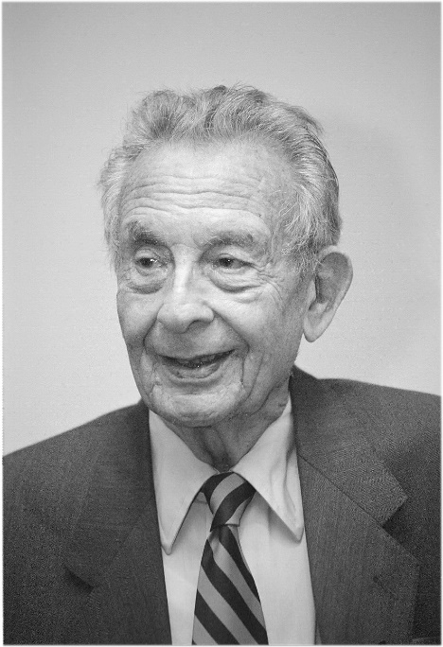
This theory is a more refined version of the effects model – where repeated exposure of the same messages/ideologies will eventually have an effect on the audience’s attitudes/values. This type of effect is cited when critics say that the audience has become desensitised, making the audience less sensitive to, for example, violent crimes in films/tv. Also, that exposure to repeated patterns of representation over long periods of time can shape and influence the way in which people perceive the world (cultivating particular views and opinions). Cultivation reinforces mainstream values (dominant ideologies)
2. CULTIVATION THEORY
GEORGE GERBNER

Slide 4
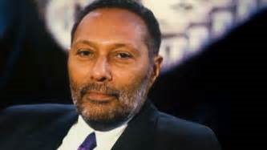
3. Reception Analysis STUART HALL When a producer constructs a text it is encoded with a meaning or messages that the producer wishes to convey to the audience. In some instances audiences will ‘correctly’ decode the message or meaning and understand what the producer was trying to say. Which is why there are 3 different ways for an audience to decode a text: Preferred/dominant reading Negotiated reading Oppositional reading

Slide 5
Preferred/dominant reading – Where the target audience receives the text they understand, and accept and share the messages/dominant values that were encoded by its producer (hegemonic reading) – for example, watching a political speech and agreeing with it. Negotiated reading – Where audience members receive the text and understand the messages/dominant values of the producers but will modify meaning/argue against certain messages (such as representations of groups etc.) To suit their own values and position. For example, neither agreeing or disagreeing with the political speech or being disinterested. Oppositional reading – Where audience members not part of the target audience reject the preferred reading/dominant values of the producers and receive/construct an alternative meaning (counter hegemonic). For example, total rejection of the political speech and active opposition.

