Slide 1
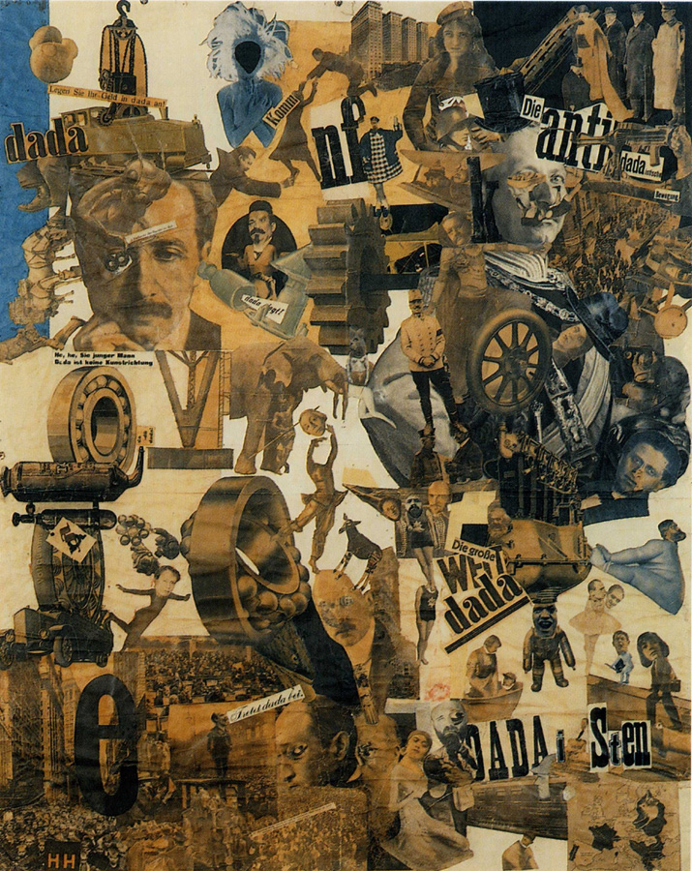
Cut with the Kitchen Knife Dada Through the Last Weimar Beer-Belly Cultural Epoch of Germany
1919-20
Hannah Höch

Slide 2
Cut With a Kitchen Knife is an example of 'photomontage'. This is in a way a form of thinking via image, deconstructing the original image to create a new narrative/frame from which to view the art (often seemingly abstract). Her photomontages exhibit a disturbing tension between pleasure and anger, confidence and anxiety. The image also includes some water-colour sections.
However, the content in the work is easily understood and is embedded with a lot of meaning. For example, many of the types of images deconstructed in these works are of or deal with the body, the machine, and language (via text). This type of content was topical at the time due to the politics of the rise of the machine and industrialism.
Hoch implies by the title of her painting that she is theoretically cutting through the male cultural epoch of Germany defining them using the words “the beer belly” with a “kitchen knife” that connects to the stereotypical view and placing of females in the home. This shows that she was fighting back at the traditional view of women as housewives and juxtaposes this image with those of political party leaders. The kitchen knife was also used to cut out the images that construct the collage and not just for symbolism.
Subject matter: The collage shows different aspects of political views of Dadaism- anti-dada, dada world, dada propaganda and dada persuasion. These are mostly shown by text and clippings of newspapers spread throughout the composition.
Head of the president of the Weimer republic put upon the body of a topless dancer. The juxtaposition between a representation of a woman in mass media and a figure of power took on a new political meaning that challenged the distribution of power in society. She reconstructed the wonderfully seductive mass media images of the New Woman with their appeal in tact but with their contours fracture in order to expose the contradictions of the new female stereotypes.

