Slide 1
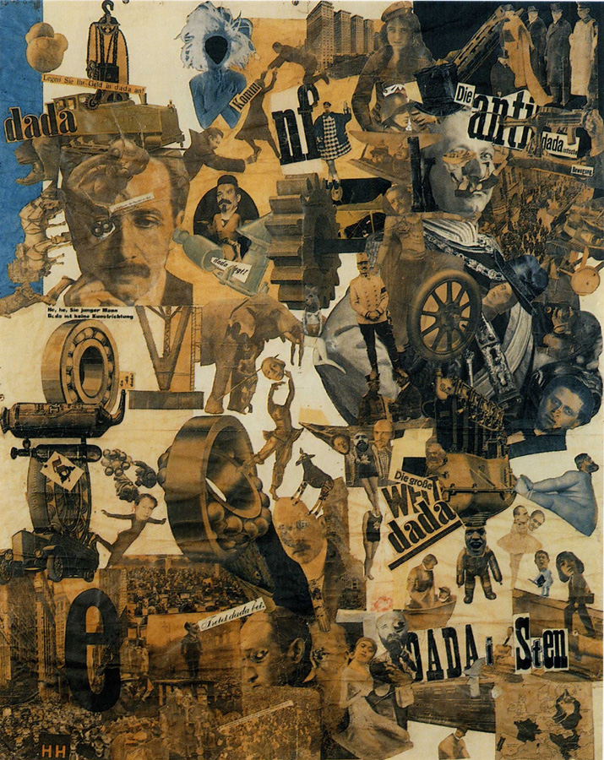
Hannah Höch,
Cut with the Dada Kitchen Knife through the Last Weimar Beer-Belly Cultural Epoch in Germany
1919
collage of pasted papers, 90 x 144 cm, Staatliche Museum, Berlin.
Influences: Friendship with Raul Houssman during 1915-20 and involvement with Berlin Club Dada-wanted to reflect their collective disgust with German nationalism in the struggling post-World WarI. After Tzara’s Dada Manifesto –Tzara published it in Berlin-same city as Hannah
Historical Context: Worked in the red cross during the start of World War I.
Subject Matter: showing different aspects of political views of Dadaism- anti-dada, dada world, dada propaganda and dada persuasion.
Useful link: http://www.flickr.com/photos/32535532@N07/3179940950/

Slide 2
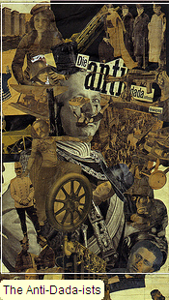
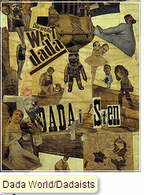
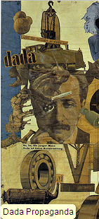
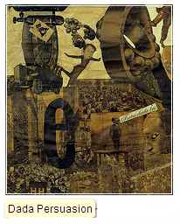
Head of General Hindenberg on top of body of dancer Sent M'ahesa
Heads of Dadaists George Grosz and Wielande Herzfelde
head of Hannah Höch pasted to the upper left of a map of countries in Europe where women have the right to vote
Head of the president of the Wiemer republic put upon the body of a topless dancer
Mechanical cog-showing use of machinery during war and machine age of the 20th century and development of the modern art
Karl Liebknecht, German Communist Party leader; he and co-party leader Rosa Luxembourg were jailed, tortured, and assassinated (January 1919) along with other left-wing party members following the Spartacist uprising
“Invest your money in Dada”
Einstein
‘He, he young man……Dada is not an art Trend’

