Slide 1
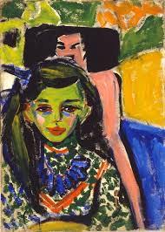
Ernst Ludwig Kirchner Fränzi in front of a Carved Chair, 1910 Oil on canvas. 71 x 49.5 cm Museo Thyssen-Bornemisza, Madrid
http://www.youtube.com/watch?v=SUu819FuYmQ
http://kino.fraia.ru/video/SUu819FuYmQ/Ernst-Ludwig-Kirchner-Fr%C3%A4nzi-in-front-of-a-Carved-Chair.html

