Slide 1
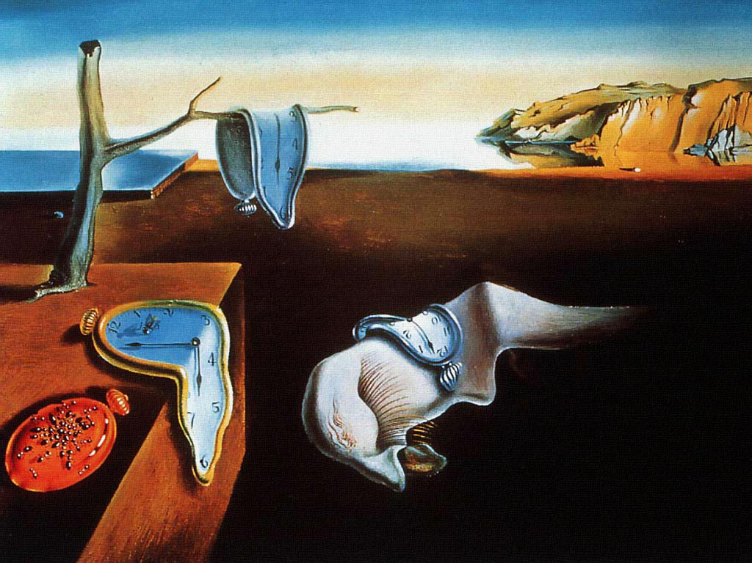
Salvador Dali
Persistence of Memory
1931

Slide 2
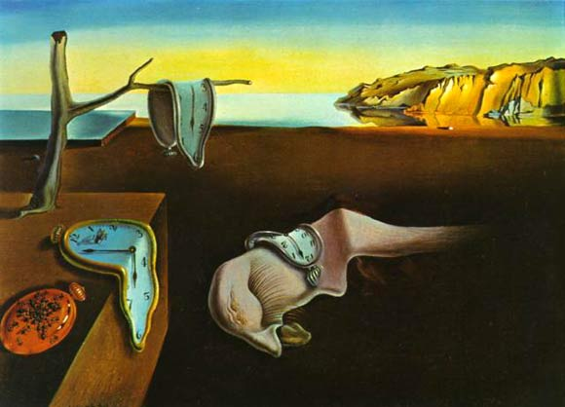
Persistence of Memory
Interest in the sub-conscious mind
The paintings combines everyday imagery and the dream like symbols are irrational, with aspects of nature and technology.
The painting can be seen as a landscape, still life and a portrait painting, showing how Dali’s sub-conscious mind incorporated various aspects of life.
Thos being a depiction of the dream means that it is an image of his subconscious mind.
Subject Matter
The surrealistic piece introduced the image of the soft melting pocket watch.
The melting watches symbolises the irrelevance of time, and suggests Einstein's theory that time is relative and not fixed.
The orange clock at the bottom left of the painting is covered in ants and Dali often uses ants in his paintings as a symbol of death, as well as a symbol of female genitalia.
Aspects of Surrealism
The aim of surrealism was to free artists from the normal association of pictorial ideas and from all excepted means of expression, so that they might create according to the irrational dictates of their subconscious mind and vision.
The piece is realistic in the style of the painting, which relates to surrealism (super- real), however there is a juxtaposition in the elements included in the painting, and the melting of clocks is very unrealistic.
Colour
The colours are realistic, however slightly idealised and heavenly in the background.
This relates to the sub conscious and dream like.
There is use of shadow in in the painting, showing the solidity of the objects, reinforcing the realism in the painting.
However, the drooping nature of the clocks relates to the dream like style.
The bright primary colours in the painting complement each other, giving it a dream like feel.
Composition
The figure in the middle of the picture symbolizes a fading creature, often when you dream you cannot pin-point the exact form of a creature.
The iconography of this painting is of a dream that Dali had experienced.
Freud's work with free association, dream analysis and the hidden unconscious was of the up most importance to the Surrealists in developing methods to liberate imagination.
Dali called it one of his “hand-painted dream photographs”

