Slide 2
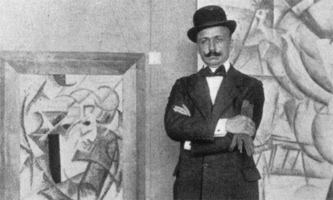
Founded in Milan in 1909
by the Italian poet Marinetti
Marinetti writes his Manifesto of Futurism which is published in a number of newspapers in January and February 1909
The manifesto sought to turn its back on Italy’s cultural heritage and instead
look towards a new world that celebrated a modern era of technological
advancement and industry
Marinetti insisted on a total rejection of various issues such as tradition, museums, libraries and feminism and instead called for the promotion of industry,
youth, war and progress
We want no part of it, the past,
we the young and strong Futurists!

Slide 3
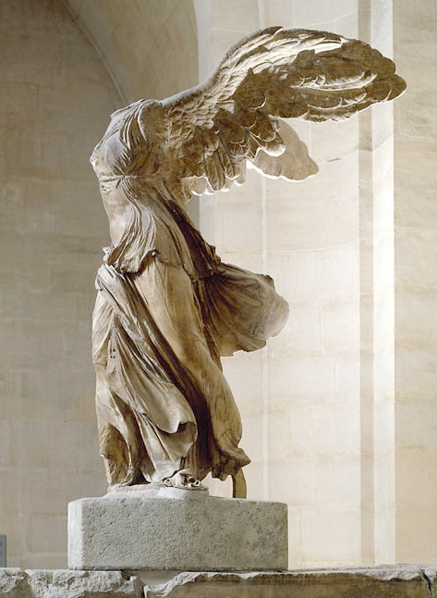
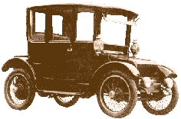
‘We declare … a new beauty, the beauty of speed. A racing motor car … is more beautiful than the Victory of Samothrace’

Slide 4
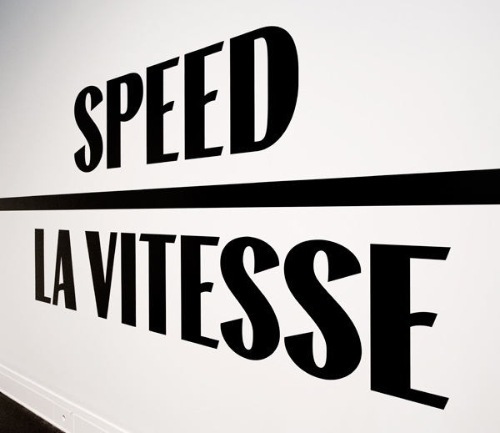
Aims
To celebrate modernity & nationality
To reject the old: “burn the museums”
To see everything in terms of “universal dynamism”
To challenge and be provocative

Slide 5
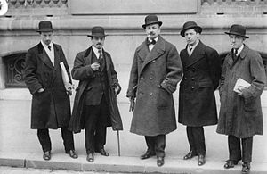
Key players
Marinetti (poet & philosopher) writer of the Futurist manifesto in 1909 and published it in Italy and France.
Umberto Boccioni is the main artist associated with the style.
Other key players include their teacher, Balla, as well as Carra, Russolo and (although he was in Paris) Severini.
Notes:
Why did he publish in Le Figaro as well as in Italy? Because Paris was the centre of the modern artworld and Marinetti was deliberately challenging and inviting notice.
Why is it important that this style is started by a poet and not by artists? What changes?
Why is it important that they named this style themselves unlike both Fauvism and Cubism which had been named in a mocking way by the art critic Louis Vauxcelles?

Slide 6
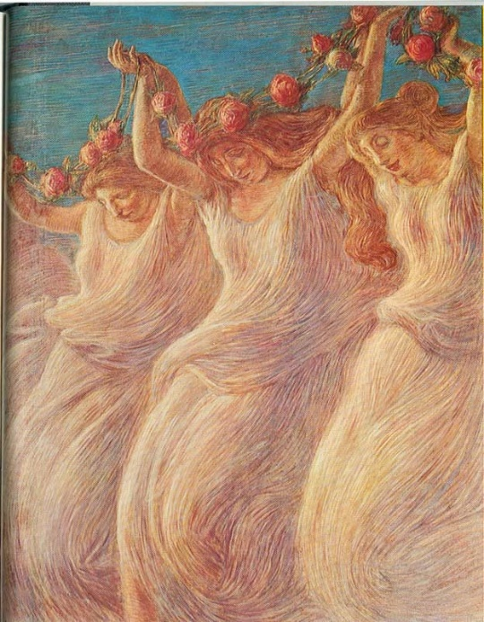
Visual Characteristics
Subject matter: Modern, machinery, movement
Composition: Flat, asymmetric
Brush handling: changes during style from early: Italian Divisionism to Cubist influences after their visit to Paris in 1911. Strong differences in personal style between members of the group.
Colour: strong, primaries
Figure handling: simplified.
Early artistic influence came from the Italian divisionists: above Previati.
Notes:
Remember M! Marinetti, Manifesto, modernity, Milan, movement, machinery – keep repeating round the class and as a plenary to get out of the room at the end of the session.

Slide 7
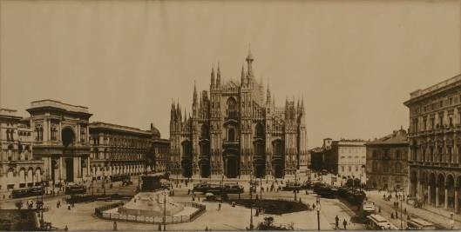
Place
Futurism was founded in Milan.
Northern, industrial city of Milan, far from the Renaissance centre of Florence and the Classical/Baroque heartland in Rome.
Italy still coming to terms with union (1871) and widespread revolt and rebellion over government impositions on labour etc which did not suit all regions.

Slide 8
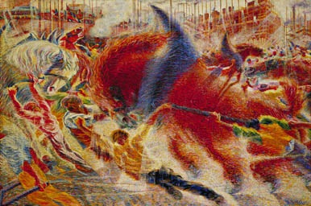
Boccioni ‘The City Rises’ 1909
The first Futurist painting?
Notes:
This is difficult to read. Get them to come up to the board one at a time and highlight different things to identify them and help visual recall. Eg: train top left, scaffolding & new industrial buildings top right, act out the figures?
Make sure they can highlight the aims, features and techniques which give it the label ‘Futurism’.
Central horse is pun on horsepower? Linked arms – surging power. Flame like, intense colours to literally add heat.
Surging figures urging revolt and modernisation on (not trying to hold it back)
Describe brushhandling and use of colour. List elements in red/yellow/blue again as a way of building visual recall.
Why have figures been simplified? (universal types rather than individuals – a celebration of the ‘mob’ this is an anarchic group with strong political opinions.

Slide 9
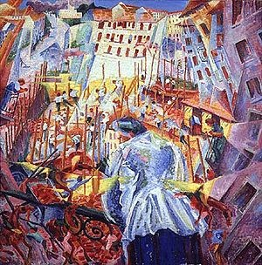
Boccioni ‘The Street Enters the House’ 1911
The group went to see Severini in Paris in 1911 who introduced them to Cubism
Notice the use of facets here
Also multiple perspectives and overlaps to create “universal dynamism” (which goes beyond what we see, but explores sound and movement too)
Notes:
Futurists also considered other names – like Dynamism for their group. Debate whether they chose the right one and what this name says about their priorities.
Boccioni publishes Technical Manifestos of Futurist Painting and Sculpture in 1912. These add artistic interpretation to Marinetti’s original manifesto which had focused on aims, life and poetry.

Slide 10
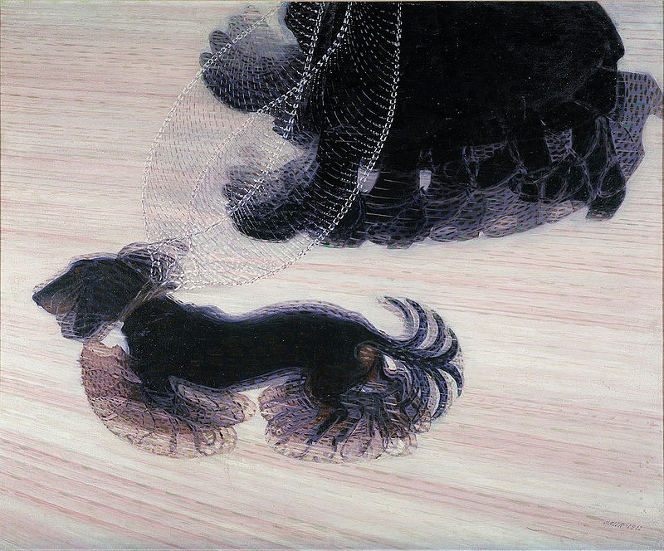
Giacomo Balla ‘Dog on a Leash’
Influence of photographers: Muybridge & Marey
How can you link this to new science of the time?
Bergson ‘the world is in a constant state of flux’
Einstein ‘Theory of Relativity’
Notes:
Unusual subject matter….
Motion – count number of tails/feet.
How else does B create a sense of ‘universal dynamism’ movement.
Bergson = hugely popular French philosopher of the time. This key phrase can be used as context (A04) to support multiple movements eg Cubism. Einstein also useful for several movements.
Balla was their teacher and older than the rest of the group. Make sure they have some biographical information to use as context and then to evaluate why his approach is so different.

Slide 11
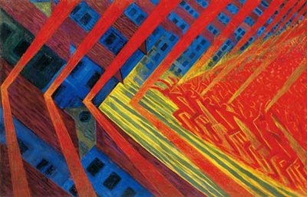
Russolo ‘The Revolt’ 1911
Writes the Technical Manifesto of Futurist ‘music’ ‘The Art of Noises’ 1913
Large scale: 150x230cm
The mob advance from the right but the sound they make ‘hits’ the city (blue) first in red chevrons of dynamic energy.
Notes:
Again, Russolo is urging the mob to rise up and revolt. This is not recording a particular incident which has happened. Can be very useful in an essay on Urban Modernism as it makes a different case.

Slide 12
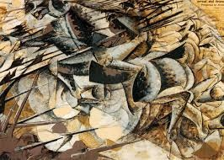
Charge of the Lancers, 1915
Late Futurist work
Just before his death during the war
Incorporates elements of collage (top right)
Much more muted palette – why?
Notes:
Shows development of style along Cubist roots. First fully Futurist exhibition at Bernheim Jeune Gallery, Paris in 1912.
Forms are not based on geometric facets, but focus on the 4th dimension (time) to show multiple moments.
One horse in motion or several? (Not sure!)
Interesting subject matter – lancers is old fashioned war technique, and gun men

Slide 13
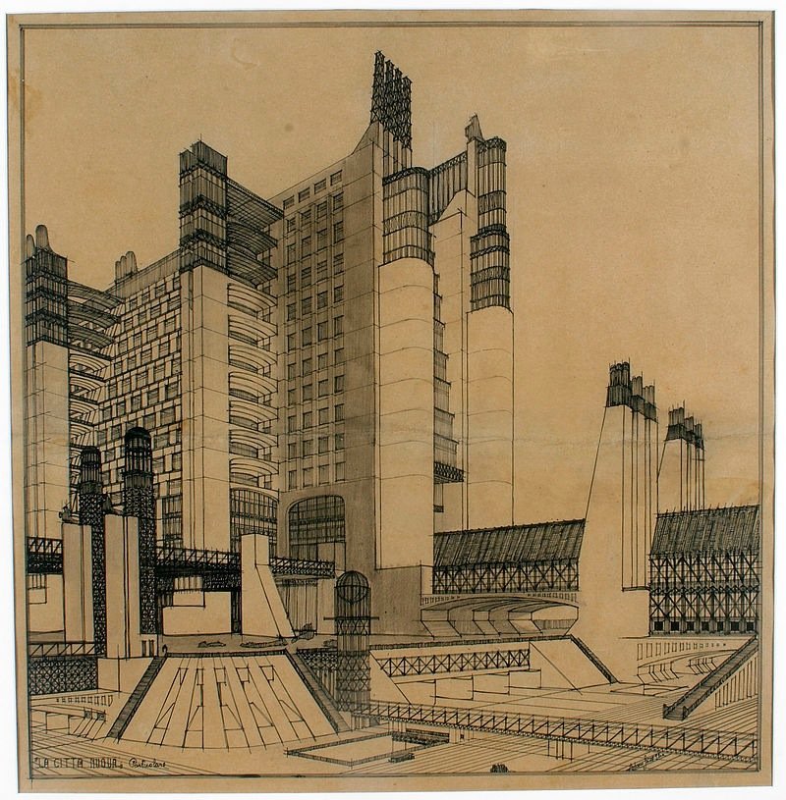
Sant’ Elia
Futurist architecture: Visions of new cities
But killed in the war, so ideas never got built.
Important to realise that this was a deliberate Movement that spanned a wide range of cultural experiences and activities.

Slide 14
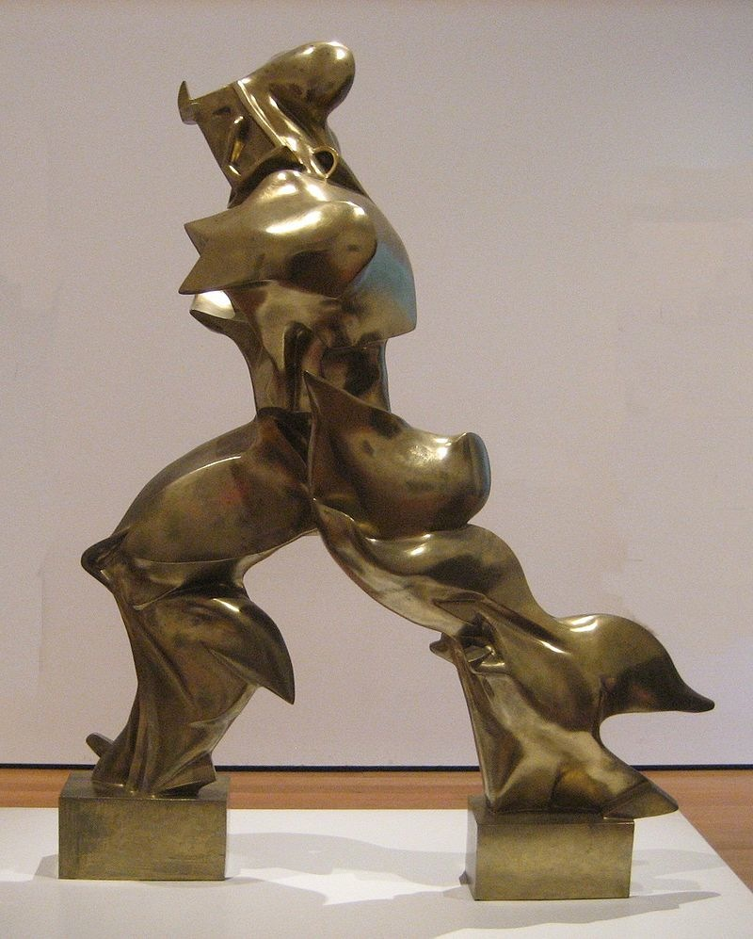
‘Unique Forms of Continuity in Space’ 1913
What is this figure?
Why does Boccioni give it this title?
What does the title mean?
Further reading: http://www.nyu.edu/projects/mediamosaic/thetitanic/pdf/ostashevsky-eugene.pdf
Notes:
NB This is in MOMA (although not always on display, but look out for it in NY!)

Slide 15
TV clips
http://www.guggenheim.org/video/italian-futurism-1909-1944-reconstructing-the-universe
https://www.youtube.com/watch?v=NZHpmJvU7sM
http://www.guggenheim.org/video/futurist-performance-and-f-t-marinetti
Notes:
From the recent Guggenheim exhibition (5 mins)
Alex Fox simple but effective, 6 mins
Futurism: Marinetti and Performance (4 mins)

