Slide 1
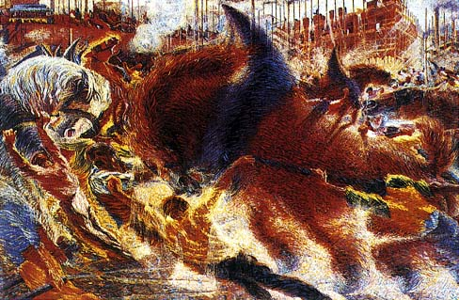

Slide 2
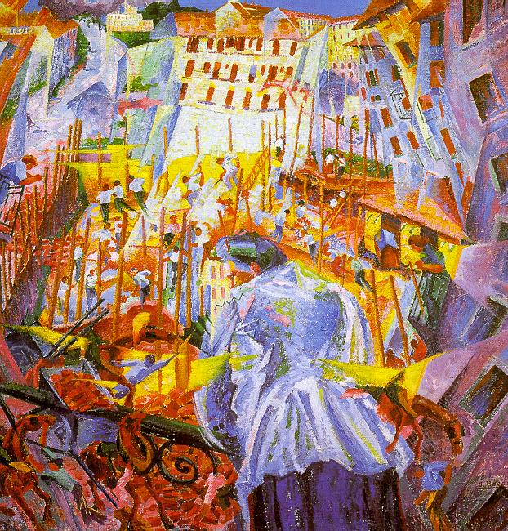

Slide 3
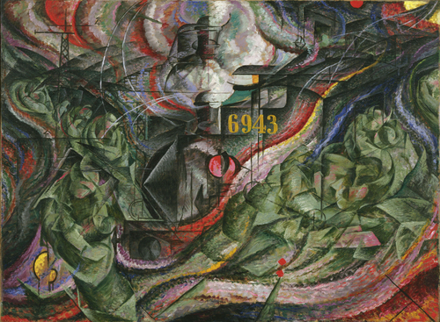

Slide 4
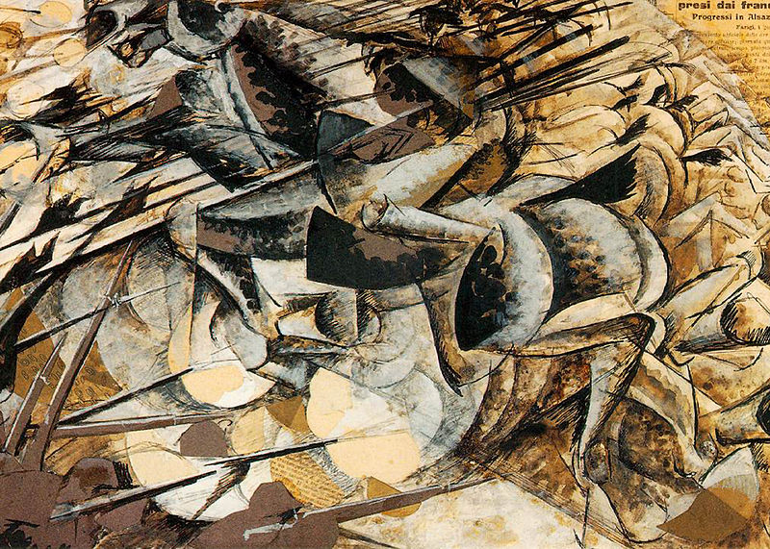

Slide 5
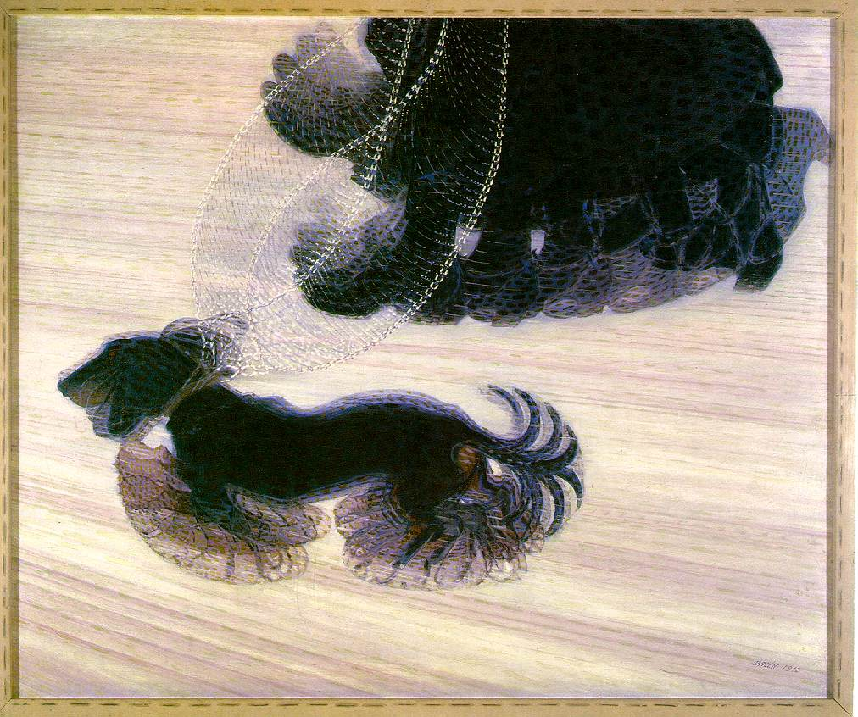
Balla ‘Dynamism of a Dog on a Leash’ 1912

Slide 6
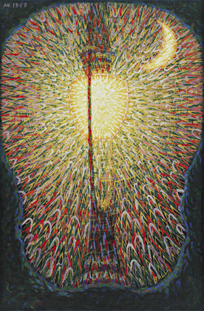
Balla ‘Street Lamp’ 1910

Slide 7
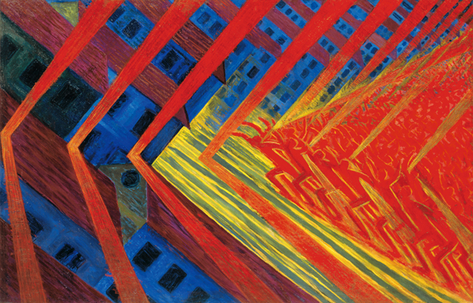
Russolo ‘The Revolt’ 1912

