Slide 1
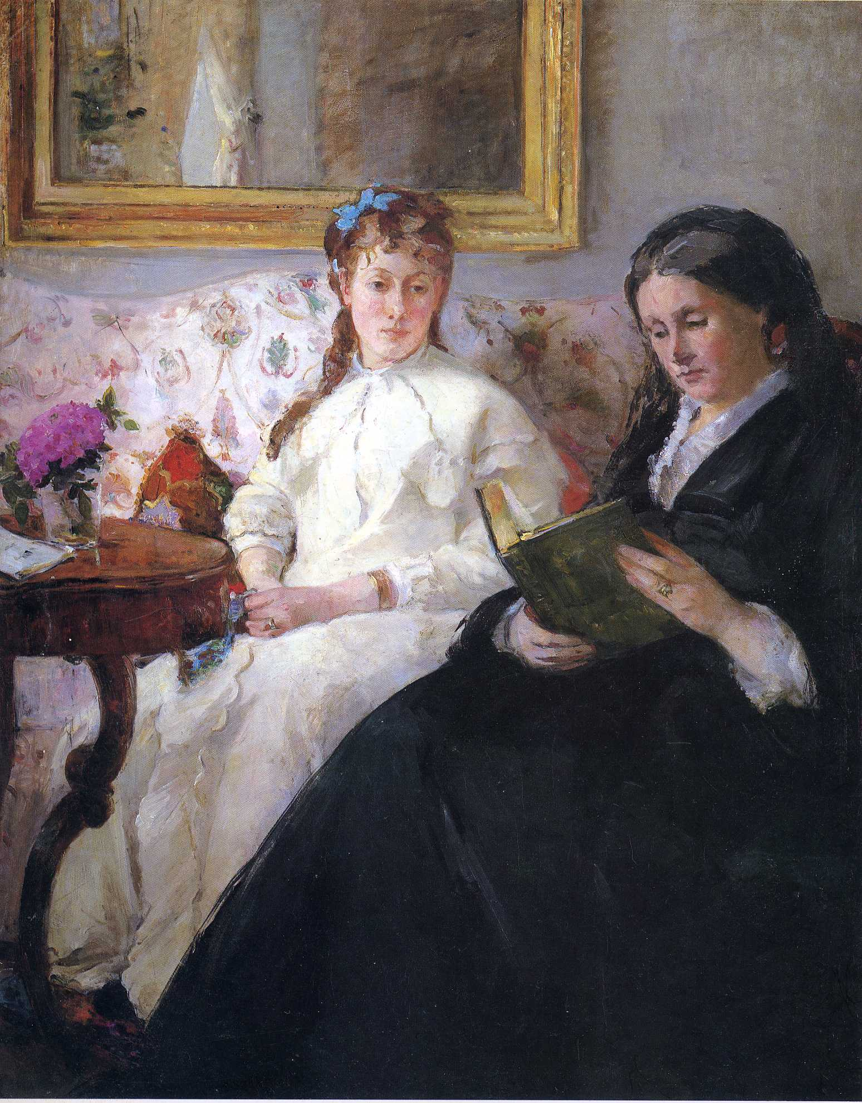
Berthe Morisot, Portrait of the Artist’s Mother and Sister, 1869-70, 81 x 101cm

Slide 2
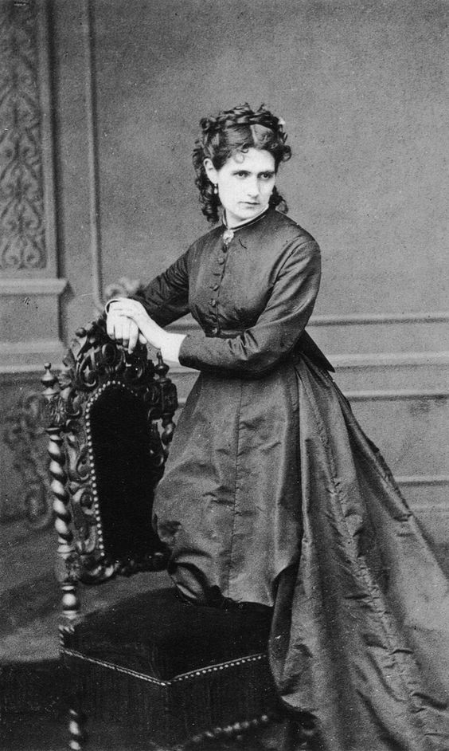
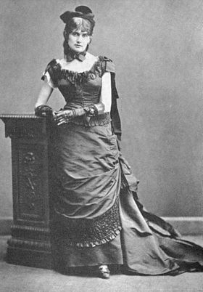
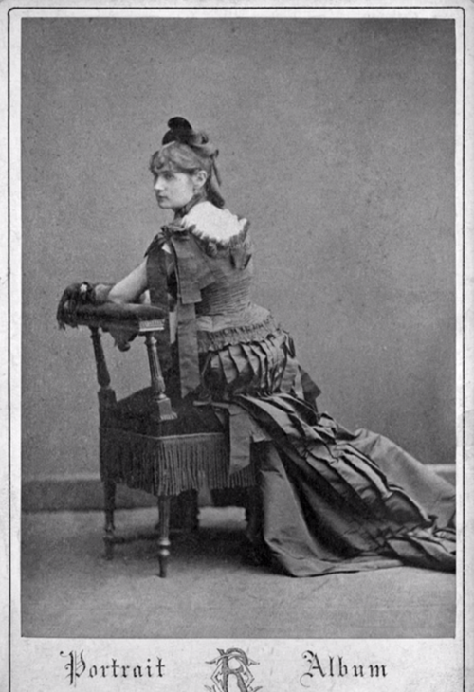
“Her name is Berthe Morisot, and she is a curiosity.”
– Le Figaro, 1880

Slide 3
Berthe Morisot, 1841-1895
Morisot was a key member of the Impressionists.
Despite showing in a number of the official Salon shows, Morisot would align herself with
the avant-garde group which included Monet, Renoir, Degas, Cézanne
Morisot came from a well-connected and wealthy family but gained the respect and admiration of her male peers for her commitment to developing her art beyond the academic tradition.

Slide 4
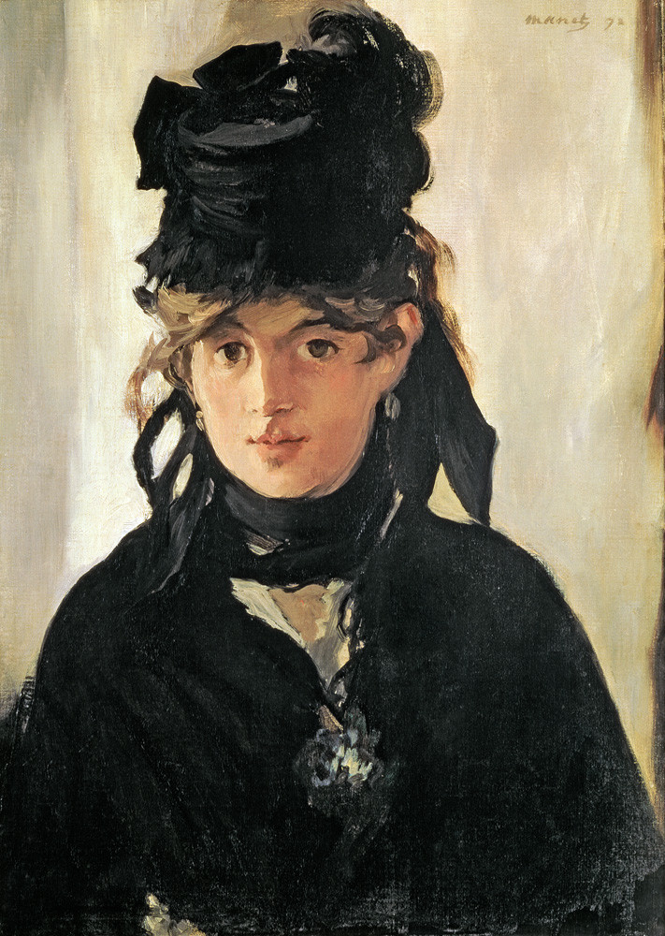
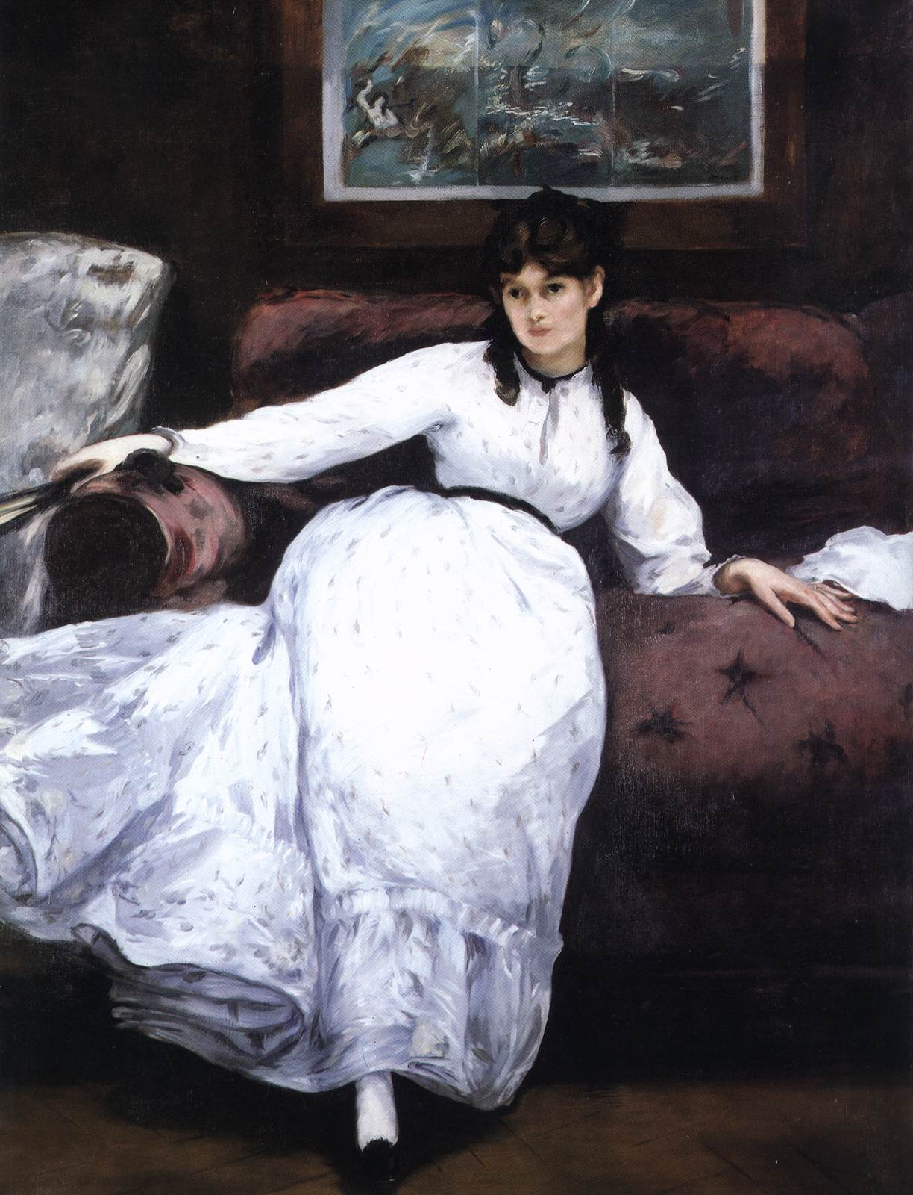
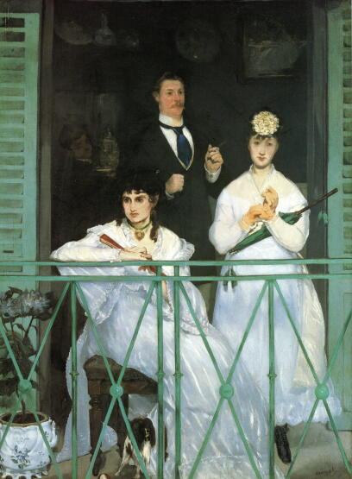
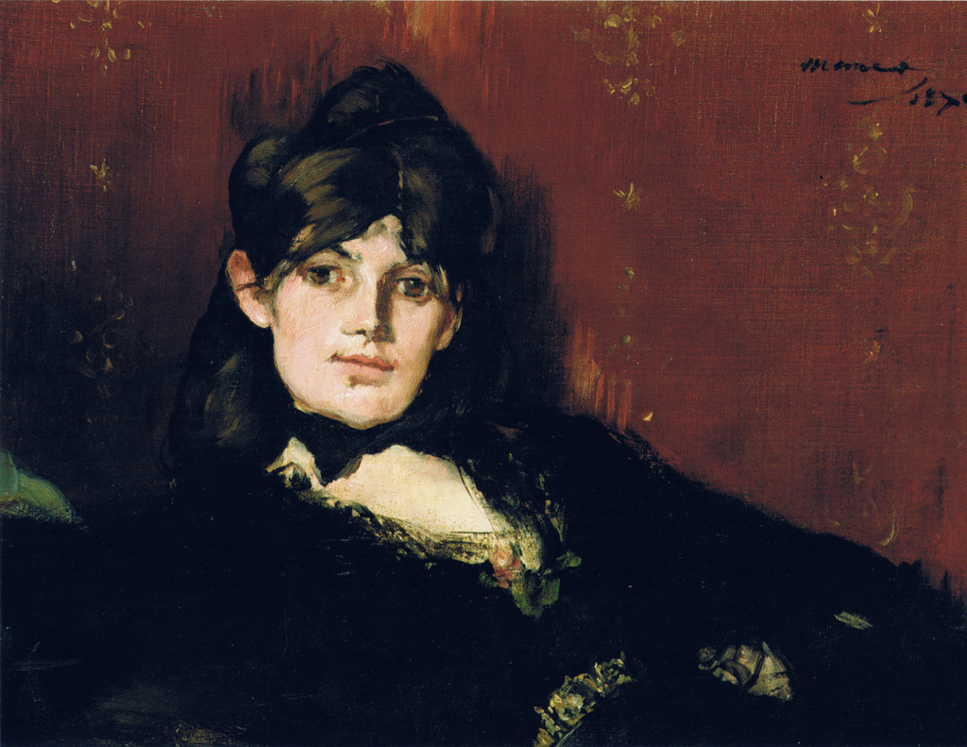
Morisot sought the help of Édouard Manet to aid her painting skills and an intense friendship
developed based on mutual respect and admiration. She appears in a number of his works.
Berthe would marry Édouard’s younger brother Eugène

Slide 5
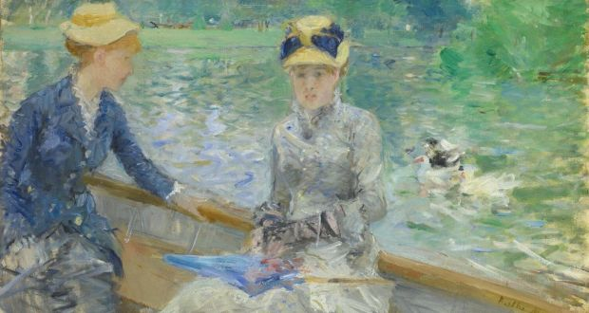
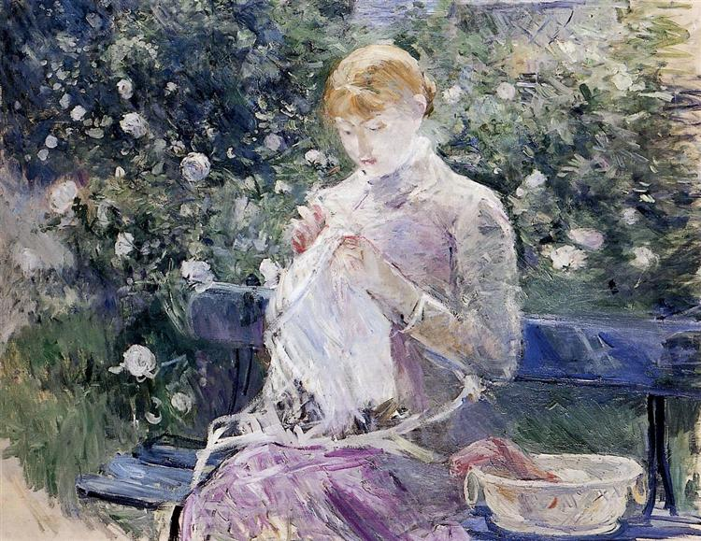
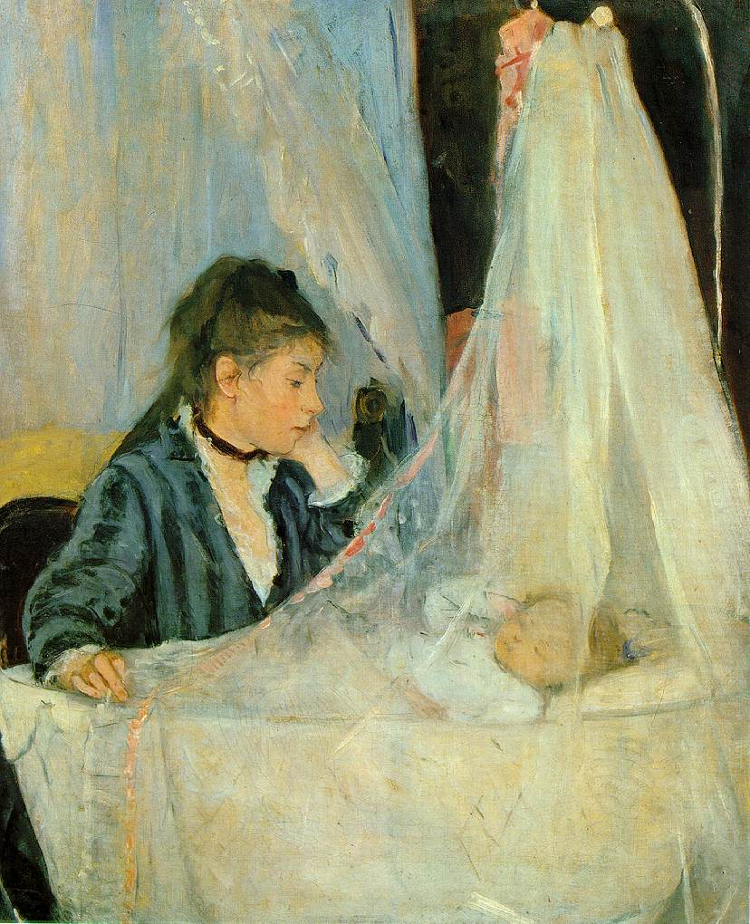
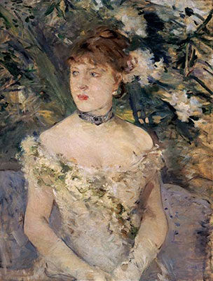
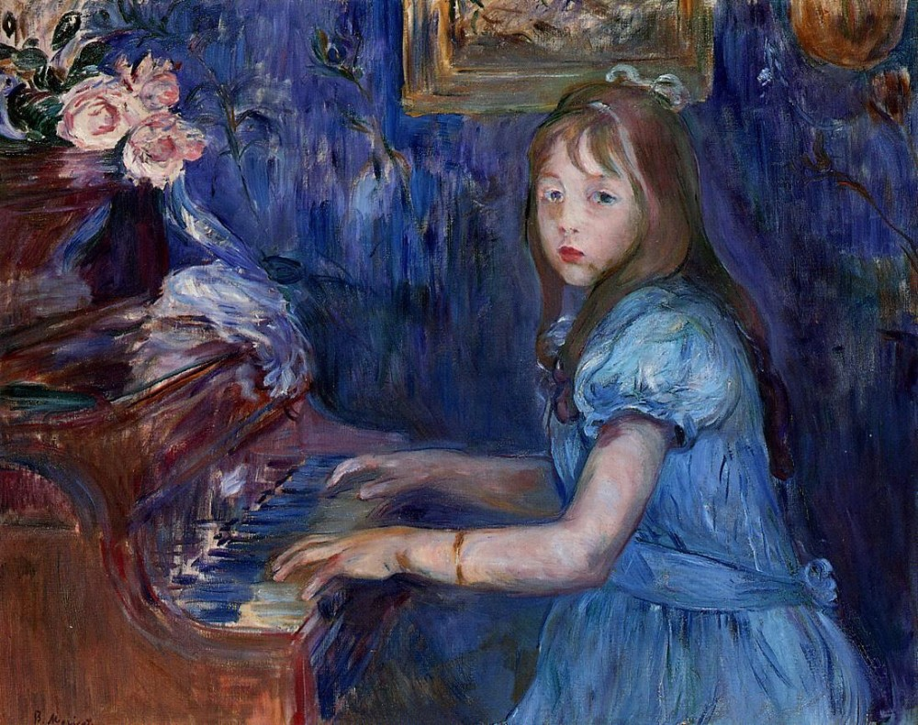
Berthe’s work is characterised by soft lighting, loose brushwork, pastel colour schemes and a focus on intimate scenes of domesticity or leisure, making her a key Impressionist artist

Slide 6
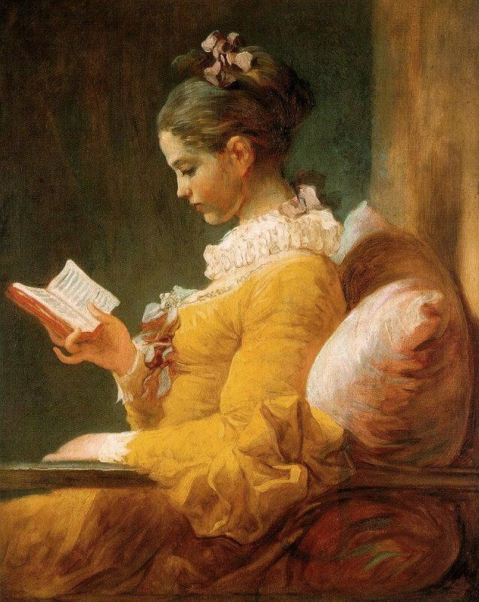
This portrait shows Berthe’s older sister Edma, dressed in white and pregnant with her first child. Berthe and Edma were very close and Edma was herself a painter before marrying.
Their mother (Marie-Joséphine-) Cornélie is shown reading a book.
Cornélie was a great-niece of the famous Rococo painter Fragonard and the soft colouring and intimate treatment is similar to Fragonard’s art. Berthe however was more avant-garde in her painting technique and treatment of composition

Slide 7
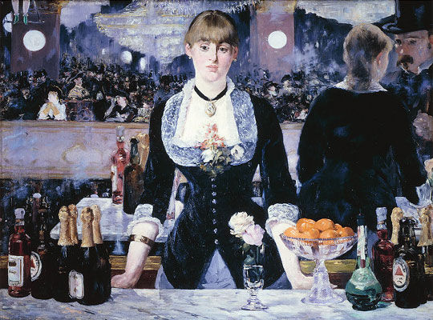
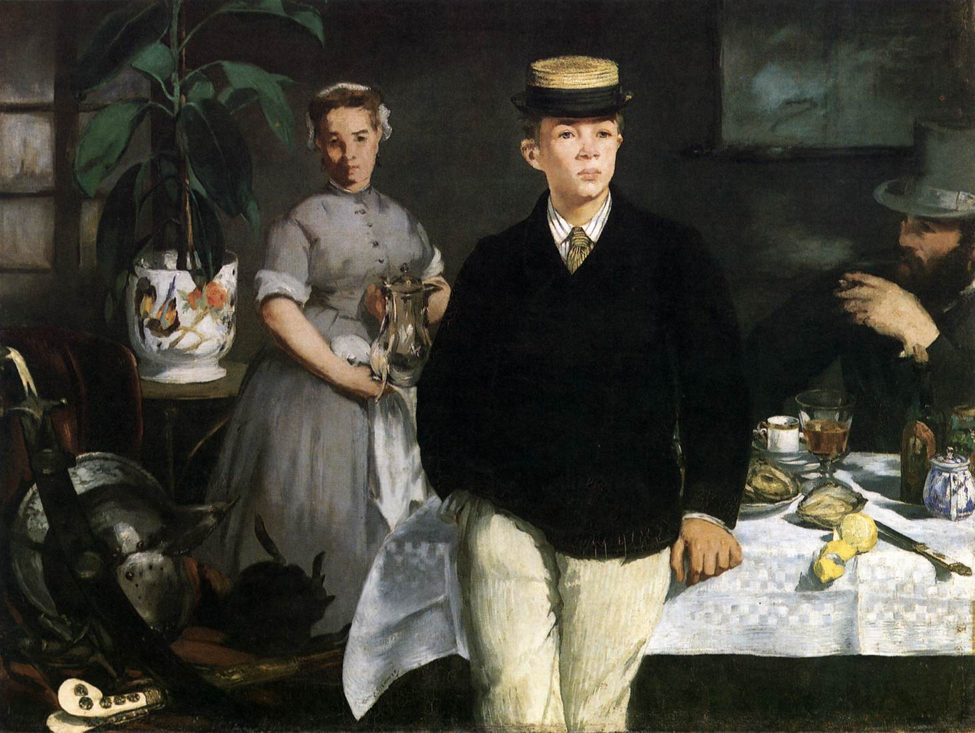
Edma’s white dress contrasts with the black worn by her mother. This colour combination shows the influence of Manet who, unlike the Impressionists, used black in many of his paintings.

Slide 8
Consider this work in terms of a depiction of leisure.
How does the artist present her family? Look at setting, costume, props and the activities they’re engaged in.
What does the subject and its representation tell us about the artist herself?
How is this work Impressionist in style? Examine the formal features and application of paint.
Can you see any influences from photography in the painting?

Slide 9
Berthe came under immense pressure to marry. Women at this time were expected to marry and fulfil a domestic role, forgoing any personal ambition. Can you apply any of this information into a more personal reading of the portrait shown here?
This work was shown at the 1870 Paris Salon and later at the 1874 First Impressionist Exhibition, by which stage she had fully joined with the Impressionists. What does the newspaper quote below imply about public attitudes towards her?
“Her name is Berthe Morisot, and she is a curiosity.”
– Le Figaro, 1880

Slide 10
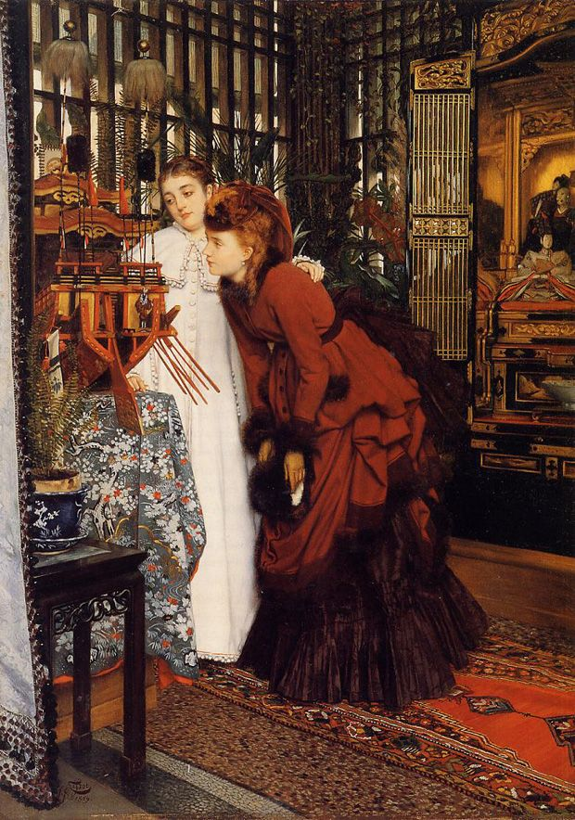
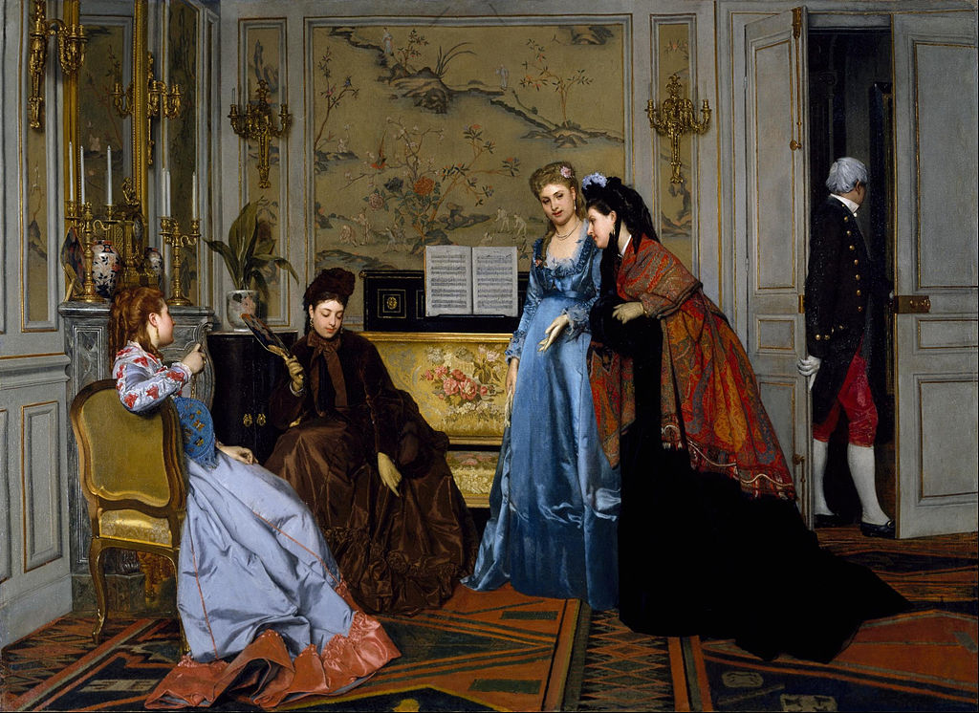
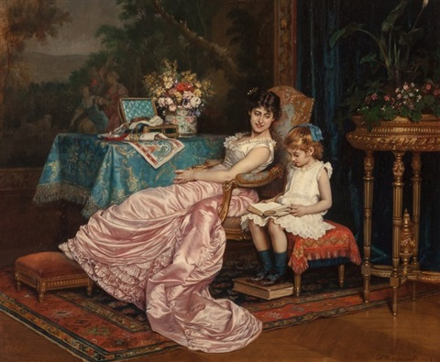
Compare Berthe’s depiction of women at leisure to similar works by other artists painted at this time. How does Morisot’s differ? Can you argue that Morisot’s painting was avant-garde?
Alfred Stevens, Figures in a Salon
James Tissot,
Women Looking at Japanese Objects
Auguste Toulmouche, Mother and Daughter Reading

