Slide 1
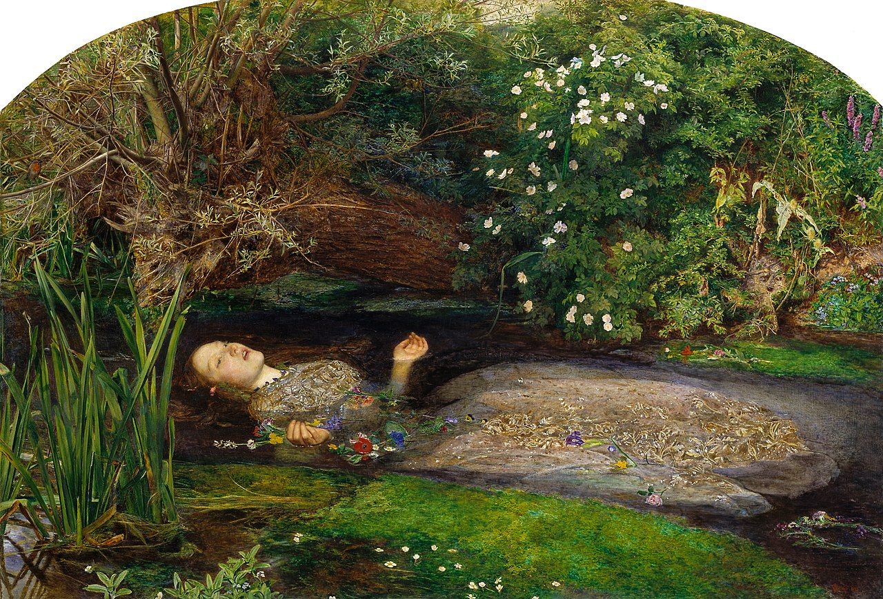
John Everett Millais, Ophelia, 1851-52, oil on canvas, 76.2 cm × 111.8 cm

Slide 2
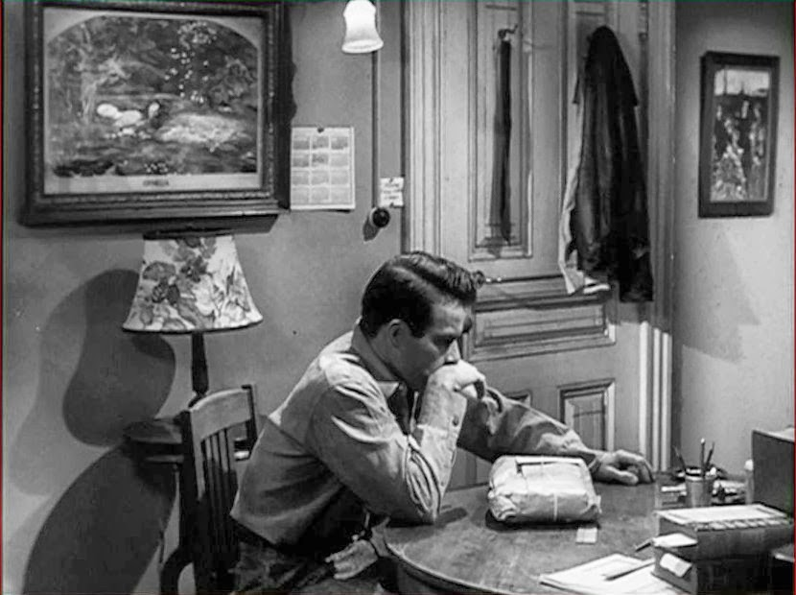
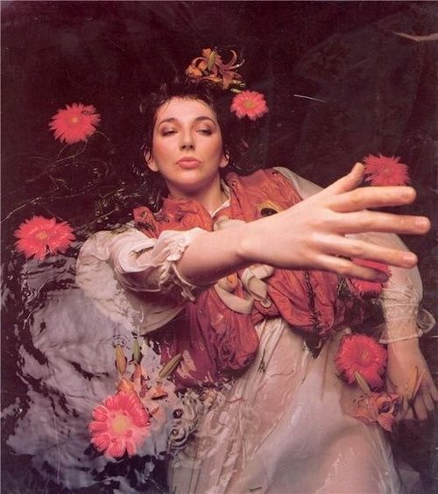
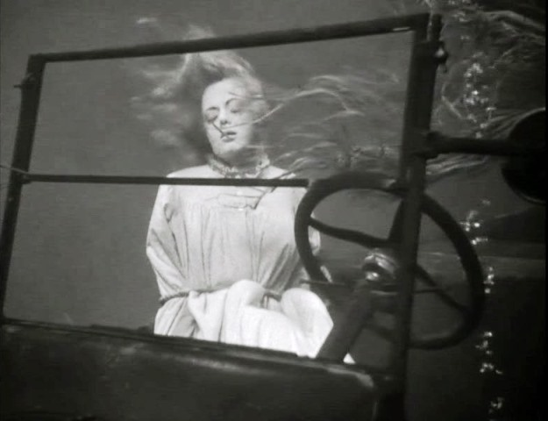
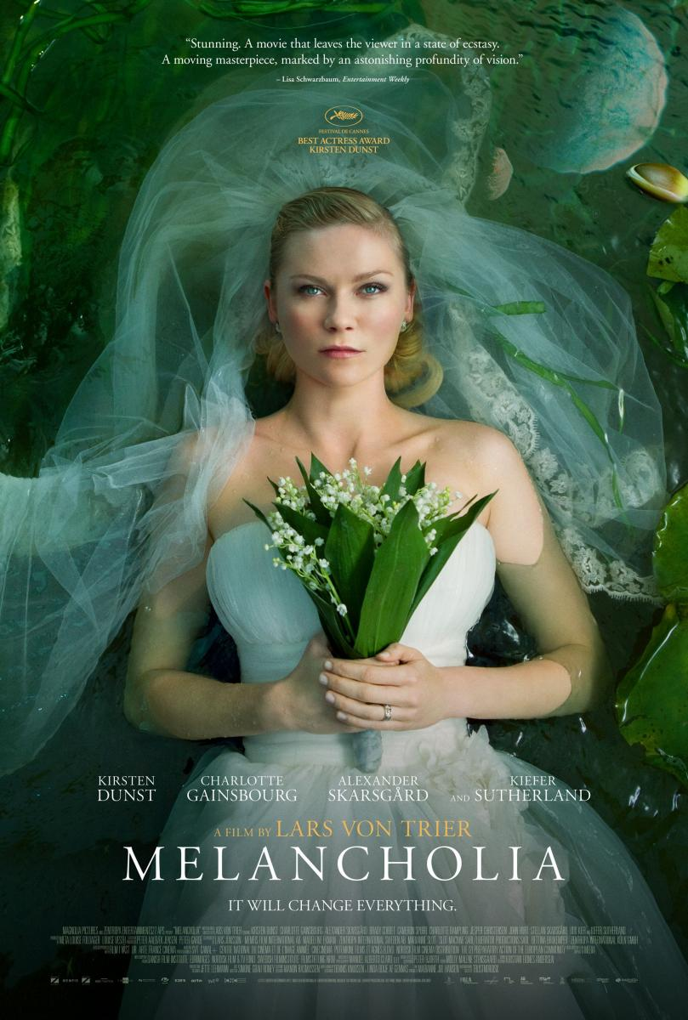
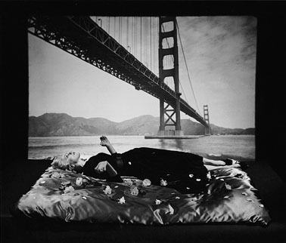
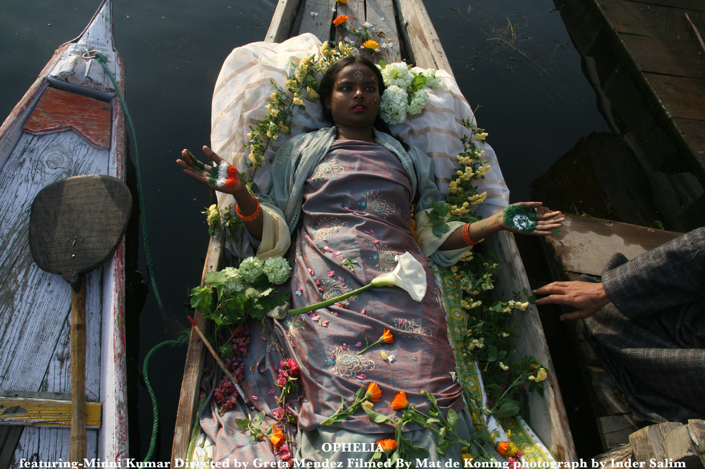
The obsession with youth, sexuality, psychiatric derangement, and mortality that marks much of the visual culture of today can very much be seen as an extension of the Ophelia phenomenon- Alison Smith, Art Historian
https://www.youtube.com/watch?v=wafe6kDBb6c
https://www.gucci.com/us/en/st/stories/advertising-campaign/article/spring-summer-2018-ignasi-monreal#style-news-video-overlay-5726515385001

Slide 3
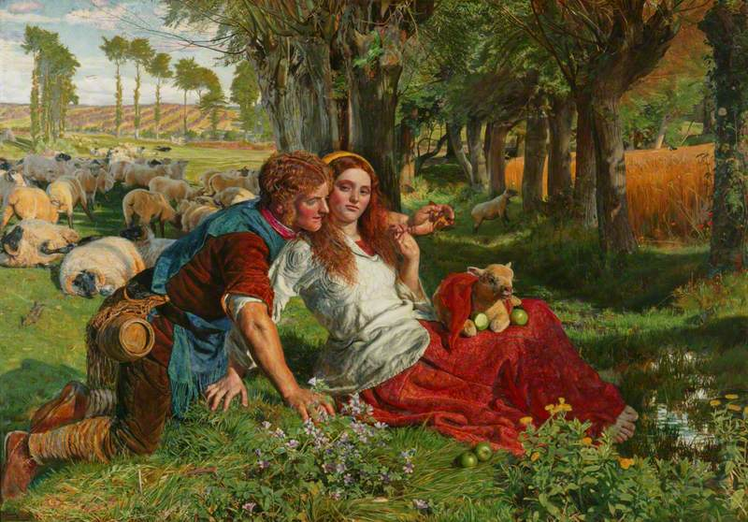
This painting illustrates the death of Ophelia in Shakespeare’s ‘Hamlet’, as described by Queen Gertrude
The landscape was painted outdoors in Ewell, Surrey. Millais painted alongside his Pre-Raphaelite colleague Holman Hunt who was working on ‘The Hireling Shepherd’.
Both artists painted the settings en plein air in an effort to
make the works look as realistic as possible.
Millais’s painting depicts the moment when Ophelia, driven mad by the death of her father who was killed by her lover Hamlet, drowns in a river.
Millais spent months outdoors trying to depict nature accurately- inspired by the Pre-Raphaelite’s rule regarding nature; ‘selecting nothing and rejecting nothing’
The painting is packed with symbolic detail, all of which
would be recognisable to a Victorian audience.
Many of the details within the painting allude to, or reference passages of text from Shakespeare’s ‘Hamlet’.
The works of Shakespeare were a great source of inspiration for the pre-Raphaelites who created many paintings which illustrated characters or events from his plays.
Millais returned to London in the autumn to finish the painting in his studio and include the figure of Ophelia.
The success of the painting, when it was shown at the Royal Academy, was partly due to the intense level of detail.
Furthermore, works whose themes dealt with tragedy,
forsaken lovers, doomed youth etc, appealed to sentimental Victorian attitudes

Slide 4
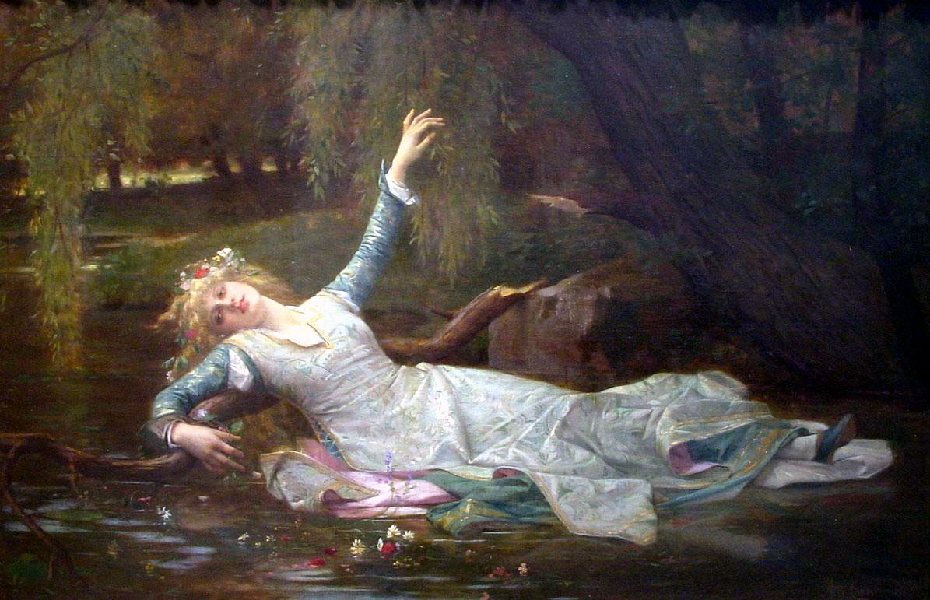
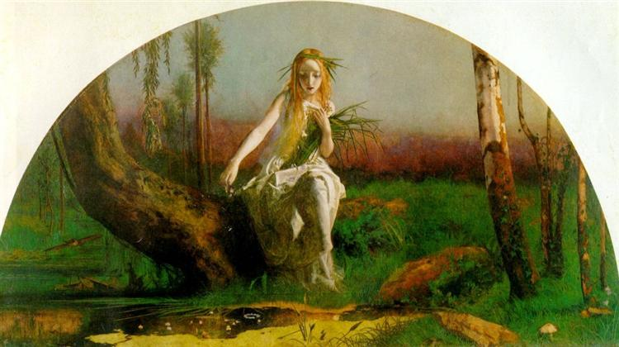
The painting caused some scandal, as Millais was one of the first artists to depict the actual death of Ophelia. Prior to this work she was typically shown in the lead-up to her death. Arthur Hughes actually completed and exhibited a less dramatic version of the event in the same year as Millais.
Millais’s ‘Ophelia’ would later be shown in Paris, to huge acclaim and inspire similar versions by Academic painters including Alexandre Cabanel. However these were more idealised and stylised, lacking the powerful depiction of death which would have stunned a Victorian audience. Millais and the Pre-Raphaelites were clearly more avant-garde in their treatment of such subjects.
Alexandre Cabanel, Ophelia, 1883
Arthur Hughes, Ophelia, 1852

Slide 5
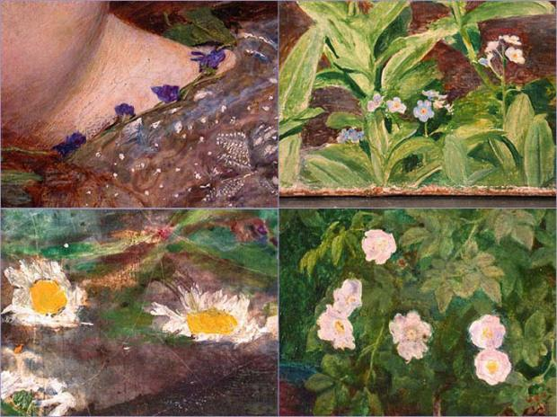
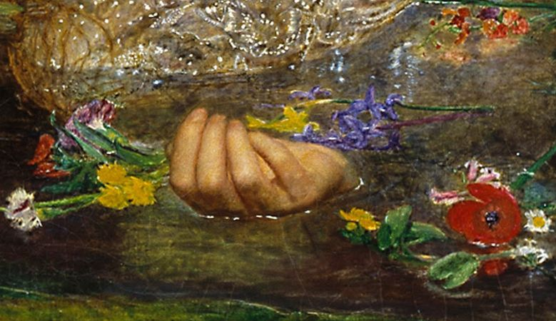
Ophelia’s death is not actually shown in Shakespeare’s play
but Queen Gertrude description of the event was used by
Millais.
There is a willow grows aslant a brook
That shows his hoar leaves in the glassy stream.
There with fantastic garlands did she come
Of crowflowers, nettles, daisies, and long purples-
Hamlet, Act IV, Scene VII, (Queen Gertrude’s speech)
Because Millais spent over 11 hours a day for five months working on the painting outdoors, the plants and flowers which appear in the work bloom at different times of the year.
Millais’s attention to botanical detail was deliberate as all these natural forms have symbolic value and help give an insight into the character/personality of Ophelia and aid the viewer in understanding the theme of the work.

Slide 6
There is a willow grows aslant a brook
That shows his hoar leaves in the glassy stream.
There with fantastic garlands did she come
Of crowflowers, nettles, daisies, and long purples
Weeping willow: sadness, forsaken love
hoar: greyish white colour
fantastic: unreal, extraordinary, strange
Shakespearean symbolism

Slide 7
crowflowers
nettles,
daisies
and long purples
Buttercups: ingratitude
Robin: “for bonny sweet robin is all my joy- Ophelia
Stinging, the pain of lost love, rejection
Innocence, purity
Orchids: sensuality
Shakespearean symbolism

Slide 8
Daisies
Violets: faithfulness
Poppies: death
Pansy: love in vain
Roses: youth, love, beauty
Buttercups
Dog Rose: pleasure and pain (of love)
Forget-me-nots: remembrance
The language of flowers in Victorian art and literature

Slide 9
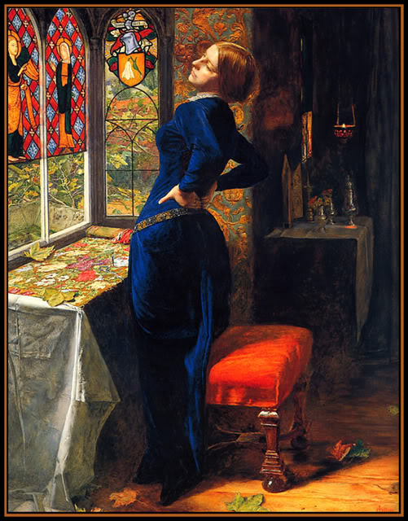
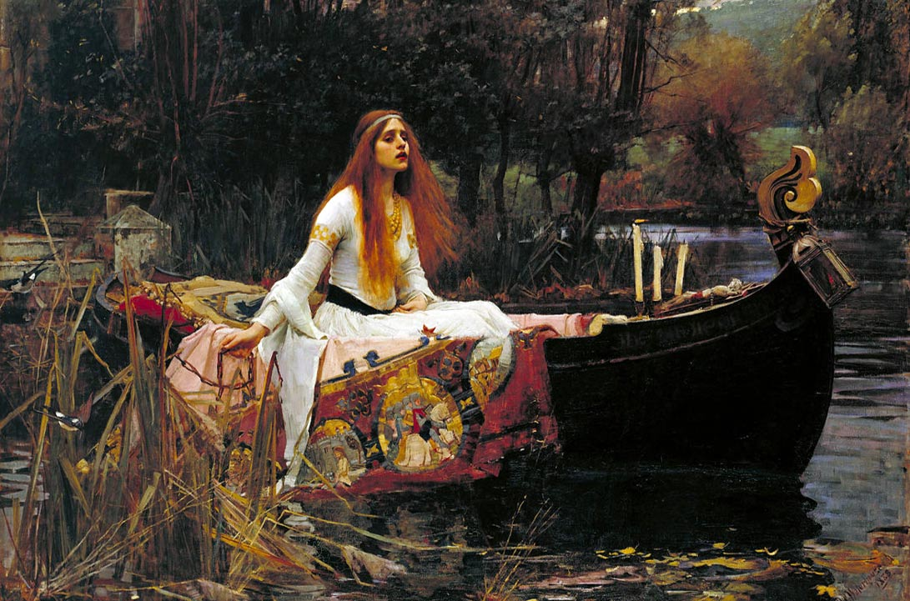
What makes this work Pre-Raphaelite in style
Detailed and accurate depiction of figure and setting.
Bright colours, clear forms and solid outlines.
Subject matter taken from literature and with a theme relating to the pain of love.
Symbolism used to convey a message.
Subject taken from a previous era but with an appeal for a
Victorian audience.
Unidealised forms such as weeds and rotting vegetation included- (rejecting not and selecting nothing).
Paint applied in a meticulous process to give a sense of realism to the work.
The subject deals with tragedy and doomed love- popular themes for the Pre-Raphaelites
Ophelia’s pose, in particular the placement of her arms and upturned hands resembles that of the crucified Christ, implying she is a martyr and shows the Pre-Raphaelites’ interest in Christian iconography.
Doomed or tragic women appear frequently in Pre-Raphaelite art. Discuss…..

