Slide 1
Class and Crime: Marxism and Neo-Marxism

Slide 2
Class and Crime
Newburn (2007) has noted that the sociology of crime and deviance has tended to focus on the crimes of the powerless rather than those of the powerful. This is largely because official statistics show that working-class people, particularly those with the least power for the lower class, are the main offenders.
(page 3 of booklet)

Slide 3
But…
Working class people are also the most likely to be victims of crime:

Slide 4
The relationship between class and crime
There is a clear relationship between crime and class, insofar as the majority of convicted offenders are drawn from the working classes. As might also be expected, there is a clear correlation between type of crime and social class. For example:
Crimes involving violence, theft from property, etc. are mainly associated with the working class.
Fraud, embezzlement and so forth are mainly middle class crimes.
Corporate crime (involving such things as insider trading, environmental crimes, market- rigging and the like) is mainly an upper class phenomenon.

Slide 5
Types of crime
What do we mean by:
Corporate crime
Occupational crime
White collar crime
(p.4 booklet)
Then read the rest of p.4 and answer the question in the box on p.5

Slide 6
Explaining class differences in crime
How would the theories we have already looked at explain class differences in crime?
Functionalism
Strain theory
Subcultural theory
Labelling theory
(p.5)

Slide 7
Marxism and labelling theory
How do Marxists agree with labelling theorists?
How do Marxists differ to labelling theorists?
(p.6)

Slide 8
Marxist explanations of crime and deviance

Slide 9
Focus on 4 main areas
Shaping/manipulation of basic values of society.
Process of law creation
Enforcement of law
Individual motivation for crime

Slide 10
Shaping/manipulation of basic values
Dominant economic class (those who own and control industry, commerce and finance) maintain control through influencing values of society.
Control is maintained through:
1. Socialisation
2. Threat

Slide 11
Shaping/manipulation of basic values
Socialisation
- involves agencies such as schools and media.
- promotes values such as “freedom”, “self-Interest”, “competition” and “property rights” (values which support the capitalist system)

Slide 12
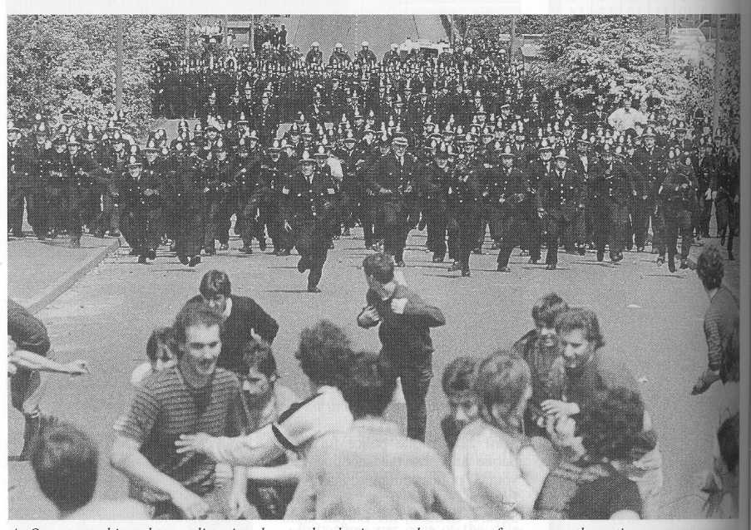
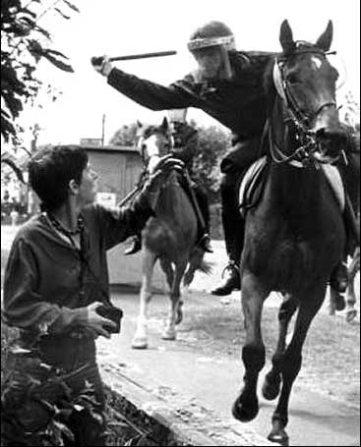
Shaping/manipulation of basic values
Threat – used to reinforce basic values when socialisation appears to have failed and capitalism seems threatened e.g. use of army/police to break General Strike in 1926, miners strike in 1984/5, inner city riots etc.
Althusser’s ideas of ISAs and RSAs are relevant here.

Slide 13
Shaping/manipulation of basic values
For Marxists, definitions of “criminal” reflect dominant capitalist values.
e.g. causing death in a street brawl is regarded as murder and likely to be punished by a custodial sentence, but death of factory workers due to employer negligence is only likely to attract a fine for the employer.

Slide 14
Shaping/manipulation of basic values
Another effect of the dominance of values by the dominant capitalist groups is that less powerful social groups (the young, the working class, ethnic minorities are more likely to be characterised as criminals by the capitalist media etc and therefore more likely to attract the attention of law enforcement agencies.

Slide 15
Law Creation
For Marxists the law is a reflection of the interests of the dominant capitalist class
Their economic and political power enables them to exert influence on the political and legal systems to pass laws which benefit them
But – Do all laws benefit only the ruling class?

Slide 16
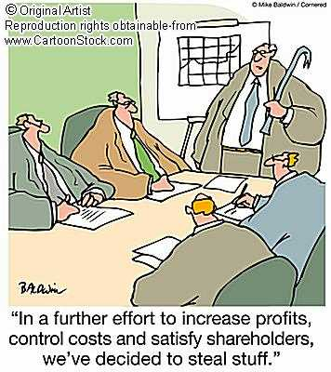
Law Enforcement
Marxists argue:
Certain types of crime are dealt with more rigorously than others. E.g. street crime is more likely to be pursued than white collar crime
Certain groups are more likely to be the focus of police attention (young, working class, ethnic minorities)
Certain types of crime are more likely to attract harsher sentencing. E.g. burglary or robbery are treated more seriously than financial swindles in the City.

Slide 17
Individual motivation for crime
Marxists see greed and self interest built into the very nature of capitalism. As a result great emphasis is placed on competition and the acquisition of wealth. It is therefore not surprising that those who have less chance of acquiring wealth legitimately turn to crime.
Capitalism is therefore Criminogenic
David Gordon
Notes:
(Note the similarity to Merton here)

Slide 18
Summary
Traditional Marxism offers a critique of functionalist accounts of crime and deviance
It points to the problems created by the inherent assumptions of Durkheim or Merton or traditional subcultural theories about the inherent status frustration and therefore criminality of the lower classes

Slide 19
Problems
Traditional Marxism seems to simply offer an inverted version of structural functionalism rather than a genuinely alternative point of view
It shares the problem of failing to offer genuine and meaningful policy options other than REVOLUTION
It neglects the processes by which laws are made, deviants labelled etc – the MICRO view
Does it let the poorer members of society “off the hook”? Any resistance to capitalism seen as good? Heroic??
And is it malestream? Lacks a clear take on sex/gender issues

Slide 20
HWK
Complete p.7-10.
Make some notes from the textbook (p.88-89): criminogenic capitalism – David Gordon; Chambliss; Snider; Pearce; and evaluation.
For the first Tuesday back.

Slide 21
Neo-Marxist approaches

Slide 22
Radical Criminology
Originated in Britain
Early 1970's
Mainly through the work of Paul Taylor, Ian Walton and Jock Young ("The New Criminology", 1973; "Critical Criminology", 1975 .
This book is found on Google e-books.

Slide 23
Radical Criminology
Marxist concepts
(social structure, economic exploitation, alienation)
MARXIST THEORY OF POWER
Interactionist concepts
(social reaction, primary and secondary deviation)
LABELLING THEORY
+

Slide 24
Critical Criminology
To understand both criminal and non-criminal behaviour:
We have to understand the social framework within which laws are created and applied by and to various groups in society.

Slide 25
Laws
"Laws" are not "neutral" expressions of social relationships.
They are created and applied in capitalist societies for two main reasons:
What do you think these are?

Slide 26
Laws
To protect certain property rights (laws governing theft, contract rights, etc.).
To maintain a form of social order that is conducive to the continued economic exploitation of the working class by the ruling class (various "public order" offences -violence, picketing, political activity and so forth).

Slide 27
Deviants:
Are “passive victims" of a labelling process.
It involves a level of choice on the part of the deviant (primary deviance).
BUT in terms of secondary deviation, the social reaction is conditioned by the ability of powerful groups to proscribe ("make unlawful") and prosecute various forms of deviance.
A Marxist take on whose theory?

Slide 28
A "fully social" theory of deviance involves consideration of the following:
a. The wider origins of a deviant act.
b. The immediate origins of a deviant act.
c. The act itself.
d. The immediate origins of a social reaction.
e. The wider origins of a deviant reaction.
f. The effects of labelling.
g. The nature of the deviant process as a whole.
(see p.11)
Notes:
Pg 420

Slide 29
Activity:
Try applying this framework to the case study on the 2011 England riots (sources in the booklet).
Write your answers down on page 12 of your workbook.
Read the article about the riots and complete p.13

Slide 30
Evaluation of Neo-Marxism
What issues are there with the neo-Marxist approach to studying crime and deviance?

Slide 31
CORPORATE CRIME

Slide 32
Definition of Corporate Crime
‘A crime committed by a person of respectability and high social status in the course of his occupation’ Sutherland, (1949).
Marxists note that although all classes commit crime, the law is selectively enforced to that higher-class and corporate offenders are less likely to be prosecuted than working-class offenders.

Slide 33
Activities
Read pp.91-94 of Webb, mark on the activity on p.19-20 the statements that are true and those that are false. Correct the statements that are incorrect. Then match up the key words on p.21.

Slide 34
Activities
Sociologists have put forward a number of explanations for white collar and corporate crime. Make a summary of these from p.93-94 of the Webb textbook on p.22 of your booklet (p.22/23 has some other sources to help you complete this).
Strain
Differential Association
Labelling
Marxism

Slide 35
Examples of Corporate Crime
Using the sources on p.22/23 of your booklet find an example of a corporate crime.
How does this crime indicate the points made by different theories?
Does it contradict any of their points?

Slide 36
Exam Question
Item: Some sociologists focus on the ‘crimes of the powerful’. Crimes committed in the interests of businesses and other large institutions can be far more harmful and costly than street crimes that we tend to think of as ‘real crime’. Corporate crime can involve breaking criminal laws but may also include breaking other kinds of law. Some sociologists argue that corporate crime results from pressures to succeed, leading to employees pursuing business aims by illegitimate means. However, others claim that it is the product of capitalism.
Applying material from the Item and you knowledge, evaluate sociological explanations of corporate crime [30 marks]

