Slide 1
Preparing for the cat

Slide 2
Do Not believe what you read
You will need to set aside about 3/4 weeks to prepare for the CAT.
Although it is an “aptitude” test, you can get better and faster with practice.

Slide 3
Key Dates
Registration opens 01 May 2015
Testing begins 01 July 2015
Registration Closes 22 September 2015
Bursary & Exemption deadline
UKCATSEN (Special Educational Needs)
22 September
Booking/Rescheduling Closes 05 October 2015
Last testing date 06 October 2015

Slide 4
For candidates sitting the examination in summer 2014, the UKCAT will consist of:
Verbal reasoning - assesses ability to critically evaluate information that is presented in a written form.
Quantitative reasoning - assesses ability to critically evaluate information presented in a numerical form.
Abstract reasoning - assesses the use of convergent and divergent thinking to infer relationships from information.
Decision analysis - assesses the ability to make sound decisions and judgements using complex information.
Situational judgement - measures capacity to understand real world situations and to identify critical factors and appropriate behaviour in dealing with them.

Slide 5
Abstract Reasoning Items
There are 4 different item types in the UKCAT test. You may see one or two of these item types:
For type 1, you will be presented with two sets of shapes labelled “Set A” and “Set B”. You will be given a test shape and asked to decide whether the test shape belongs to Set A, Set B, or Neither.
For type 2, you will be presented with a series of shapes. You will be asked to select the next shape in the series.
For type 3, you will be presented with a statement, involving a group of shapes. You will be asked to determine which shape completes the statement.
For type 4, you will be presented with two sets of shapes labelled “Set A” and “Set B”. You will be asked to select which of the four response options belongs to Set A or Set B.

Slide 6
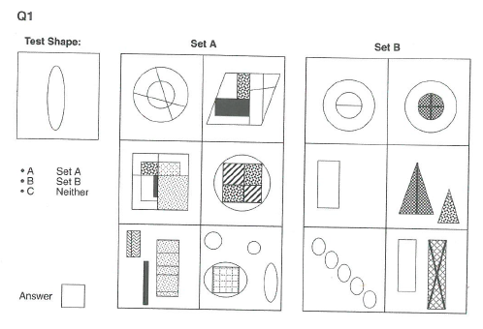

Slide 7
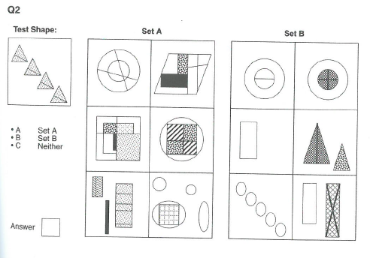

Slide 8
http://www.amazon.co.uk/s/ref=nb_sb_ss_i_2_5/279-1834271-1993369?url=search-alias%3Daps&field-keywords=ukcat%20books&sprefix=ukcat%2Caps%2C163
http://www.ukcat.ac.uk/
http://www.ukcat.ac.uk/App_Media/uploads/pdf/2014%20Preliminary%20Mean%20Scores%20140814.pdf

