Slide 1
I have read The Periodic Table by Primo Levi. The problems described in the book interested me a lot and made me want to tackle these sorts of problems. For example he describes being given a small sample of a number of compounds, and being asked to use his own knowledge to perform analytical tests to discover all the different atoms present in the sample. This seemed fascinating to me. I have also read The Disappearing Spoon by Sam Kean, which showed me that chemistry could be more interesting and complex than the GCSE syllabus I was currently studying. It made me keen to take chemistry further and learn a more in depth and complete picture of what is really occurring in chemistry.

Slide 2
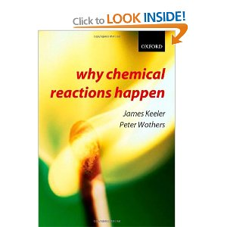
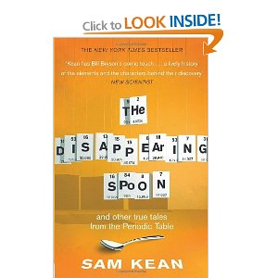
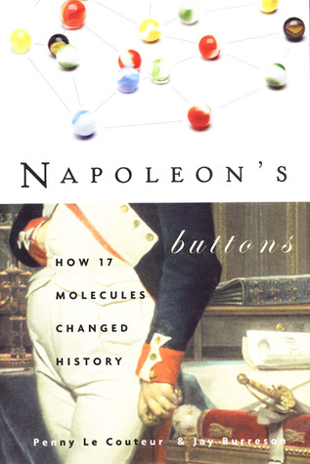

Slide 3
My experience and knowledge of Physics is being further enriched by the opportunity of pursuing an extended project at my college. Inspired again by Jim Al-Khalili’s talk, it is entitled “Is there anything left to discover?” This is a perfect chance for me to do some in depth work and research into this idea which I find tremendously enjoyable. I am reading several books, my favourite being ‘Physics of the Impossible’ by Michio Kaku

Slide 4
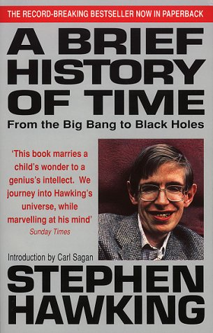
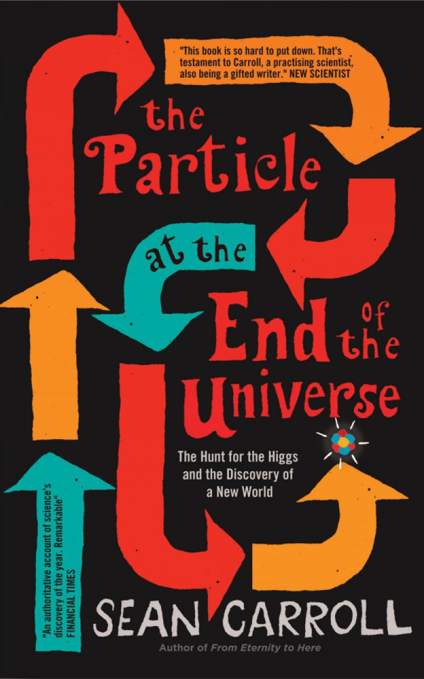
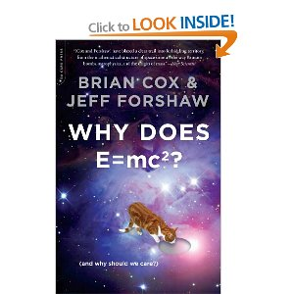

Slide 5
Further, my early fascination with nature later spurred research at local university lectures (e.g. Gaia vs. Goldilocks), as well as in science journals, blogs and magazines. The sheer depth and breadth of knowledge, ideas and debate shared by scientists, from nanoscale protein interactions to DNA sequences conserved over millennia, has been inspirational.

Slide 6
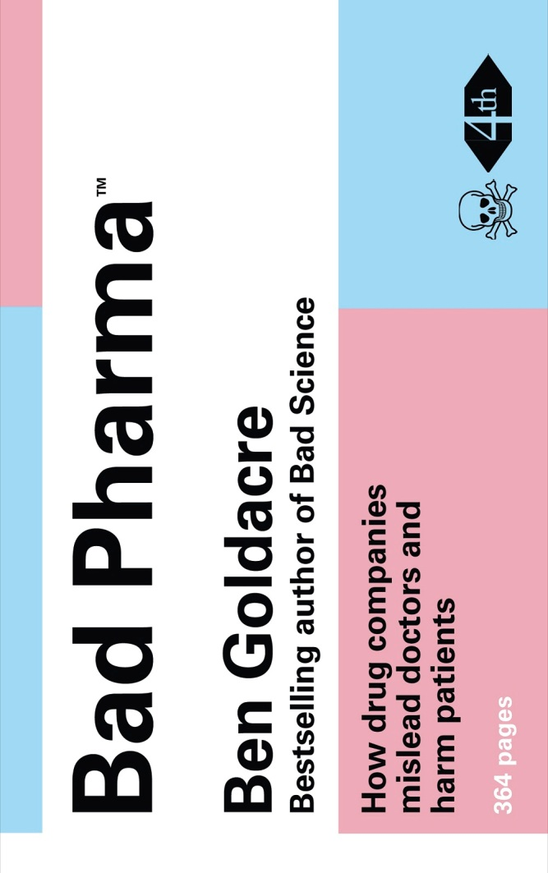
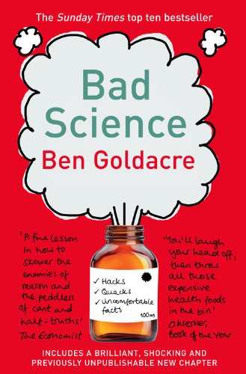

Slide 7
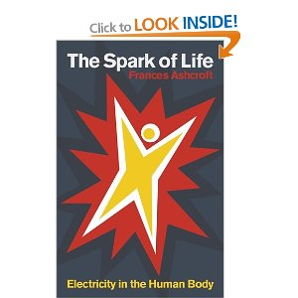
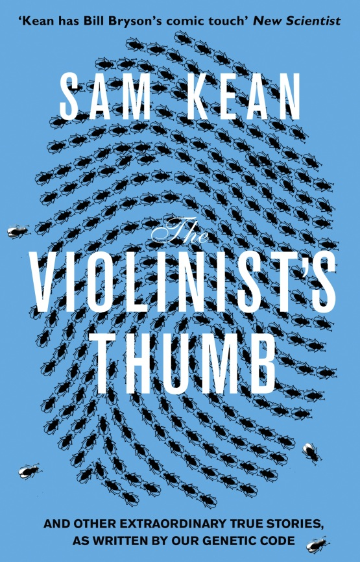
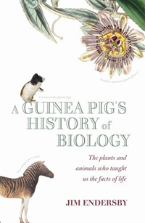

Slide 8
In Our time
http://www.bbc.co.uk/programmes/b006qykl
Inside the ethics committee
http://www.bbc.co.uk/programmes/b007xbtd
Infinite monkey cage
http://www.bbc.co.uk/programmes/b00snr0w
Material World
http://www.bbc.co.uk/programmes/b006qyyb
The Life scientific
http://www.bbc.co.uk/programmes/b015sqc7

