Slide 1
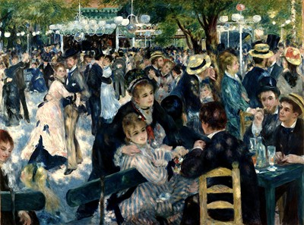
Impressionism Recap Quiz!!!
In which country did Impressionism originate?
Which style preceded Impressionism?
Name three Impressionist artists from this period….
What was the name of the venue where artists showed their work every year?
What is the term used to describe painting outdoors?
Which style/type of painting were the Impressionists trying to break away from or reject?
Name one thing that the Impressionists were interested in depicting in their work
What term do we use to describe something that is ahead of its time?
Name one characteristic of Impressionist painting
Name one technical advancement of this period which the Impressionists would use
Which non-European art form influenced artists of this period?
What is the correct title of this painting?

