Slide 1
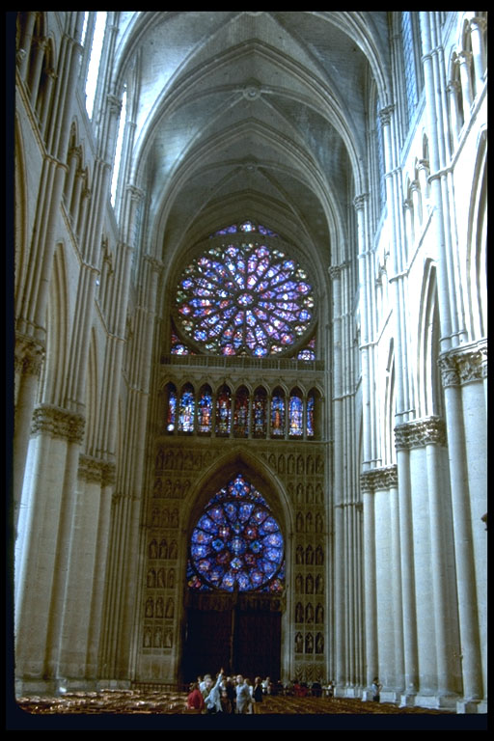
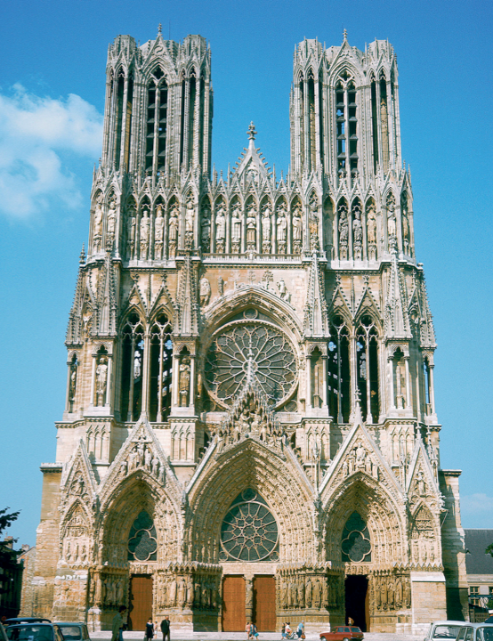
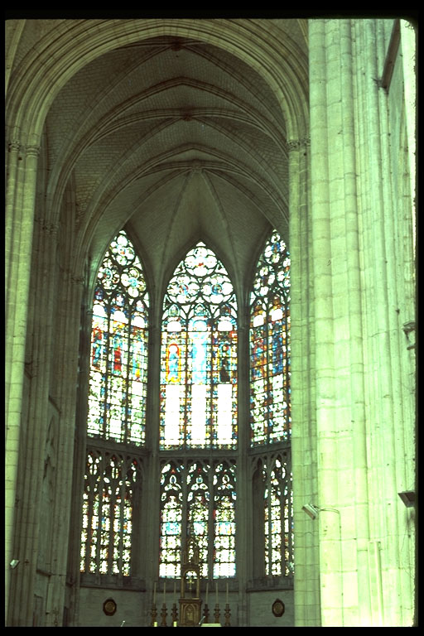
Gothic architecture

Slide 2
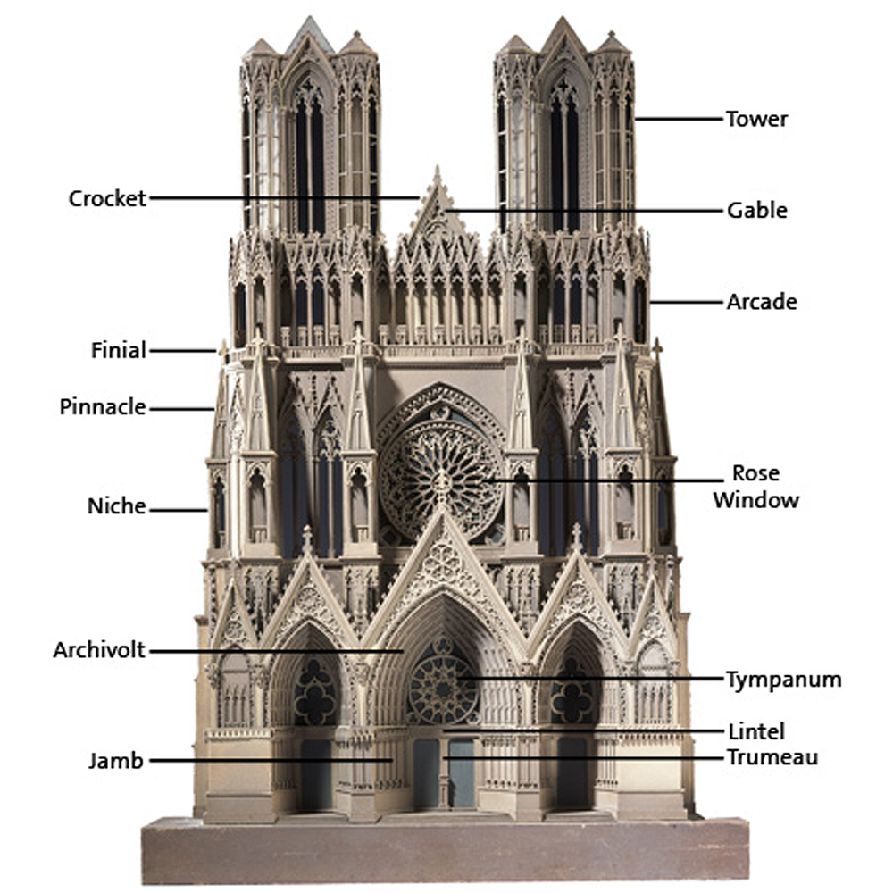
How many parts can you label?

Slide 4
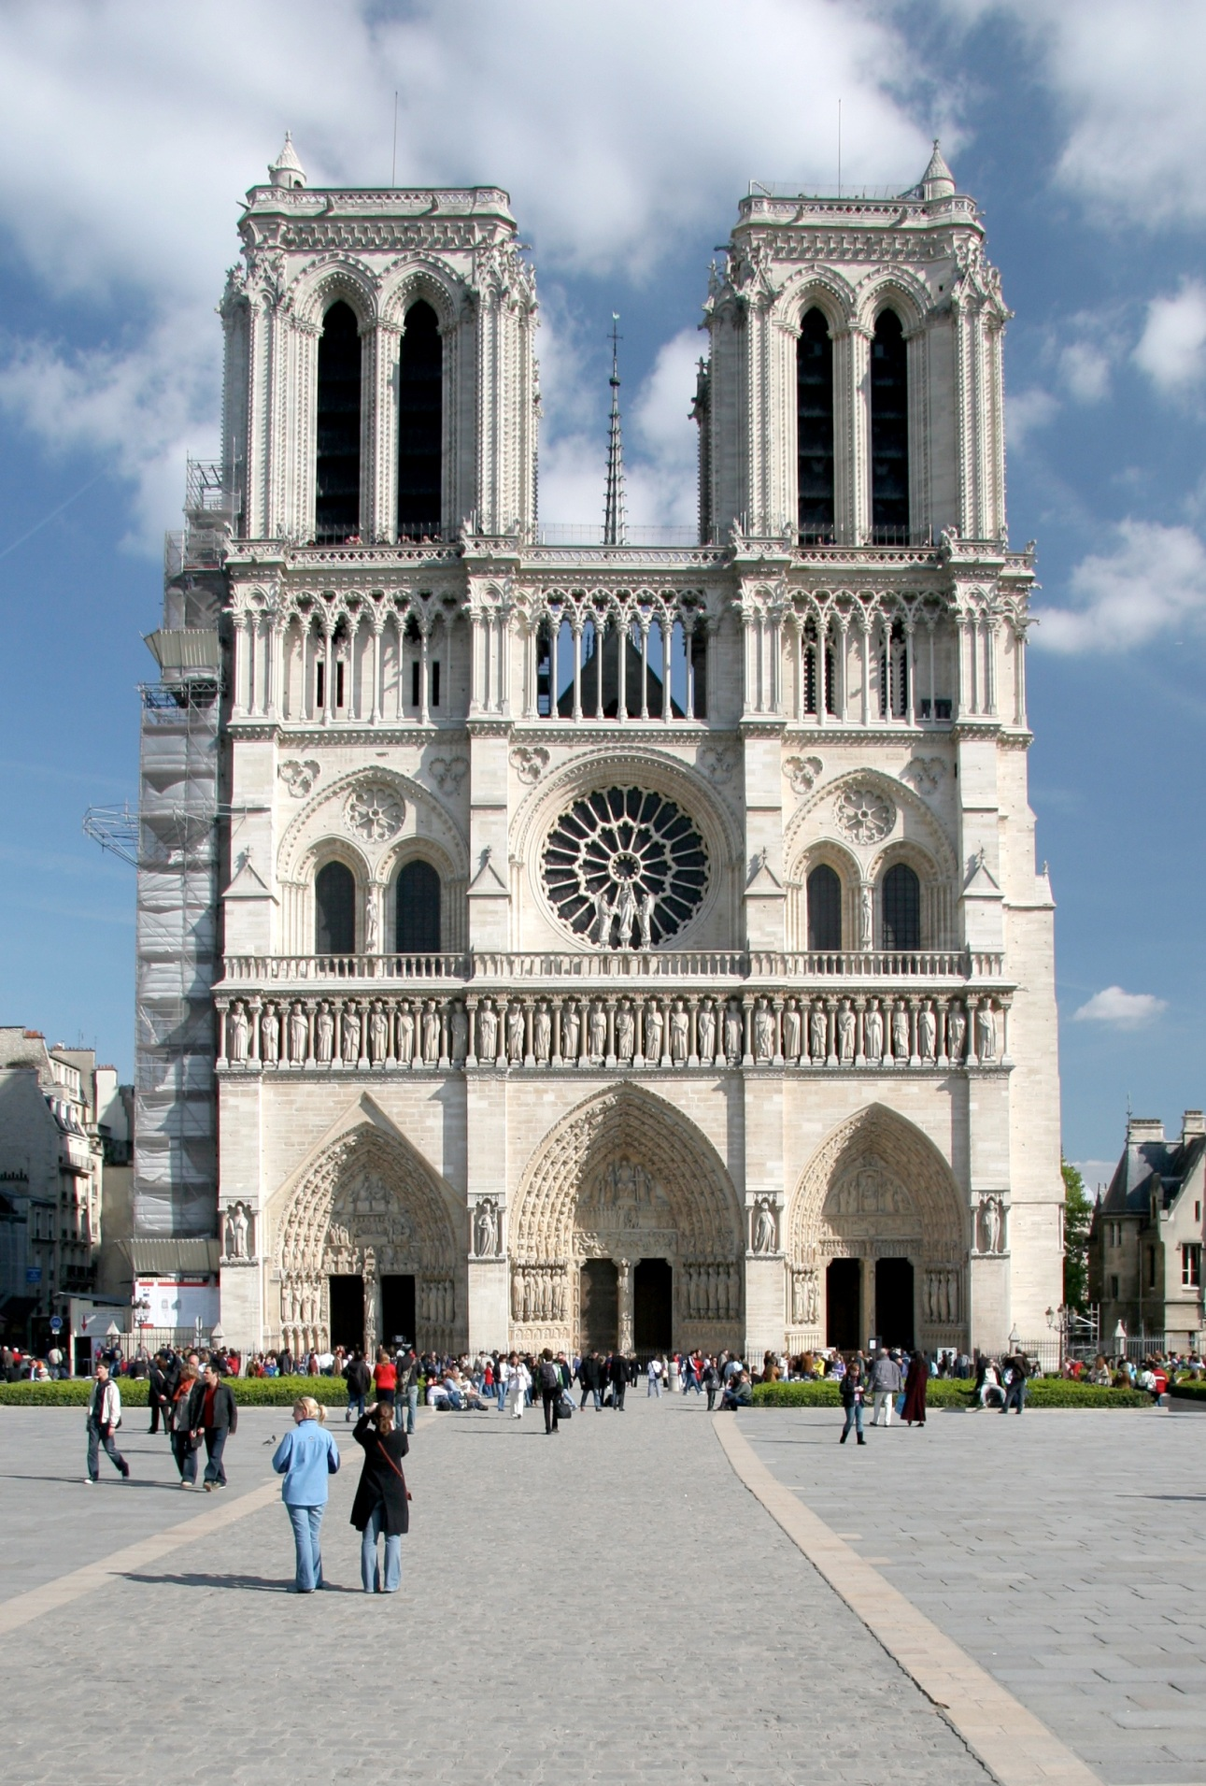
Can you draw the floor plan from what you see?

Slide 5
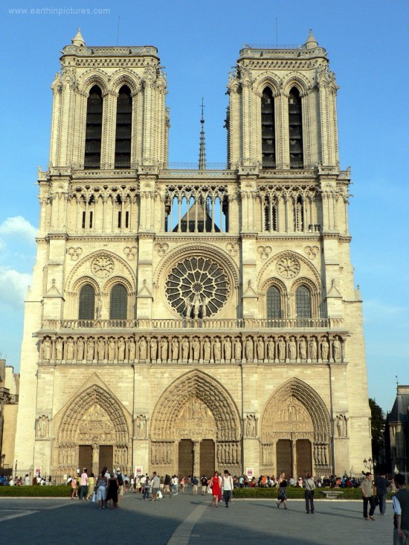

Slide 6
What is the overall effect of a gothic cathedral?

Slide 7
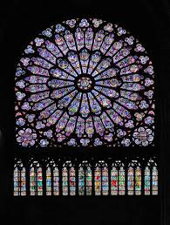
Notre Dame of Paris

Slide 8
What is a cathedral?
A cathedral is a church containing a cathedra (chair or seat of bishop) and so the principal church of a diocese.

Slide 9
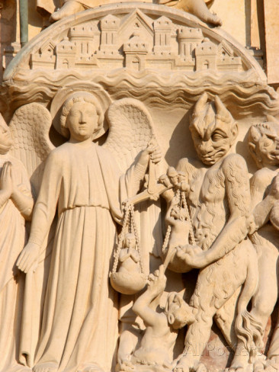
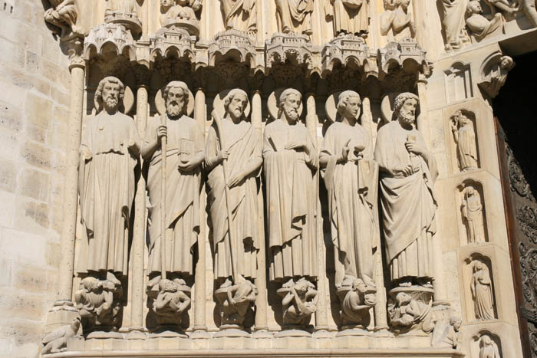
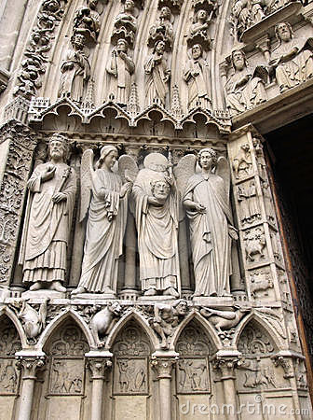
Form - Sculpture

Slide 10
Cathedrals - Functions
All Medieval cathedrals shared similar functions both religious and social
To provide large and different spaces in which people can worship
To symbolise the heavenly city of God where the saved will find eternal life
To represent the power and prestige of the Church
To mystify and impress the ordinary people who were the worshippers.
To illustrate stories from the Bible and Christian theology

Slide 11
https://www.youtube.com/watch?v=O61ng_QqC4I - intro

Slide 12
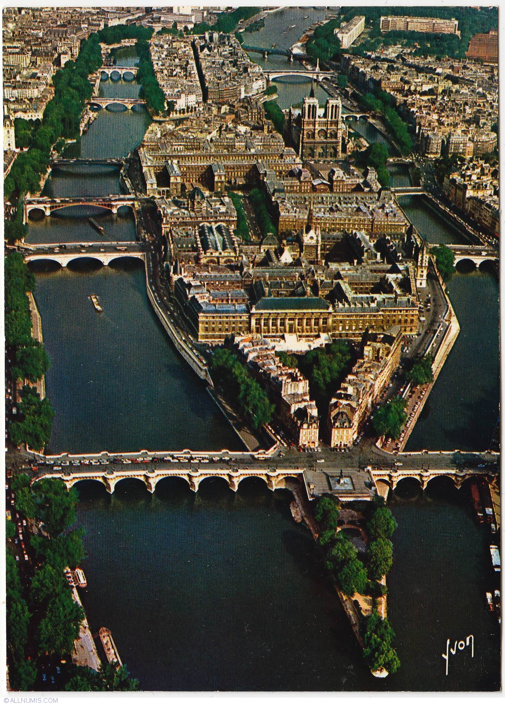
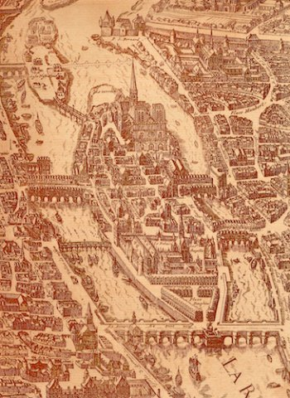

Slide 13
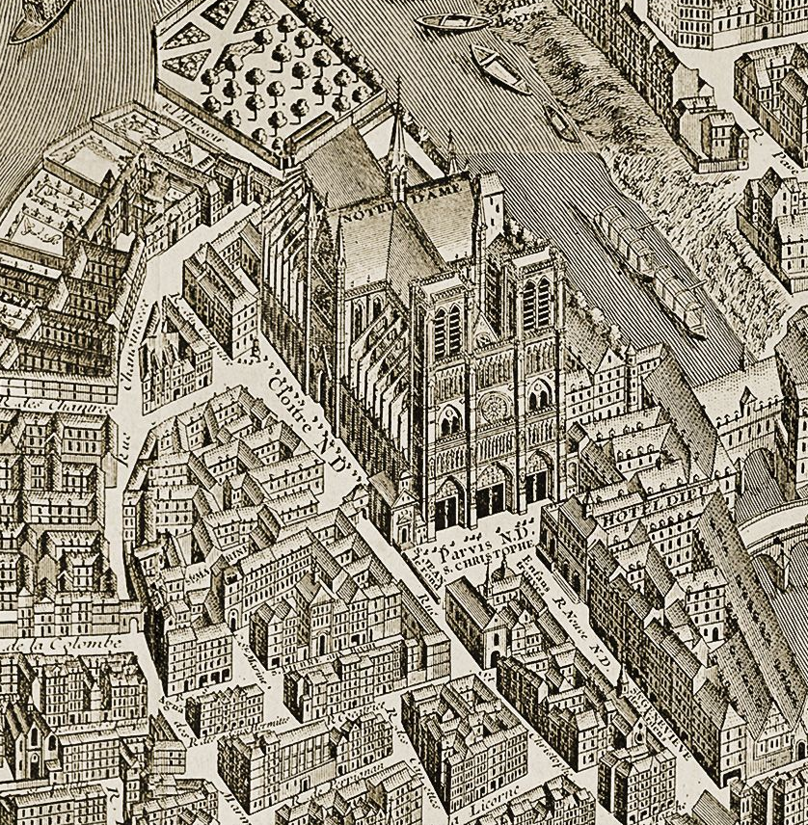
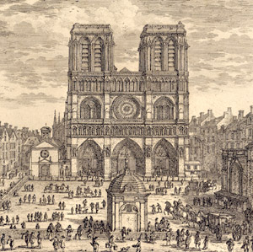

Slide 14
On the “Île de la Cité”
The Île de la Cité is formed by two meanders of the Seine.
the cradle of ‘Paris’
birthplace of Roman river commerce.
site is an imperial and administrative residence and remain a royal residence until the Louvre was built.

Slide 15
Layout

Slide 16
What is the ‘style’ of Notre Dame?
Ideals/ideas?
what they were trying to achieve
Characteristics ?
Symmetrical / asymmetrical, simple/elaborate, geometric, formal, rational, powerful, decorative, , heavy…etc
Formal features?
composition, scale, depth, colour, material, decoration?

Slide 17
Group work
Collate image sheets for the cathedral: façade, plan, interior & at least 3 detail shots for close analysis.
2. Create a key fact box:
Architects
Dates
Location
size (scale)
Dimensions
Materials
style ‘label’.

Slide 18
Dimensions of Notre Dame
Impressive dimensions : 41 m wide 43 m high up to the base of the towers 63 m up to the top of the towers
nearly 110 feet in height
402 feet in length
and its dimensions were larger than any Gothic church built prior to it.

Slide 19
Group work
Advanced technology? (Innovations? machinery?)
Background France and Paris?
Background of the cathedral? (its history)
Construction of the cathedral? (Development?)
Maurice de Scully?
Sculptures on the cathedral?
Materials? (Stone? Wood? …)
Importance of ND de Paris? (Events throughout history? Relics?...)
Development of Gothic Style and ND’s place in Gothic?

Slide 20
Form of façade

Slide 21
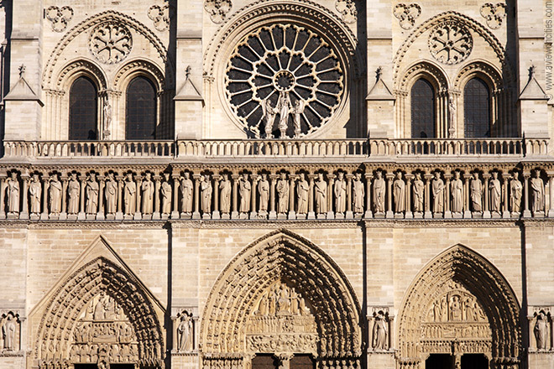

Slide 22
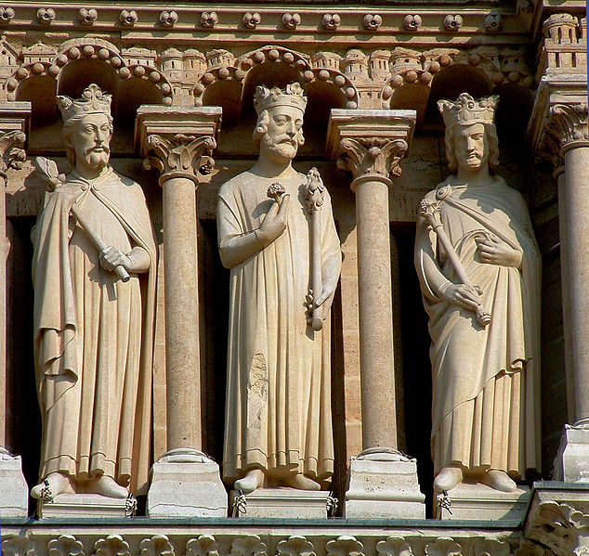

Slide 23
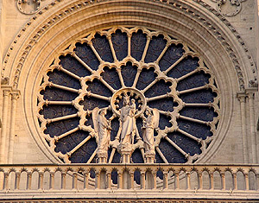
Rose window

Slide 24
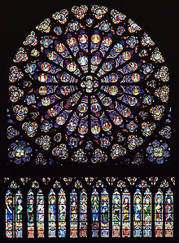
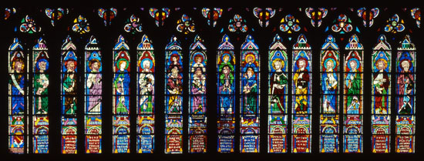
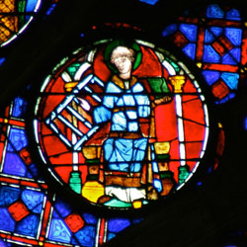
was gift from king Saint Louis.
constructed in 1260
reached 12.90 metres in diameter
height of nearly 19m including its bay
It has eighty-four panes divided into four circles

Slide 25
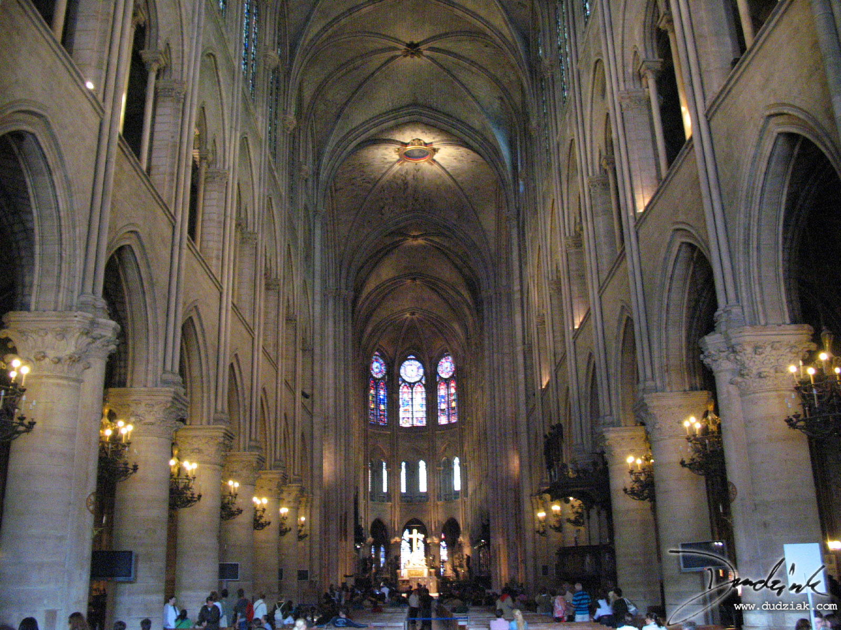

Slide 26
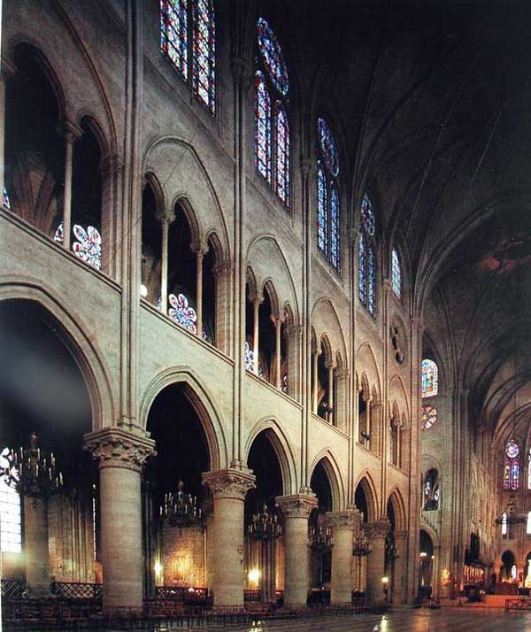
Form - Interior
Large interior
very large nave with large amounts of stained glass
Three storey elevation with arcades, triforium and clerestory

Slide 27
Form - Sculpture

Slide 28
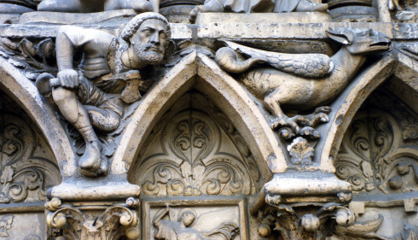
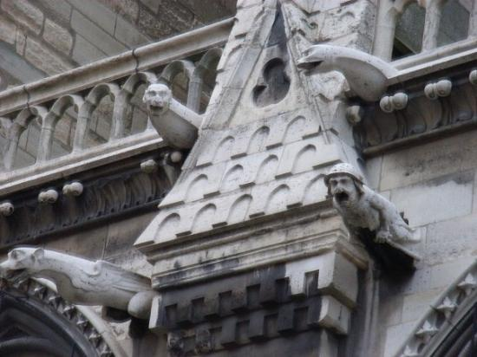

Slide 29
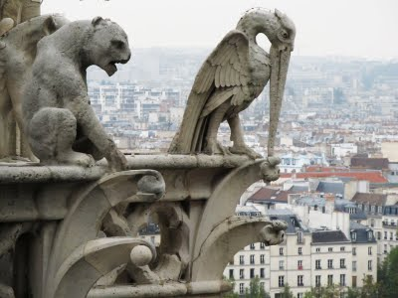
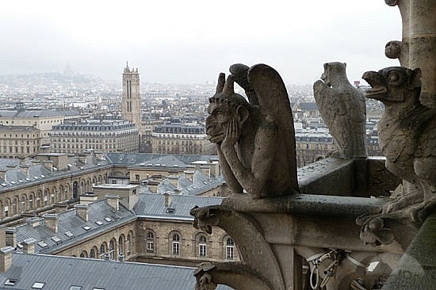
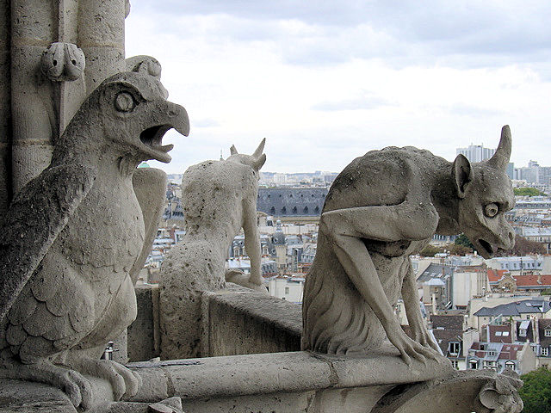

Slide 30
Brief historical context
Period of great demographic expansion and economic dynamism and was affirming its status in the kingdom of France as:
the political capital of the Capetian kings
(increasing power of the king of France)
an economic centre, as a craftsmen’s and merchant’s village developed on the bank of the river Seine
a major intellectual and teaching centre: international influence of the cathedral school.
Increased importance of monks of cult of St Denis - synonymous with Parisian identity.

Slide 31
Maurice de Sully was bishop of Paris from 1160 to 1196.
Wanted to rebuild a cathedral church dedicated to the Virgin Mary (Notre-Dame) and making it a bishop’s church, a canon church and a baptistery.
The intention to construct the tallest cathedral in the world can be traced to the foundation, which the builders prepared with 30 foot deep footings of precisely cut hard stone.

Slide 32
Maurice de Sully had the political power and resources to build the cathedral of such sheer size.
Notre Dame had access to tax money, and controlled more than half the land on the Ile-de-la-Cité.
Notre Dame was intended to tower above the low roofs of medieval Paris with the cross shape clearly visible.

Slide 33
This project was the focal point of an enormous urban construction site:
demolition of the former church
creation of a square, or parvis which would serve as an intermediary space between the secular world and the sacred world: an area for catechism and learning through the portal sculptures;
opening of the Rue Neuve:
a wide street that would give a large population easy access to the cathedral;
it would be stage to major processions over the centuries
to make possible the transport ofconstruction materials.

Slide 34
Maurice of Sully and his influence
Amazed by other constructions in the new style like Saint Denis of cathedrals of Sens, Noyon, Laon.
Maurice de Sully decided to give the capital a cathedral worthy of France’s largest city.
Friend & confident of King Louis VII who encourages and supports his projet.
Collaboration of many : King Louis VII, the Church, notable residents of the city, and the entire population participated in construction: some offered money, others offered their labour, while others offered their knowledge.

Slide 35
Background
Notre-Dame’s first stone laid in 1163 in the presence of Pope Alexander III.
gothic style already seen in a few building :
in 1140 with the dedication of the Abbey of Saint-Denis built by Abbé Suger;
in 1150: Noyon; in 1153: Senlis; in 1160: Laon, Sens.

Slide 36
Four major construction campaigns
Led by builders: Jean de Chelles, Pierre de Montreuil, Pierre de Chelles, Jean Ravy, Jean le Bouteiller.
1163-1182 : construction of the choir and double deambulatory. (first builder)
1182-1190 : construction of the last three bays in the nave, the side aisles and the tribunes. (second builder).
1190-1225 : edification of the façade and the first two bays in the nave (third builder).
1225-1250 : upper gallery and two towers on the façade (fourth builder).

Slide 37
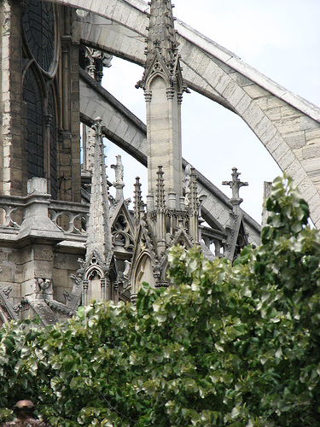
‘Technology
and
engineering’

Slide 38
Notre Dame’s architectural advances
How were cathedrals built?
http://www.youtube.com/watch?v=24N94rZ7XtU – from 12’30 min to 35 minutes

Slide 39
Materials: Stone
Notre-Dame was built from stone called cliquart
so were the other medieval churches of Paris, as well as the Louvre for instance.
This stone, was taken out on the Left Bank of the river Seine.
Qualities: creamy color and easy to work with and that it hardens in the air.

Slide 40
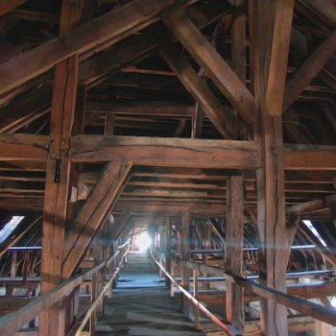
Wood structure
Notre-Dame de Paris’s structure is one of the oldest in Paris
The structure is made from oak. Its dimensions are very impressive: 120 m long, 13 m wide at the nave, 40 m in the transept and 10 m high.

Slide 41
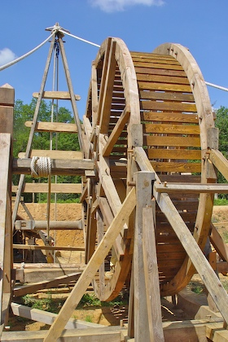
Techniques
wheelbarrow
Cranes
Winches
steeple jacks—a type of human hamster wheel -to raise material up for construction.

Slide 42
What was the role of Notre Dame in forming the urban identity of what was becoming a "capital" city, seat of the kings of France and the most populous centre in northern Europe?
Nationality?

Slide 43
Gothic architecture
The style of architecture we now call Gothic first emerged in Île-de-France (the region around Paris), around 1140.
It evolved during the construction of great churches in the Paris region in a move towards greater height, light and volume.
and was initially called « Francigenum Opus » (or opus modernum meaning “French work”

Slide 46
Gallery of Kings
These painted statues were added to the cathedral in the first third of the 13th century and quickly became familiar representations of the kings of France.
From 1284 onwards, they were presented in this way. And this tradition would be perpetuated throughout the centuries.
This is why, during the troubled time of the Revolution, these statues would be attacked and mutilated as symbols of royal despotism.

Slide 47
Since it was built, the cathedral has been one of the main symbols of Paris and of France:
It has been stage to major religious and political events
Parisians watched over body of King Saint Louis
King Philip the Fair opened the first Estates General of the Kingdom of France in 1302;
in 1572, King Henry IV married Marguerite de Valois, and where he converted to Catholicism in 1594;
it is where Pope Pius VII crowned Napoleon I Emperor of the French in 1804;
it was also at Notre-Dame that the Te Deum was sung at the end of the First and Second World Wars

Slide 48
Other videos
http://www.youtube.com/watch?v=pFv_xsns-EI from 2’44 Episode 4 : the age of Gothic
4’ Background
http://www.youtube.com/watch?v=0v_nD15Tll0 construction

