Slide 1
Biotechnology

Slide 2
Artificial Selection
https://www.youtube.com/watch?v=IDN-QeVhQTc

Slide 3
Recent techniques
Knocking out genes to see what they do
Duplicating genes
Inserting recombinant DNA
Synthetic organisms

Slide 4
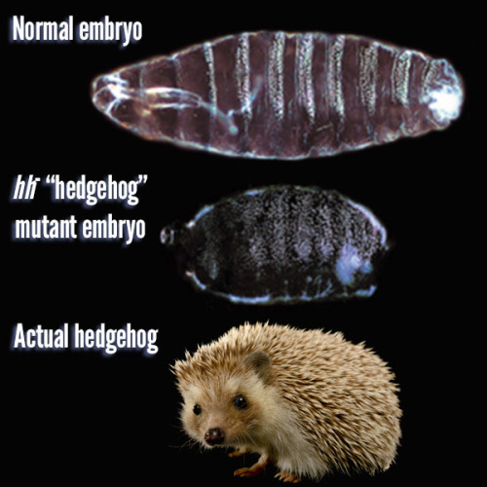
Knocking out genes to see what they do
http://io9.com/the-strange-history-of-how-a-gene-was-named-sonic-hedg-1691732678
http://www.theguardian.com/science/2011/oct/26/sonic-hedgehog-gene

Slide 5
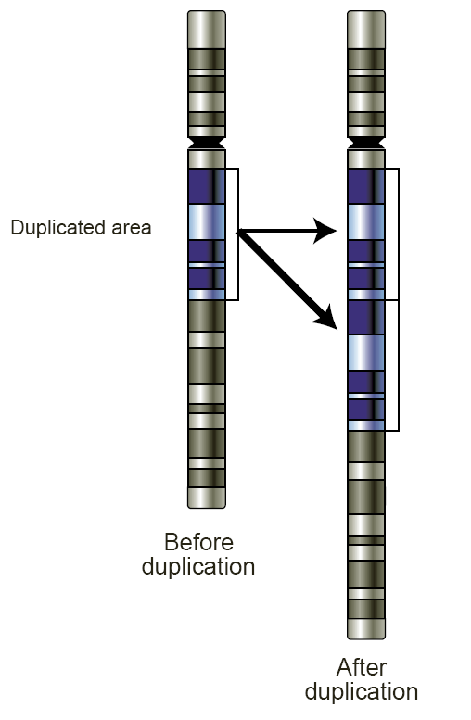
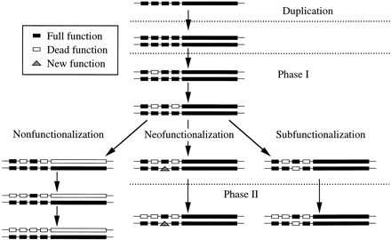
Duplicating genes

Slide 6
Recombinant DNA
Recombinant DNA (rDNA) molecules are DNA molecules formed by laboratory methods of genetic recombination (such as molecular cloning) to bring together genetic material from multiple sources, creating sequences that would not otherwise be found in the genome.

Slide 7
Recombinant DNA
https://www.youtube.com/watch?hl=en-GB&v=x2jUMG2E-ic&gl=GB
SPIDERGOATS!
https://www.youtube.com/watch?v=yvEhfDEFusM
https://www.youtube.com/watch?v=B0zT9CN3-50

Slide 8
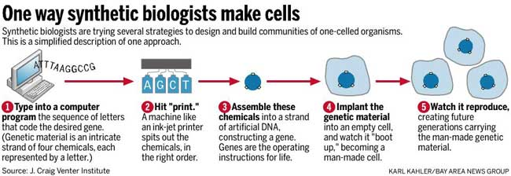
Synthetic Organisms
http://biobuilder.org/teacher-resources/

Slide 9
And finally…..epigenetics
https://www.youtube.com/watch?v=qklq33KsQVI
https://www.youtube.com/watch?v=67VVkKB9hxs

