Slide 1
GRAPHICS
PROJECT
GUIDE
3 week short Independent Project

Slide 3
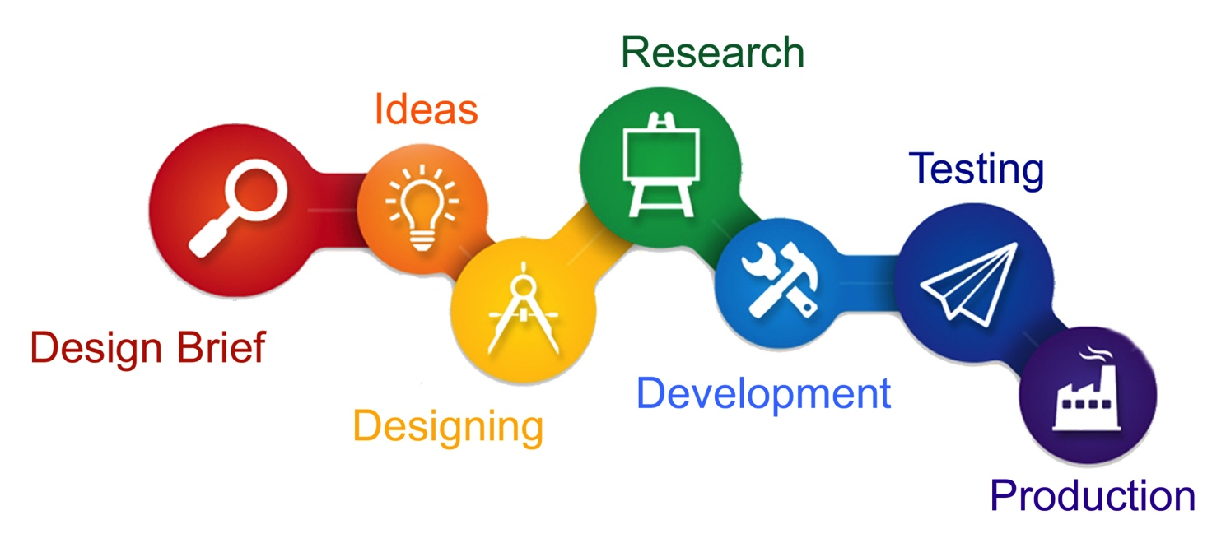
A. Select one theme/topic/question.
The starting points are themes/questions from which you will select one topic to use for your project. You will then develop a range of designs based on your own research (the designers’ work you like, copies of their techniques and your own versions, analysis of existing design solutions, your own experiments and explorations).
These are the key stages:
Select one question/theme and create an introduction to this topic
Initial research (analysed research + notes)
A minimum of 2 designer studies to consist of explorations and analysis through ‘copies’ and your own versions
Create your Design Brief (and Specification written)
Your own ideas explored and developed. Create and complete your design solution(s).
Evaluate and reflect.

Slide 4
B. Design Brief + Analysed Research = 1 or 2 sides
At the beginning of the project you must produce your own Design Brief in relation to your chosen theme/topic. Create a 1st draft and final edit of your Design Brief. A strong, focused and creative design brief will help your project to develop successfully. Small tweaks can be made later.
There are a couple of main reasons why any graphic design project needs a detailed design brief: It spells out exactly what clients want to achieve. And it acts as a point of reference for you, your teachers and A-Level examiners. Use the headings below to outline the purpose of your Self-directed project. If a heading is not relevant to your project you can skip it.
Corporate profile: A summary of the client/business and a brief history will help.
Market position: A realistic evaluation of the company’s service/product relative to what competitors are doing.
Target Market: A description of your intended consumers/audience (demographic). Include age, gender, income, employment, geography, lifestyle of those the client wants to reach.
Current situation: An explanation of what’s happening to bring about the need for this project e.g., a new product launch.
Communication background: Previous and present communication activity, such as research, advertising, direct mail, graphic design, public relations, etc.
Communication task: What’s the intended message? Where possible, include information to be shown in the designed item e.g. taglines, body text, imagery, etc.
Objectives: What does the client want to achieve? Where possible, make the objectives specific and the results measurable, e.g. increase sales, raise awareness, appeal to a new market etc.

Slide 5
C. Designer Studies
This section consists of Research, exploring designers’ styles/techniques, copying their own and creating your own versions in the style of designers.
For the 3 week short project you must produce a minimum of 2 designer/artist studies. At least 1x A3 page for each designer/artist. You are allowed to produce more than 2 designer/artist studies.
Remember each designer study should include:
Research of the designer/analysis of artwork (presented as a tab/flap)
At least 1x copy of designer’s work
Your own versions related to your theme, in the same style of the designer
Please use varied mediums and techniques, digital, off-screen, combination of digital and off-screen techniques. Include annotations and step-by-step process.
REFLECTION*

Slide 6
D. Generate your Initial ideas/designs + initial developments
= x4 A3 sides minimum These designs should consist of small thumbnails drawings + small and medium sized designs.
Develop your initial designs for your chosen theme/topic.
You have already produced at least 2x designer/artist studies. Within each study you have created your own versions in the style of the designers. These designs should have been related to your chosen theme. Your initial developments should include both typography and pictorial (images/illustration).
You are to choose your strongest designs from your own versions and develop these designs using a range of mediums/techniques. Don’t forget to keep referencing your designer’s work!
Your developments must be a combination of digital, off-screen, and a combination of both. Work on different pre-prepared surfaces. Refer back to your research for inspiration and add to your research.
Remember, in your previous projects you have used lots of off-screen techniques, revisit some of these for this project and explore new ones.
Suggestions of pages for this section (remember to use flaps/tabs/concertinas/overlays to strengthen the journey of design):
Typography exploration = 1-2 sides to begin with (include both digital and off-screen exploration)
Logo design development = 1-2 sides (reference the styles of your chosen designers, explore trends, create variations etc.)
Pictorial/images development = 2 sides (include hand drawn designs; sketches and doodles, include notes and annotations; digital versions of your drawings – keep referencing the styles of your chosen designers!)
Is Photography relevant to your project = dedicate a 1-2 sides or flaps/tabs/concertinas/overlays of your photography (include contact sheets; notes, annotations; manipulate images digitally using CAD software/using off-screen techniques; apply typography and illustration etc.
REFLECTION*
ADDITIONAL RESEARCH**
IMPROVEMENTS***

Slide 7
E. Continue Developments (on-going process) = 2-3 A3 sides minimum.
Developments must include designs and explorations of both typography and pictorial (images, illustrations, photography etc.).
This section of your project will depend on the contents (aims, objectives, intended outcomes) of your Design Brief.
Exploring layouts and compositions. Analysing your own work. Incorporate typographic systems.
Do not settle on your first designs - create variations – you must edit, refine, adjust, perfect, experiment etc.
Reference designers/styles for both your typography designs and pictorial designs. Keep on referencing your chosen designers/artists/movements/styles. Perhaps look at additional designers for more reference.
Add to your research if you discover more inspiration.
Use varied mediums/techniques; digital, off-screen and combination: e.g. printmaking; lino-cut; carborundrum, etching (perspex/wood); laser-cutting; screen-printing; sewing/textiles; photography; pre-preparing papers; 3D design; building/making; ink; paint; wax etching (wax batik pot); laminates; metal/wire; spray paint; collage; mixed media; found materials (newspapers, magazines etc.); create your own repeat patterns; using photocopier/printer as a tool for image making; various drawing techniques (looking, not looking, drawing with opposite hand, drawing with two pencils), incorporate positive/negative space, digital CAD techniques; observational drawing; explore patterns and mark making etc.
Plenty of experimentation, trial and error, annotation and evaluation of your work and progress throughout project.
Suggestions of pages for this section:
(Further) Typography exploration = at least 2 sides to begin with (include both digital and off-screen exploration)
(Further) Logo design development = at least 2 sides (reference the styles of your chosen designers, explore trends, create variations etc.)
(Further) Pictorial/images development = at least 2 sides (include hand drawn designs; lino-cut; collage; mixed media; photography etc.)
Perhaps you are designing a series of posters = dedicate a minimum of 2 sides for initial poster designs (layouts and compositions)
Is Photography relevant to your project = dedicate a minimum of 2 sides for your photography (include contact sheets; notes, annotations; manipulate images digitally using CAD software/using off-screen techniques; apply typography and illustration etc.
REFLECTION*
IMPROVEMENTS***

Slide 8
F. Initial tests / mock-ups / dummy tests = 1-2 A3 sides
At this stage you could begin to create, present and evaluate initial tests / mock-ups / dummy tests for your project (on-going process), mount into sketchbook as you go along = 2-4 sides minimum to begin with.
The number of sides will depend on what you set out to create in your Design Brief.
Suggestions:
What do your illustrations/designs look like when you put them into context? e.g. on poster designs, website layouts, magazine/book covers.
You could make tests of designs for business cards/loyalty cards/gift cards/membership cards/store cards etc. incorporating both typography and pictorial designs.
Are you making a book/cover/magazine/packaging – have you tried making it? What are the measurements/dimensions/ratios?
Create mock-ups of packaging to see which of your designs are most effective.
Test how your designs will look in certain situations (use Photoshop); posters in the underground, buses, trucks, other transport etc.; billboards/banners/flags in various locations; designs used in social media or advertisements online (website, email, mobile, apps etc.)
Explore different layouts/compositions/colour palettes? Explore different materials/papers.
Reflect and evaluate your design. How effective is the design?
Have you designed a new logo or rebrand – how does it look on business card/poster/packaging/ branding/advertising/online?
What does your target market think of your work and progress? Show them your mock-ups and dummy tests, record feedback and use to reflect/refine/further develop project.
Are you meeting the requirements of your Design Brief? Reflections on what your final outcome(s) will be?
Use the feedback and feed forward comments from peer-to-peer and group assessment to improve and develop your projects.
REFLECTION*
ADDITIONAL RESEARCH**
IMPROVEMENTS***

Slide 9
G. Further Developments = flaps/tabs/concertinas/overlays
Further Developments must include substantial amount of design development and explorations (both typography and pictorial).
+ Additional tests/mock-ups/dummy-tests of your designs.
You must annotate, evaluate and reflect on your work and progress throughout your development.
All of you must continue to develop your projects. Each project is unique therefore this section will vary depending on what you have explored so far and what you intend to explore next. Refer back to your Design Brief (aims, objectives, intended outcomes) to ensure you are on track.
Perhaps at this stage you want to edit your Design Brief to include additional outcomes/extensions to your project e.g. Your original Design Brief may include outcomes such as posters, magazine/book covers, food/drink packaging design etc. You could incorporate a QR code on your poster/cover/packaging, which could be scanned and link to an app or online website that relates to your brand/product/charity/company/promotion etc. Therefore the extension to your project could be to design the layout of this app or website, exploring typography and pictorial design. How might your existing designs (typography/pictorial/graphics) look on this app or website? You decide!
*If you want to incorporate the style of a different designer/artist you must produce a new artist/designer study (x2 sides per designer; each designer study must include written research about designers + analysis of artwork + 1 copy of designer artwork + your own versions in the style of…). Reminder - when you are creating your own versions in the style of the designer, these versions should be related to your theme/project.
Further develop your layouts and compositions – tests/mock-ups/dummy-tests; annotate, evaluate and reflect your work and progress.
Do not settle on your first designs - create variations – you must edit, refine, adjust, perfect, experiment etc.
Reference designers/styles for both your typography designs and pictorial designs. Keep on referencing your chosen designers/artists/movements/styles.
Plenty of experimentation, trial and error, annotation and evaluation of your work and progress throughout project.
Use varied mediums/techniques; digital, off-screen and combination: e.g. printmaking; lino-cut; carborundrum, etching (perspex/wood); laser-cutting; screen-printing; sewing/textiles; photography; pre-preparing papers; 3D design; building/making; ink; paint; wax etching (wax batik pot); laminates; metal/wire; spray paint; collage; mixed media; found materials (newspapers, magazines etc.); patterns and mark making; using photocopier/printer as a tool for image making; various drawing techniques (looking, not looking, drawing with opposite hand, drawing with two pencils), incorporate positive/negative space, digital CAD techniques; observational drawing etc.
*Ensure work is completed, printed and mounted into your books.

Slide 10
H. Planning Page
After you have successfully made tests/mock-ups/dummy-tests for your project, you are to produce Planning Page (e.g. A4 flap/tab) in preparation for creating your Final Outcome(s).
These planning page(s) will help you to reflect on the work and progress of your whole project, whilst taking into consideration what has been successful and what needs improving. Preparation and organisation is important. Be efficient - do your best to plan exactly what you will be doing to create your outcomes.
I. Design Production - Final Designs / Outcomes = 1-2 A3 pages
Carefully print/make your final outcomes. Print on the correct paper quality at the correct size, using the correct printer settings. Trim accurately. These final outcomes could be used as part of your final end of year show – consider how you would present your outcomes e.g. mount onto foam board; framed/box-framed; A1 print; installation; presented on plinth etc.
J. In-Situ Testing and Evaluation = 1-2 A3 pages include the use of flap/tab/concertina/overlay
In-Situ Testing: Put your product(s)/outcome(s) to the test in its intended environment. Ask the target market for their opinions. Can they understand your intended message? This section could be included in your Evaluation.
Evaluation: Reflect upon the success of your outcome(s) in relation to your brief. Be critical and suggest improvements where necessary. Include HQ photos of your outcome(s) where necessary.
REFLECTION*
ADDITIONAL RESEARCH**
IMPROVEMENTS***
J. Production. Presentation of Final Outcomes
Carefully Present your final outcome(s) in your sketchbook.
These planning pages will help you to reflect on the work and progress of your whole project, whilst taking into consideration what has been successful and what needs improving. Preparation and organisation is important. Be efficient - do your best to plan exactly what you will be doing to create your outcomes.

