Slide 1
Representation

Slide 2
What is ‘Representation’?
Representation is the way the media RE-PRESENT individuals, groups, events and issues.
The Crash
MEDIATION
Your REPRESENTATION
of the crash

Slide 3
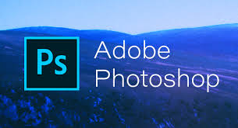
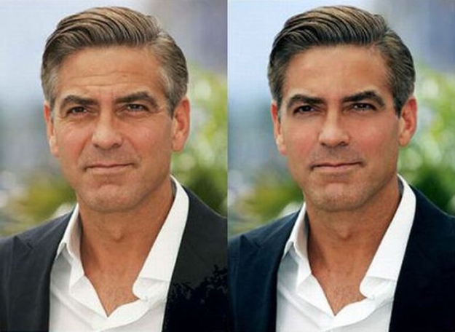
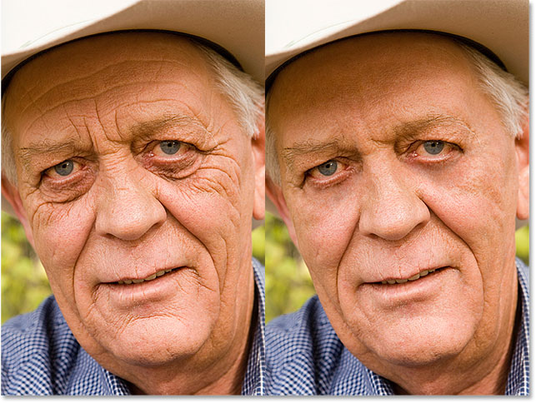
Mediation

Slide 4
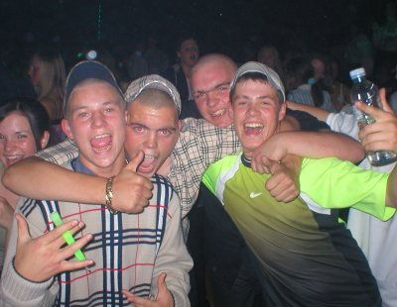
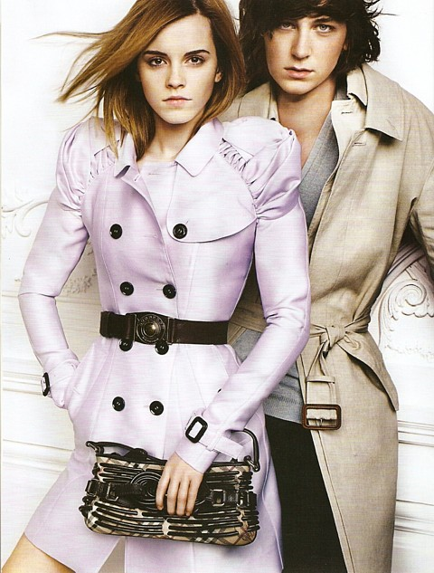
Burberry used to be REPRESENTED as sophisticated and expensive. Then it was REPRESENTED as part of ‘chav’ culture. But the representation has recently reverted back to its old associations – of an upmarket British designer brand.

Slide 5
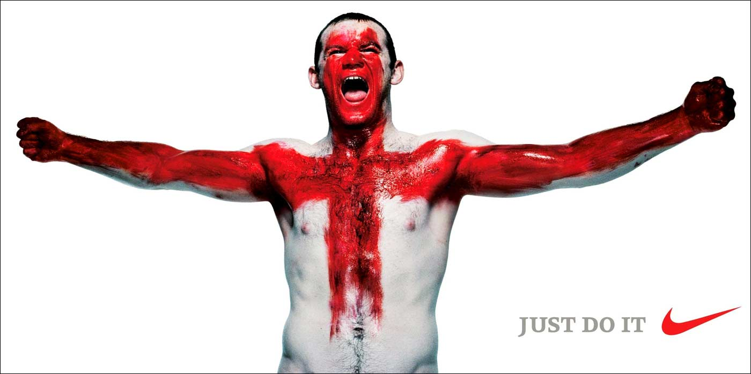
Applying Representation to Advertisements
Why does he have red & white paint on his body? What might this represent?
How is Rooney being represented? Think about his body language; what might he have done?
This advertisement was created by an ADVERTISING AGENCY for Nike. Why doesn’t it have ‘Nike’ on the advert?
Who is the AUDIENCE for this advertisement and where might we see it?

Slide 6
LYNX Analyse the advert using media language.
Written Codes – Look at the language, consider modes of address. Consider the colour and type of font.
Visual Codes – Mise en scene - body language, facial expression, costume, make-up, setting, props.
Technical Codes – Camera work, framing and angles, lighting, colour, use of editing and cropping.
What is being sold and what ideology is being attached to this product?
Who is the target audience?
What assumptions does this advert make about gender?

Slide 7
The Male Gaze – Mulvey 1975
The "male gaze" was predominant in classical Hollywood filmmaking.
Laura Mulvey's essay "Visual Pleasure and Narrative Cinema" gave one of the most widely influential versions of this argument.
This argument holds that through the use of various film techniques, such as the point of view shot, a typical film's viewer becomes aligned with the point of view of its male protagonist.
Women function as passive objects of this gaze, while the male is actively looking at her.

Slide 8
Task:
Finish for H/W
Find examples of the following:
Images of Women advertising to Women
Images of Women advertising to Men
Images of Women aimed at both sexes
Compile a PowerPoint which will:
Apply the ‘male gaze’ theory (if appropriate)
Analyse representations within the images
Discuss the main differences between all three
Discuss the ideology of each found image

