Slide 1
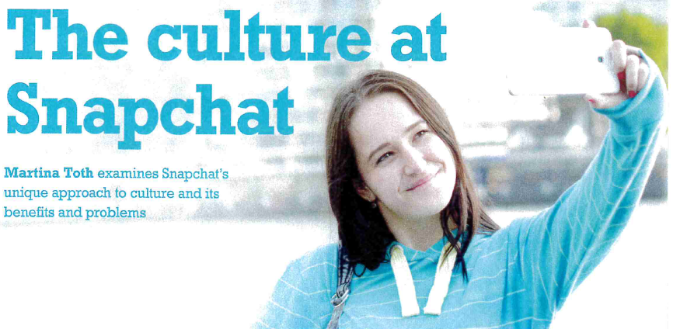

Unit 6 Principles of Management
Snapchat Case Study
Activity 1 & 2

Slide 2
Activity 1
Write a report to the Board of Directors that
Investigates what the existing culture is at Snapchat
Makes recommendations for improvements to the culture to ensure that Snapchat remains a competitive organisation

Slide 3
Activity 2
Having investigated the culture at Snapchat prepare a 6 slide presentation to the Board making recommendations for change to the Management and Leadership style to enable cultural change
Slides should be direct and to the point with additional information in the notes pages

Slide 4
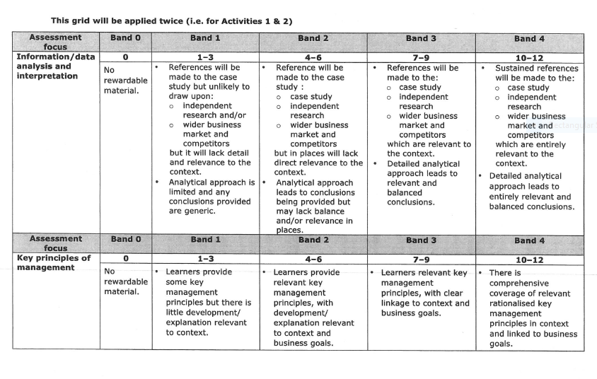

Slide 5
