Slide 1
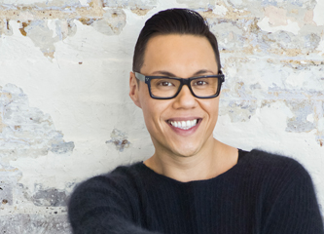
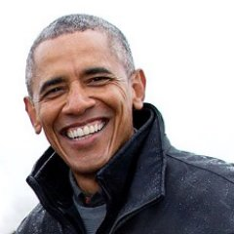
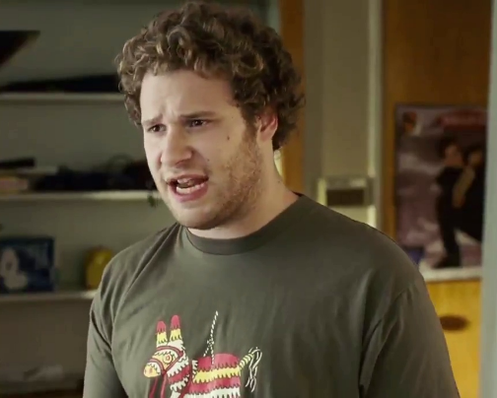
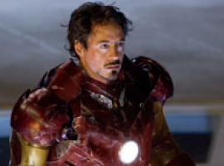
Representations of men in contemporary media

Slide 2
Representations of masculinity
‘Masculinity’ is a concept that is made up of rigid stereotypes, just like ‘femininity’.
Representations of men across all media tend to focus on:
Strength (physical and intellectual)
Power
Sexual attractiveness (which may be based on the above)
Physique
Independence (of thought, action)

Slide 3
So, where have these representations come from?
Historical context:
The dominant values of each culture can be seen to be reflected in gender ideals and masculine identity reflects social and economic aspects of specific cultures.

Slide 4
The changing roles of men
In the early 20th century the man was head of the household – the breadwinner. He had status at work – either as a manual labourer using strength and stamina in his work or in a professional environment where he would be ambitious (and possibly in charge of others).
WW1 – men in combat and women starting to work
1930s – depression (deprived of work)
1960s/70s – 2nd wave of feminism and equal rights for all

Slide 5
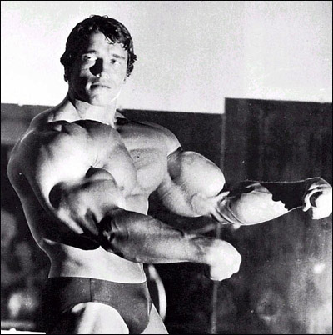
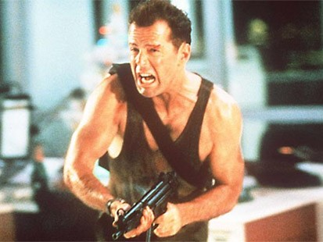
1980s – The Action Genre as a Response: Reclaiming Masculine Identity
Arnie and Sly’s version of masculinity: Yvonne Tasker – academic and writer calls this ‘pumped up masculinity’ and an attempt to reinstate an idea of male strength and power through the visual representation of a muscular body.
Tasker calls this ‘hyper-masculine’ as it is beyond any realistic ideal and shows an extreme version of the male physique – fantasy males. They are able to ignore the social changes which have marginalised the need for extreme strength. What are your views on these representations?
Bruce Willis (Die Hard, 1988) and Mel Gibson’s manliness – also embodies traditional masculine traits but are a more attainable ideal.
This male represents an idea of the ‘working class’ male and can be seen to be nostalgic of a time when men’s roles were clearly defined and their place in society was certain.
Could these representations be seen as a reaction against feminism?

Slide 6
Action hero
Action films in the 1980s reinforced society’s idea of the ‘hero’ through:
Their physique
Ability to cope in any situation
Security: man as protector, keeping female lead safe etc.
Has society departed from these stereotypes of men? What have we moved on to in terms of heroes?

Slide 7
The changing roles of men (cont’d)
Late 1980s/Early 90s - Also saw rise of the gay movement and the advent of the ‘new man’ – men more involved with home life/caring for children/metrosexual
1990s – rise of the new lad – overstated heterosexuality
2000s – loser, action hero, guy candy…

Slide 8
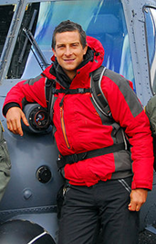
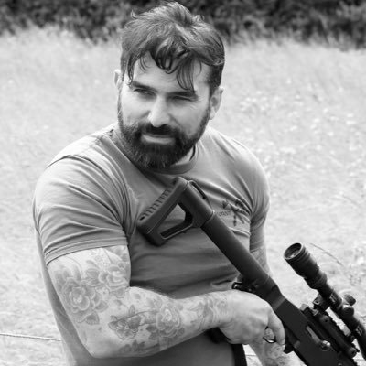
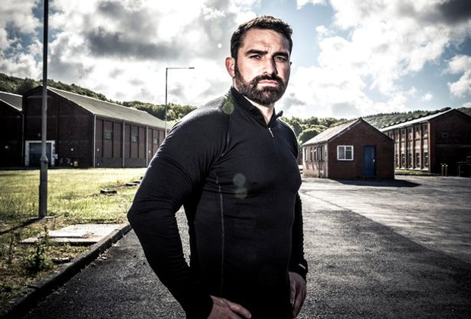
Action Hero – reinvented for the 21st century
Bear Grylls, Man vs Wild
Anthony Middleton, SAS Who Dares Wins

Slide 9
Bear Grylls as Action Man
Contemporary hero
James Bond (high action opening)
Talking over helicopter = overcoming elements
‘Man vs. Wild’ connotates challenge
Name ‘Bear’
Modern man proving himself
In today’s consumer culture there’s no real risk any more so men find ‘constructed challenges’

Slide 10
The new ‘hero’
Who can you think of who fulfils this role today?

Slide 11
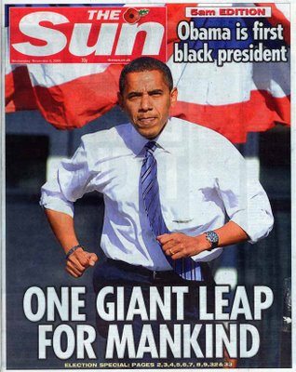
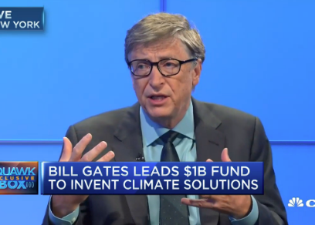
Heroes
Obama?
Bill Gates?

Slide 12
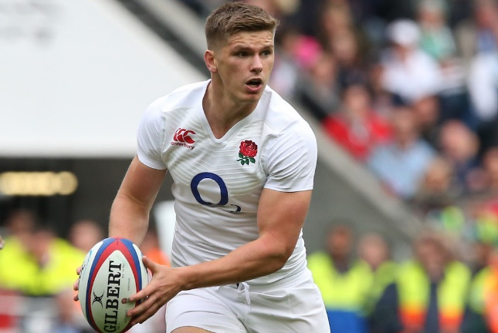
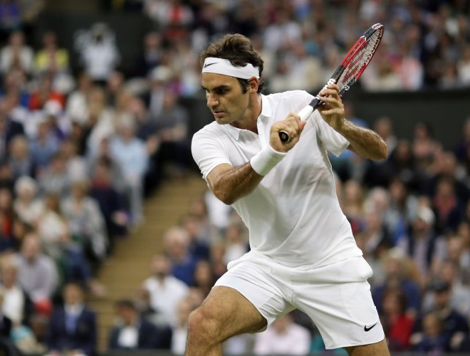
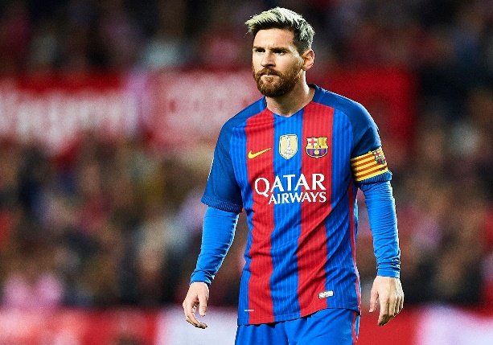
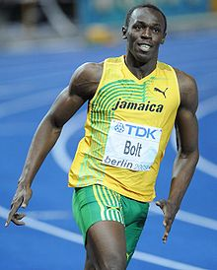
Sporting heroes
Owen Farrell
Roger Federer
Lionel Messi
Usain Bolt
Lionel Messi

Slide 13
Activity
The hero is not the only type of representation of masculinity in modern texts.
What other stereotypes of masculine identity exist today?

Slide 14
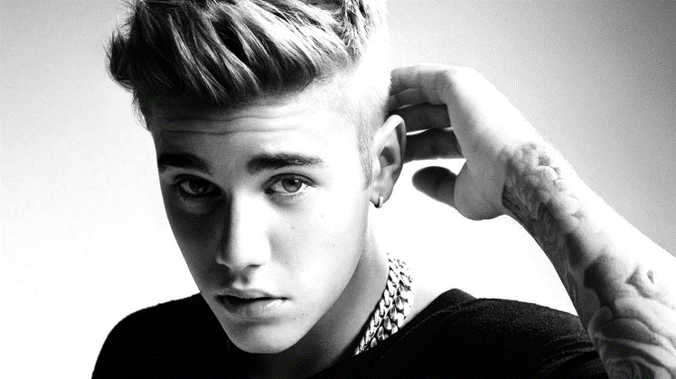
‘Metrosexual’ men/post-feminism Male feminised through advertising and consumer culture.

Slide 15
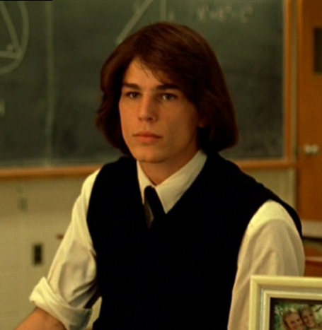
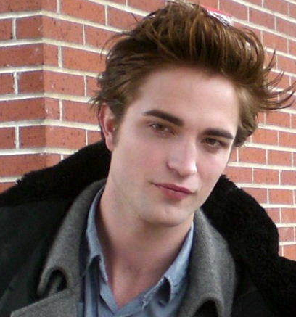
Guy Candy (Female Gaze)
Josh Hartnett in The Virgin Suicides, 1999
Twilight film franchise (love rivals – binary opposites – hunky vs. pale and interesting). Men represented as feminised – eg. Robert Pattinson pretty)

Slide 16
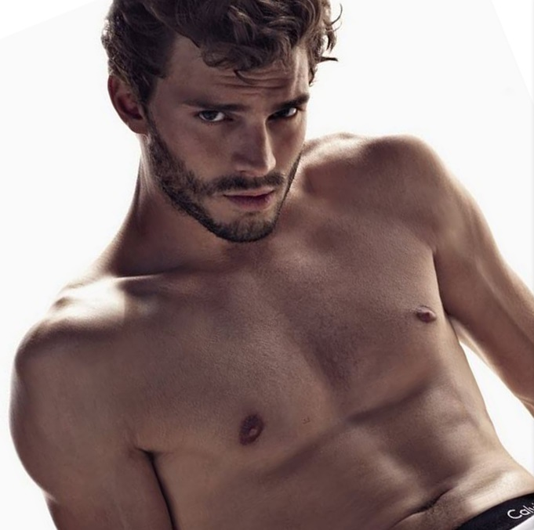
Guy Candy
Aiden Turner, Poldark
Jamie Dornan, Fifty Shades

Slide 17
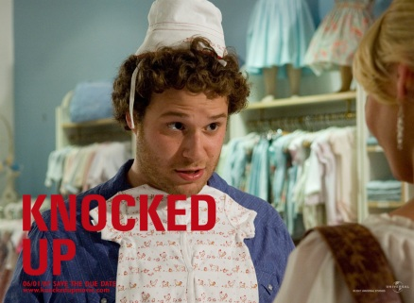
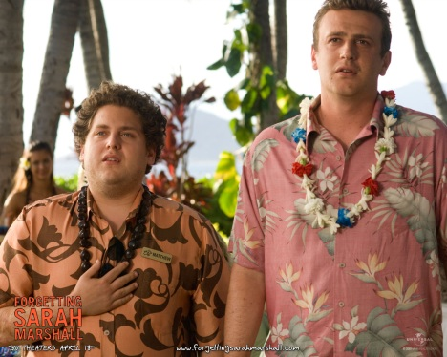
The Loser (early 2000s)
Knocked Up, 2007, Forgetting Sarah Marshall, 2008
Differs from typical rom/com guys– slackers/average Joe/wants a girl without changing
Shows women in post-feminist era – successful/in control of their lives

Slide 18
Where we are now…
For the last decade or so, Hollywood has appeared to have almost given up producing any film that was not about a comic book superhero fighting a CGI apocalypse: Thor, The Incredible Hulk, Captain America, Iron Man, Superman, Batman, Spider-Man, X-Men.
Some might wonder if Hollywood was over-compensating: if you want to know what a crisis in popular masculinity looks like, look no further then all those super, super men.
In these films, all the power is generally in the hands of white men (dominant ideology)
Why do you think this is the case?
Can you think of any texts that challenge this patriarchal ideology?

Slide 19
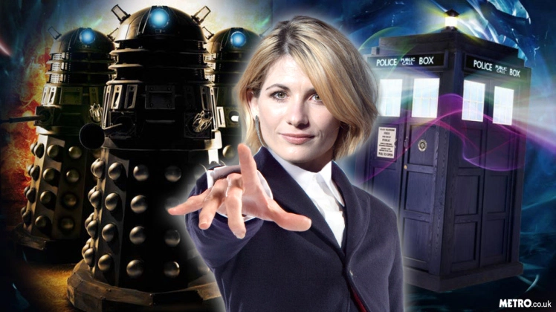
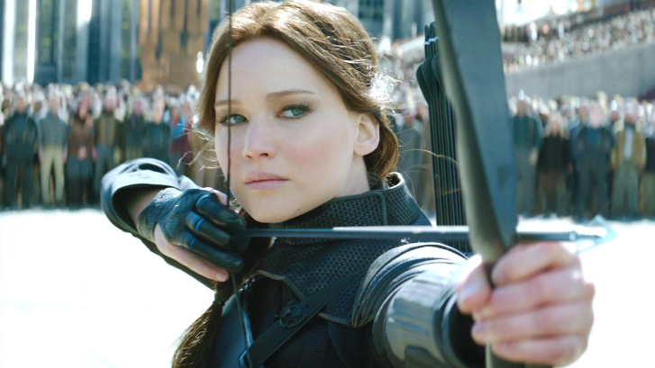
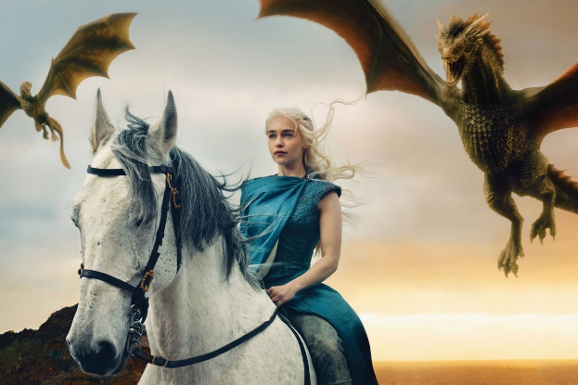
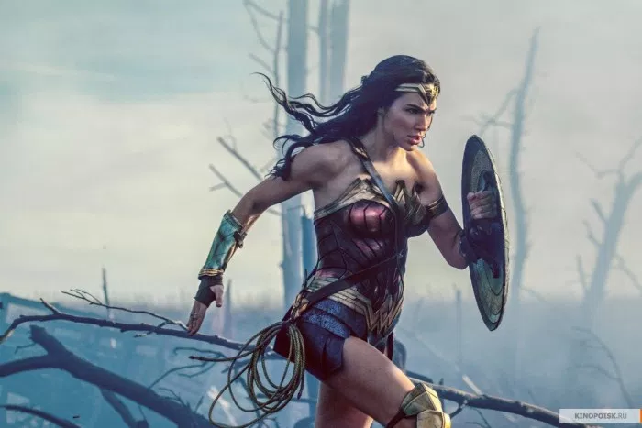
Rise of the female action hero?

Slide 20
Homework Task:
You will be given either a man on the cover of a magazine to analyse.
Please use the Key Representation Questions to analyse the representation and to help structure your answer.
Please type your analysis and use double-lined spacing.

Slide 21
Key representations questions
What kind of world is being constructed by media texts?
Who is in control of the text? Whose ideas and values are expressed through the representations?
How are stereotypes used as shorthand to represent certain groups of people?
How has the representation been constructed – consider mise-en-scene/anchorage – visual and technical codes.
How will audiences interpret the representation within texts? Who are the texts aimed at?
What ideologies / messages might be contained within the representations?

