Slide 1
An Introduction to Genre

Slide 2
Essentially genre is a way in which media texts are:
organized
categorised
consumed.

Slide 3
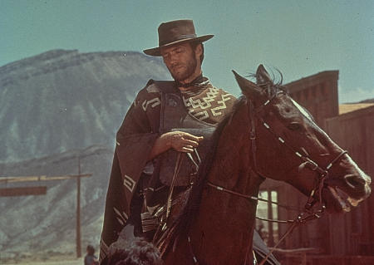

Slide 4
Western/Cowboy

Slide 5
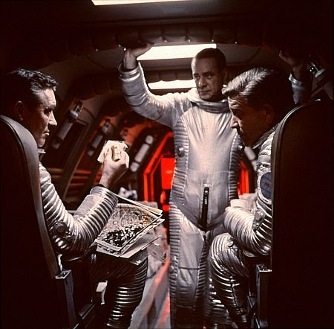

Slide 6
Sci-Fi

Slide 7
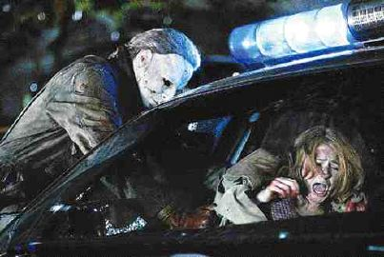

Slide 8
Horror

Slide 9
For each genre category there are specific visual and narrative expectations called codes and conventions.
CODES: (elements you see and ‘read’)
CONVENTIONS: (themes and expectations)

Slide 10
CODES: (elements you see and ‘read’)
The opening credits (typography, title language)
Mise-en-scene (setting, lighting, costume, hair, make-up, props, posture, gesture and facial expressions)
Iconography (images/symbols which become associated/synonymous with a particular genre)

Slide 11
CONVENTIONS: (themes and expectations)
Character types
Particular stars
A certain type of plot (conflict and resolution)
A particular type of resolution
Soundtrack (music, speech and sound effects)
A particular set of messages and values

Slide 12
Genre and Audience
It can be said that audiences like genre, because it offers reassurance and familiarity. Genre films have patterns and repetition.
However audiences can get bored….

Slide 13
Hybrid
A fusion of more than one genre
A film that uses codes and conventions and contains the visual iconography of more than one genre

Slide 14
Comedy
Romance

