Slide 1
KEY TERMS SO FAR…

Slide 2
Narrative Stories and how they are structured
Notes:
2

Slide 3
Definition
The term narrative is used to describe how film, television, advert stories are structured.
STORY: WHAT is depicted, the events of the film
NARRATIVE: HOW the story is structured and presented to us

Slide 4
Narrative Structure
Linear Narrative
The story is told in chronological order
It is simple and straight forward
Non-Linear Narrative
The story will not be told in order
It may be confusing and ambiguous in places

Slide 5
task
Turn to the person next to you and find a different way to tell 1 of the following stories …
Structure the narrative so the story is told in linear form
Structure the narrative so the story is told in non-linear form
You could also think about developing different elements of the story to help
A girl meets a boy whilst travelling the world Will they have their happily ever after? | A deadly toxin has been threatened to be released by a group of terrorists A secret government agency is tasked to stopping them

Slide 6
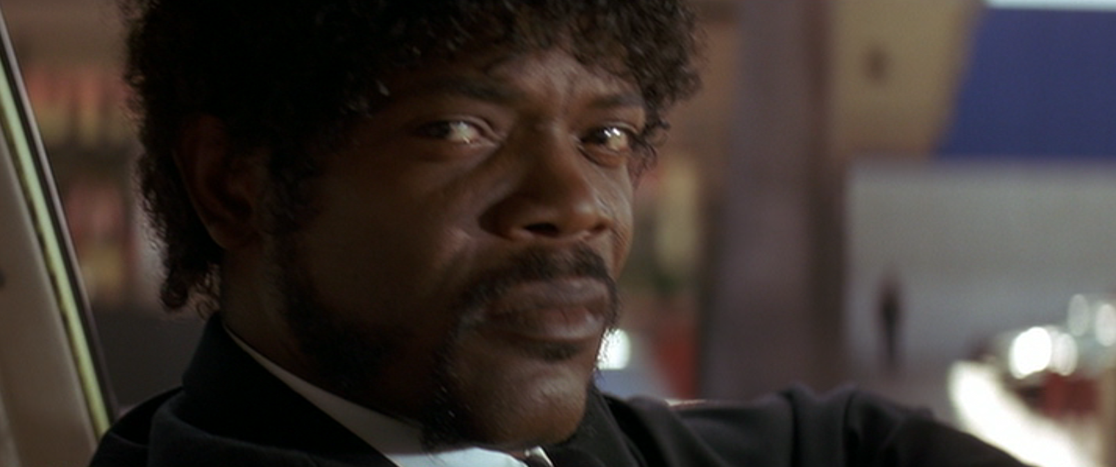
Non-linear
Can anyone think of any film examples that have a Nonlinear narrative structure?
Pulp Fiction (Quentin Tarantino, 1994)

Slide 7
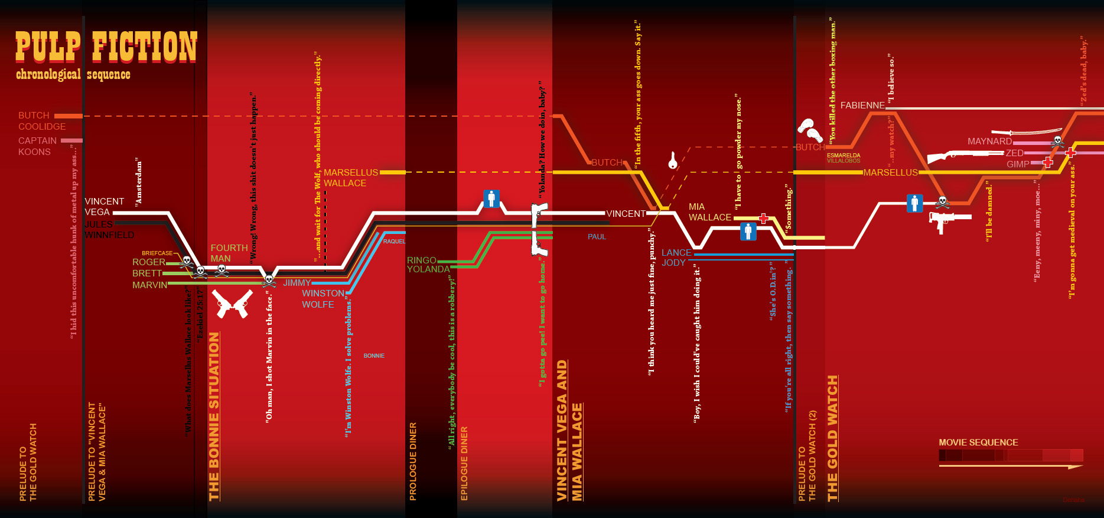

Slide 8
Linear and theory
Tzvetan Todorov, in his book The Fantastic outlines several stages that a plot works through.
This has become known as Todorov’s narrative theory of equilibrium
1 | A state of equilibrium
2 | A disruption of the equilibrium
3 | A recognition of the disruption
4 | Attempt to repair the disruption
5 | Restatement of the (new) equilibrium

Slide 9
Tzvetan Todorov
1 | A state of equilibrium
2 | A disruption of the equilibrium
3 | A recognition of the disruption
4 | Attempt to repair the disruption
5 | Restatement of the (new) equilibrium

Slide 10
Tzvetan Todorov
1 | A state of equilibrium | Small birds arriving on wire
2 | A disruption of the equilibrium
3 | A recognition of the disruption
4 | Attempt to repair the disruption
5 | Restatement of the (new) equilibrium

Slide 11
Tzvetan Todorov
1 | A state of equilibrium | Small birds arriving on wire
2 | A disruption of the equilibrium | Large bird arriving on wire
3 | A recognition of the disruption
4 | Attempt to repair the disruption
5 | Restatement of the (new) equilibrium

Slide 12
Tzvetan Todorov
1 | A state of equilibrium | Small birds arriving on wire
2 | A disruption of the equilibrium | Large bird arriving on wire
3 | A recognition of the disruption | All birds sinking on the wire
4 | Attempt to repair the disruption
5 | Restatement of the (new) equilibrium

Slide 13
Tzvetan Todorov
1 | A state of equilibrium | Small birds arriving on wire
2 | A disruption of the equilibrium | Large bird arriving on wire
3 | A recognition of the disruption | All birds sinking on the wire
4 | Attempt to repair the disruption | Attempts to remove large bird from the wire
5 | Restatement of the (new) equilibrium

Slide 14
Tzvetan Todorov
1 | A state of equilibrium | Small birds arriving on wire
2 | A disruption of the equilibrium | Large bird arriving on wire
3 | A recognition of the disruption | All birds sinking on the wire
4 | Attempt to repair the disruption | Attempts to remove large bird from the wire
5 | Restatement of the (new) equilibrium | All the birds on the floor

Slide 15
Tzvetan Todorov
1 | A state of equilibrium
2 | A disruption of the equilibrium
3 | A recognition of the disruption
4 | Attempt to repair the disruption
5 | Restatement of the (new) equilibrium

Slide 16
Tzvetan Todorov
Now apply this to more Pixar shorts…
1 | A state of equilibrium
2 | A disruption of the equilibrium
3 | A recognition of the disruption
4 | Attempt to repair the disruption
5 | Restatement of the (new) equilibrium
Consider the last 3 films you have seen, do they follow this structure?

