Slide 1
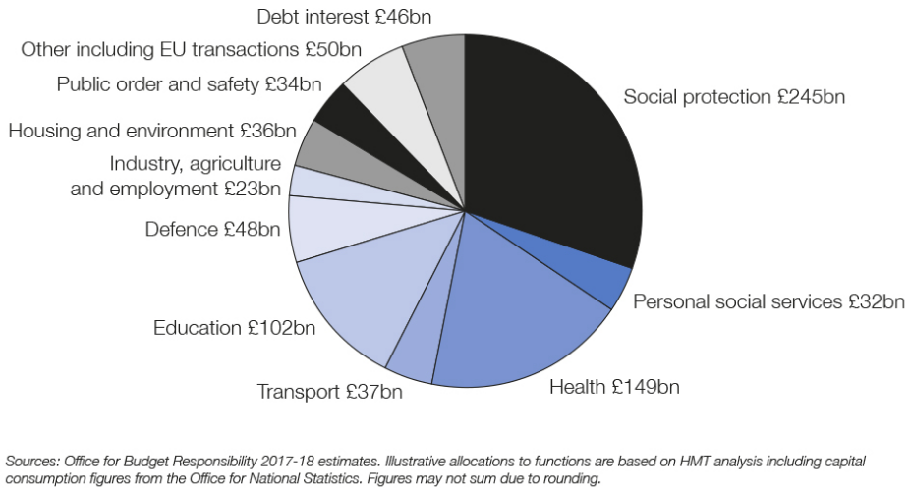
Fiscal and Supply Side Policies
Page 2

Slide 2
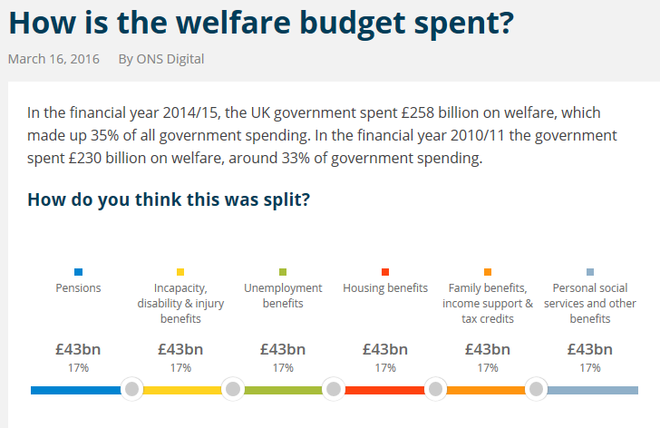
Page 2

Slide 3
Extension 1
Page 3

Slide 4
Page 3

Slide 5
Starter… Think logically (15 mins)
Page 5 & Notes
Number handout pages 1 to 42 (1 is the cover page, 42 is the ‘Plenary Pyramid’ page)
Page 5 – complete Activity 1 and Activity 2
What happens NATURALLY to the amount of tax revenue collected in a ‘BOOM’ and why? EXPLAIN! (Hint: these are called AUTOMATIC STABILISERS)
What happens NATURALLY to the amount of G in a ‘boom’ and why? EXPLAIN!
Ext: Draw the impact this will have on a business cycle diagram - the diagram where you have trend growth and actual growth (i.e. the diagram pre and post the effect of the automatic stabilisers)

Slide 6
Balanced Budget Fiscal Expansion
Notes
Balanced Budget Fiscal Expansion is a Keynesian concept – Keynes advocated ‘counter-cyclical fiscal policy’.
Keynes believed a Government could increase AD through changing G and T, whilst leaving the overall fiscal budget balance the same.
……if you increase G and T equally, the increased G (on capital spending) has a bigger positive impact (multiplier) on economic growth than the negative impact (negative multiplier) of higher T.
Therefore, by financing GOVERNMENT CAPITAL SPENDING through higher taxes such as income tax, we can, in theory, increase economic growth without increasing the budget deficit.

Slide 7
Questions (10 mins)
Notes
A Government chooses to increase INCOME TAX tax temporarily, to fund the building of the new ‘Crossrail’ train line…
Analysis = Explain how this may lead to Keynes’ theory of fiscal expansion through a balanced budget (focus on the multiplier effect)
Evaluation = explain a downside to this policy (could there be negative consequences)?
Ext: Would the Government be better off to fund Crossrail with a rise in CORPORATION TAX instead of INCOME TAX? Why/Why not?

Slide 8
Extension 2
Page 4

Slide 9
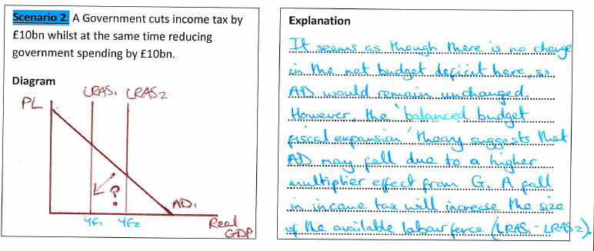
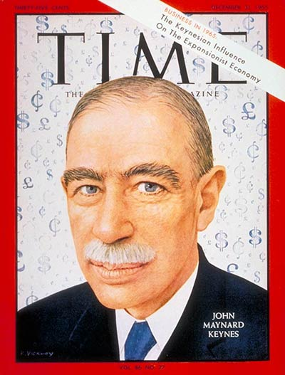
Page 4

Slide 10
Page 4

Slide 11
Questions (10 mins)
Notes
A Government chooses to increase INCOME TAX tax temporarily, to fund the building of the new ‘Crossrail’ train line…
Analysis = Explain how this may lead to Keynes’ theory of fiscal expansion through a balanced budget (focus on the difference in the multiplier effect)
Evaluation = explain a downside to this policy (could there be negative consequences)?
Ext: Would the Government be better off to fund Crossrail with a rise in CORPORATION TAX instead of INCOME TAX? Why/Why not?

Slide 12
Starter (5 mins)
Page 5
Page 5: Complete Activity 1 and Activity 2
Ext 1: What happens NATURALLY to the amount of tax revenue collected in a ‘BOOM’ and why? EXPLAIN! (Hint: these are called AUTOMATIC STABILISERS)
Hint: income tax, VAT, corporation tax
Ext 2: What happens NATURALLY to the amount of G in a ‘boom’ and why? EXPLAIN!
NOTE PAPER (Page 10)

Slide 14
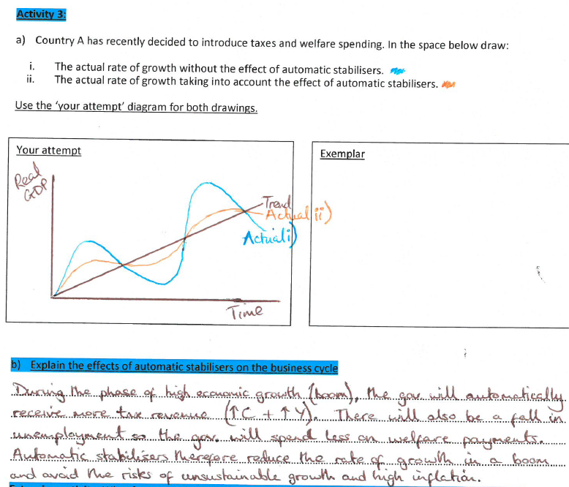
Automatic Stabilisers:
Activity 3 (8 mins)
Page 6

Slide 15
Home Work:
Reading and activities on page 15 to 24 (skip the Anderton activity on p20)
Hint: Use Tutor2u to help you
Due in your first lesson of next week

Slide 16
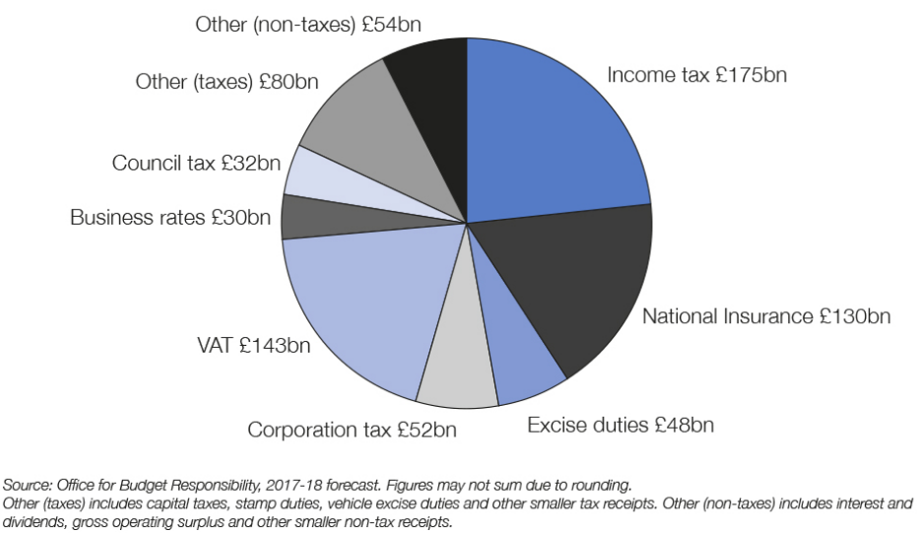
Fiscal Austerity: Activity 1 (10 mins)
Page 7
Taxation 2017-18
G = £802 bn
T = £744 bn
PSNCR = £58bn

Slide 17
Macro and Micro benefits of G (8 mins)
Page 8
MACRO
Economic growth (increase PPF)
Stable prices
Productivity gains
Lower unemployment
Smooth out fluctuations in the business cycle (counter-cyclical)
Ev = size of the multiplier?
MICRO
Reduction in inequality through welfare e.g. working tax credits
Consumption of merit goods
Provision of public goods
Provision of necessities such as state education and the NHS
Ev = budget deficit and national debt?

Slide 18
Starter: What are the drawbacks of Government Spending?
Page 9

Slide 19
Resource Crowding Out
Pages 9-11
http://www.youtube.com/watch?v=PHaMaQ5271o
“When growth in G leads to a transfer of scarce resources from the private sector to the public sector, where productivity is likely to be lower”
£4.6bn
Privately funded firms struggle to compete as they compete as they cannot attract the best labour
Tax revenue which is earmarked for a specific purpose
Advertising revenue
BBC broadcasting is a ‘quasi-public good’ and provides a diverse and affordable high quality service – i.e. good provision for all
Notes:
£145.50 pa for tv license.

Slide 20
Financial Crowding Out (10 mins)
Pages 12-13
Banks
Households, Firms, Governments
Lower r = more incentive to take out loans (higher demand)
Higher r = more incentive to supply loans (higher supply)
Increase in D for loans = shift right in D from D1 to D2
D1 to D2 causes extension up and along the S curve (higher r)
Reduce I due to higher cost of borrowing

Slide 21
Large budget deficits can lead to a decrease in economic growth because…
Pages 16-17
Budget deficit means that Government must borrow more
To do this, it issues bonds (gilts)
Which in turn cause a rise in D for loans
And a corresponding extension in S
Which results in a higher rate of interest
Higher interest rates put off private sector I due to an increased cost of borrowing
Which causes AD to shift left (decrease)
And a fall in Real GDP.
Activity 4: To what extent is the growth in G as % GDP damaging to the UK economy?
An = Benefits of G (balanced budget fiscal expansion, multiplier, crowding in, macro objectives)
Ev = Drawbacks of G (crowding out, concerns over national debt interest which cost the UK £53bn in 2014/15
Conclusion = Answer the question! Justify your position

Slide 22
Direct or Indirect Tax?
Pages 19 & 22
“Which of the tax regimes do you prefer? Explain and justify your answer”
Direct
Income tax
Corporation tax
Inheritance tax
National insurance
Capital Gains tax
Indirect
Council tax
VAT
Excise duty

Slide 23
Cyclical v Structural Budget deficit
Pages 23-24
Cyclical:
Structural:
Extension: They have experienced a large fall in revenue from oil due to the fall in the oil price.

Slide 24
Starter (10 mins): Fiscal Policy (note paper)
What does PSNCR stand for?
What is the difference between a CYCLICAL and a STRUCTURAL budget deficit?
Explain how AUTOMATIC STABILISERS provide a natural boost to the business cycle during a RECESSION
Explain the concept of FINANCIAL CROWDING OUT (Govt. runs a budget deficit…)
Ext: Make a plan for the following 25 marker:
“To what extent do you believe FISCAL AUSTERITY has benefited the UK economy”
Tip: you may wish to refer to Keynes theory of BALANCED BUDGET FISCAL EXPANSION and CROWDING OUT in your answer

Slide 25
Supply-Side Policies
Pages 25-28
“Policies that improve the productive capacity/potential of an economy, illustrated by an outward shift of the PPF/LRAS”
Work to do:
Page 25, Activity 1 (2 mins)
Page 27, Activity 1 (10 mins)
Page 28, Activity 2 (10 mins)

Slide 26
The Laffer Curve
Page 29-30
https://www.youtube.com/watch?v=fw5rp7MfD-Q
Starter (answers on note paper):
Is there an optimal rate of direct taxation (i.e. of income tax or corporation tax?) What is it?
Explain how reducing income tax is a supply side policy?
Make 2 evaluation points for part b)
Work to do (15 mins):
Watch the clip and answer questions (p29)
Answer the questions on p30

Slide 27
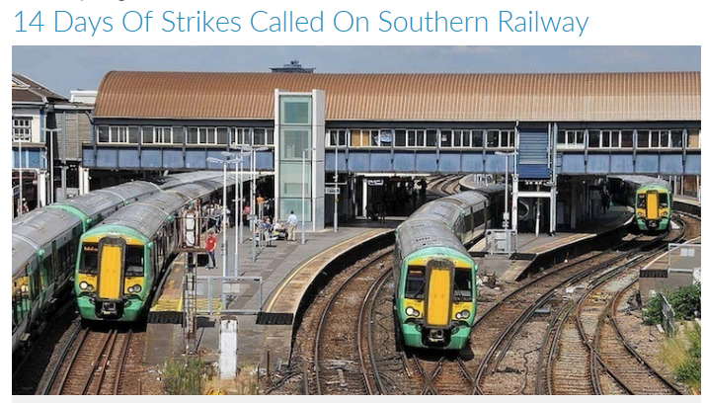
Trade Unions
Discussion
What is a Trade Union (TU)?
Why is the RMT striking?
How is reducing TU power a supply side policy?
What are the downsides to reducing the power of TU’s?

Slide 28
Trade Union Reforms
Pages 31-32
https://www.youtube.com/watch?v=vSLajVt_n7k
“Organisations of workers that seek through collective bargaining with employers to protect and improve the real incomes of their members and improve job security”
Work to do:
Listen to clip and answer the questions (3 mins)
Margaret Thatcher’s Trade Union reforms (10 mins)

Slide 29
PPF, LRAS and Trend Growth
Page 38

