Slide 1
Economic Growth

Slide 2
Short Run Economic Growth

Slide 3
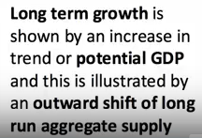
Long Run Economic Growth

Slide 4
Short Run Economic Growth
Cyclical changes
Changes in AD
Changes in Aggregate Supply
Short term external shocks
Short term policy changes

Slide 5
Long Run Economic Growth
Supply side driven or Structural in nature
Potential output/trend rate of growth
Productivity of labour and capital
Technological progress and strength of enterprise
Changes in labour force
Investment rates

Slide 6
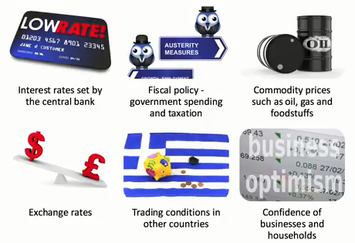
Key Factors affecting SR Growth

Slide 7
Key Factors Affecting Long Run Economic Growth

Slide 8
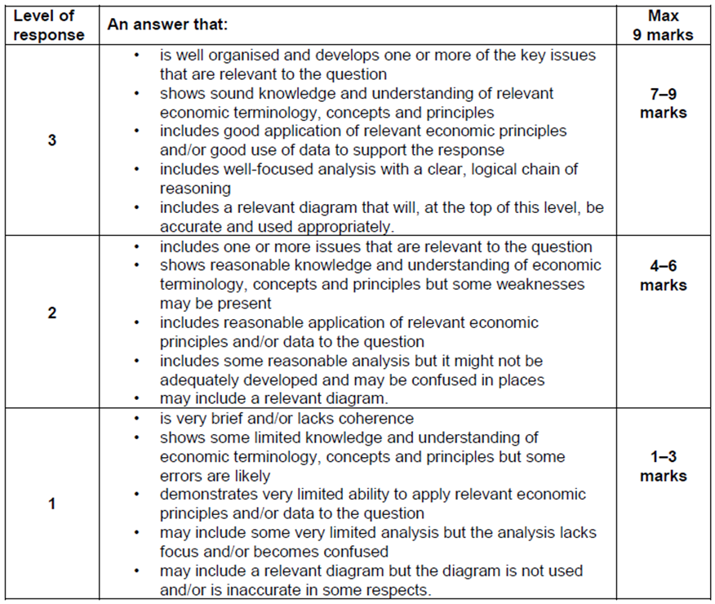
STARTER
“With the help of a diagram, explain why a fall in interest rates will lead to a rise in AD”
(9 marks)
Technique
2 points, 2 paras
Telegraph point
Explain point (6-8 chains of analysis)
Draw a diagram

Slide 9
Monetarists vs Keynesians
It’s the money supply – if it grows faster than output grows, the consumption increases, because people feel better off
But this leads to inflation, which reduces AD (reduced C and X-M)
Markets automatically correct themselves as wages are flexible
Governments should spend money to stimulate demand and utilise the multiplier and accelerator effects that comes from “Animal Spirits”
Downward spiral occurs once full output is reached (demand & investment falls
Wages are not flexible downwards therefore Gov needs to spend to stimulate

Slide 10
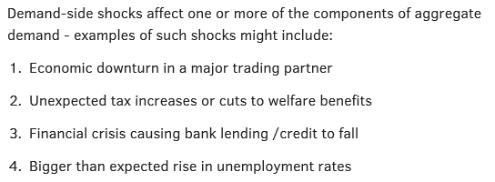
Demand Side Shocks

Slide 11
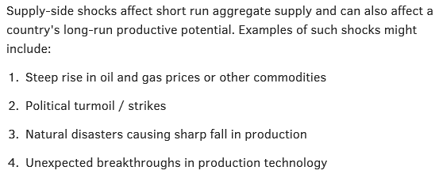
Supply Side Shocks

Slide 12
Benefits and Drawbacks of Economic Growth
Benefits
Higher Living standards (GNI per capita) rising HDI
Higher employment – reducing income inequality
Fiscal Dividend – higher tax & lower gov spending
Accelerator Effects
Drawbacks
Inflation - Demand pull & cost push
Environmental – negative externalities increase
Inequality of income and wealth

Slide 13
Fiscal Policy (Demand side)
Identify the 3 types of government spending
Explain the difference between budget deficit and current account deficit
Draw two diagrams Keynesian & classical AD/AS that shows unemployment
Choose a fiscal policy to increase economic growth and explain how it will lead to growth (be specific about type of T & G)
Draw the impact of your policy on the diagram
Explain the impact of your policy on Unemployment, Balance of payments and the rate of inflation
What impact will your policy have on the Budget deficit SR & LR

Slide 14
Fiscal Policy (Supply side)
How do the following measures affect both AD (identify component)and AS & LRAS:-
Lowering income tax
increasing corporation tax
investment in infrastructure projects (HS2)
Cut in Education spending by £20bn

Slide 15
Fiscal Revision
Explain the following
Automatic stabilisers
Crowding out (Resource)
Financial crowding out – draw a diagram to explain
Crowding in
Difference between budget deficit and national debt
Difference between a cyclical and a structural deficit
Hypothecated tax
Difference between progressive and regressive tax (give examples)

Slide 16
Fiscal Revision
Explain the following
Difference between budget deficit and national debt
Difference between a budget deficit and a current account deficit
Hypothecated tax
Difference between progressive and regressive tax (give examples)

Slide 17
With the help of a diagram, explain why the level of spare capacity is usually inversely correlated with the amount of inflationary pressure in an economy 9 marks
Make a point – 4-6 logical chains of AD/AS analysis and use a diagram to help explain.
Make a second point – 4-6 logical chains of AD/AS analysis and use a diagram to help explain.

Slide 18
Assess the view that a sustained fall in the price of oil can only have positive outcomes for the UK economy 25 marks
Make a point – 4-6 logical chains of AD/AS analysis and use a diagram to help explain.
Make a second point – 4-6 logical chains of AD/AS analysis and use a diagram to help explain.
Make a third point – 4-6 logical chains of AD/AS analysis and use a diagram to help explain.

Slide 19
Explain the term progressive tax and analyse why a rise in income tax may lead to lower tax revenue 9 marks
Define a key term
Use a diagram
Use data where possible to support your answer.
Make a point – 4-6 logical chains of AD/AS analysis and use a diagram to help explain.
Make a second point – 4-6 logical chains of AD/AS analysis and use a diagram to help explain.

Slide 20
Explain the factors which are likely to cause a large budget deficit 15 marks
Define a key term
Use a diagram
Use data where possible to support your answer.
Make a point – 4-6 logical chains of AD/AS analysis and use a diagram to help explain.
Make a second point – 4-6 logical chains of AD/AS analysis and use a diagram to help explain.
Make a third point – 4-6 logical chains of AD/AS analysis and use a diagram to help explain.

Slide 21
Explain the economic reasons for government spending. 15 Marks
Define a key term
Use a diagram
Use data where possible to support your answer.
Make a point – 4-6 logical chains of AD/AS analysis and use a diagram to help explain.
Make a second point – 4-6 logical chains of AD/AS analysis and use a diagram to help explain.
Make a third point – 4-6 logical chains of AD/AS analysis and use a diagram to help explain.

