Slide 1
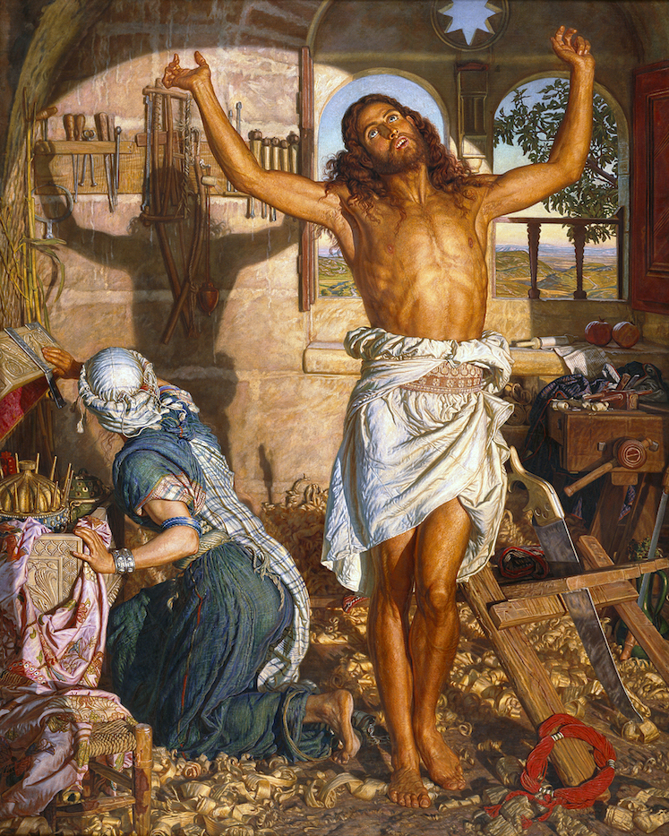
William Holman Hunt,
The Shadow of Death,
1873
Oil on canvas, 212 x 168cm

Slide 2
Style: Pre-Raphaelite
Realism mixed with symbolism
Christian iconography used to assist
the viewer in interpreting the scene
Christ is shown as a carpenter, this is
representative of His life prior to
preaching the word of God
He is placed in a carpenter’s workshop
and is shown stretching after a day’s
work
His stretching pose casts a shadow
on the wall behind which prefigures
His crucifixion pose and is witnessed
by his mother Mary who kneels beside
him.
We see a literal foreshadowing of
Christ’s crucifixion.
Typology is the term used to describe
applying symbolic meaning to objects
within the painting and Christ’s life or
a religious scene

Slide 3
Objects within the painting are used to
Indicate Christ’s life and also how His
death will occur
Carpenters tools= the Cross
Plumb bob= Christ’s (sacred) heart
Reeds= the sceptre given to Christ before the Crucifixion by Roman soldiers who mocked Him
Window in the shape of a halo
Window in the shape of a star (of Bethlehem)
The gifts from the Magi (wise men), given at His birth
Landscape of Galilee, where Jesus will wander, converting and preaching to His followers
Shadow cast by saw handle symbolising the spear which pierced His side
Headband representing the Crown of Thorns
Scroll with passages from the Old Testament
Pomegranates- traditional symbol of the Resurrection

Slide 4
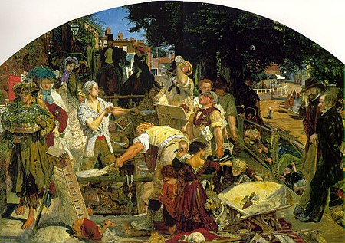
Christ’s physique is shown as
muscular and strong. This links with
the Victorian social commentator
Thomas Carlyle’s theories on the
importance of physical labour for the
wellbeing of the individual.
Which key work have we looked at
that also referenced this theory?
Christ therefore appears both
spiritually and physically strong due to
being engaged in manual labour rather
than living an idle lifestyle. Christ’s
preaching will also be seen as work
and therefore important- for everyone

Slide 5
Holman Hunt has also been inspired
by the philosophical movement known
as Muscular Christianity.
This was a popular Victorian concept
which linked patriotism, masculinity,
discipline with moral and physical
strength. Physical education and
team play were combined with
Christian teaching in public schools to
create a society of physically and
morally idealised individuals.
Hunt has presented Christ as having an
Idealised and athletic body which has
been achieved through hard work and
spiritual devotion- typical of the
Muscular Christianity movement.

Slide 6
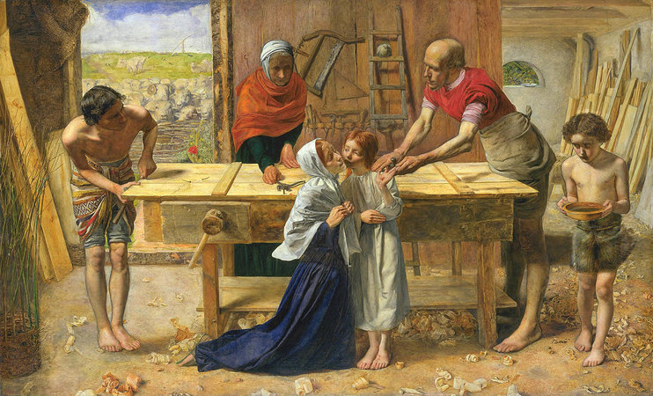
Other Pre-Raphaelite representations of Christ as a carpenter
Christ in the House of His Parents by Millais, was painted more than twenty years before
Holman Hunt’s work but also contains Christian iconography, symbolism and a pre-figuring
of Christ’s crucifixion.

Slide 7
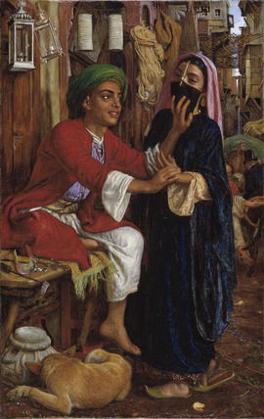
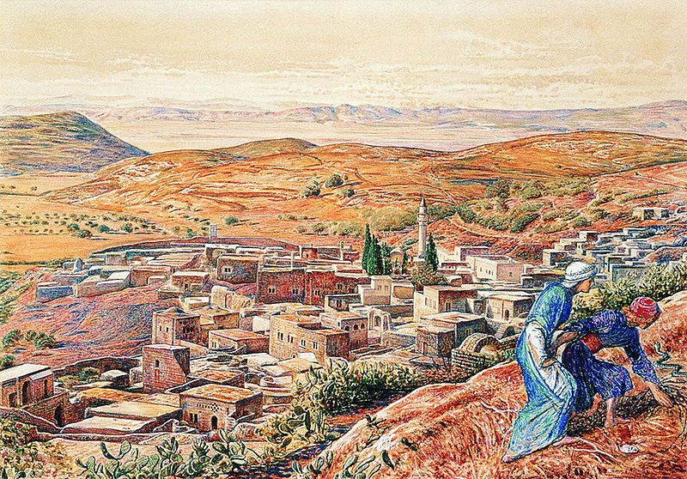
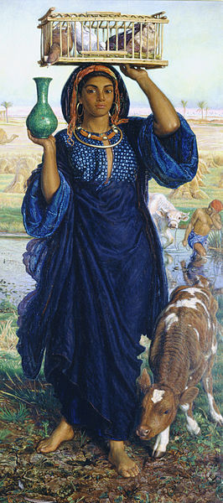
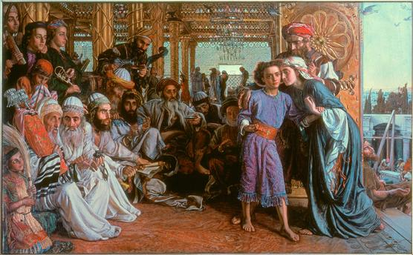
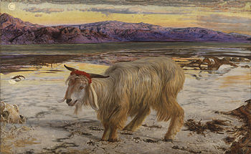
Holman Hunt made numerous trips abroad, in particular to the Holy Land and the Middle East, searching for locations which would act as the backdrop to his religious works and also to find models whose ethnicity was the same as the subjects he wished to depict.

Slide 8
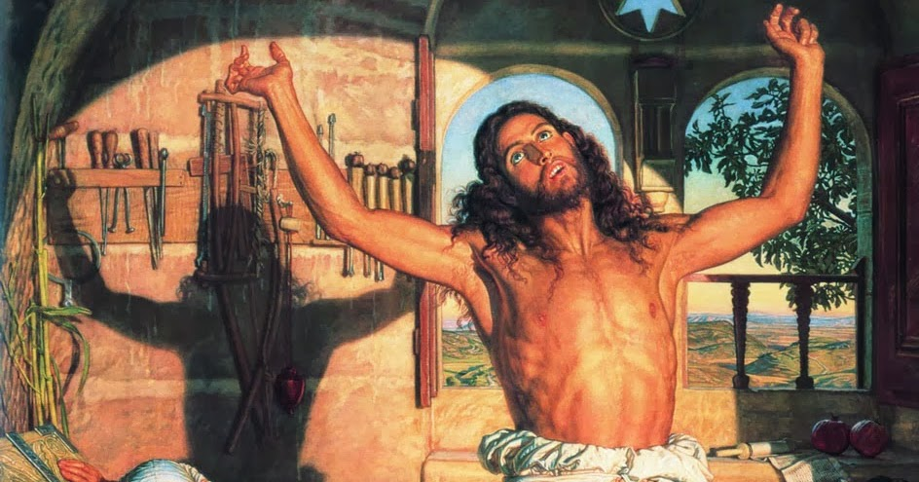
Holman Hunt made numerous trips abroad, in particular to the Holy Land and the Middle East, searching for locations which would act as the backdrop to his religious works and also to find models whose ethnicity was the same as the subjects he wished to depict.

Slide 9
Holman Hunt frequently produced a pamphlet to accompany his pictures when exhibiting them. These would explain to the viewer of the painting the artist’s concept and highlight the symbolism and metaphors included within the painting.
For The Shadow of Death he produced a pamphlet and included reviews from the Times……
The Shadow of Death “was painted in the conviction that Art, as one of its uses, may be employed
to realise facts of importance in the history of human thought and faith".
"to this day there is no picture representing Christ in full manhood enduring the burden of common
toil . . . Mr. Hunt aims to show Him, as He may have been seen by His brethren, while still gaining
His bread by the sweat of His face, during His first but longest humiliation."
Holman Hunt was hugely successful by this period and his works achieved huge prices from art collectors who would then sell prints of the paintings to the public. As a result, Holman Hunt’s works were seen around the world in print form.
https://en.wikipedia.org/wiki/The_Shadow_of_Death

Slide 10
How does Holman Hunt’s painting differ to the Gauguin religious painting we looked at?
What message is each artist trying to convey? Why choose a religious subject? How/why is their respective style important?

