Slide 1
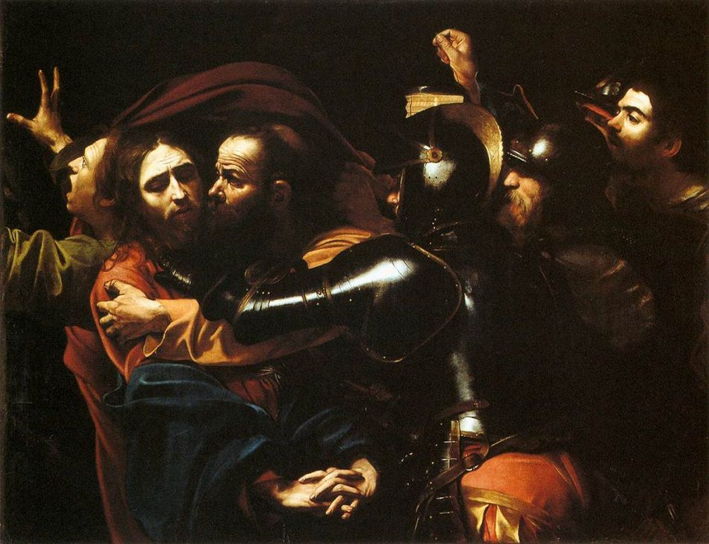
The Baroque

Slide 2
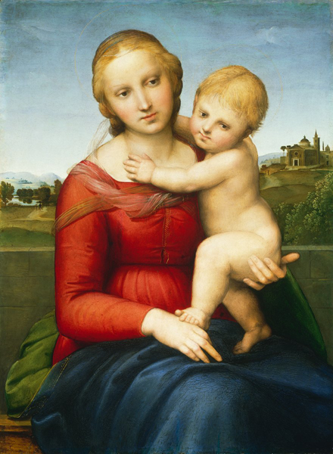
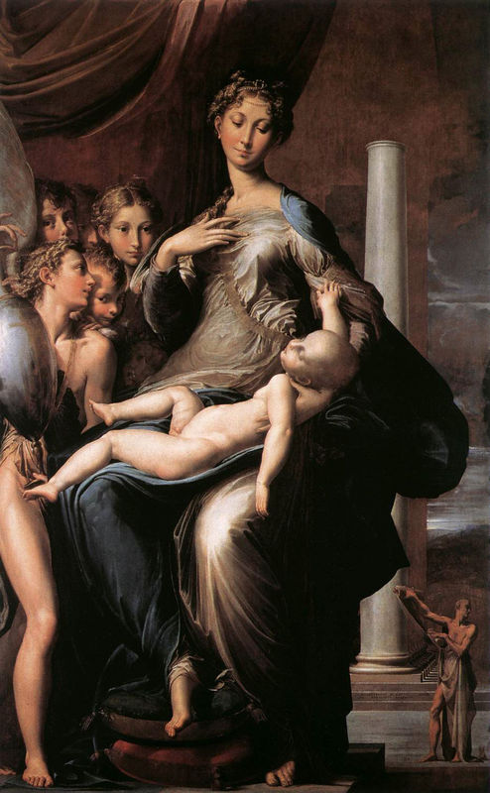
Renaissance
Mannerism

Slide 3
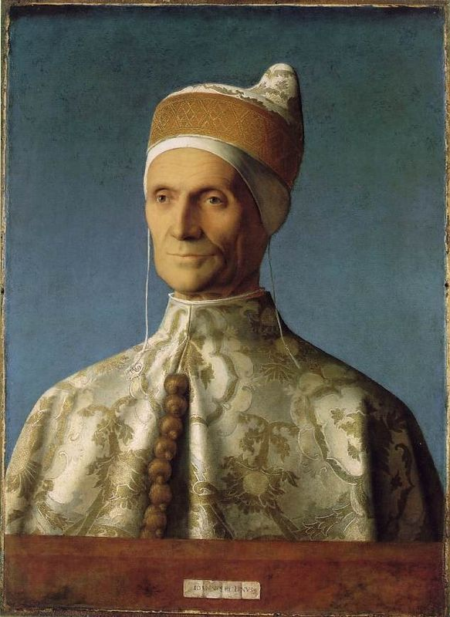
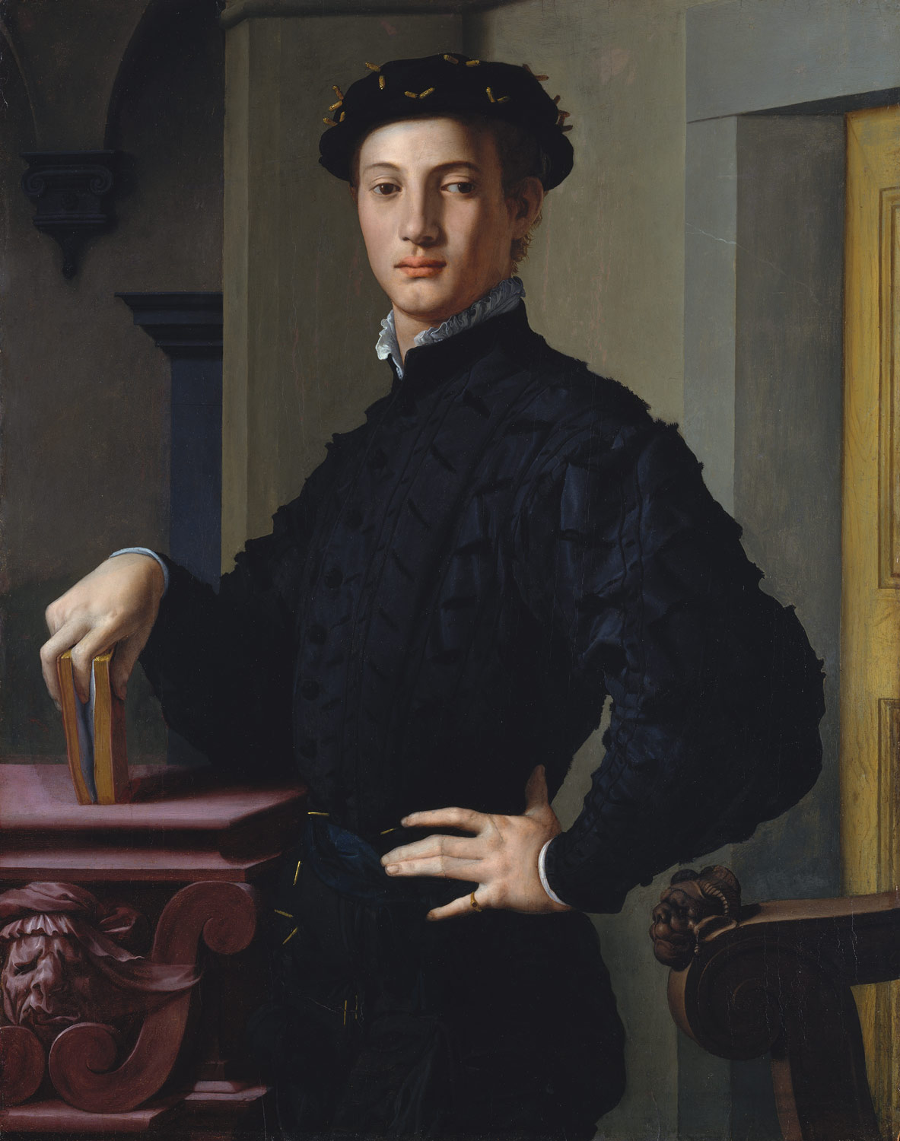
Renaissance
Mannerism

Slide 4
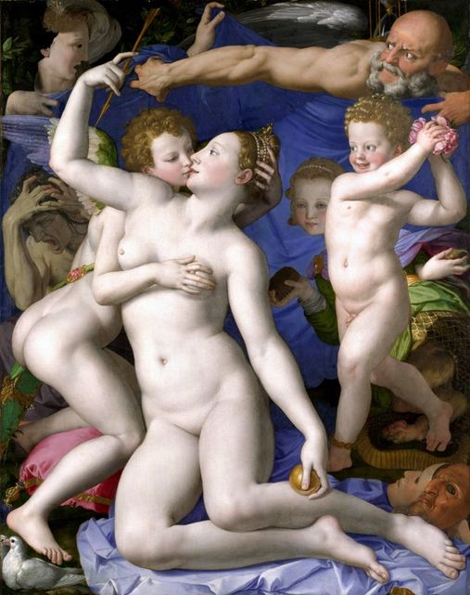
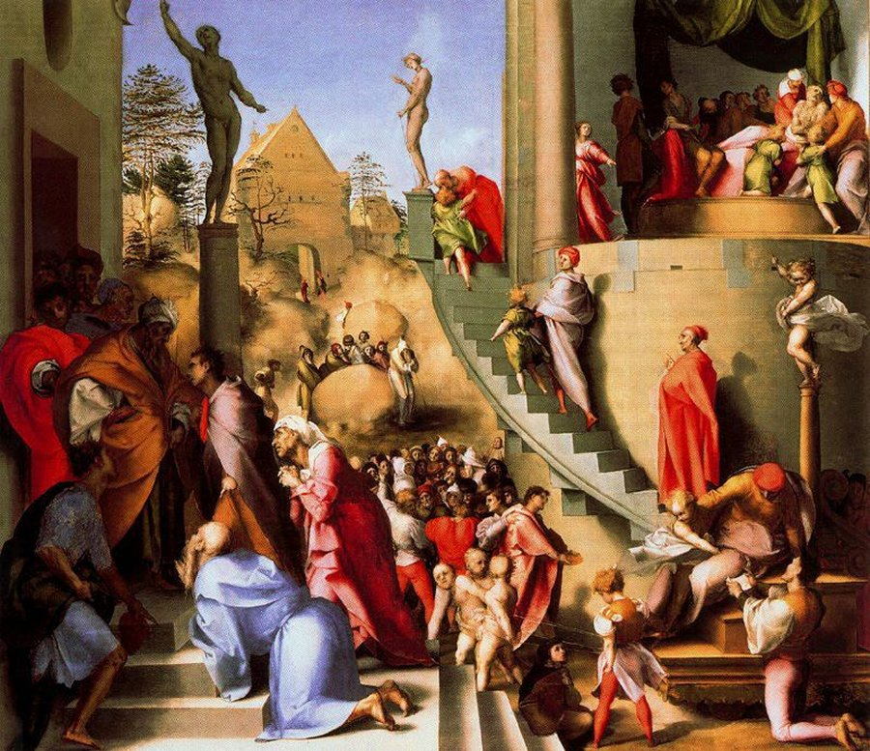
Mannerism was a style which followed the Renaissance. Mannerist artists created complex compositions filled with elongated figures in contrived poses and gestures.
The works were often allegorical and there was a focus on elegance and surface appearance rather than works with a moral message. These works appealed to a wealthy and educated audience.

Slide 5
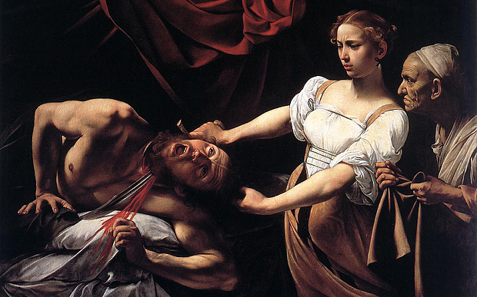
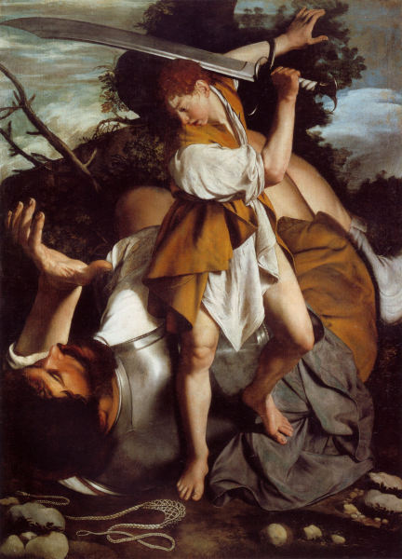
Baroque was a reaction against the superficiality of Mannerism.
Baroque art was created to be direct and easily understood by the viewer.
The Catholic Church was under pressure due to the Reformation.
In an attempt to bring people back to Catholicism, artists were commissioned to create
works of art which told stories from the Bible or the lives of saints.
Artists focussed on the key moment in these stories, showing the most important part
of the narrative and used light, dramatic poses/gestures, clear details and realism.

Slide 6
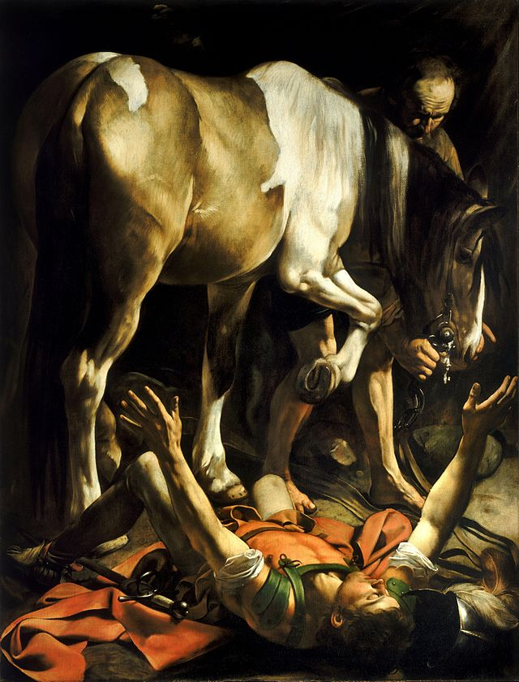
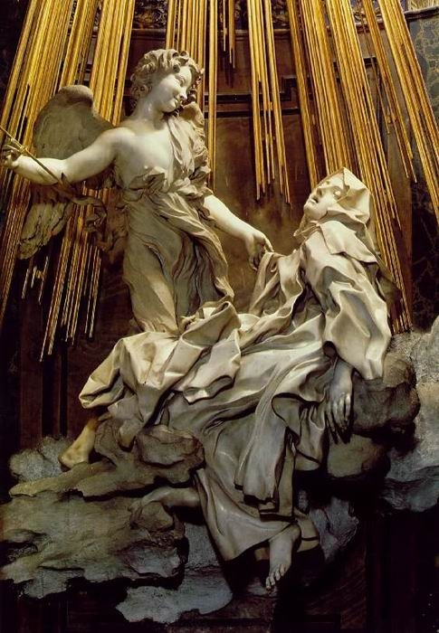
Caravaggio, The Conversion of St Paul, 1601
230 cm × 175 cm
Bernini, The Ecstasy of St Teresa, 1647–52
life-sized

Slide 7
