Slide 1
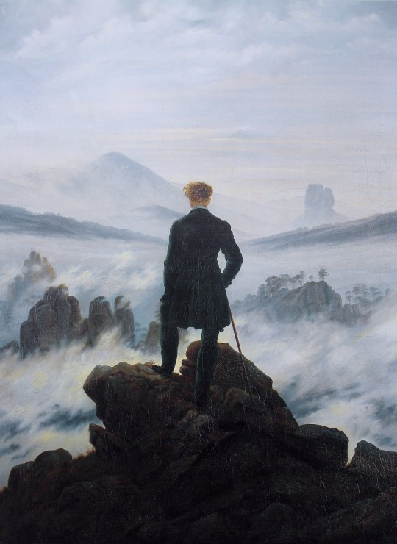
Romanticism

Slide 2
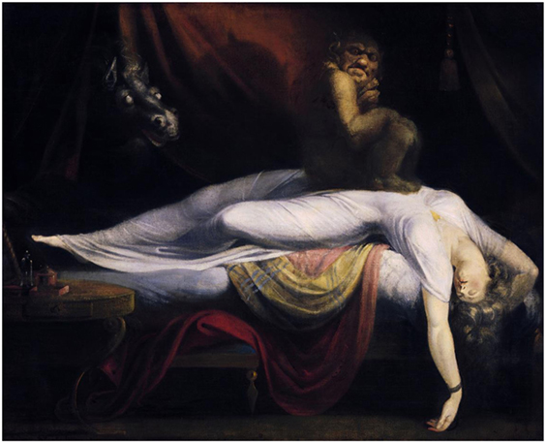
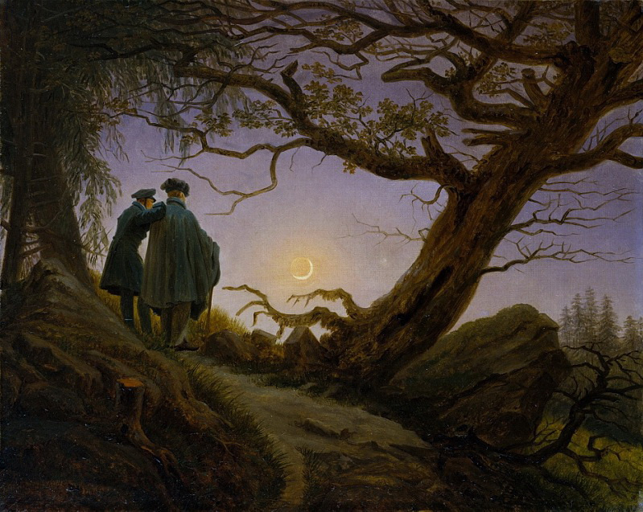
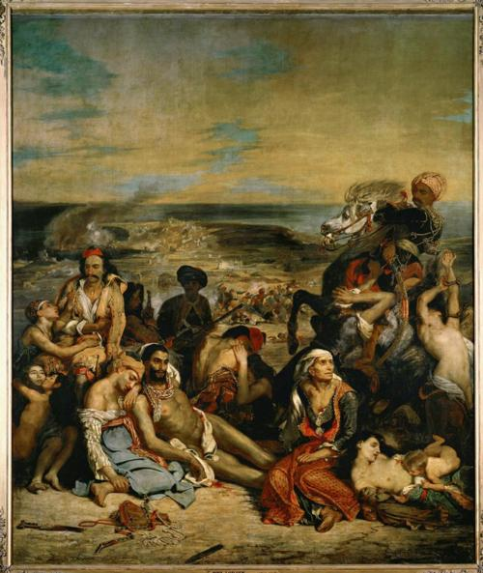
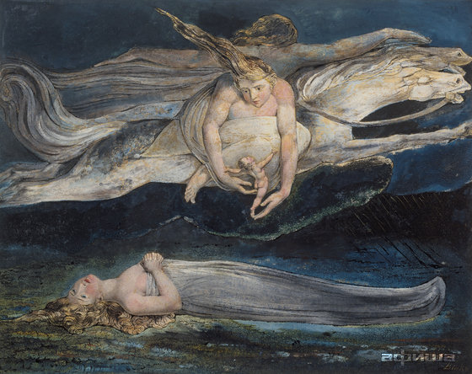
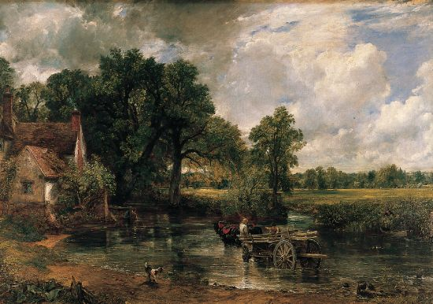
Romanticism
https://www.youtube.com/watch?v=OiRWBI0JTYQ

Slide 3
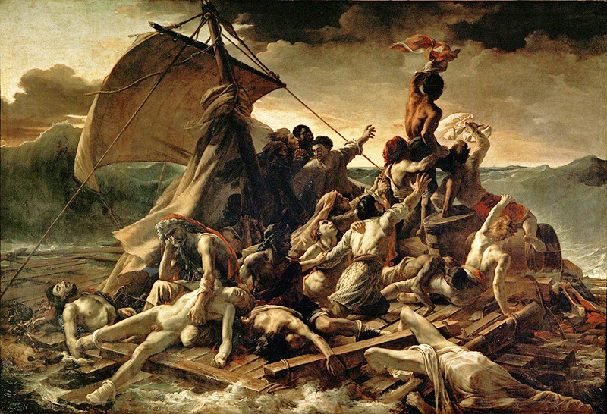
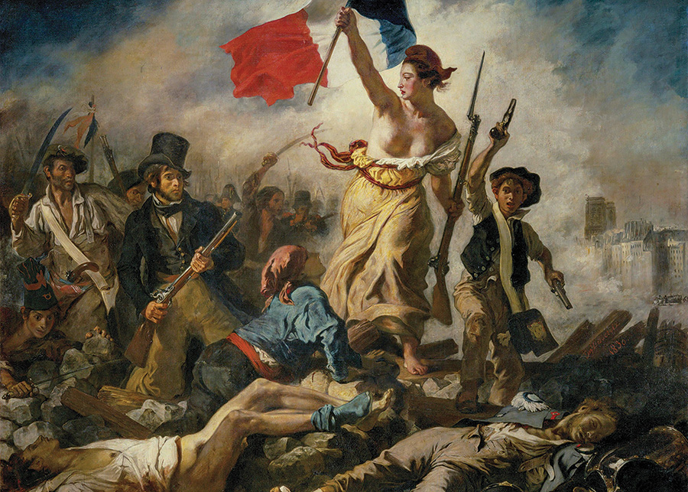
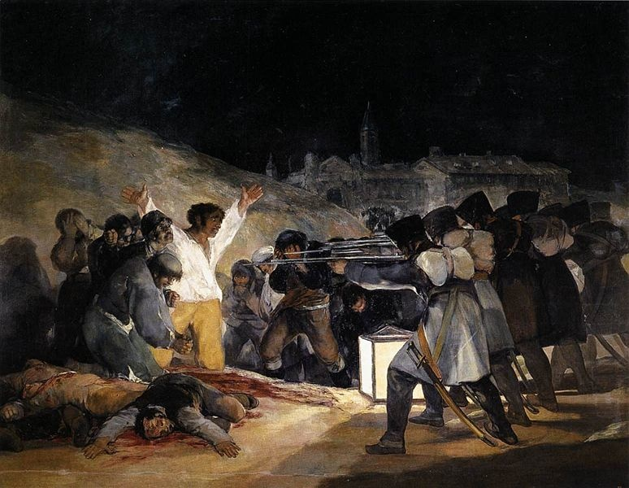
In groups, create a powerpoint on one of the following paintings. Research the subject of the work and explain how it’s Romantic in style. You will present your work to the rest of the class.
Caspar David Friedrich,
Wanderer Above a Sea of Fog
Gericault,
The Raft of the Medusa
Delacroix, Liberty Leading the People
Goya, Third of May, 1808

Slide 4
One person can make the PowerPoint, with other team members researching the work itself. If necessary, include other examples by the artist which also fit into the category of Romanticism.
Think of Romantic concepts including:
Sublime
Passionate
Individuality
Anti-order
Originality
Imagination
Visionary
Emotion
Nature
Rebellion
Violence
Dramatic

