Slide 1
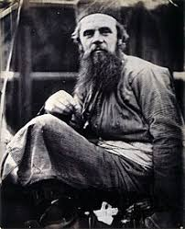
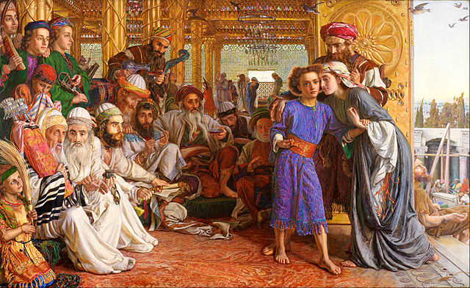
Specified Artist: William Holman Hunt
Founding member of the Pre-Raphaelite Brotherhood
Studied at the Royal Academy, where he met Millais
Gained the support of John Ruskin and followed many of the
principles of Ruskin including truth to nature
Deeply spiritual, Holman Hunt made many visits to the Holy Land
and the Middle East in search of locations and models for his religious themed works

Slide 2
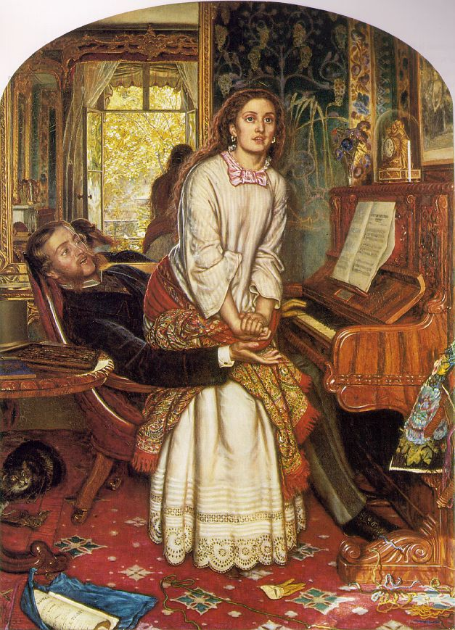
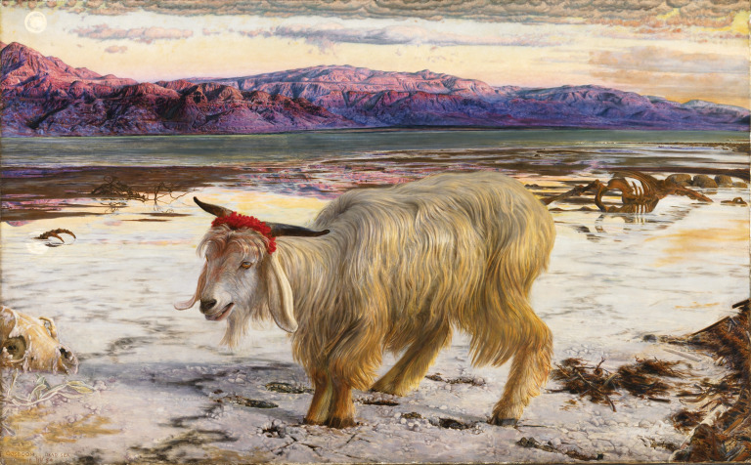
His contemporary genre scenes also contained moralising messages which would be popular with a conservative Victorian audience
His works are characterised by intense detail, symbolism, accurate observation of figures and forms
He pioneered painting en plein air as did Millais

Slide 3
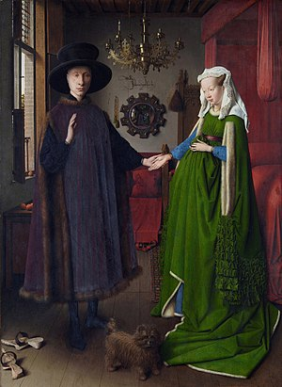
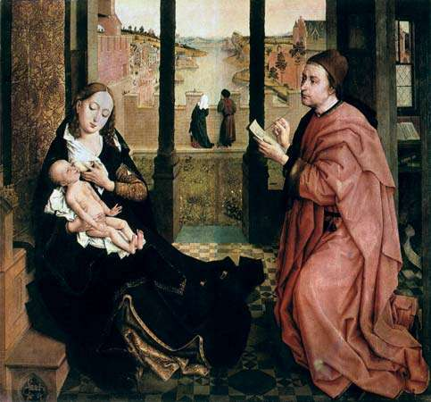
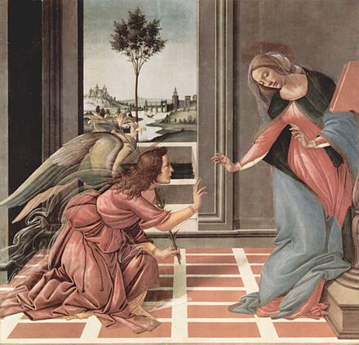
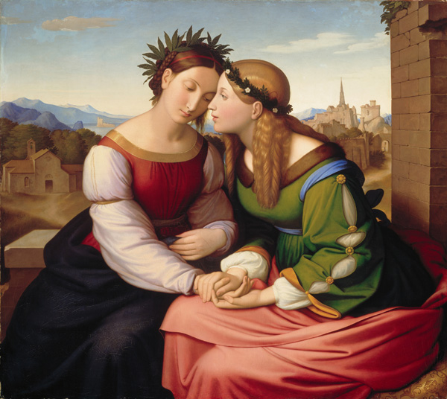
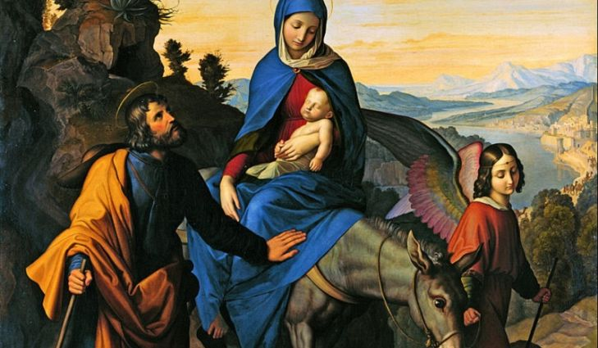
The works of Northern Renaissance artists such as Jan Van Eyck and Rogier Van Der
Weyden were an inspiration, as were early Renaissance artists from the 15th Century
and also the Nazarenes- a German group of artists from the early 1800s

Slide 4
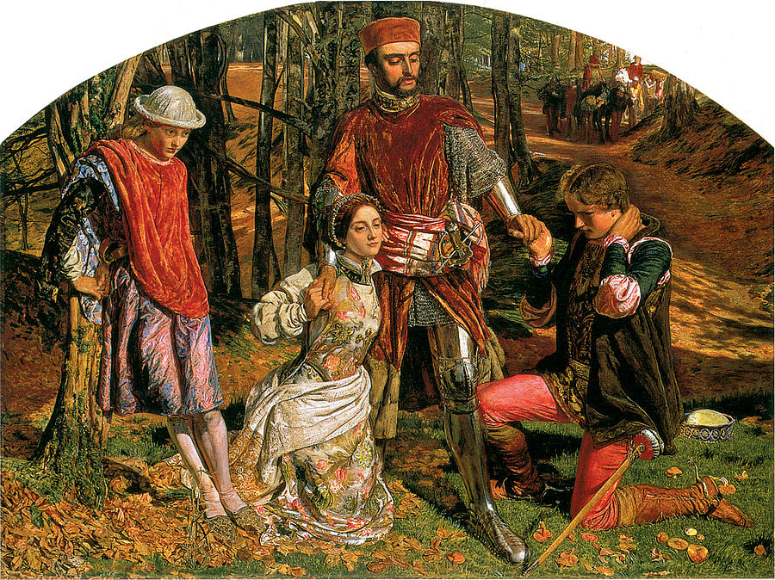
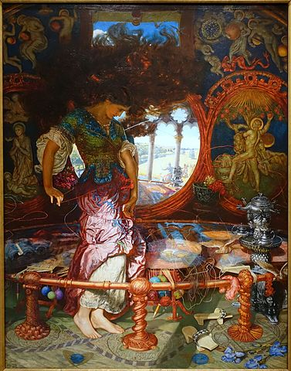
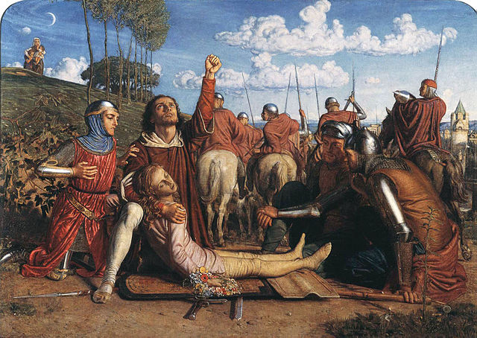
Because of the Pre-Raphaelites’ interest in medieval literature, many of Holman Hunt’s works
are based on medieval subjects. He also referenced Romantic and Victorian literature

Slide 5
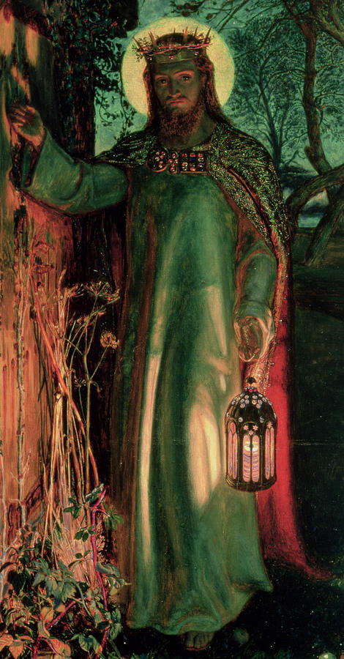
His works received such acclaim during the Victorian era that many of his paintings were toured around the world. One example was sent to Australia and estimates say it was seen by 100 people every minute and seen by 2 million in total
In 1905 he received the Order of Merit, a prestigious award
given to people who excel in a particular field such as the
military, the Sciences, the Arts
Thousands turned out to his funeral at St Paul’s Cathedral- where he’s buried
His obituary in the Times compared him to other artists buried in St Paul’s, stating ‘none of them ever worked more strenuously or successfully than he to inspire his fellow men to lofty ideals and to wed beauty with religion’

Slide 6
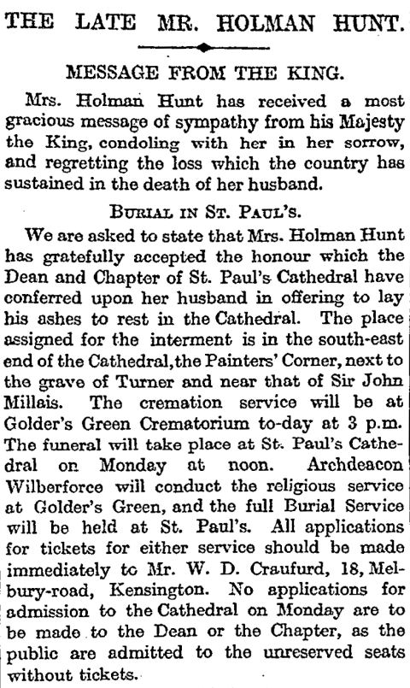
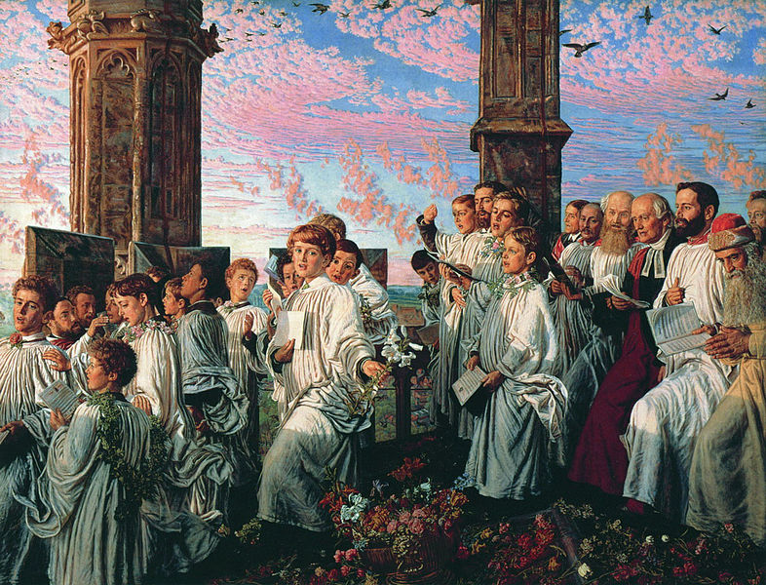

Slide 7
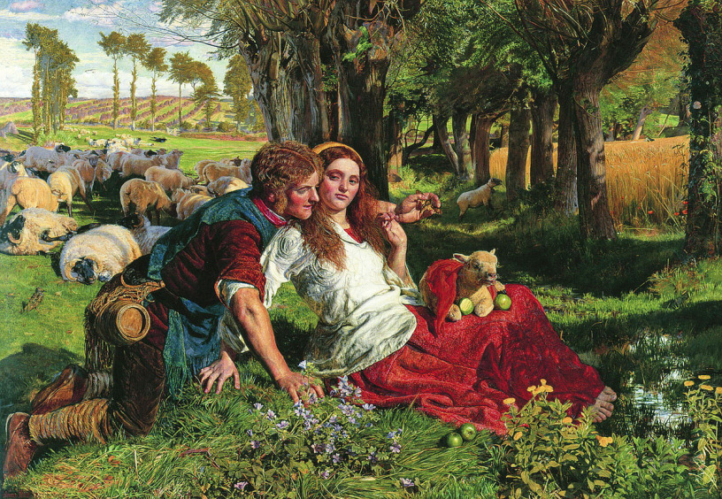
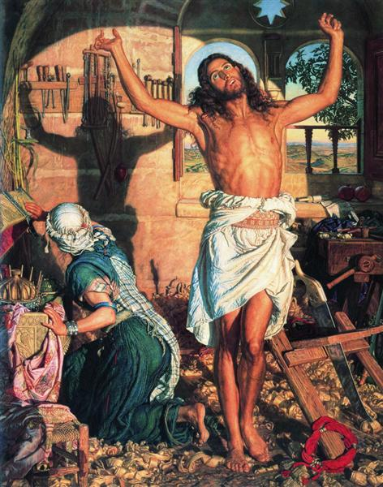
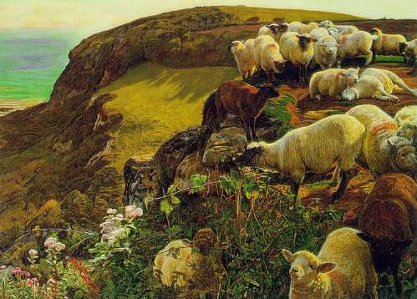
Key works for Specified Artist
The Hireling Shepherd, 1851
The Shadow of Death, completed 1873
Our English Coasts 1852, 1852

