Slide 1
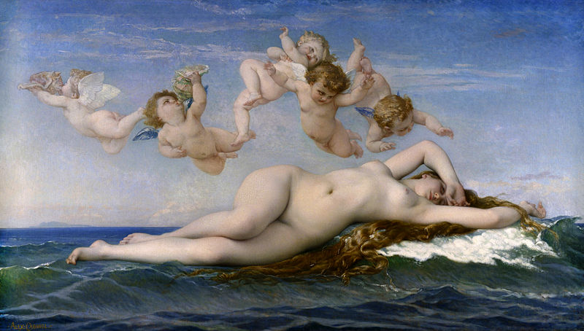
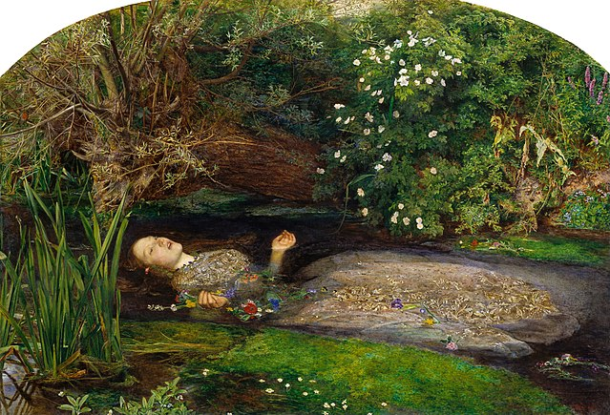
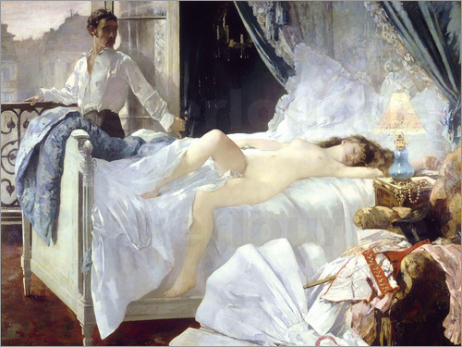
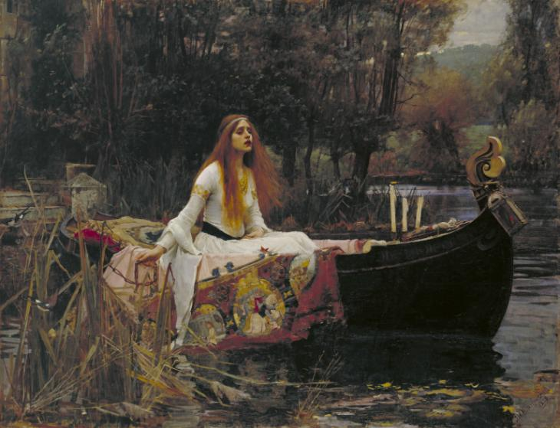
Mythological and Literary Subjects in 19th Century art
Mythological and literary subjects were a particularly popular theme in 19th Century art
Consider why there was a such a rise in popularity with these subjects at this time
What social and cultural factors have occurred to explain this?

Slide 2
Alexandre Cabanel, The Birth of Venus, 1863, oil on canvas, 130 cm × 225 cm
Mythological: Research the ‘origin’ myth of Venus. How was she born?
Style: This work is considered Academic in style. Explain why
How does this work fit within the theme of mythological painting? Can you see a narrative?
Alexandre Cabanel was one of the most famous and popular artists of his day. How does this work differ
to the French avant-garde paintings we have studied?

Slide 3
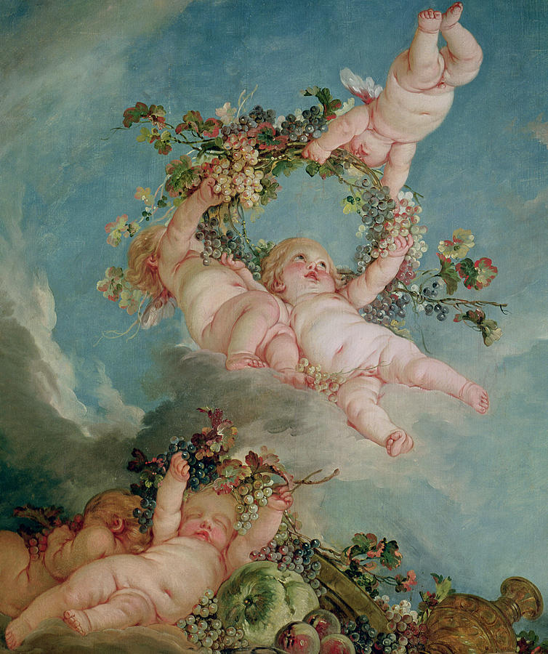
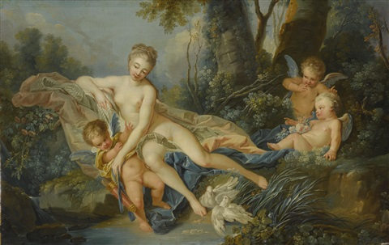
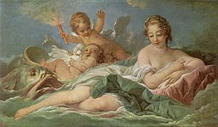
The inclusion of the putti is similar to those found in works by the 18th Century Rococo artist François Boucher. The pastel colouring and treatment of a mythological subject is likewise typical of Boucher.
There was a major revival of the Rococo style during the French Second Empire in painting and the decorative arts. Cabanel is responding to this taste for 18th Century art in The Birth of Venus

Slide 4
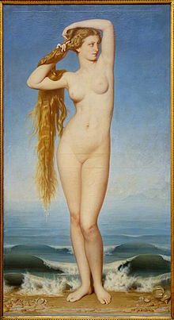
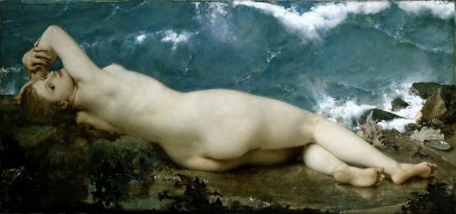
The painting was shown to great success at the 1863 Paris Salon and was one of a number of depictions of Venus exhibited in the Salon that year. Critics would nickname that year’s Salon ‘the Salon of Venus’.
The Emperor Napoleon III bought Cabanel’s Venus for his private collection.
What do such works tell us about the Salon audience of the time?
Consider the struggles facing avant-garde artists such as the Realists or the Impressionists when faced with competition from Academic artists.

Slide 5
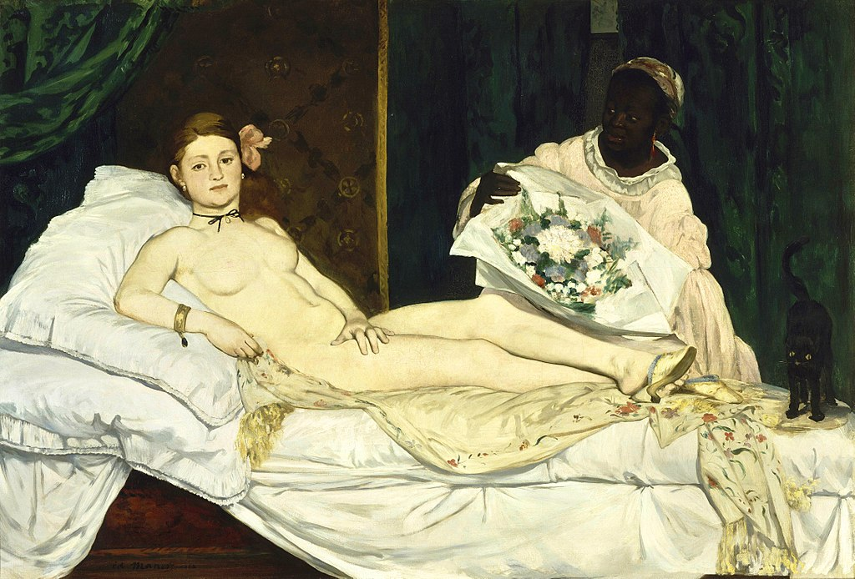
Cabanel was seen as a quintessential Academic artist, but was also a strong opponent of the Impressionists and in particular Manet.
Manet painted Olympia the same year that Cabanel painted his Birth of Venus.
How does Manet’s avant-garde female nude differ in terms of technique and presentation of the female figure to Cabanel’s?

Slide 6
Despite being awarded the Gold Medal for this painting and receiving the Legion of Honour for his contribution to art Cabanel faced criticism from supporters of avant-garde art.
The writer and critic Emile Zola (who was Manet’s main supporter) described Cabanel’s depiction of Venus as a goddess, drowned in a sea of milk, resembles a delicious courtesan, but not of flesh and blood – that would be indecent – but made of a sort of pink and white marzipan…
Another writer and critic, Théophile Gautier, was also sceptical of the nude figure and wrote: one has drawn aside curtains to reveal a young woman asleep; she reclines on her bed, the crest of a wave, stretches out her arms…abandons herself to the waves that rock her…..The swell makes her body arch and accentuates her youthful charms all the more strongly…

Slide 7
Describe the figure/form of Venus, how has she been painted/presented to the viewer? Look also at colour, composition, light/tone, technique. This work can also be used to answer a question on the ‘female figure in painting’.

