Slide 1
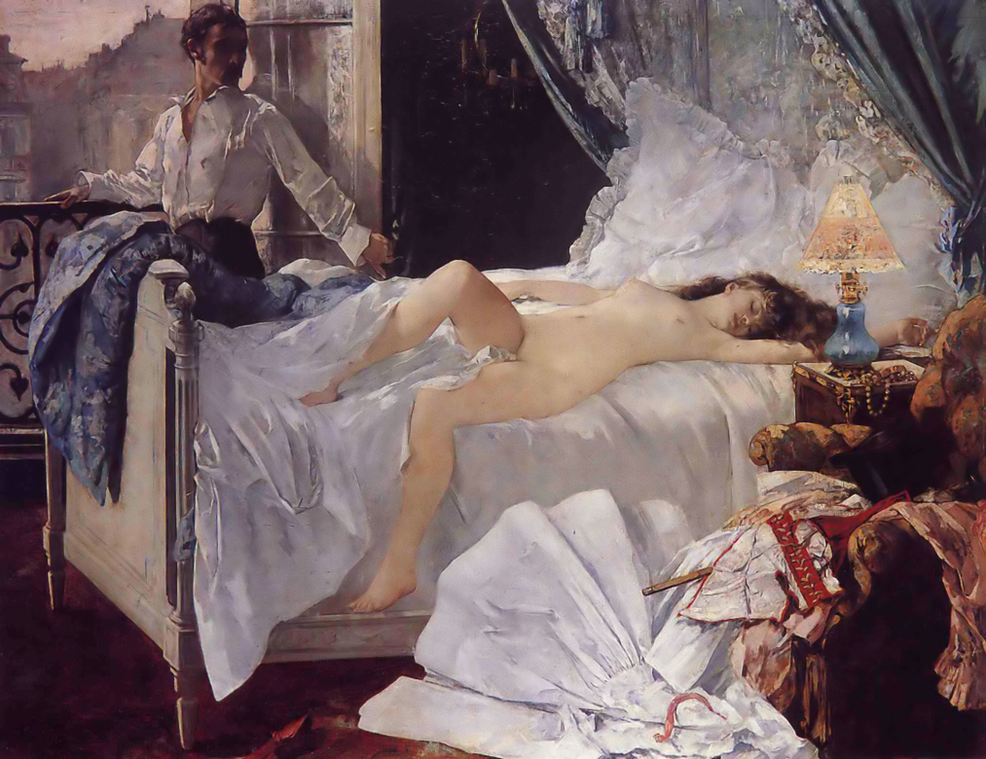
Henri Gervex, Rolla, 1878, oil on canvas, 175 x 220cm

Slide 2
Scope of work: Literary subjects in painting
Based on the poem ‘Rolla’ by Alfred Musset
Rolla published in 1833 describes a young man called Jacques Rolla who has wasted his inheritance on
drinking and free-living
He meets Marie, a young prostitute who is seeking an escape from the misery of her life
This painting depicts Rolla the morning after a night spent with Marie.
Rolla stands at a window, overlooking Paris and realises he has wasted not only his money but his life
While Marie sleeps he decides to end his life
In the poem, Marie wakes and tries to persuade Rolla that she loves him and is willing to sell her only possession of value ( a gold necklace) to pay some of his debts
Rolla however drinks poison and kisses Marie before dying in her arms
When from her living breast she raised his drooping head,
Pallid with staring eyes, Jacques Rolla fell back dead.
His spirit forth had flown in that chaste, tender kiss
But for a moment both had known love’s holy bliss

Slide 3
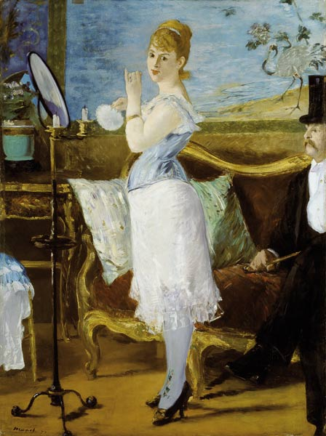
Gervex trained under Cabanel. His technique is a combination of academic painting and elements of realism
Marie is shown as idealised, typical of academic female nudes of the period
Soft light puts a focus on her as she fills the centre of the composition
Rolla’s face is shown in shadows, giving him an ambiguous appearance and suggests his mind is clouded with dark thoughts
Gervex was friends with avant-garde painters including Manet and Degas. He was inspired by Manet’s painting Nana which depicts of prostitute of that era
Degas encouraged Gervex to break with the idealism of Academic art by adding realism to the scene. In the foreground Gervex depicts a pile of discarded clothing and it was this frank display of a controversial subject which caused a scandal rather than the nude figure of Marie
The work was banned from the 1878 Paris Salon. Gervex instead exhibited it in a privately owned gallery for three months where thousands queued to see the controversial work

Slide 4
(Jacques) Rolla
Marie
Table lamp still
burning in the morning
Paris viewed through an open window
Marie’s necklace, mentioned in the poem
Marie’s discarded clothes including a corset
Bedroom decorated in ostentatious, expensive Rococo Revival furniture- popular with the bourgeoisie
Rolla’s cane/walking stick

Slide 5
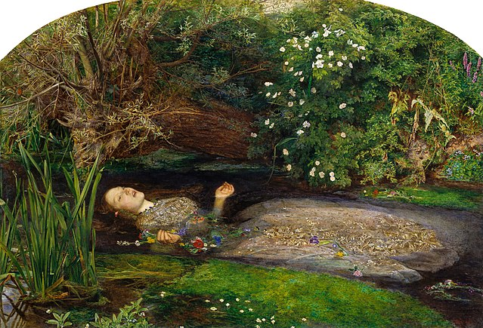
Consider the differences between these two depictions of literary subjects.
Think about the content of each work, the treatment of figure, setting, props, technique

