Slide 1
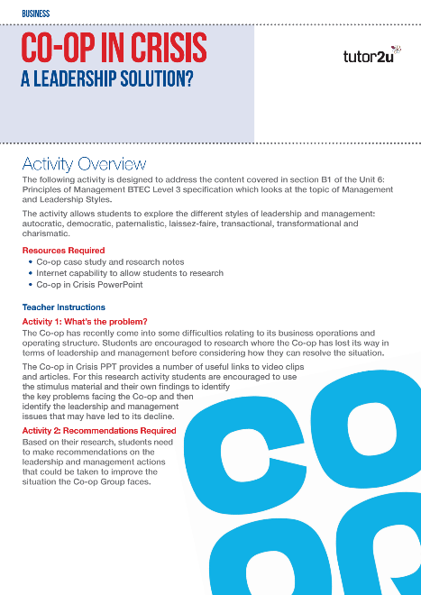
Unit 6: Principles of Management
Management and Leadership Styles
Useful links to stimulus material for Co-op in Crisis Resource

Slide 2
“The results today represent a disaster for the Co-op in 2013”

Slide 3
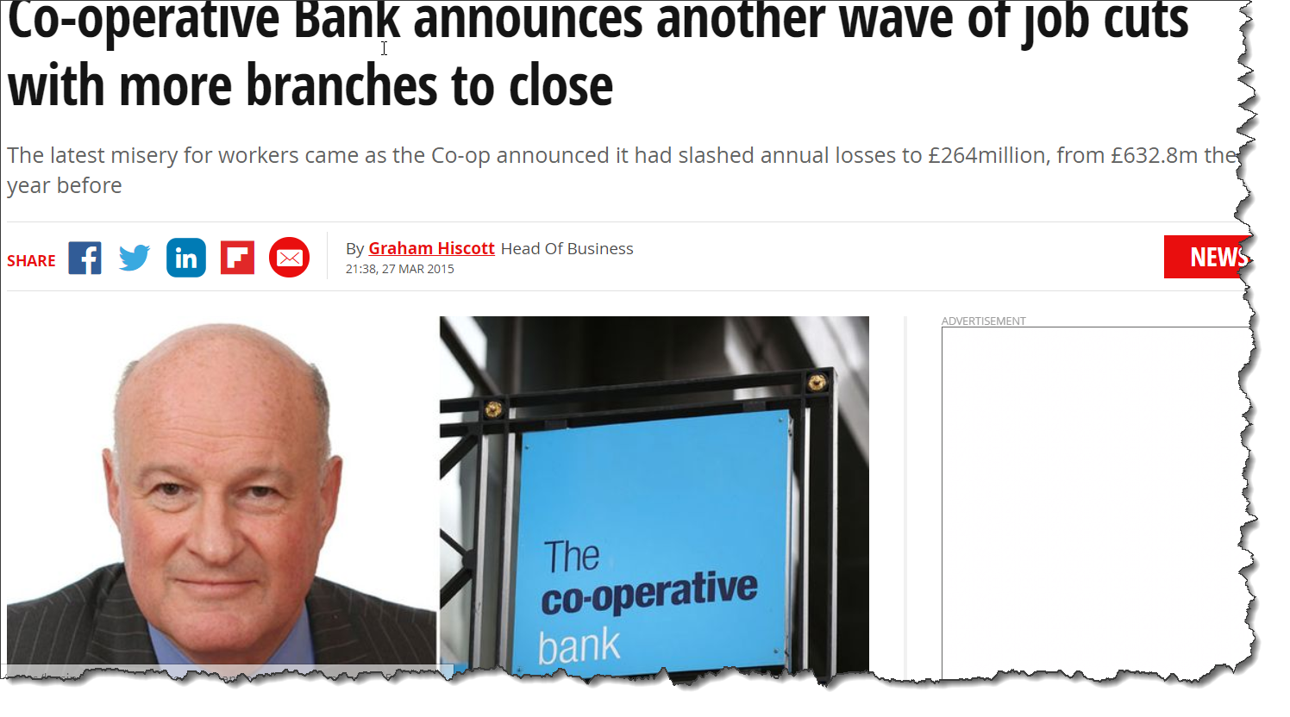
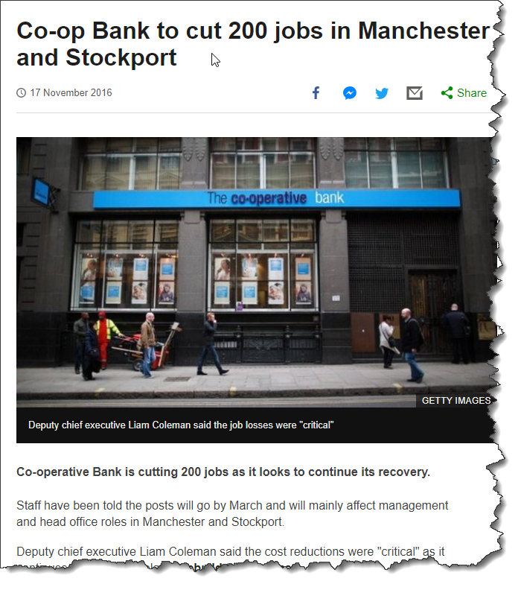
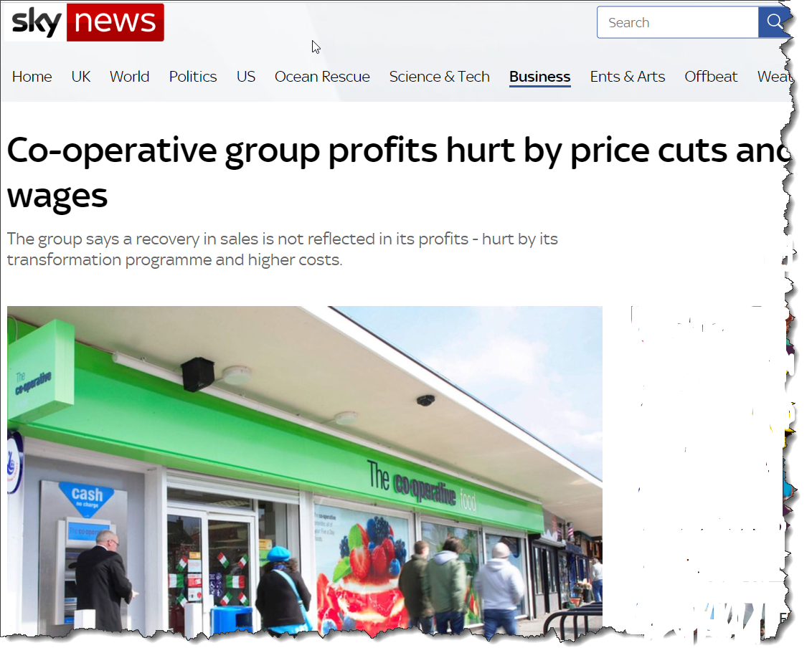
How the Co-op group struggled…

Slide 4
2018 – A Positive Outlook for the Co-op
Discuss the impact of leadership and management on the
Co-op group’s improvement in business performance

