Slide 1

Ryanair Case Study
Activity 1
Management and Leadership
Relevant issues and theory to discuss

Slide 2
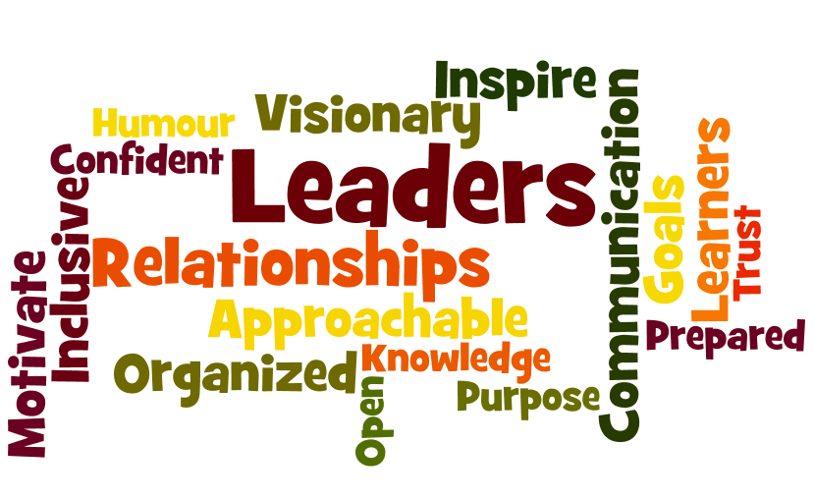
What are the qualities you need to be a successful chief executive?
Instilling an inspiring vision?
Motivating?
Decision making?
Team Building?
Problem Solving?
Consulting?
Communicating?
Leading by example?
Managing conflict?
Using emotional intelligence?

Slide 3
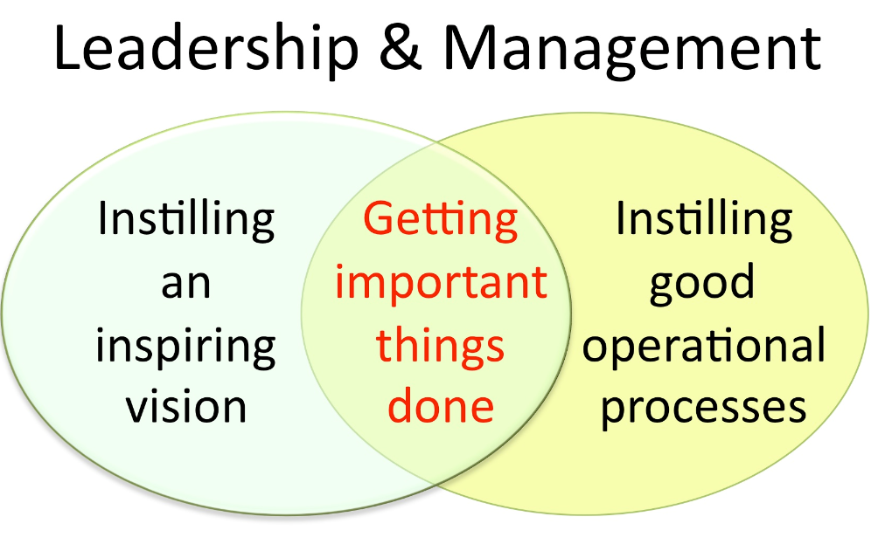
Notes:
www.businesscasestudies.co.uk (A series of real-life business cases studies on a variety of management-related issues.)
Leadership: The eight essential skills
1. Give a clear sense of direction
2. Bring the customer into the boardroom
3. Communicate clearly - inside and out
4. Be flexible but not floppy
5. Take risks but don’t bet the company
6. Build the team around you
7. Listen with humility, act with courage
8. Earn your reward through building trust

Slide 4
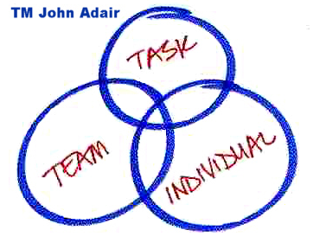
Action Centred Leadership
John Adair's Action-Centred Leadership model provides a simple model for leadership and the management of any team, group or organisation.
Good managers and leaders should have full command of the three main areas of the model, and should be able to use each of the elements according to the situation.
Keeping the right balance, gets results, builds morale, improves quality, develops teams and productivity, and is the mark of a successful manager and leader.
Notes:
www.johnadair.co.uk (Articles and media on Adair’s work)
www.businessballs.com (Action centred leadership)
John Adair's Action Centred Leadership - a model for team leadership and management
John Adair's simple Action-Centred Leadership model provides a great blueprint for leadership and the management of any team, group or organization.
Action Centred Leadership is also a simple leadership and management model, which makes it easy to remember and apply, and to adapt for your own situation.
Good managers and leaders should have full command of the three main areas of the Action Centred Leadership model, and should be able to use each of the elements according to the situation.
Being able to do all of these things, and keep the right balance, gets results, builds morale, improves quality, develops teams and productivity, and is the mark of a successful manager and leader.

Slide 5
Transformational and Transactional
Transactional leaders focus on the role of supervision, organisation, and group performance. They are concerned about the status quo and day-to-day progress toward goals.
Transformational leaders work to enhance the motivation and engagement of followers by directing their behaviour toward a shared vision
Notes:
http://www.bized.co.uk (Leadership and management)
https://www.mindtools.com/pages/article/transformational-leadership.htm
Transformational?
Harriet Green – Thomas Cook
George Davies – Next, Asda
Gandhi
Nelson Mandela
Alex Ferguson
Ronaldo
Beckham
Steve Jobs
Jeremy Corbyn?
Transactional?
Theresa May
John Scully (ousted Steve Jobs from Apple)

Slide 6
Transactional leaders
And, they do this by closely monitoring performance. If an employee does what is asked of them, a reward may follow. If not, the leader will intervene to clarify expectations and reinforce goals.
Sometimes they will use punishment when performance is unacceptable.
Notes:
If people are good only because they fear punishment, and hope for reward, then we are a sorry lot indeed. – Albert Einstein

Slide 7

types of managers & leaders
Fiedler’s Situational Contingency Theory
The Concept of Leadership Continuum for Management Behaviour
McGregor X and Y Manager Theory
Notes:
http://www.bized.co.uk (Leadership and management)
www.mindtools.com

Slide 8
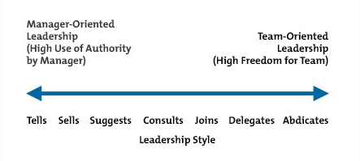
Tannenbaum-Schmidt leadership continuum for management behaviour
Notes:
The Tannenbaum-Schmidt Continuum shows where a manager's approach lies on a continuum, running from the manager exerting rigid authority at one extreme, through to the team having full freedom to act at the other.
One popular approach to leadership, the "contingency" approach, argues that your choice should be based on the situation, and not on your personal preferences (here, "contingency" means that your approach is dependent on, or contingent upon, the situation).
In 1958, contingency theorists Robert Tannenbaum and Warren Schmidt identified a continuum of seven distinct leadership styles, which they published in the Harvard Business Review. By understanding this continuum, you can see some of the options available to you, and these help you think about which leadership style is most appropriate in a given situation.

Slide 9
Tannenbaum-Schmidt leadership continuum for management behaviour
Notes:
The Tannenbaum-Schmidt Continuum shows where a manager's approach lies on a continuum, running from the manager exerting rigid authority at one extreme, through to the team having full freedom to act at the other.
One popular approach to leadership, the "contingency" approach, argues that your choice should be based on the situation, and not on your personal preferences (here, "contingency" means that your approach is dependent on, or contingent upon, the situation).
In 1958, contingency theorists Robert Tannenbaum and Warren Schmidt identified a continuum of seven distinct leadership styles, which they published in the Harvard Business Review. By understanding this continuum, you can see some of the options available to you, and these help you think about which leadership style is most appropriate in a given situation.

Slide 10
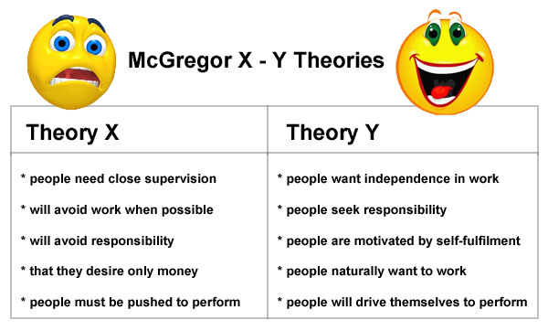
Mcgregor
Notes:
Theory x
Workers are motivated by money
Workers are lazy and dislike work, they must be pushed to perform
Workers are selfish and ignore the needs of organisations
Workers avoid responsibility and lack ambition
Workers need to be controlled and directed by management
Theory Y
Workers have many different needs which motivate them
Workers can enjoy work, they are motivated by self fulfilment
People want independence and responsibility
If motivated, workers can organise themselves and drive themselves to perform
Management should create a situation where workers can show creativity and apply their job knowledge

Slide 11
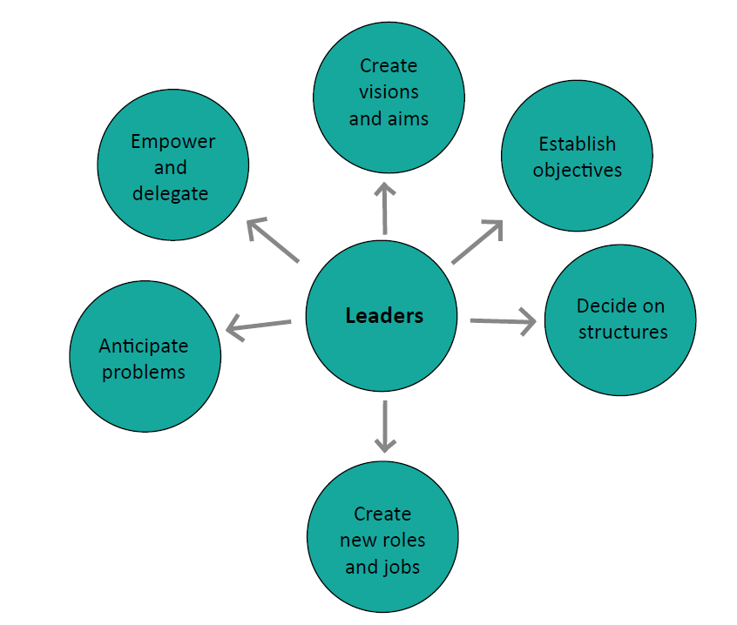
Leadership skills
Intellectual
Interpersonal
Realistic aspirations
Vision
Communication
Creativity
Commitment
Identify and respond to change
Notes:
Leadership is an important function in small business. Leadership and management represent two completely different business concepts. Leadership is commonly defined as establishing a clear vision, communicating the vision with others and resolving the conflicts between various individuals who are responsible for completing the company&amp;rsquo;s vision. Management is the organization and coordination of various economic resources in a business. Leadership can have a significant impact on an organization&amp;rsquo;s performance.

Slide 12
Leadership skills
Intellectual
Interpersonal
Realistic aspirations
Vision
Communication
Creativity
Commitment
Identify and respond to change
Notes:
Leadership is an important function in small business. Leadership and management represent two completely different business concepts. Leadership is commonly defined as establishing a clear vision, communicating the vision with others and resolving the conflicts between various individuals who are responsible for completing the company&amp;rsquo;s vision. Management is the organization and coordination of various economic resources in a business. Leadership can have a significant impact on an organization&amp;rsquo;s performance.

Slide 13
Democratic (Participative)
Focus of power is more with the group as a whole
Leadership functions are shared within the group
Employees have greater involvement in decision-making – but potentially this slows-down decision-making
Emphasis on delegation and consultation – but the leader still has the final say
Perhaps the most popular leadership style because of the positive emotional connotations of acting democratically
A potential trade-off between speed of decision-making and better motivation and morale?
Likely to be most effective when used with skilled, free-thinking and experienced subordinates
Notes:
The democratic leadership style consists of the leader sharing the decision-making abilities with group members by promoting the interests of the group members and by practicing social equality.^{[5]}
The boundaries of democratic participation tend to be circumscribed by the organization or the group needs and the instrumental value of people's attributes (skills, attitudes, etc.). The democratic style encompasses the notion that everyone, by virtue of their human status, should play a part in the group's decisions. However, the democratic style of leadership still requires guidance and control by a specific leader. The democratic style demands the leader to make decisions on who should be called upon within the group and who is given the right to participate in, make and vote on decisions.^{[6]} Traits of a Good Leader compiled by the Santa Clara University and the Tom Peters Group:
Honest – Display sincerity, integrity, and candor in all your actions. Deceptive behavior will not inspire trust.
Competent – Base your actions on reason and moral principles. Do not make decisions based on childlike emotional desires or feelings.
Forward-looking – Set goals and have a vision of the future. The vision must be owned throughout the organization. Effective leaders envision what they want and how to get it. They habitually pick priorities stemming from their basic values.
Inspiring – Display confidence in all that you do. By showing endurance in mental, physical, and spiritual stamina, you will inspire others to reach for new heights. Take charge when necessary.
Intelligent – Read, study, and seek challenging assignments.
Fair-minded – Show fair treatment to all people. Prejudice is the enemy of justice. Display empathy by being sensitive to the feelings, values, interests, and well-being of others.
Broad-minded – Seek out diversity.
Courageous – Have the perseverance to accomplish a goal, regardless of the seemingly insurmountable obstacles. Display a confident calmness when under stress.
Straightforward – Use sound judgment to make a good decisions at the right time.
Imaginative – Make timely and appropriate changes in your thinking, plans, and methods. Show creativity by thinking of new and better goals, ideas, and solutions to problems. Be innovative!
Research has found that this leadership style is one of the most effective and creates higher productivity, better contributions from group members and increased group morale. Democratic leadership can lead to better ideas and more creative solutions to problems because group members are encouraged to share their thoughts and ideas. While democratic leadership is one of the most effective leadership styles, it does have some potential downsides. In situations where roles are unclear or time is of the essence, democratic leadership can lead to communication failures and uncompleted projects. Democratic leadership works best in situations where group members are skilled and eager to share their knowledge. It is also important to have plenty of time to allow people to contribute, develop a plan and then vote on the best course of action.[

Slide 14
motivating
Motivation is about the ways a business can encourage staff to work hard
Increased output results by extra effort from workers.
Improved quality as staff take a greater pride in their work.
A higher level of staff retention. Workers are keen to stay with the firm and also reluctant to take unnecessary days off work.
Notes:
http://www.bbc.co.uk/schools/gcsebitesize/business/people/motivationrev1.shtml
Companies can motivate employees to do a better job than they otherwise would. Incentives that can be offered to staff include increased pay or improved working conditions. Motivational theories suggest ways to encourage employees to work harder.
What is motivation?
Motivation is about the ways a business can encourage staff to give their best. Motivated staff care about the success of the business and work better. A motivated workforce results in:
Increased output caused by extra effort from workers.
Improved quality as staff take a greater pride in their work.
A higher level of staff retention. Workers are keen to stay with the firm and also reluctant to take unnecessary days off work.
Managers can influence employee motivation in a variety of ways
Monetary factors: some staff work harder if offered higher pay.
Non monetary factors: other staff respond to incentives that have nothing to do with pay, eg improved working conditions or the chance to win promotion.
Payment methods
Managers can motivate staff by paying a fair wage. Payment methods include:
Time rate: staff are paid for the number of hours worked.
Overtime: staff are paid extra for working beyond normal hours.
Piece rate: staff are paid for the number of items produced.
Commission: staff are paid for the number of items they sell.
Performance related pay: staff get a bonus for meeting a target set by their manager.
Profit sharing: staff receive a part of any profits made by the business.
Salary: staff are paid monthly no matter how many hours they work.
Fringe benefits: are payments in kind, eg a company car or staff discounts.
Non-pay methods of motivation
Managers can motivate staff using factors other than pay through:
Job rotation: staff are switched between different tasks to reduce monotony.
Job enlargement: staff are given more tasks to do of similar difficulty.
Job enrichment: staff are given more interesting and challenging tasks.
Empowerment: staff are given the authority to make decisions about how they do their job.
Putting groups of workers in a team who are responsible together for completing a certain task.

Slide 15
What are the qualities you need to be a successful chief executive?
Instilling an inspiring vision?
Motivating?
Decision making?
Team Building?
Problem Solving?
Consulting?
Communicating?
Leading by example?
Managing conflict?
Using emotional intelligence?

