Slide 1
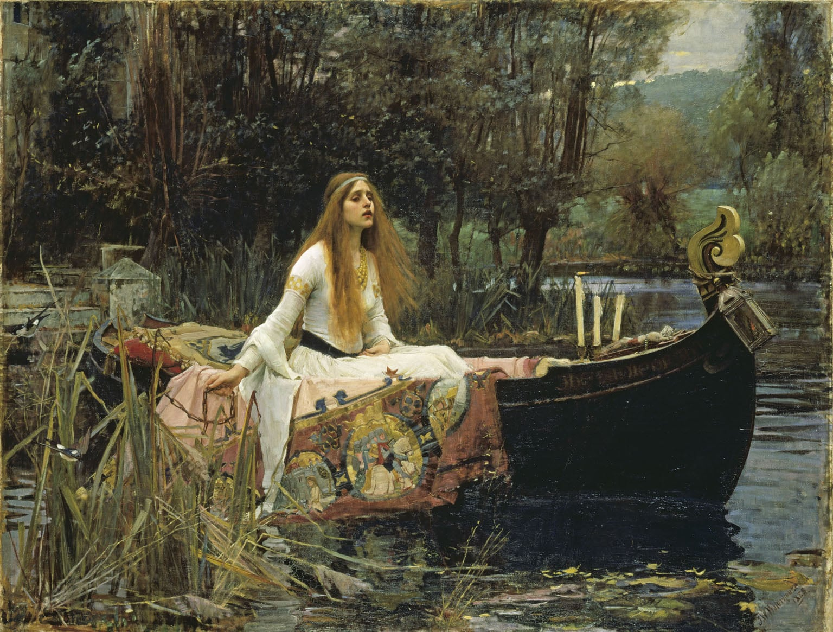
John William Waterhouse, The Lady of Shalott, 1888, oil on canvas, 153 x 200 cm

Slide 2
This painting depicts the final moments from Tennyson’s poem The Lady of Shalott
The poem, written in 1832, is set during the age of King Arthur and was a popular subject with Victorian and Pre-Raphaelite artists due to its romantic and tragic subject matter
The poem tells the story of a lady who lives imprisoned in a tower on an island upstream from Camelot. She is under a curse and compelled to experience life only through looking at reflections in a mirror
She spends her time weaving scenes of the outside world that she sees reflected in the mirror
One day she sees the reflection of Sir Lancelot passing on horseback. She falls in love with his image and goes to the window to see him in reality
The mirror cracks in half and she realises that the curse has come upon her
She is now compelled to leave the tower, she sails a boat downstream to Camelot. However before she reaches her destination she has died
The poem deals with issues such as unrequited love, rebellion, and with frequent references to the natural world. It is set in the Age of Chivalry and uses symbolism to support the narrative.
Waterhouse references these aspects in his painting which illustrates the final verses.

Slide 3
And down the river’s dim expanse
Like some bold seer in a trance,
Seeing all his own mischance –
With glassy countenance
Did she look to Camelot.
And at the closing of the day
She loosed the chain, and down she lay;
The broad stream bore her far away,
The Lady of Shalott.

Slide 4
Candles burning out, symbolising the end of her life
Chain she has loosened
Crucifix suggesting redemption
Distraught
facial
expression
Twilight, illustrating
the closing of the day
Medieval
costume
…and round about the prow she wrote the Lady of Shalott
Tapestry with the scenes of life she has woven including Sir Lancelot on horseback

Slide 5
Painting technique is looser and more fluid than the Pre-Raphaelite’s meticulous method of painting
Waterhouse keeps the focus on a literal depiction of Tennyson’s poem
Large scale gives the work a sense of importance, typical of history painting in the 19th Century
White suggests purity and makes the figure stand out from the background
Naturalistic depiction of water, foliage and wildlife- more Impressionistic than Pre-Raphaelite

Slide 6
The overall colour scheme is dark but realistic and shows a close observation of nature and natural light
The composition is traditional with a centrally placed main character. More detailed areas in the foreground contrast with the looser impressionistic background. This gives atmospheric perspective
to the work.
The whole scene is evenly lit so that we can make out all the details and thus follow the narrative of
painting
The Lady of Shalott’s face shows a realistic depiction of someone distraught or in turmoil
Tennyson’s poetry was popular with a Victorian audience as themes he addressed such as doomed and tragic female characters appealed to the sentimental attitudes of the time
Likewise poems and literature set in medieval times or dealing with themes from England’s mythical past proved popular with Pre-Raphaelites as they
were inspired by the visual art of medieval times
The Lady of Shalott appears in numerous paintings of the period

Slide 7
