Slide 1
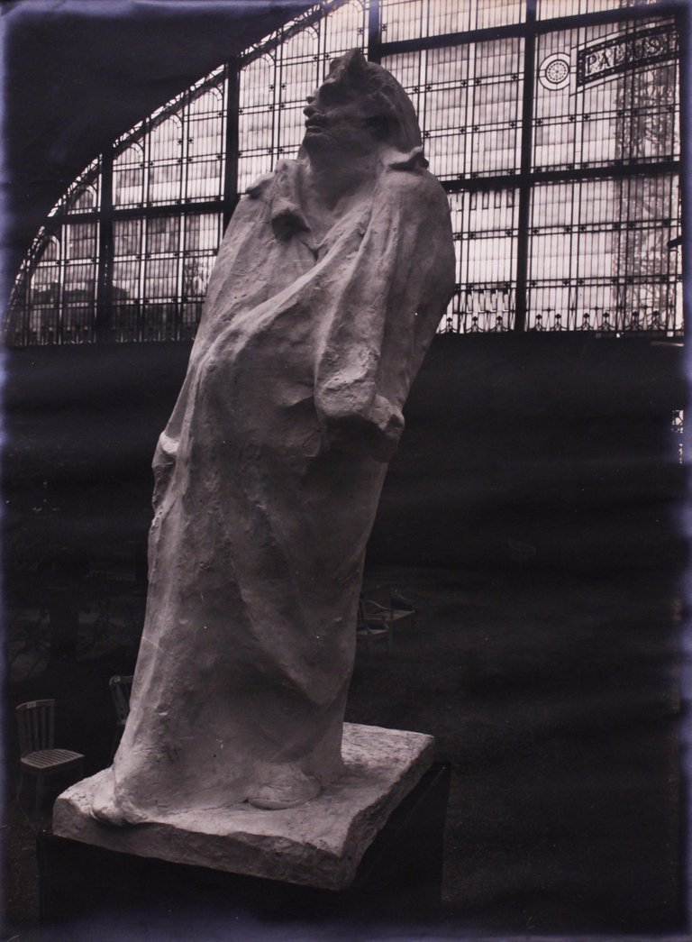
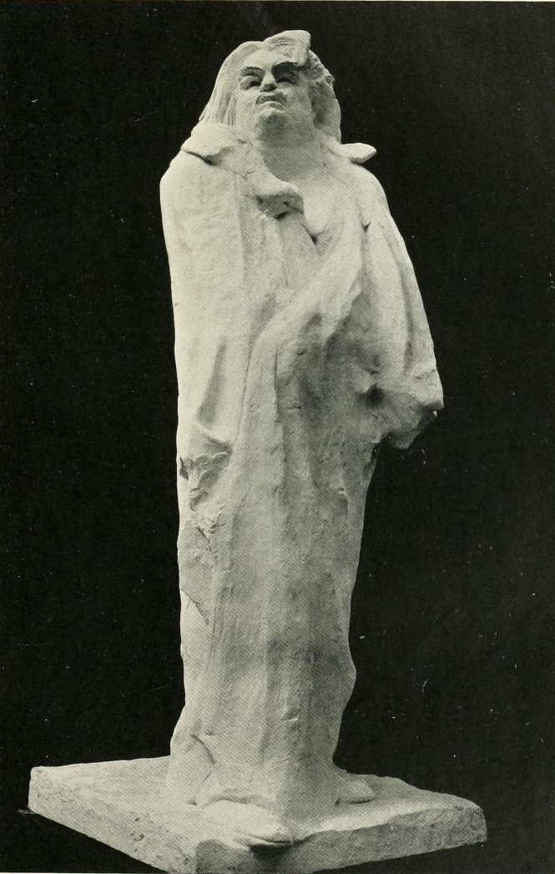
Monument to Balzac (1892-1897) by Auguste Rodin, plaster, 282cm high

Slide 2
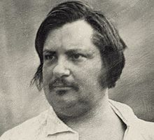
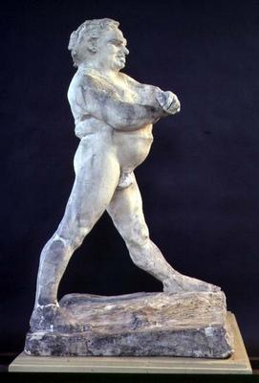
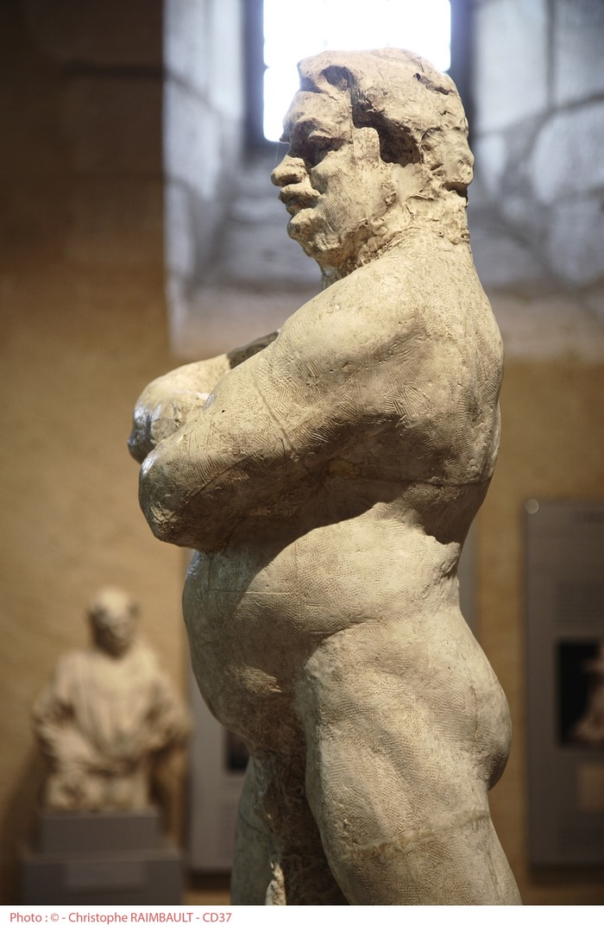
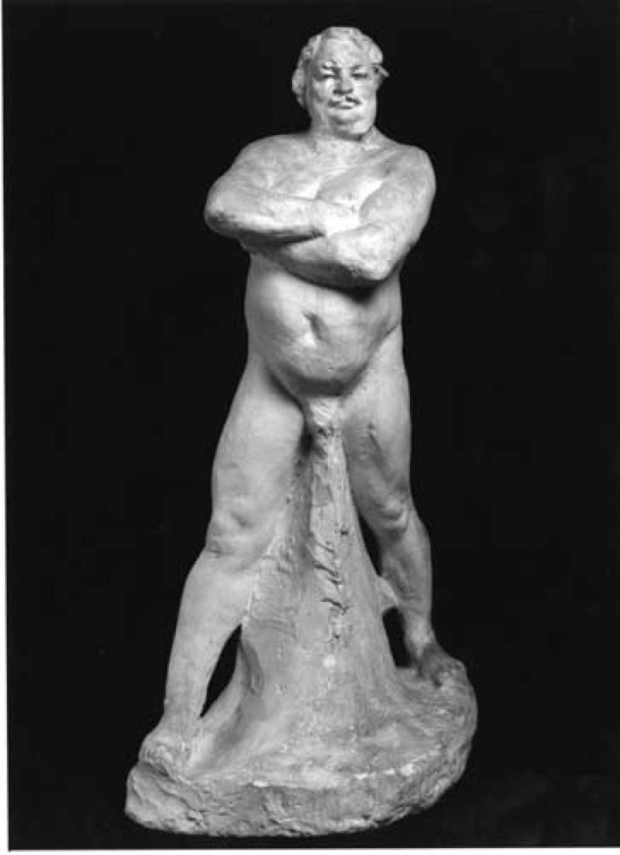
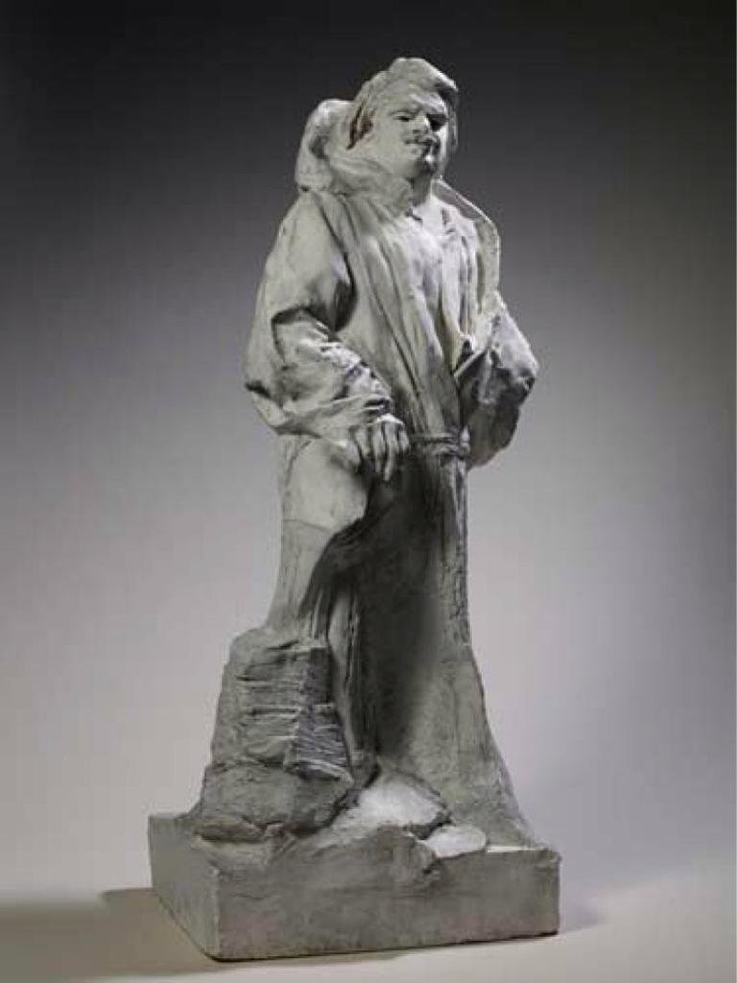
About the subject:
Honoré de Balzac (1799-1850), was one of the most famous French novelists of the nineteenth century and considered an inspiration for Victorian novelist Charles Dickens.
In 1892, over 40 years after Balzac’s death, the Societe des
Gens de Lettres commissioned Rodin to create a memorial to
the writer.
Rodin would spend five years working on the commission and
agonised over how best to depict Balzac.
Rodin considered carefully both the figure of Balzac and also the clothing and props associated with the writer.
Using clay, he modelled a series of nude standing figures which might represent Balzac. These varied from realistic to stylised.

Slide 3
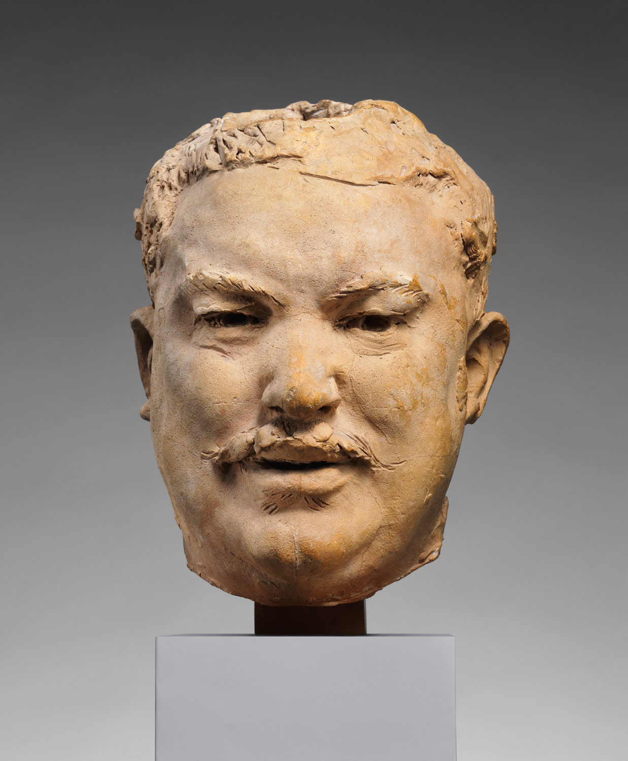
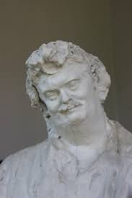
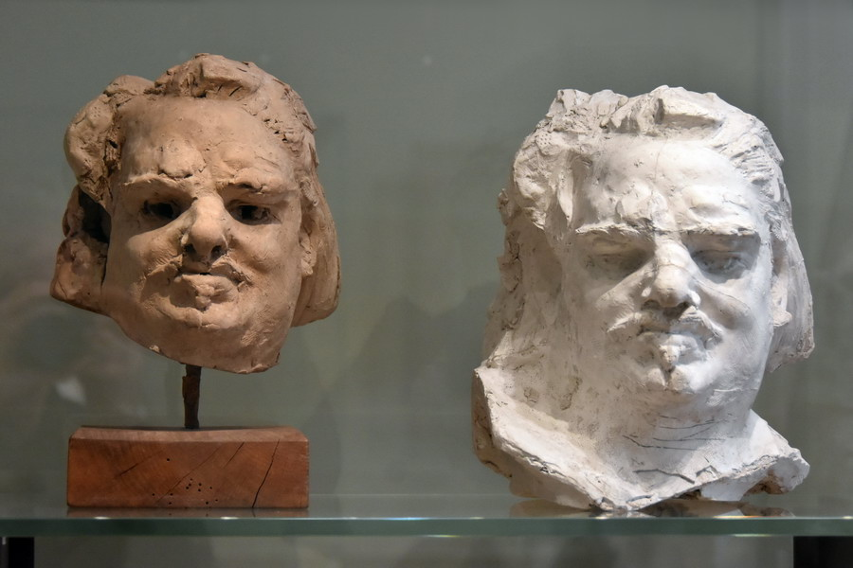
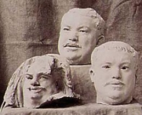
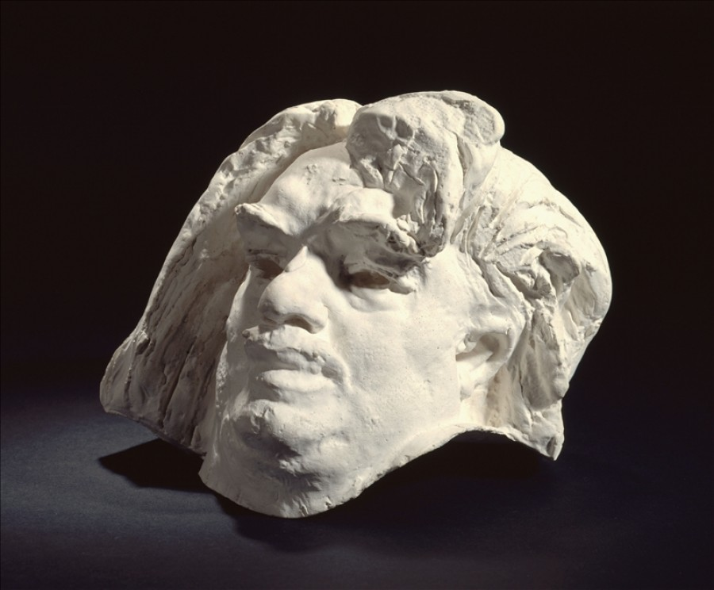
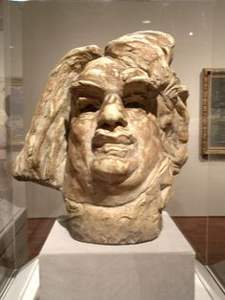
For the head of Balzac, Rodin journeyed to the writer’s home town and studied the heads of local men who would have been the same generation as Balzac.
He created a series of realistic heads which became more stylised with each version.
Maquettes (studies) for the head of Balzac. These would originally have been modelled in clay before firing in a kiln or cast in plaster.
Note how they vary from realistic to stylised. Consider why.

Slide 4
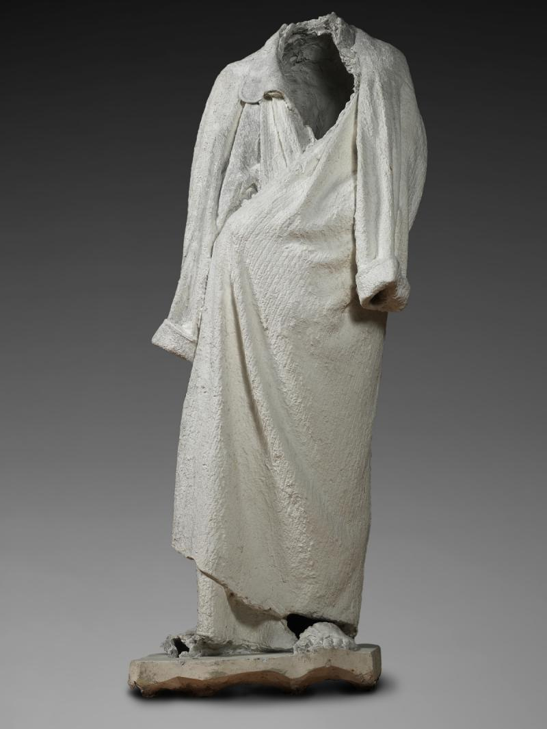
Once he was satisfied with the figure, Rodin then turned his attention to the clothing.
Balzac was famous for wearing a dressing gown while he worked and the commissioners wished to have him depicted in one.
Rodin commissioned Balzac’s tailor to create an exact replica of Balzac’s dressing gown. He then dipped the dressing gown in liquid plaster and dressed his sculpted figure of Balzac.
The dressing gown was draped to cover the figure beneath, giving an ambiguous and stylised appearance to the work.
A plaster replica of the completed sculpture was exhibited at the 1898 Salon and scandalised both public and critics. Nicknamed the snowman, it was described as a block of salt caught in a shower of rain.
Rodin’s commissioners refused to accept the work as it wasn’t a realistic depiction of the writer and it broke with the conventions of what a commemorative sculpture was. Rodin returned the money paid to him for his work and it was only after his death that a bronze cast was made of the plaster original.

Slide 5
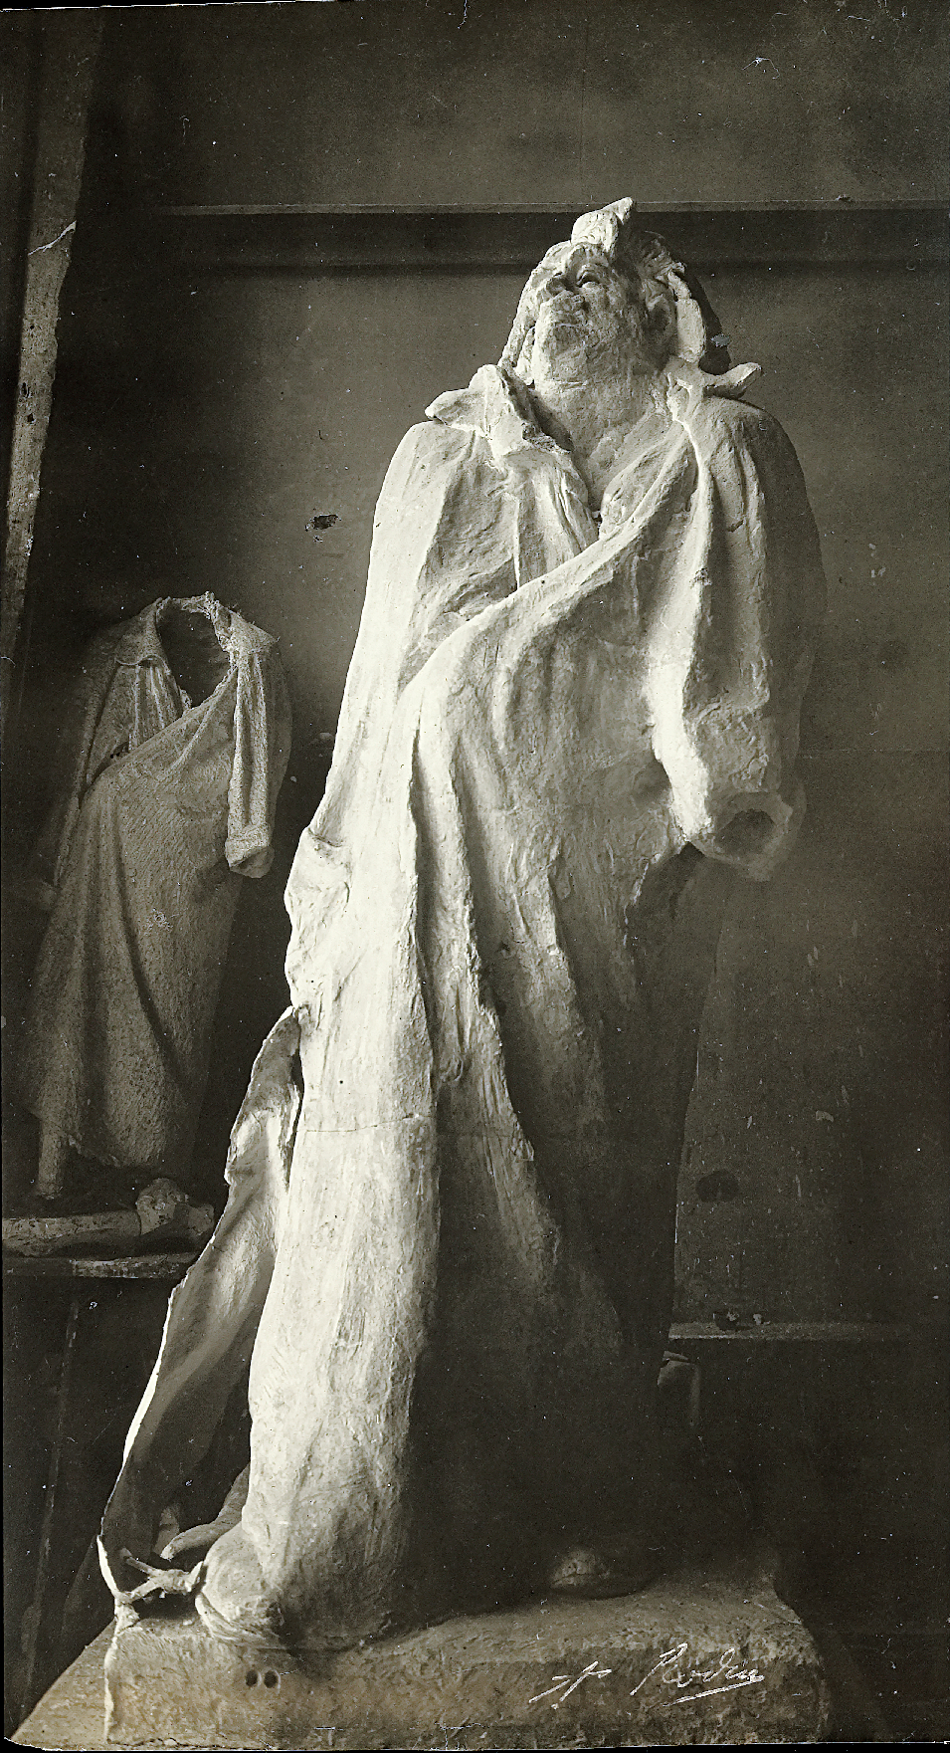

Slide 6
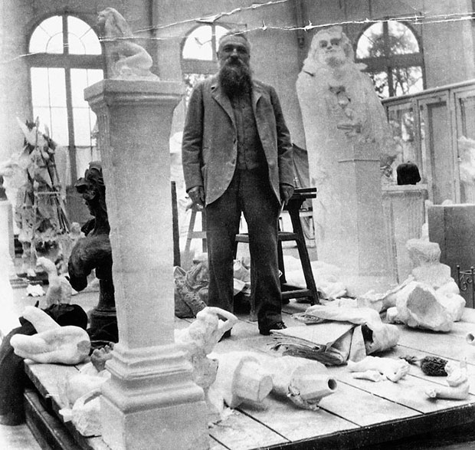
Rodin: There was only one way to evoke my subject: I had to show Balzac in his study, breathless, hair in disorder, eyes lost in a dream; a genius who in his little room reconstructs a whole society piece by piece in order to bring it to tumultuous life.. who never rests, turns night into day, drives himself vainly to fill the holes left by his debts...

Slide 7
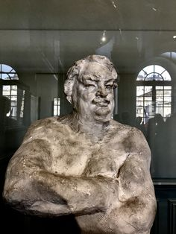
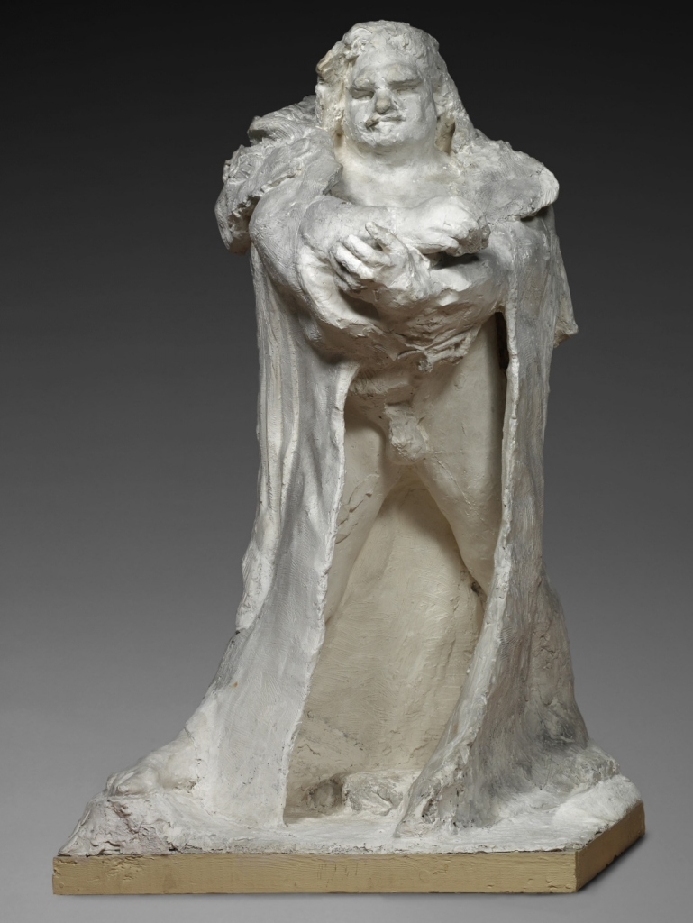
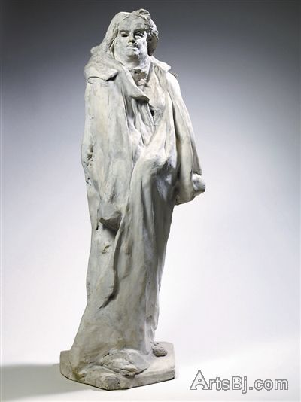
Various working versions of the subject by Rodin

Slide 8
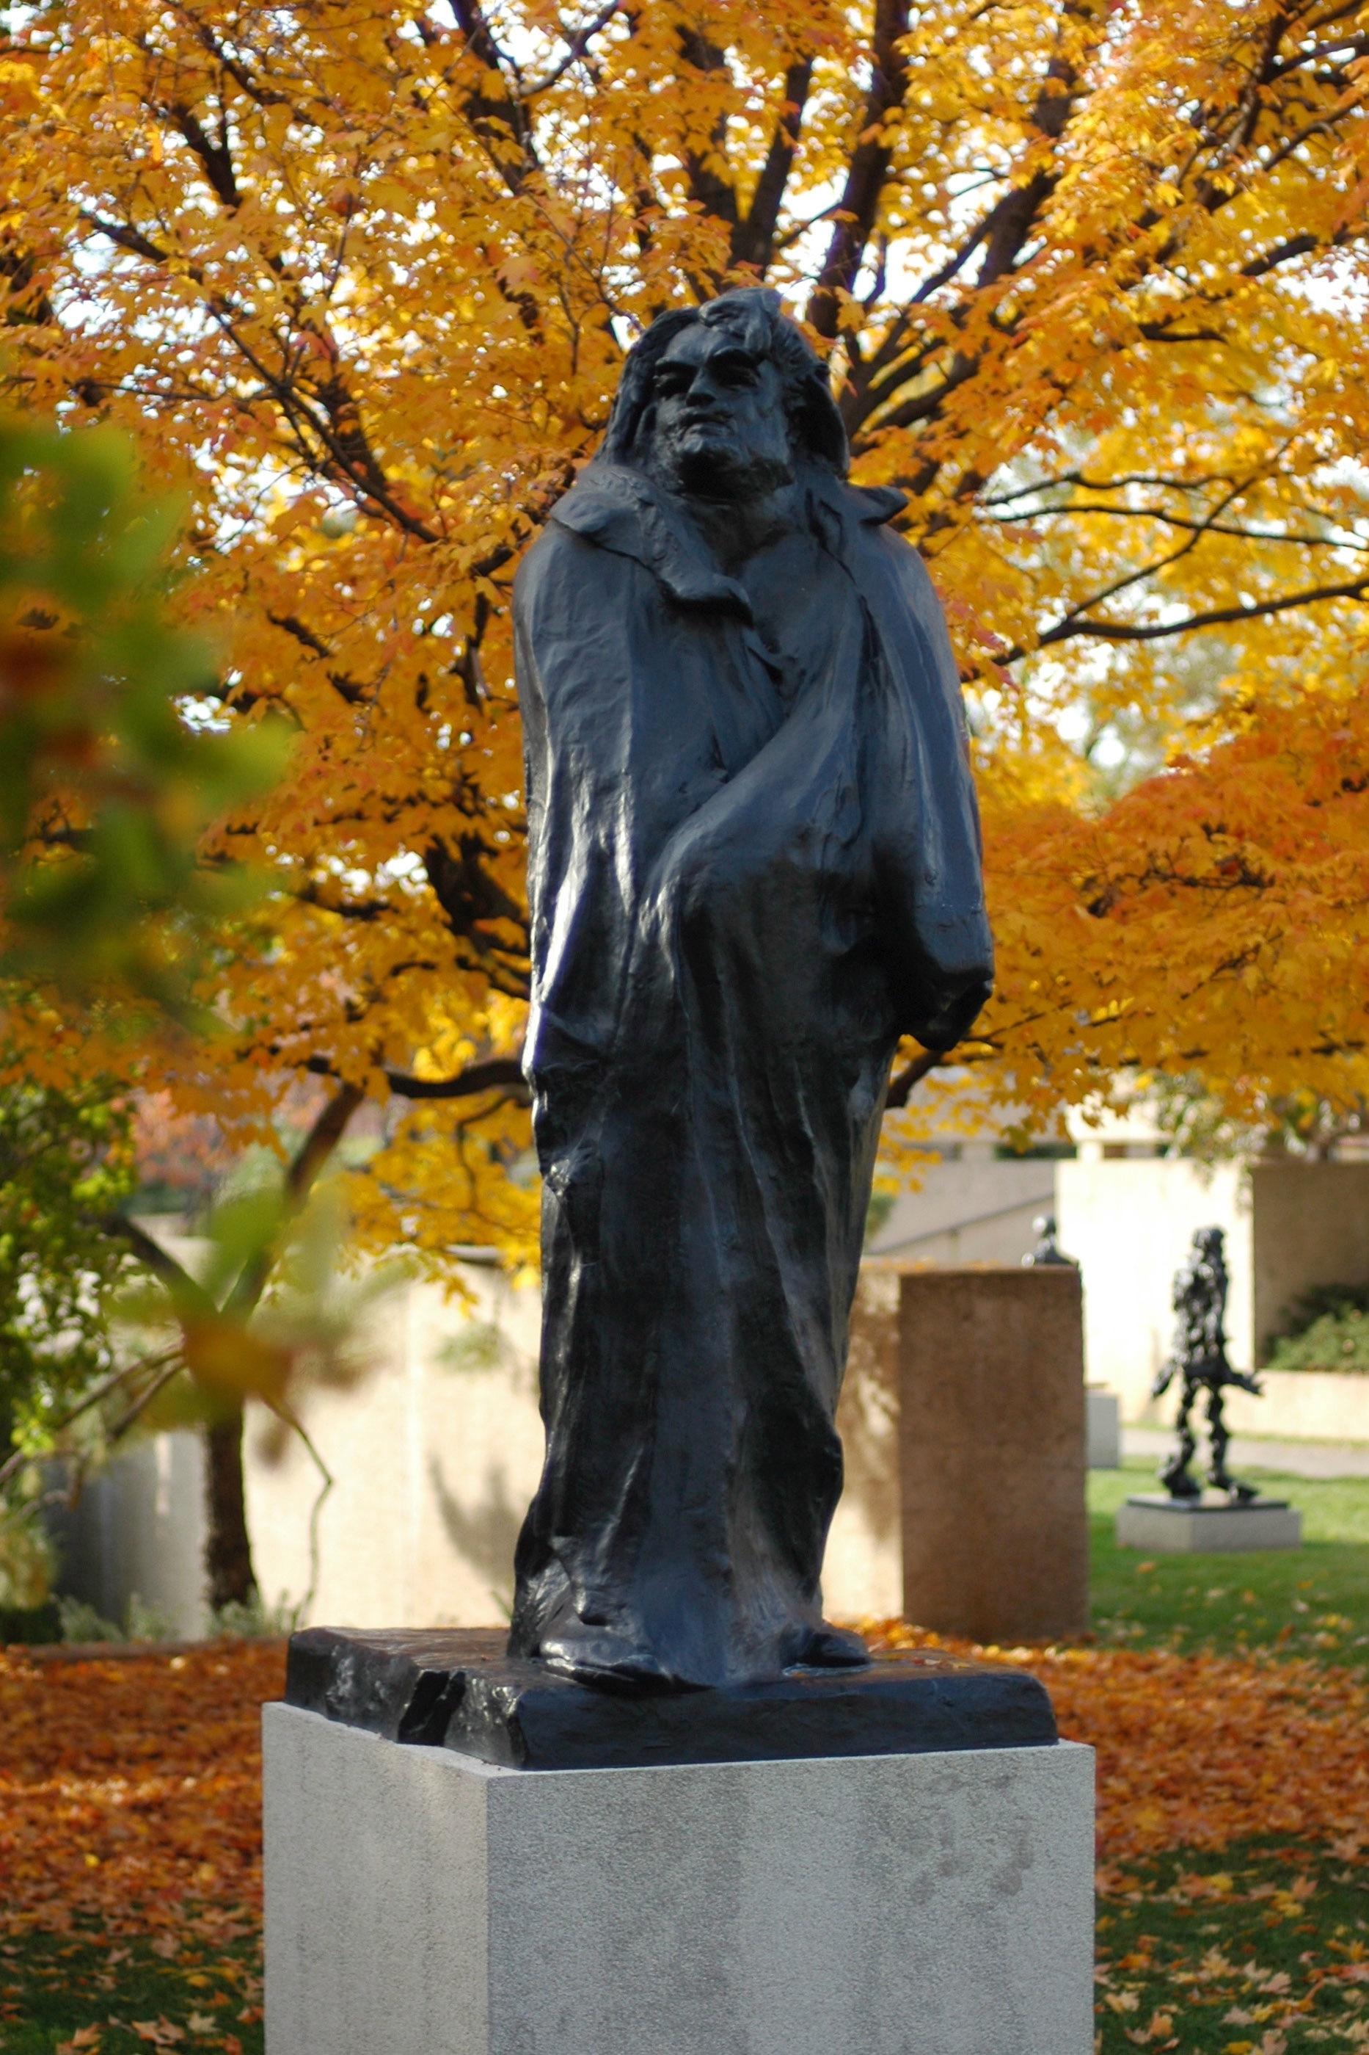
Bronze replicas, cast in the 20th Century, after the death of Rodin

Slide 9
Remember: You will only discuss the plaster version of the work, do NOT discuss/use the bronze version to answer questions as this was created after our timeframe
Rodin is our SPECIFIED SCULPTOR

