Slide 1
Photograph the same subject matter in a variety of ways.
We have investigated how we can photograph from various viewpoints and distances physically and how we can use focus to draw the viewers attention to particular areas within the frame.
Now we should think about how are photographs can be about different visual qualities of our subject.

Slide 2
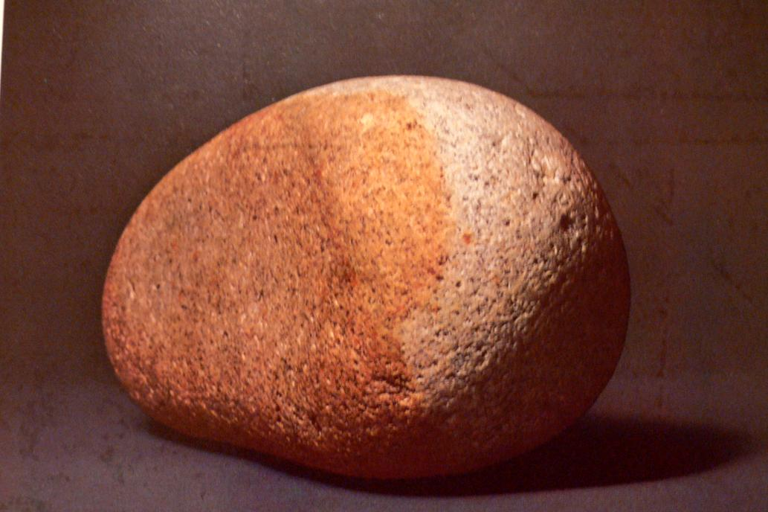
The following images by Sebastian Milito published in 1981 are all of the same stone.

Slide 3
This image of the stone is like a straight forward document of it. The framing is close around the form of the stone giving it a sense of bulk that maybe we would not get otherwise.

Slide 4
Is this image “Art”? Or is it just a record? Compare it to the next image…

Slide 5
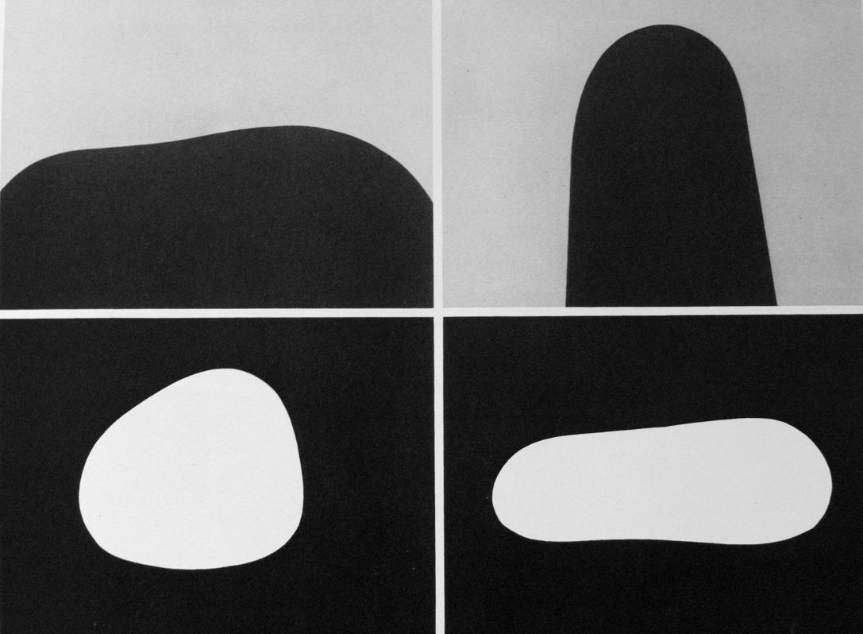
What are these pictures about? Are they inviting us to think about a particular aspect of the stones? Are they more “Art” than the previous shot?

Slide 6
Are these pictures about shape? How has the photographer/artist drawn our attention to ‘shape’?

Slide 7
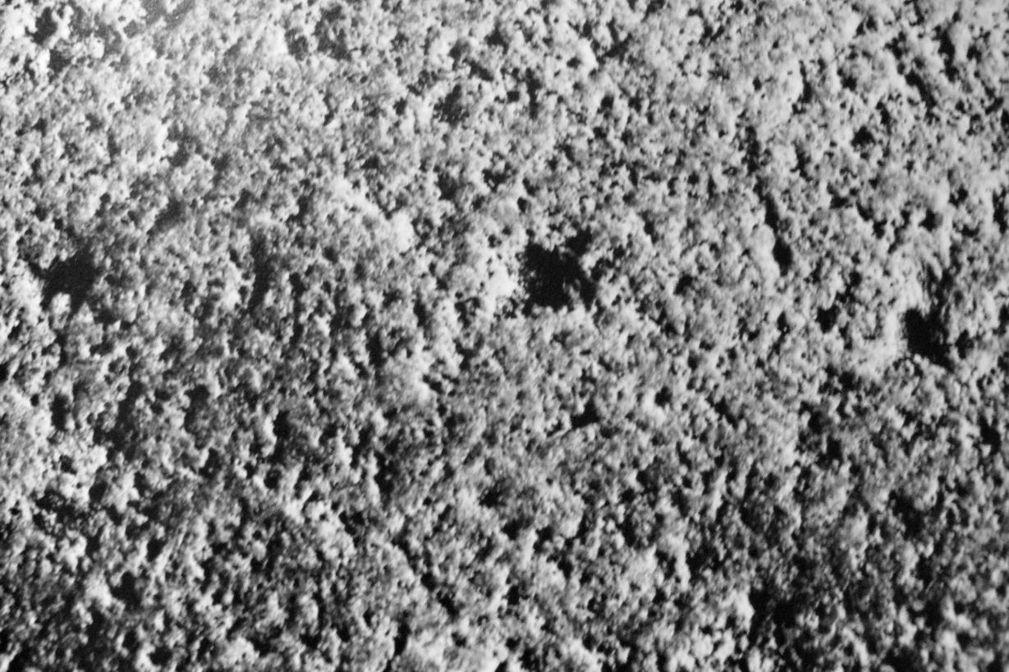
What is this picture about? What has been excluded? How?

Slide 8
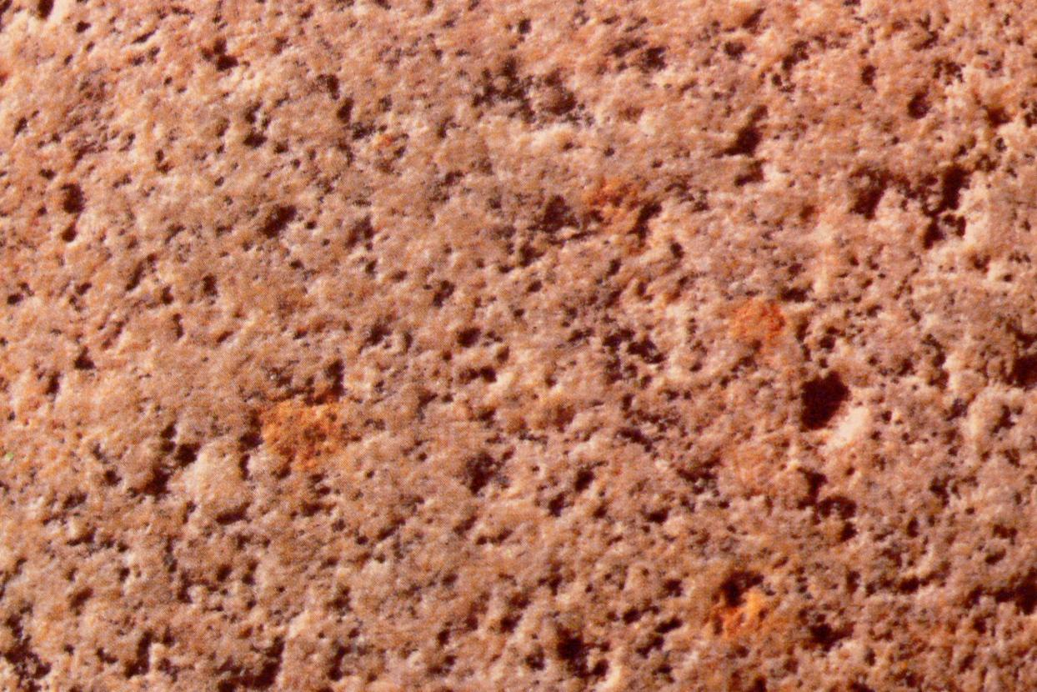
What been included here that wasn’t in the previous picture? Do we feel any different or think about anything differently as a result of this?

Slide 9
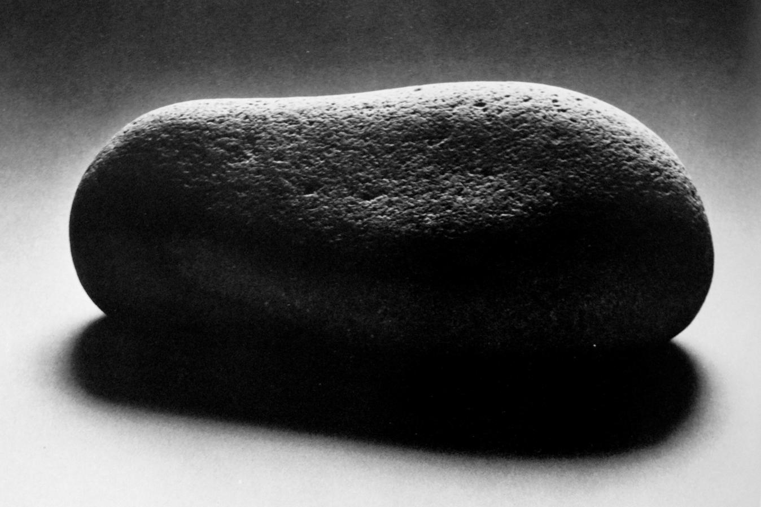
What is this picture about?

Slide 10
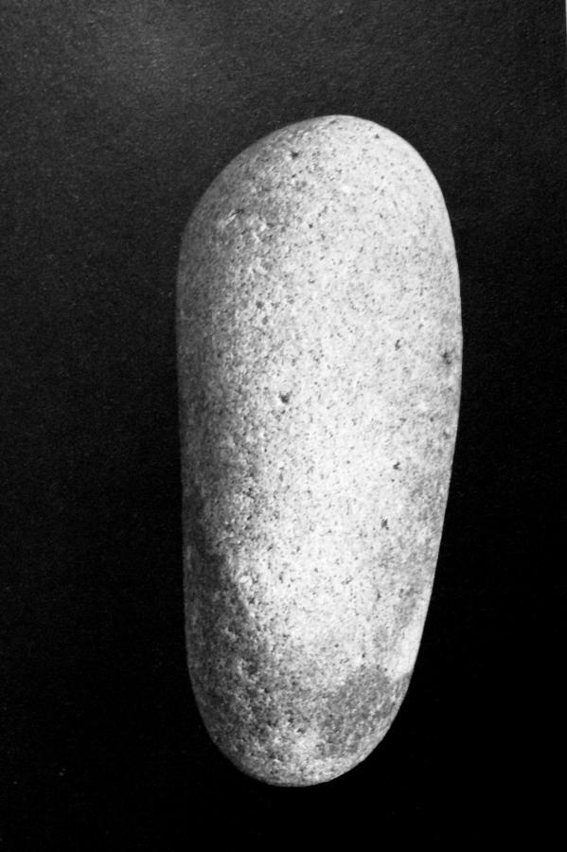
Milito has experimented with how he can examine: -Shape -Texture -Tone -Light and shadow -Colour
How can you work with these aspects in relation to the subject matter of the photography that you are doing?

