Slide 1
Homeostatic processes
A detector (receptor) of the change which sends a message to the
Coordinator (brain – eg hypothalamus or pituitary gland) communicates with the
Effector – a muscle or a gland which carries out a corrective process

Slide 2
Negative feedback
To maintain their internal environment organisms need a self regulating mechanism. In most animals this is achieved by negative feedback.
Negative feedback works by initiating corrective mechanisms whenever the internal environment deviates from its normal or acceptable level.
Thermoregulation: an example of a negative feedback loop
body temperature increases
corrective mechanisms
normal body temperature
normal body temperature
body temperature decreases
corrective mechanisms

Slide 3
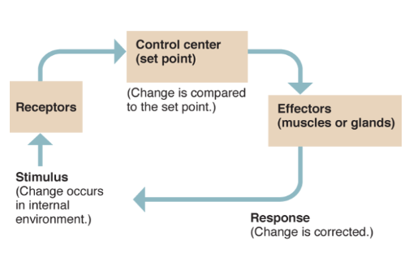

Slide 4
Factors that must be controlled
Water potential
Concentration of solutes in the blood and tissue fluid eg amino acids and glucose
Temperature
pH
Concentration of oxygen
Concentration of carbon dioxide
Blood pressure

Slide 5
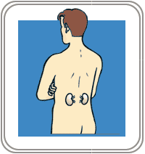
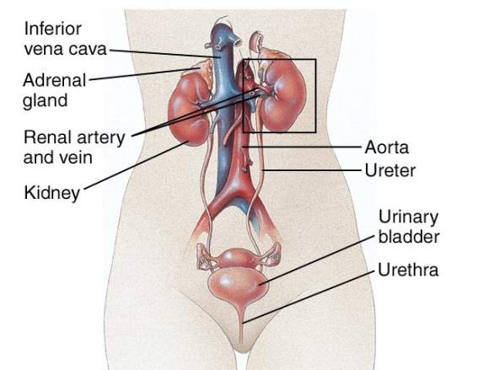
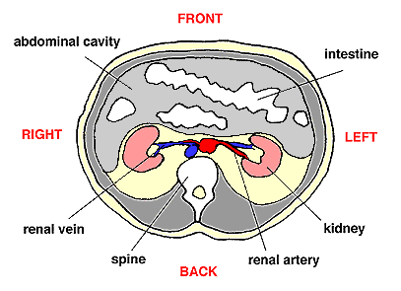
Where are your kidneys? What are the associated structures? What is the blood supply?

Slide 6
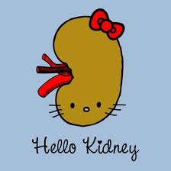
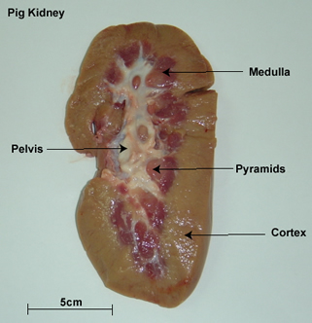
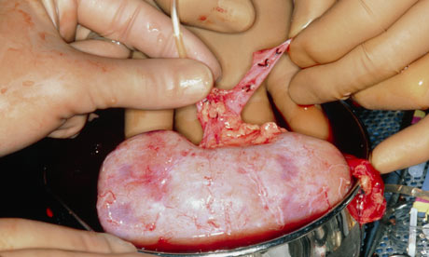
kidney structure and function

Slide 7
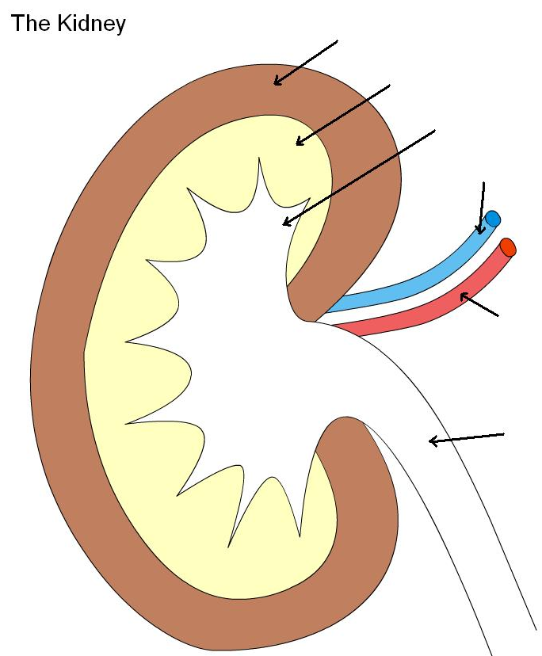
Cortex
Medulla
Nephron
Pelvis
Renal vein
Renal artery
Ureter
http://www.kscience.co.uk/animations/kidney.swf

Slide 8
Why are kidneys important?
They remove nitrogenous waste material – urea
They are involved in osmoregulation. That is they help to maintain the water potential of the blood within narrow limits.

Slide 9
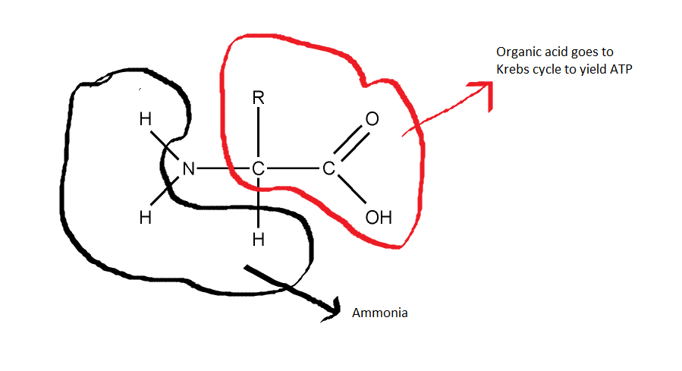
Ammonia is a waste product of this metabolic process.
Ammonia is a strong alkali.
(the rest of the deaminated amino acid becomes an organic acid that can be respired in Krebs cycle and yield ATP – look back at your notes from 4.2)
Ammonia combines with another waste product of metabolism, carbon dioxide and urea is formed.

Slide 10
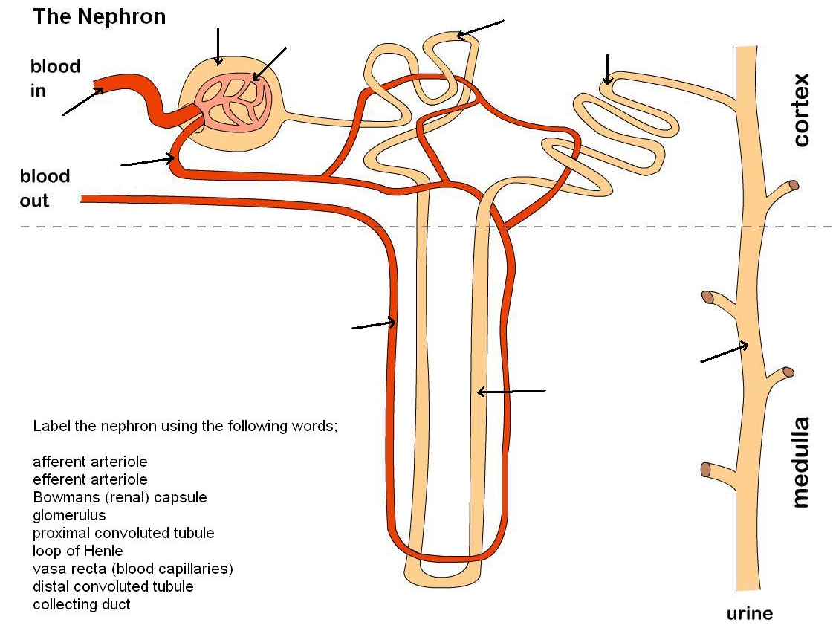

Slide 12
Selective reabsorption
Ultrafiltration
Control of blood pH
Osmoregulation

Slide 13
https://www.youtube.com/watch?v=cYyJF_aSC6o

