Slide 1
Newspapers
Component One, Section B
Media Industries

Slide 2
Newspapers are studied in Section A and B in Component 1. This is an in-depth study looking at all areas of the theoretical framework:
Representation
Language
Industry
Audience

Slide 3
The Newspaper Industry
Newspapers have been published in Britain for over 300 years. The industry has faced many challenges and several local titles have closed.
In 2016 The Independent national newspaper became an online-only product
Sales of newspapers have been falling in recent years as the industry faces increasing competition from online and 24-hour television news.

Slide 4
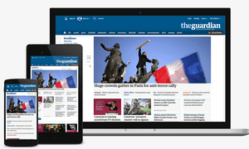
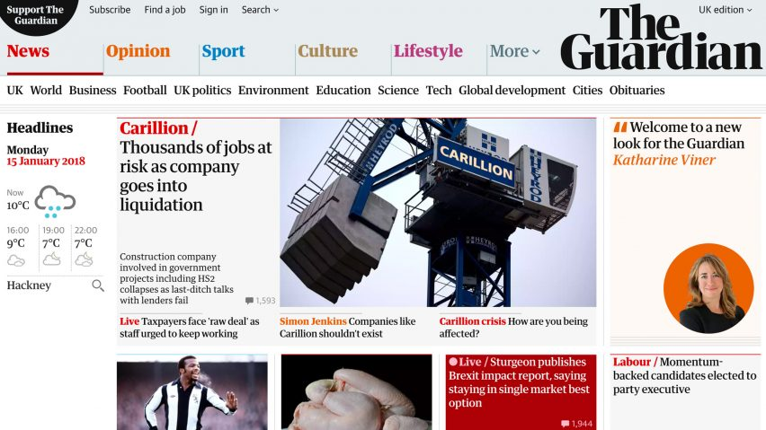
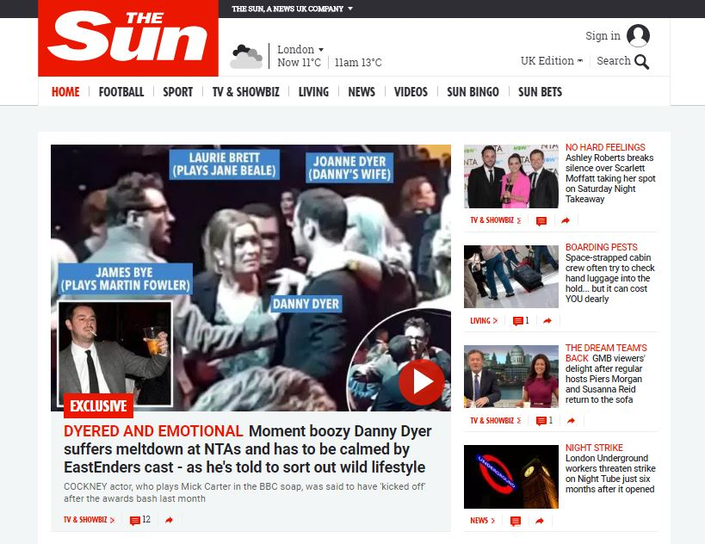
The newspaper industry has responded to this challenge by using new technologies to circulate content.
Websites
Social media feeds
Regularly updated so readers can access the latest news.

Slide 5
Ownership
The newspaper industry is very powerful. Newspapers communicate messages about important issues and are read by large numbers of people.
In Britain, there are a small number of newspaper publishers that control the majority of the industry.
News UK, which owns The Sun and The Times
DMGT, owns the Daily Mail
Trinity Mirror, owns Daily Mirror
This potentially limits the range of viewpoints and messages the readers receive, especially as the two newspapers with the largest circulation, The Sun and The Daily Mail, have right wing political leaning
70% of newspapers in UK

Slide 6
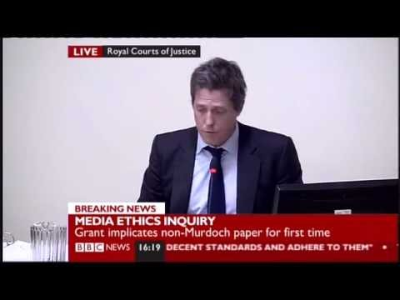
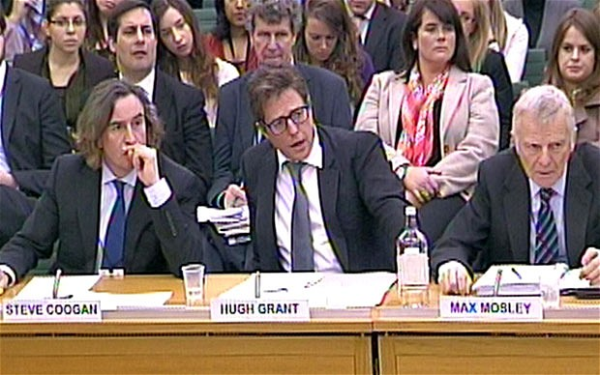
Regulation
There have been changes in the way the newspaper industry is regulated in recent years, as a result of the Phone Hacking Scandal. The Press Complaints Commission was the regulator at the time.
The Leveson Inquiry set up in 2011 recommended that:
- newspapers should be self-regulated, overseen by a new independent body
- the new regulator should have the power to deal with complaints about the breach of standards

Slide 7
Regulation
The Independent Press Standards Organisation (IPSO)was formed following the Leveson Inquiry and now regulates many newspapers and magazines in Britain.
Task:
Research the IPSO Editors Code of Practise and make notes about the Key Areas.
Now note down details about recent rulings on the Sun newspaper

Slide 8
Audience
You will study selected pages of the website, in order to identify key industry and audience issues.
Task:
Study the pages of the Sun and the webpages
Note down details of all the advertisements you can see
What types of product are advertised in the Sun?
What does the advertising suggest about the target audience for The Sun?
Do the same products or services appear in print and on the website?
Note down any references to other News UK products
Identify three key features in the set text front cover and three key features of the website and consider how these appeal to different audiences.

Slide 9
How to approach the question
Point: make a point about what is similar or different about representation in the newspaper front page
Example: give specific examples (at least one from each) from your venn diagram/annotations to back this point up
Explain: how the example/s actually communicate the representations to the audience
Challenge: Link to representation theory / effect on the audience
At least three paragraphs and an overall conclusion

