Slide 1
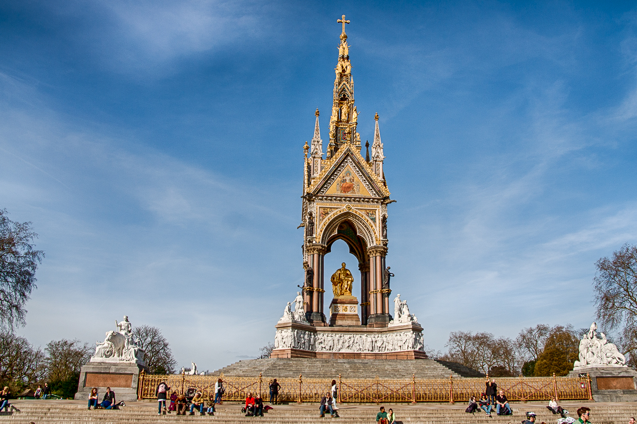
Gilbert Scott, The Albert Memorial, opened 1872, London, 54 metres tall

Slide 2
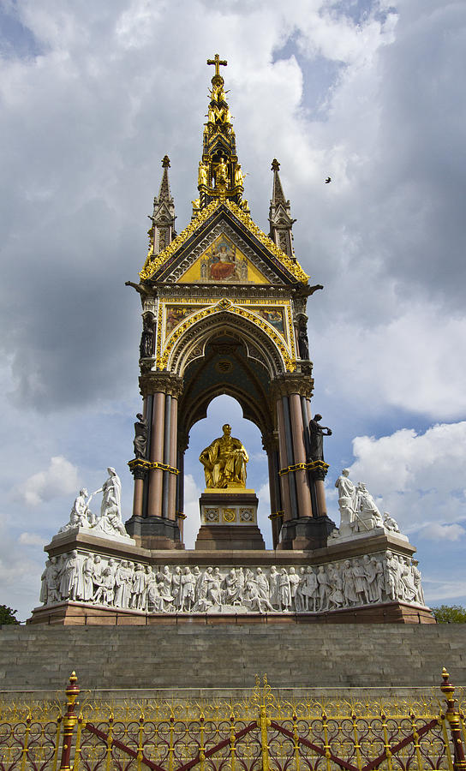
Context
Commissioned in 1862 by Queen Victoria in memory of
her husband Prince Albert, who had died in 1861
Paid for by public subscription. The monument is located in Kensington Gardens, near the museum area which Albert was responsible for establishing and close to the site where the Great Exhibition had been held and which Albert was instrumental in co-ordinating
The design by George Gilbert Scott, the famous Victorian architect, who won from a shortlist of six submissions.
The monument would take over ten years to complete and is in the Gothic Revival style.
Albert had been immensely popular with the public and this was one of many monuments constructed to honour him after his death.

Slide 3
Design
A gilded bronze statue of Albert sits beneath a Gothic style canopy
The canopy stands on clusters of columns and is topped by a flèche (spire) and pinnacles- all typically Gothic
The base of the structure is a high relief frieze in white marble and known as the Parnassus Frieze
The whole monument is elevated above ground level by a series of steps and is railed off. This gives an imposing appearance to the work
Allegorical figures appear throughout the structure. We see
representations for characters such as Medicine, Chemistry and Astronomy. These show Albert’s interest in the Sciences and the Arts
Beneath these are allegorical representations for industry including Agriculture and Commerce
The Parnassus Frieze contains 169 life-sized depictions of artists, writers, musicians and creative individuals from history including Shakespeare, Van Eyck, Raphael, Beethoven, Michelangelo
Parnassus was the resting place of the Muses in Greek Mythology and this frieze demonstrates Albert’s interest in the Arts and culture

Slide 4
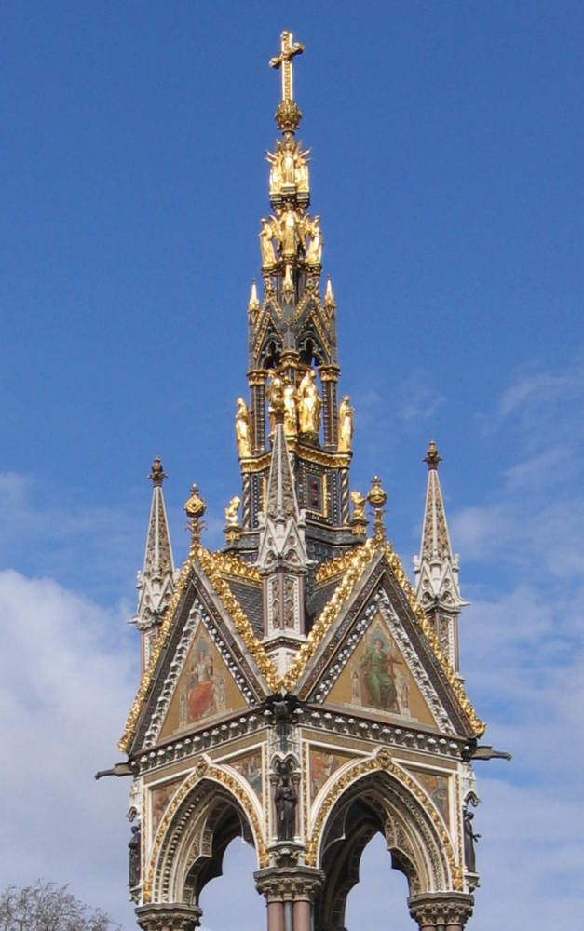
Design
Christian symbolism is placed in the upper section: we
see the Virtues; Faith, Hope and Charity
These illustrate Albert’s devout Christian spirituality
Angels are shown close to a cross on the top, reminding
us that this is a memorial created after the death of the subject
Mosaics in the tympana and spandrels of the canopy
show themes such as Poetry, Music and Literature
On the outer corners of the steps are allegorical
sculptures representing four continents. These
show Albert’s interest in international affairs and the
spread of the British Empire

Slide 5
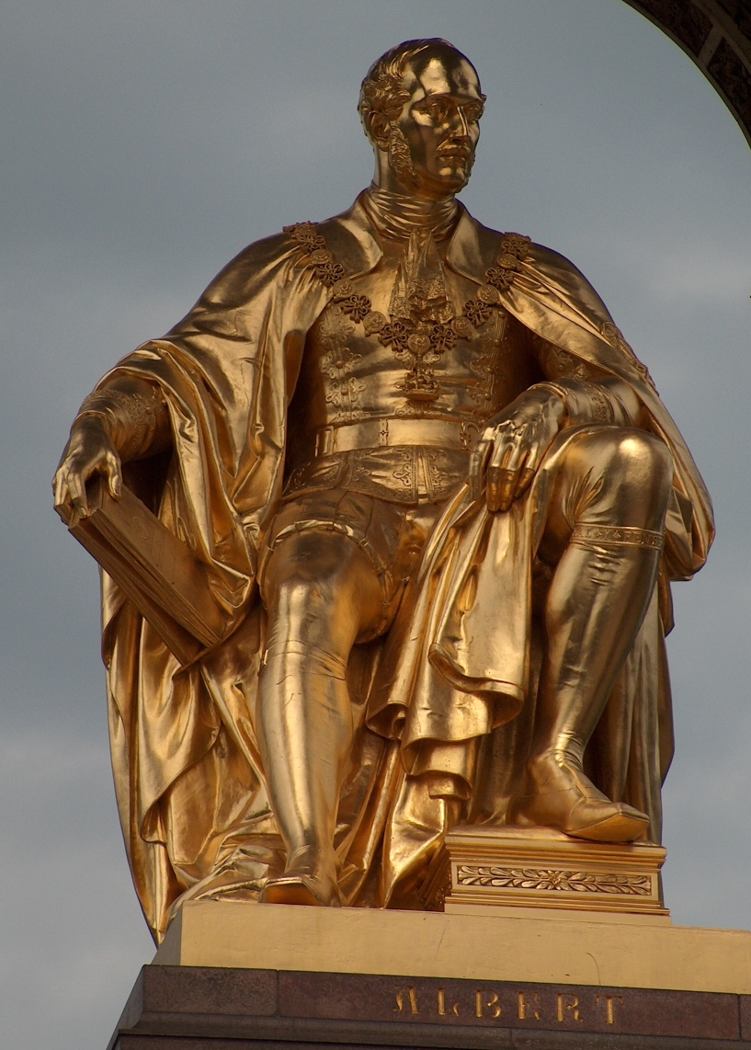
Albert
Albert is shown seated and dressed as a Knight of
the Garter- the highest honour of Chivalry in Britain
Albert holds a copy of a catalogue from the Great
Exhibition (of 1851). This was the first of a series of
World Fairs which occurred in the 19th Century and Albert was fundamental to the organisation of this event
He looks in the direction of Exhibition Road in Kensington. This is a area containing venues such as the V&A, Royal College of Art, Natural History Museum and was developed on the advice of Albert. Profits from the revenue of the Great Exhibition were used to purchase land in that area and it was nicknamed Albertopolis in the Victorian era
His first name is inscribed at his feet. A longer dedication to him is inscribed in the canopy. QUEEN VICTORIA AND HER PEOPLE TO THE MEMORY OF ALBERT PRINCE CONSORT AS A TRIBUTE OF THEIR GRATITUDE FOR A LIFE DEVOTED TO THE PUBLIC GOOD.

Slide 6
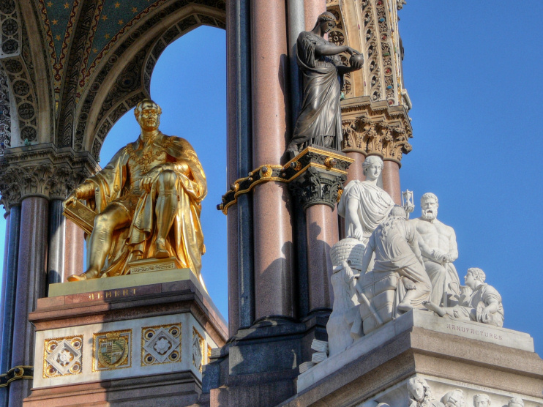
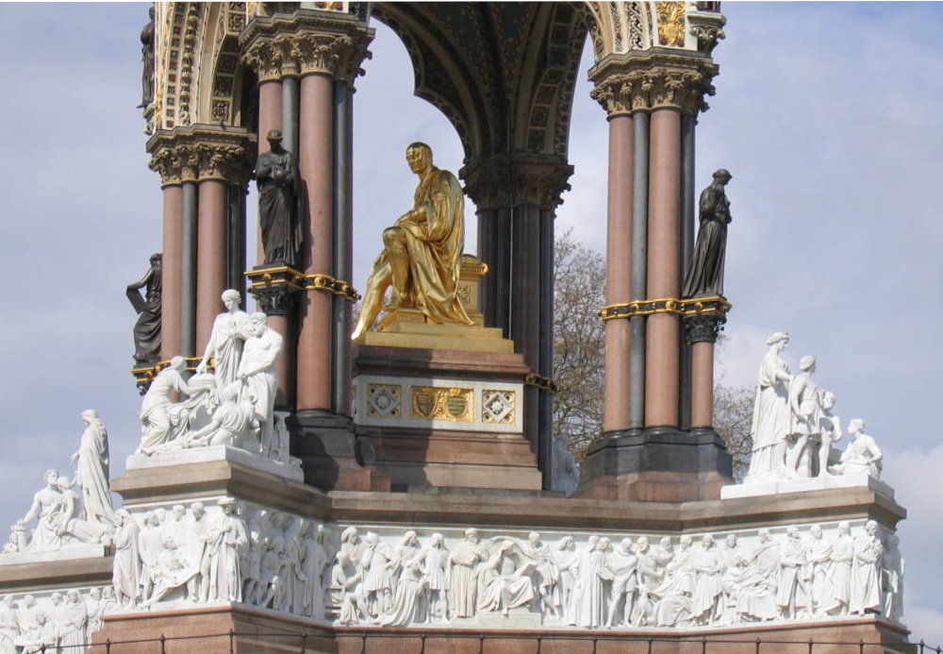
Leading artists and sculptors of the day were responsible for the statuary, mosaics and structure- all responding to the design of Gilbert Scott

Slide 7
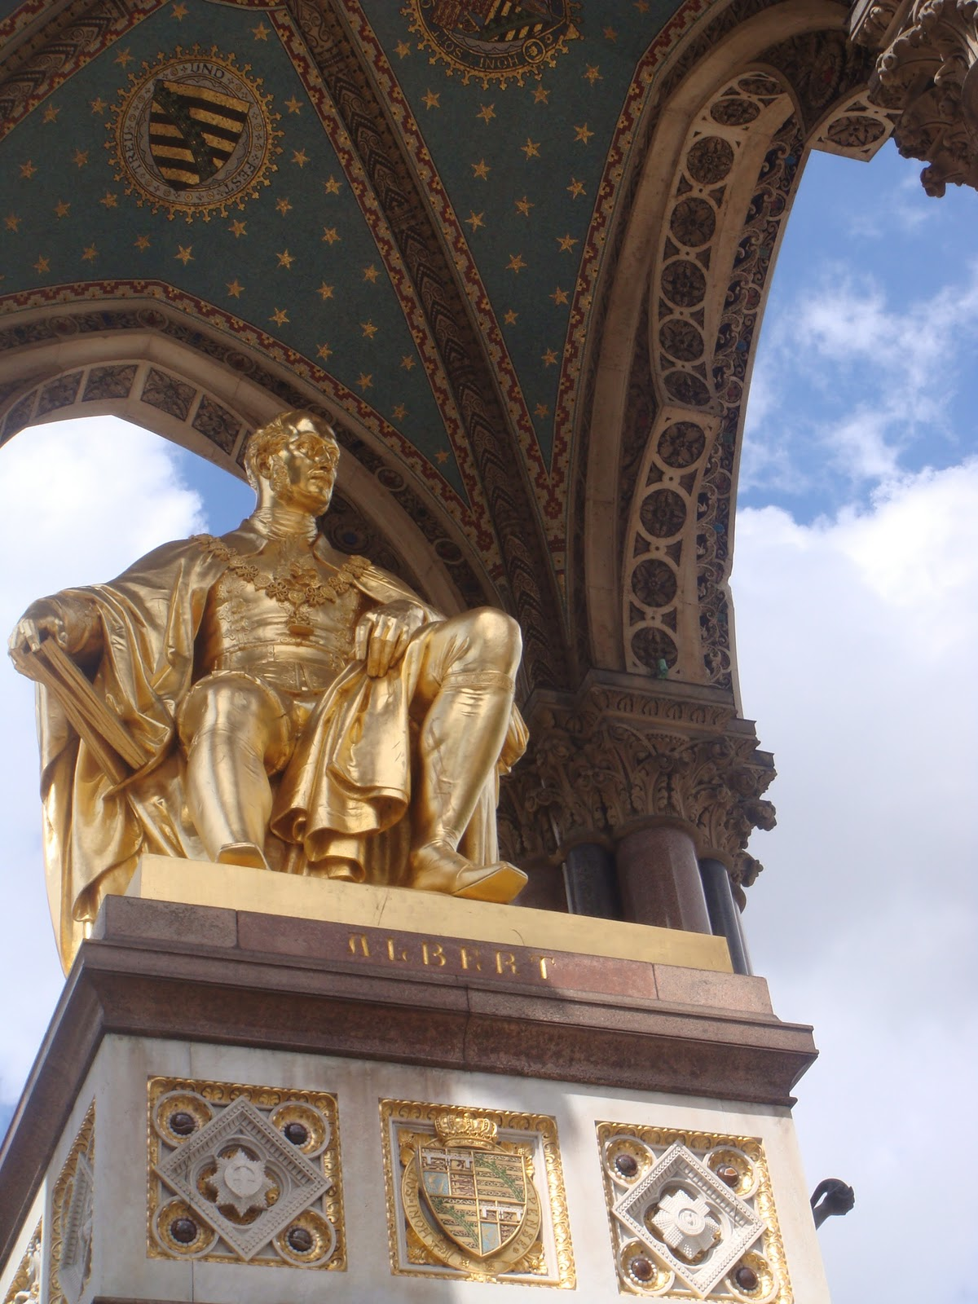
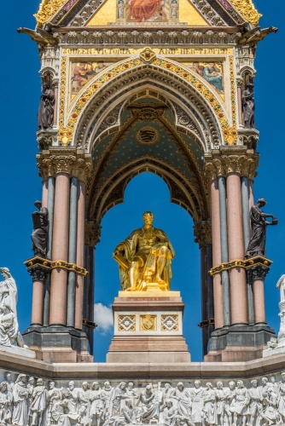
The structure is polychromatic due to the various colours appearing in it. Red and black stone and marble columns support the brick and stone canopy
The interior of the canopy is a blue and gold constellation of stars in mosaic
The figure of Albert, the angels on the spire and the Virtues are made from gilt bronze
White marble is used for the Parnassus Frieze and the allegorical figurative groups
The mosaics in the tympana and spandrels are made from coloured glass.
The overall effect of the monument is a precious jewel-like appearance which pays honour to a popular
Individual
List of Materials
Gilt Bronze
Bronze
Marble
Stone
Glass mosaic
Brick
Processes
Carving
Gilding
Casting
Brickwork
Mosaic work
Foundation and structural construction

Slide 8
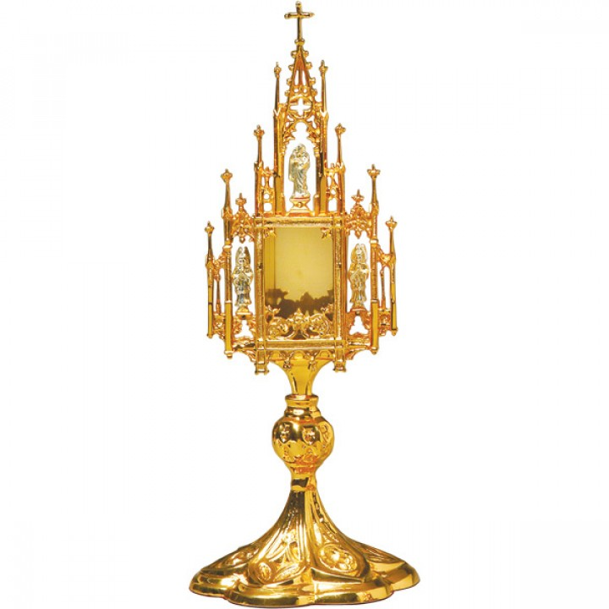
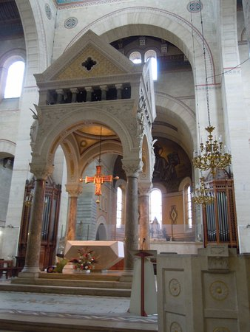
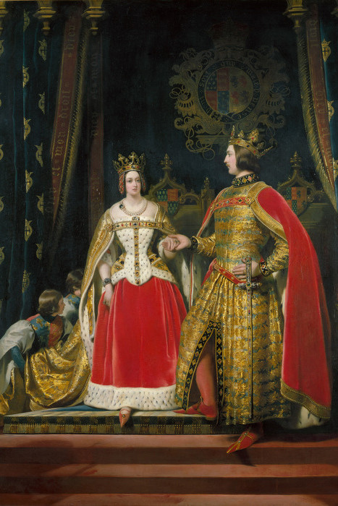
The design resembles a reliquary- a jewelled casket which contained a religious artefact
This implies that the memory of Albert is sacred to the people of Britain and he was seen as saintly
Gilbert Scott based his design on a ciborium. This is a canopy often found in Christian religious buildings and placed over the altar
The ornate appearance link to Victorian Britain’s interest in the revival of Medieval and Gothic design and
links to the Pre-Raphaelites’ fascination for subject matter for those eras. Prince Albert was also strongly interested in Medieval and Gothic history art and architecture.

Slide 9
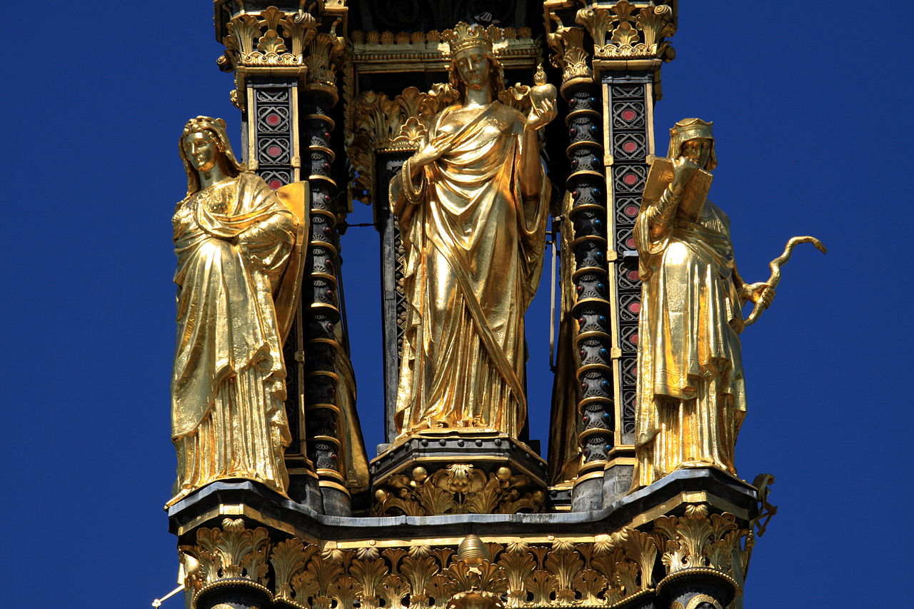
Allegorical representations of Faith, Hope and Charity
https://www.youtube.com/watch?v=oyP294BII-4

Slide 10
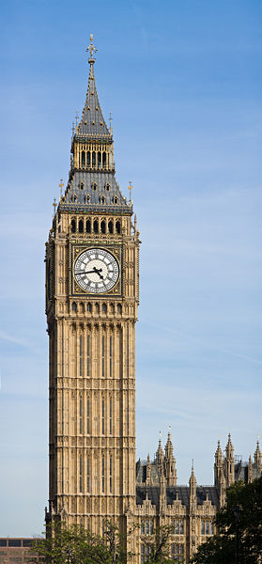
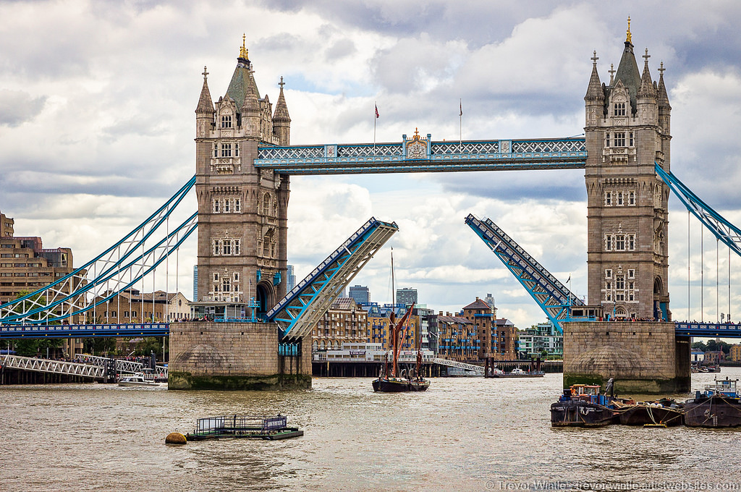
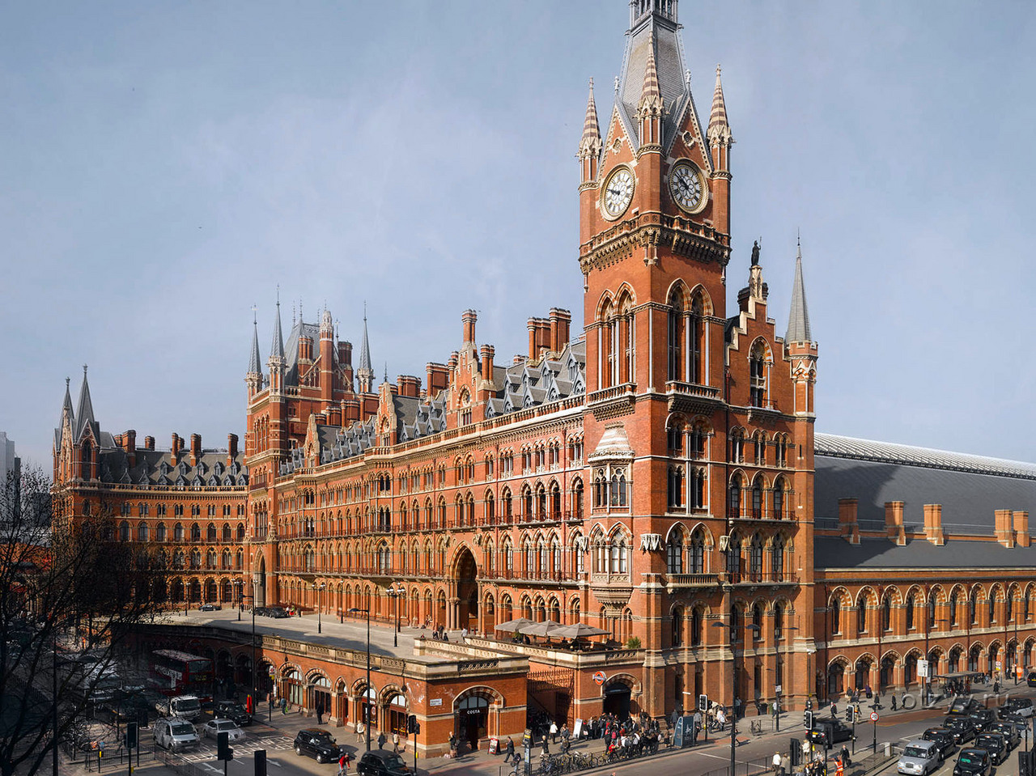
About Gilbert Scott and the Gothic Revival
Sir Gilbert Scott was a prolific architect of the Victorian era and a champion of the Gothic Revival
Gothic Revival aka neo-Gothic or Victorian Gothic saw the reintroduction of the Gothic style into architecture and design. It was not exclusive to religious buildings as it had been in the Gothic era but was applied to commercial, domestic and public buildings
The Victorian architect Pugin was key in promoting the style in Britain. John Ruskin was also a keen supporter of the style. He admired the efforts that Gothic stone carvers had put into the detailing in religious buildings which helped promote the message of Christianity
The Church of England was undergoing reforms at this time. Anglo-Catholicism which emphasised the Catholic aspects of Anglicanism, saw a rise in demand for parish churches and cemeteries. The neo-Gothic style became the most popular style for such venues

Slide 11
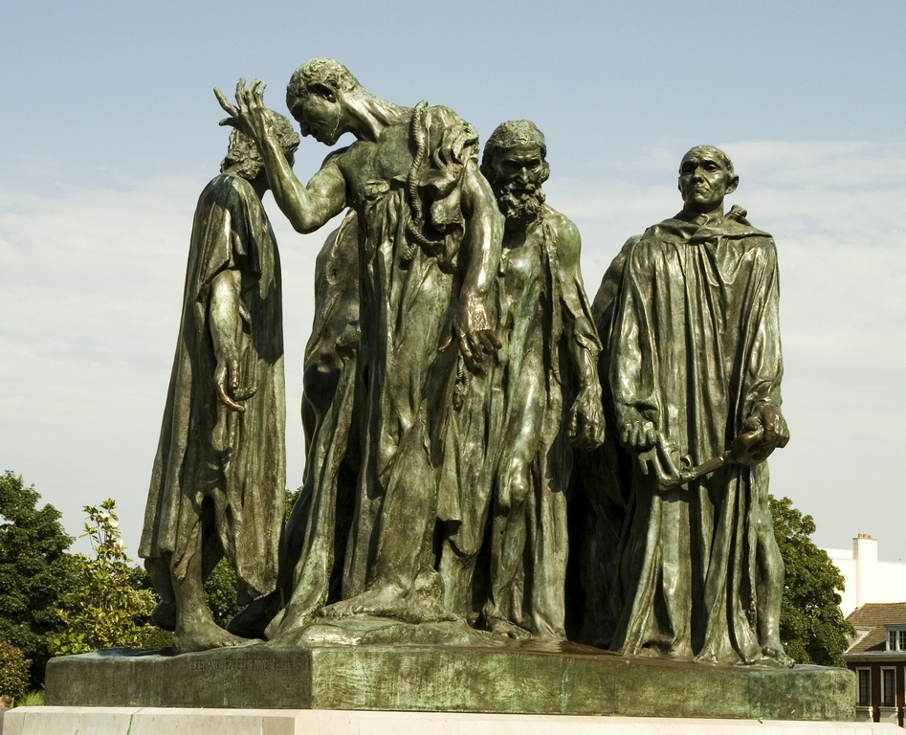
Consider how the Albert Memorial differs to The
Burghers of Calais. Both are commemorative
works but their appearances contrast significantly.

