Slide 1
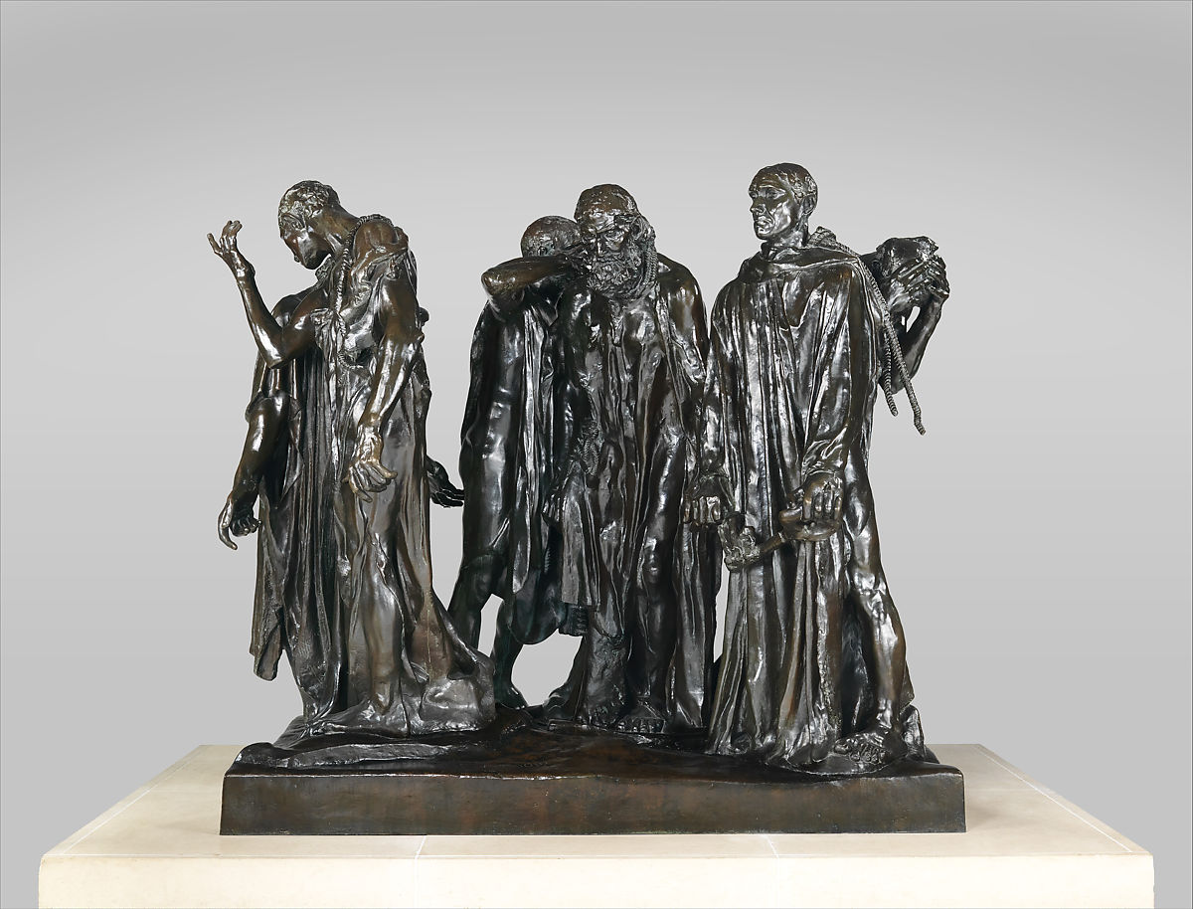
The Burghers of Calias, Auguste Rodin, 1884-1989

Slide 2
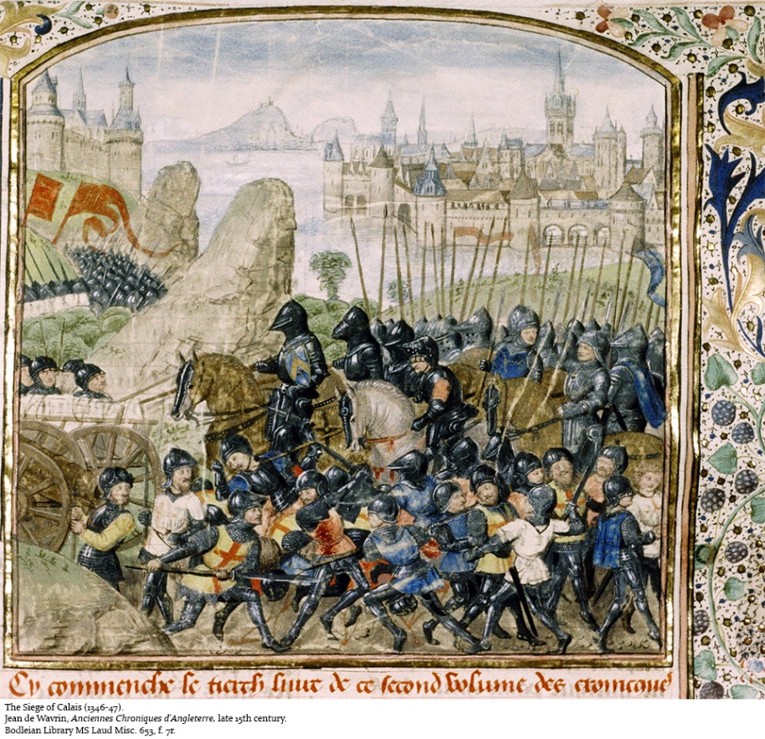
Who commissioned this work, why and for where?
Commissioned by the French city of Calais to create a sculptor to commemorate the heroism of Eustache de Saint-Pierre during the hundred years war (1337-1453)
The Event it commemorates
When Calais had been under siege for 11 months, King Edward III made a deal with the citizens of Calais, they could surrender peacefully if 6 prominent member of the city council agreed to give up their lives. Eustache de Saint-Pierre was the leader of the group who agreed to sacrifice themselves for the citizens of the city.
However their lives were eventually spared. Rodin has
decided to depict these men going to their
deaths to demonstrate their heroism.
Who is the main character?
All figures are depicted with the same prominence
however Eustache de Saint-Pierre was the leader of the group.

Slide 3
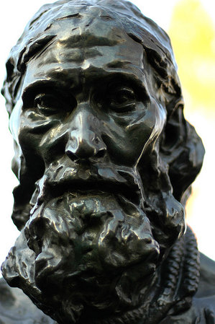
How is the main character depicted?
Eustache de Saint-Pierre is depicted with his head bowed in the centre of the gathering. He was the leader, the first to volunteer and surrender.
There are six figures in the group covered in worn cloth. They are depicted as being underweight with visible bones and veins. None of them make eye contact and do so by bowing their heads and gazing into the distance.
How many figures are included?
6 figures are depicted
How are they depicted?
The figures are depicted as thin and tattered clothing, which shows their weariness from an 11 month siege.
Featured and proportions have been distorted to intensify the expressiveness of the figures.
Scale
The figures are depicted as larger than life-size and their hands and feet are disproportionately large showing how this decision is literally weighing them down.

Slide 4
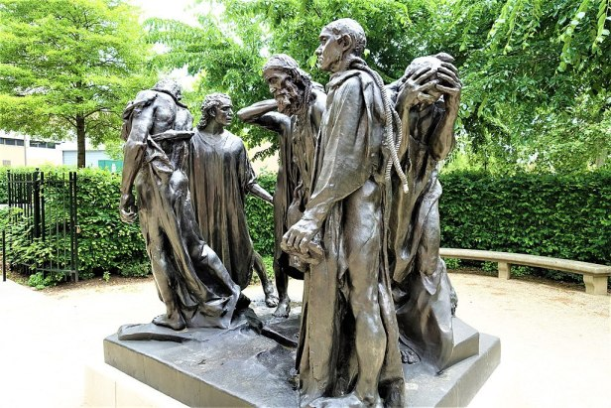
Composition
All figures are stood at the same level, evoking the brotherhood between these men in their bravery.
All the figures face different directions making it hard to depict who the leader of the group is, as Rodin has elected not to use a more traditional hierarchical arrangement also known as pyramidal composition, where the most prominent figure is placed at the front.
The sculpture has many focal points, it must be viewed from all sides to appreciate it in its entirety. Typically, academic style sculpture presents a single point of reference and has a clear front and back.
How the work was intended to be displayed
The patron’s wanted the work to be displayed on a pedestal which would place the figures in a god-like, traditionally heroic status so for the first work, Rodin did this. However the raised pedestal did not allow people to view the work as Rodin had intended so his second version did not have a pedestal, this version was placed in the Musee Rodin in Paris. This allowed the viewer to view the detailed facial expressions and gestures of the people making them feel part of the group, personally experiencing the tragic event.

Slide 5
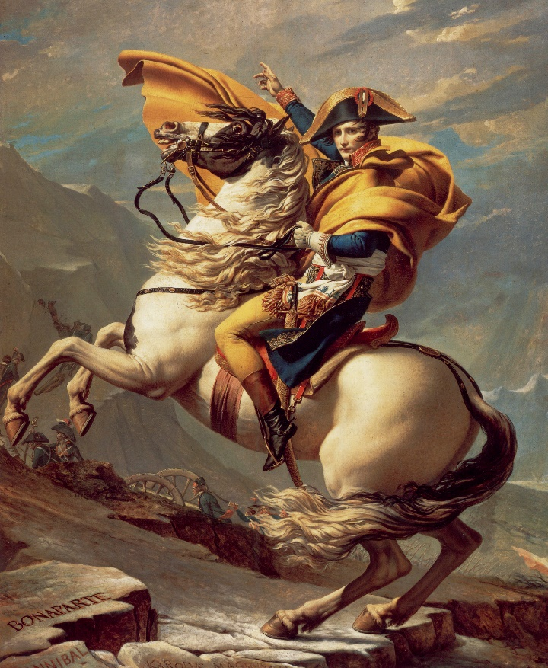
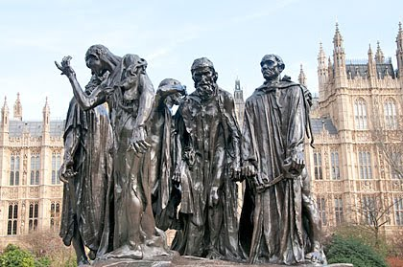
Rodin’s depiction of Heroism
Rodin’s monument portrays the 6 Burghers as troubled and isolated individuals but not glorified in the traditional sense
The figures are depicted without the confidence and assertiveness of the traditional hero but they are seen as conflicted, afraid and struggling with indecision and anguish.
The figures reveal their vulnerabilities. The committee was looking for a traditional depiction of bravery and fraternity, with lifted chins and upright posture with reassuring facial expressions of bravery in the face of adversity. However each of Rodin’s Burghers exhibits his own response to this decision, none of which conform to the traditional heroic formula.
Eustache de Saint-Pierre is stooped, gaunt and elderly rather than straight-backed, young and muscular. He hesitates rather than marching forward to lead the group to their sacrifice.

Slide 6
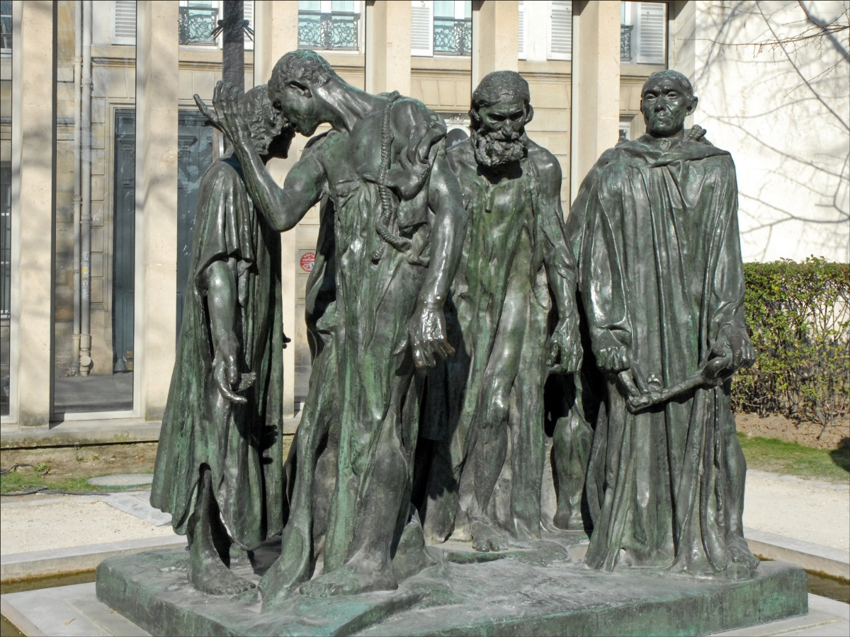
Rodin’s use of Bronze
Rodin has chosen to use bronze for this sculpture because it was going to be presented outdoors and bronze is a very durable material more suited to an outdoor environment
Bronze has a high tensile strength which allows for outstretched fingers and limbs which can be more expressive.
It also allows for lots of detail
The strength of the material symbolises the strength of these men, their sacrifice and their mental trauma.

